Slide 1
Discourse and Society
Presented by
Mohammed i. Khalil
Course tutor
Prof. dr. ahmed Q. Abid

Slide 2
Discourse communities
A key notion in the area of discourse analysis is the concept of a Discourse Community (A discourse community is a group of people who share some kind of activity. Members of a discourse community have particular ways of communicating with each other. They generally have shared goals and may have shared values and beliefs. A person is often a member of more than one discourse community. There may also be discourse communities within discourse communities.

Slide 3
Discourse communities
The group must have some set of common goals, mechanisms for communication and some way of providing the exchange of information among its members. And must have its own particular genres, its own set of specialized terminology and vocabulary and a high level of expertise in its particular area.
The ways in which people communicate with each other and exchange information will vary according to the group that may ​include meetings, newsletters, casual conversations or a range of other types of written and/or spoken communication.

Slide 4
Discourse communities
People have different degrees of membership of discourse communities and at times the borders between them may not always be clear cut. Discourse communities may consist of close-knit networks of members such as writers of poetry and their readers, or members such as advertising producers.
Discourse communities may also be made up of several overlapping groups of people. A person may also have to operate in a number of different roles in the same discourse community as (a call centre operator and a member of a poetry group).

Slide 5
Discourse communities
Devitt adds to this discussion by proposing three types of groups of language users: communities, collectives and networks.
Communities: are groups of people who share substantial amounts of time together in common endeavors (such as a group of people who all work in the same office).
Collectives: are groups of people that form around a single repeated interest without the frequency of contact of a community (such as people who are members of a bee-keeping group).

Slide 6
Discourse communities
Networks: are groups of people that are not as tightly knit as speech communities with connections being made by one person who knows another person (such as connections that are made through email messages sent and received by people who may never have met each other, and perhaps never will).

Slide 7
Language as social and local practice
Speakers often have a stock of social identities, discourse community memberships and a linguistic stock that they draw on for their linguistic interactions. That is, they may have a number of languages or language varieties they use to interact in within their particular communities. This kind of situation is common in many parts of the world. The choice of language or language variety may be determined by the domain the language is being used in, such as with family, among friends and in religious, educational and employment settings.

Slide 8
Language as social and local practice
Social factors such as who we are speaking to, social context of interaction, topic, function and goal of the interaction, the social distance between speakers, the formality of the setting or type of interaction and the status of each speaker are also important for accounting for the language choice that a person makes in these kinds of settings.
The US legal drama (The Good Wife) provides an example of the use of language by the same speaker in different social, professional and personal settings.

Slide 9
Language as social and local practice
The language is both a social and local practice, and the meanings that are made through the use of language are based in the ideologies, activities and beliefs of what it means to be in a particular place, at a particular time and in a particular setting.
People fashion their ways of speaking, moving their styles this way or that as they move their personae through situations from moment to moment, from day to day, and through the life course. In this process, ‘people do not simply use social meaning – they both produce and reproduce it’ .

Slide 10
Discourse and gender
Early work in the analysis of gender and discourse looked at the relationship between the use of language and the biological category of sex. This has now moved to an examination of the ways language is used in relation to the social category, or rather the socially constructed category, of gender. Thus, from the moment a female child is born and someone says ‘It’s a girl!’ that child learns how to do being a girl in the particular society and culture, from the way she talks through to the way she walks, smiles, dresses and combs her hair.

Slide 11
Discourse and gender
Gender, then, is a (part of the routine, ongoing work of everyday, mundane, social interaction, that is, the product of social practice). Gender as Swann pointed out: has come to be seen as highly fluid, or less well defined than it once appeared. In line with gender theory more generally, researchers interested in language and gender have focused increasingly on plurality and diversity amongst female and male language users, and on gender as performativity when it is done in context, rather than a fixed attribute.

Slide 12
Discourse and gender
The discussion of how men and women speak, and what they do when they speak, in which it extended to how people speak about men and women.
For example, compared the use of the terms woman and lady and found that the social significance of these terms has changed over the last 30 years. She found woman, for example, has moved from being marked as impolite to a situation where this is no longer the case (although woman is more frequently used in written British English than in spoken British English).

Slide 13
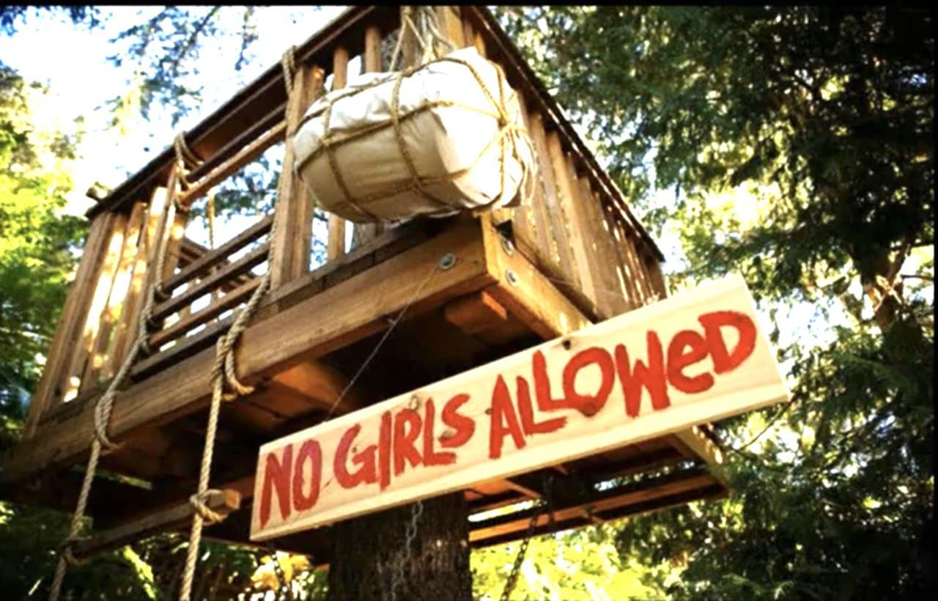
Discourse and gender
A group of boys form a club, they have a tree house where they meet. And outside they put a sign says (NO GIRLS ALLOWED). so the boys from identity of males, with themselves with actions of maleness like climbing trees, hunting and protect the tree house and so on.

Slide 14
Discourse and gender
Hall’s ( 1995 ) study of the use of language by telephone sex workers in the United States provides a further example of how speakers create gendered identities through their use of language. Not all of the sex workers in Hall’s study were heterosexual, although this was the persona they were projecting; nor were they all female. One was a male Mexican American who took pride in being able to ‘replicate’ Asian, Latina and Black women’s personas though his use of accent, intonation, voice quality and choice of vocabulary. The workers, thus, used ‘gendered styles to construct sexual meaning’.

Slide 15
Discourse and gender
Gender, is ‘not something a person “has”, but something that a person does. Gender (and in turn other identities) is not a result of what people (already) are but a result of, among other things, the way they talk and what they do. As Eckert and McConnell-Ginet ( 2003 : 4) argue:

Slide 16
Discourse and gender
Gender identity then is a complex construction. All levels of language and discourse, as well as aspects of nonverbal and other kinds of behavior are involved in doing gender. Gender, further, interacts with other factors such as social class and ethnicity.
As Holmes observes: (gender is only one part of a person’s social identity which will be more or less salient in different contexts. In some contexts, for example, it may be more important to emphasize one’s professional expertise, one’s ethnic identity, or one’s age than one’s gender).

Slide 17
Discourse and gender
Gender doesn’t just exist, but is continually produced, reproduced, and indeed changed through people’s performance of gendered acts, as they project their own claimed gender identities, ratify or challenge other’s identities, and in various ways support or challenge systems of gender relations and privilege.

Slide 18
Discourse and gender
‘The relationship between language and gender is almost always indirect, mediated by something else’. The ways that people speak are associated with particular roles, activities and personality traits, such as being a mother, gossiping and being modest.

Slide 19
Discourse and gender
In some cases, a person’s different identities may be difficult to separate. The actual balance between them is not determined in advance by some general principle but has to be negotiated in specific situations, since meaning is not only in the language itself but also in the context where language is used by particular speakers for particular purposes. A person, then, will have a multiplicity of identities or personae which may be at play all at the same time, at different levels of prominence.

Slide 20
Discourse and gender
They may not all be equally salient at a particular moment . Rather, one or more of these identities may be foregrounded at different points in time and for different (conscious or unconscious) reasons. Different aspects of identity, further, may be inseparable from each other

Slide 21
THANK YOU

