Slide 1
Discourse and Genre
Submitted by
Yasamin Waleed

Slide 2
One of the key ways in which people communicate with each other is
through the participation in particular communicative events, or genres.
examples of genres
news reports,
business reports,
parliamentary speeches,
summing up in a court of law
weather reports.
.

Slide 3
What is a genre?
Genres are activities that people engage in through the use of language.
Two types of genre
- Spoken genres - academic lectures and casual conversations
- Written genres- Newspaper reports and academic essays.
-Genres may typically be performed by a aimed at a particular
audience, such as an academic lecture being delivered by a
lecturer to a group of undergraduate students.

Slide 4
Various definitions of genres
Martin’s ( 1984 : 25) defines genre as ‘a staged, goal-oriented, purposeful activity in which speakers engage as members of our culture.
-Swales ( 2004 : 61) prefers the notion of ‘metaphor’ for talking about genres
Miller's notion of Genre
- Miller’s ( 1984 ) notion of ‘genre as social action’ has been especially important in the area known as rhetorical genre studies
A genre is defined, not in terms of ‘the substance or the form of
discourse but on the action it is used to accomplish’ (Miller 1984 : 151)

Slide 5
The Sydney School of genre analysis
- The notion of genre is important in the teaching of writing and reading in the work of the Sydney School of genre studies.
- the term( schematic structure) is often used to describe the discourse structure of texts.
- Martin's notion of genre corresponds to Malinowski’s notion of context of culture and is responsible for the schematic structure of a text.
- The register (Halliday 1989c ) of the text, on the other hand, corresponds to Malinowski’s context of situation and is responsible for the language features of a text.

Slide 6
Genre analysis and English for specific purposes
- Swales(1981 , 1990 , 2004 ) employed the teaching of English for specific purposes on analyses of the discourse structure of research article introductions.
Swales use the notion of moves to describe the discourse structure of texts
Rhetorical genre studies
- Researchers in rhetorical genre studies describe genres as part of the social processes by which knowledge about reality and the world are made
- Miller ( 1984 : 165) argues that genres ‘serve as keys to understanding how to participate in the actions of a community

Slide 7
Choice and constraint in the use of spoken and written genres
Swales ( 2004 ) discusses the view of genre in which there are both choices and constraints, regularity and chaos
Assigning a text to a genre category
Cook ( 1989 ) argues that we draw on many aspects of language and context to do this.-
The author of the text and the intended audience of the text
the purpose of text
the situation in which the text occurs
the physical form and, in the case of written texts
the title of the text
pre-sequence to the text, such as ‘Once upon a time’ as
well as the discourse structure of the text

Slide 8
the content of the text
the level of formality of the text,
the style or register of the text and whether it is a spoken or a
written text
Relationships between genres
A recent development in genre theory has been the notions of genre networks , genre chains , genre sets and repertoires of genres
-A key issue here is the way the use of one genre may assume or depend on the use of a number of other interrelated genres. An example of this is the academic essay

Slide 9
Figure 4.2 A genre chain: Applying for a job
At times people may draw on a repertoire of genres to carry out a particular task. A company may, for example, seek further information on a job applicant by means of a telephone call, an email, a letter, a fax or (in some circumstances) a casual conversation

Slide 10
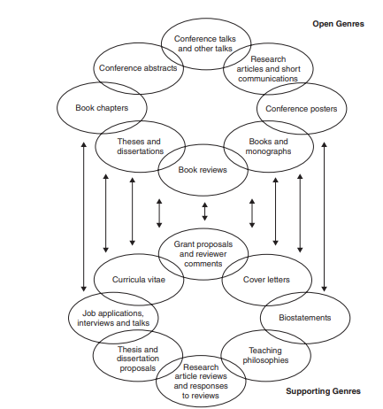
An example of a genre network Figure 4.3 is an example of a genre network based on the genres research students at US universities need to be familiar with.

Slide 11
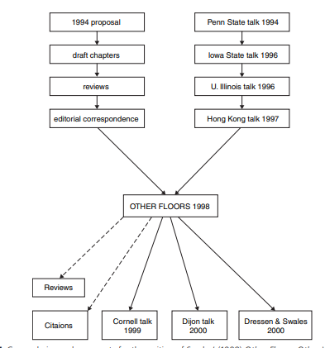
Figure 4.4 shows the genre chains and genre sets around the writing of Swales’ ( 1998 ) book Other Floors, Other Voices

Slide 12
Written genres across cultures
-Kalpan (1966) : Different patterns in the academic essay of student from different languages and culture
Connor(1996):Contrastive rhetoric
Connnor(2004):Intercultural rhetoric
Wang ( 2007 ), examines the relationship between texts and the sociocultural contexts in which they are produced in order to gain an understanding of why the texts have been written as they are

Slide 13
Spoken genres across cultures .
It is important to remember, that while there may be ways of performing the same genre across cultures that are quite similar, there may also be parts of the genre that are significantly (and importantly) quite different.
Genre and academic writing
-The notion of genre is especially important for the teaching of
academic writing, In Britain and the United States, for example,
English for specific purposes genre work has focused mostly on
second language graduate student writing

Slide 14
Discourse and academic writing
Many of the analyses of the discourse structure of academic texts have been based on Swales’ work in this area.
One model that has had a particular impact in this area is what has come to be known as the CARS (Create a research space) framework (see Feak and Swales 2011 )
Language and academic writing
There have been a number of views on the nature of genre-specific language. Hutchinson and Waters (1987), for example, made a distinction between the language of an area of specialization and the language of the genres found in these particular areas

Slide 15
Academic writing and metadiscourse
The term metadiscourse was first coined by the linguist Zellig Harris ( 1959 ) to describe the way in which a writer or speaker tries to guide their audience’s perception of their text (Hyland 2005b ).
Williams (1981) , describes metadiscourse as ‘writing about writing’

Slide 16
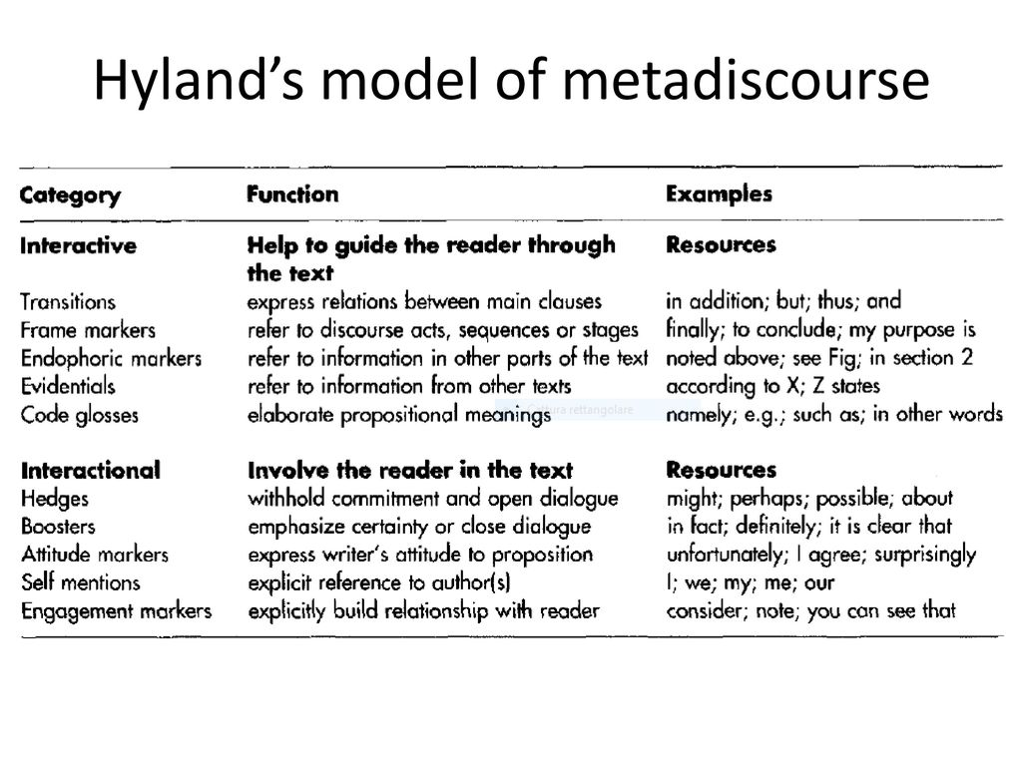

Slide 17
Generic Structure
The concept of generic structure derived from the word “genre” implying the type of discourse. Hasan stated that generic structure potential is the resource of all the discourses, including three elements: obligatory elements, optional elements, and iterative elements
According to Hasan (1978), each genre of text is a generalized structural formula, which permits an array of actual structures.
In Hasan’s words, “the obligatory elements define the genre to which a text belongs”

