Slide 1
Recursion

Slide 2
Overview
Conjoining
Embedding
Recursion

Slide 3
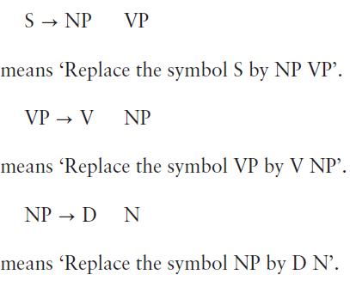
Rewrite Rules
The information found on a tree diagram can be alternatively expressed by rewrite rules.
A rewrite rule is a replacement rule, in which the symbol to the left of an arrow is replaced by an expanded form written to the right of the arrow.

Slide 4
Rewrite Rules
The main advantage of rewrite rules is that they are explicit, which leaves nothing to imagination. Rewrite rules can include optional constituents that allow us to enlarge the sentence.
Rewrite rules provide a sketchy picture of the structure of the sentence under investigation.
Therefore, a combination of rewrite rules and a lexicon is a good way of specifying the basic structure of a language.

Slide 5
Rewrite Rules
Rewrite Rules for “The duct bit the burglar”.
S NP VP
VP V NP
NP D N
A combination of rewrite rules and lexicon for the same sentence can be as follows:
N duck, burglar
V bit
D the

Slide 6
Conjoining
Conjoining is a recursive process in which two or more sub-sentences of equal importance are attached together to form a single one.
As in “Sam finished his homework, and Jane wrote a poem”.
S
S1 S2
NP VP NP VP
V NP Conj. V NP
In theory an indefinite number of sentences could be joined together.

Slide 7
Conjoining
Conjoining is a recursive process in which two or more sub-sentences of equal importance are attached together to form a single one.
As in “Sam finished his homework, and Jane wrote a poem”.
S
S1 S2
NP VP NP VP
V NP Conj. V NP
In theory an indefinite number of sentences could be joined together.

Slide 8
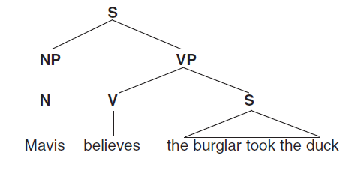
Embedding
Embedding is another recursive process in which two or more subsidiary sentences are inserted into one main sentence.

Slide 9
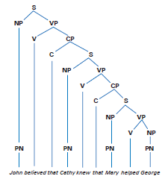
Embedding
In theory, a sentence can have an indefinite number of sentences embedded in it.

Slide 10
Recursion
Conjoining and embedding are important types of recursion.
Recursion is the possibility of repeatedly reusing the same construction, so that there is no fixed limit to the length of sentences.
Languages, in principle, contain infinite number of sentences, which are composed by means of a finite number of sentence patters.
The infinite number of sentences in each language can be produced because of the property of recursion.

