Slide 1
Syntax and Sentence patterns

Slide 2
Overview
Tree Diagrams
Rewrite Rules

Slide 3
Tree Diagram
Constituent analysis can be represented most clearly on a tree diagram.
A tree diagram is an annotation technique used to represents how sentences can be analyzed into its constituents. It is called as such because its branches resemble the branches of an upside-down tree where successive layers of constituents are shown.
A family metaphor is used to refer to the intersections (nodes) on a tree diagram: mothers, daughters and sisters.

Slide 4
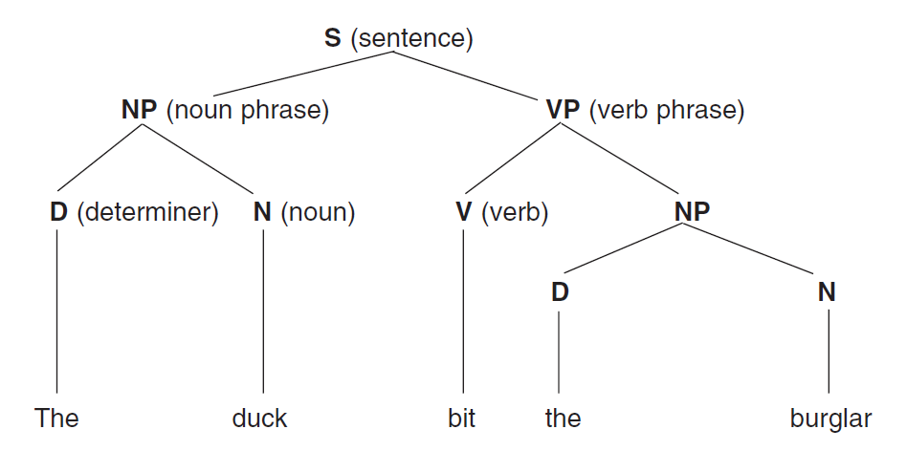
Tree Diagram

Slide 5
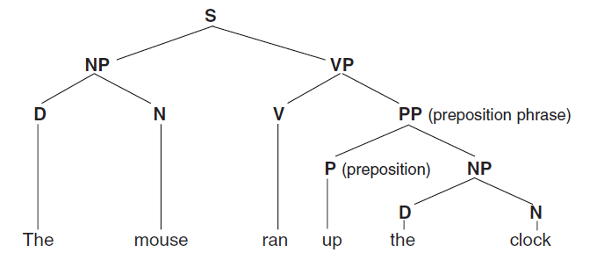
Tree Diagram

Slide 6
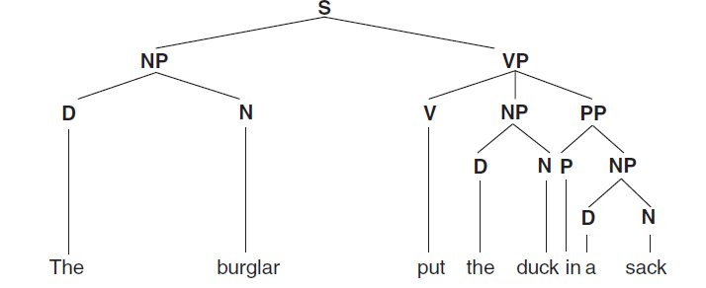
Tree Diagram

Slide 7
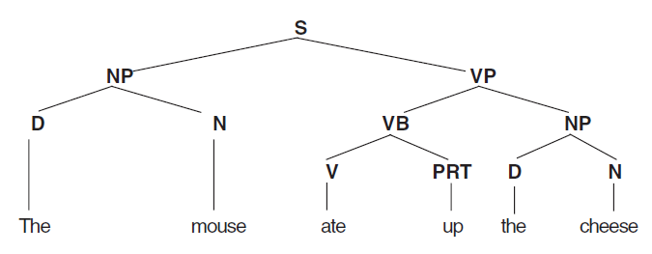
Tree Diagram

Slide 8
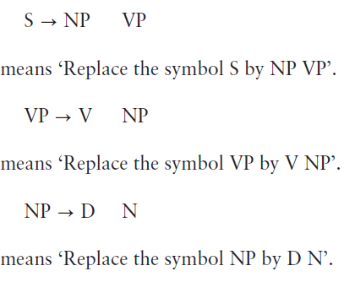
Rewrite Rules
The information found on a tree diagram can be alternatively expressed by rewrite rules.
A rewrite rule is a replacement rule, in which the symbol to the left of an arrow is replaced by an expanded form written to the right of the arrow.

Slide 9
Rewrite Rules
The main advantage of rewrite rules is that they are explicit, which leaves nothing to imagination. Rewrite rules can include optional constituents that allow us to enlarge the sentence.
Rewrite rules provide a sketchy picture of the structure of the sentence under investigation.
Therefore, a combination of rewrite rules and a lexicon is a good way of specifying the basic structure of a language.

Slide 10
Rewrite Rules
Rewrite Rules for “The duct bit the burglar”.
S NP VP
VP V NP
NP D N
A combination of rewrite rules and lexicon for the same sentence is shown as follow:
N duck, burglar
V bit
D the

