Slide 1
Qur’anic Macro Text
By
Ibrahim Talaat Ibrahim

Slide 2
Outline
Introduction
1.Macro Text Features Occurrence
2. Types of Quranic Sentence Occurrence
Examples about sentence Occurrence
3. Macro Text Synonyms
4. Macro Text Repetition
4.1. Repetition of Content Words
4.2. Repetition of Function Words
4.1.1. Examples about Repetition of Content Words
4.2. Repetition of Function Words
4.2.1. Examples about Repetition of Function Words
5.Macro Text Formulas
6.Macro Text Epithets
7.Macro Text Leitmotifs
7.1. Examples about Macro Text Leitmotifs
8.Macro Text Parables
8.1.Examples about Parables
9. Macro Text Premise and Rebuttal
9.1.Examples about Premises
10. Macro Text Deductive Argument
10.1. Example about Macro Deductive Argument
11.Macro Text Shift in the Glorious Qur'an
12. Macro Text Noun-initial Sentences (Aya)
13. Macro Text Mutashabihat
13.1. Examples about Macro Text Mutashabihat
14. Macro Text Thematic Coherence
Surat AL-Ikhlas Textual Analysis
15. Macro Text Relevance-Based Lexical Item
15.1. Examples about Macro Text Relevance-Based Lexical Item
Conclusion
References

Slide 3
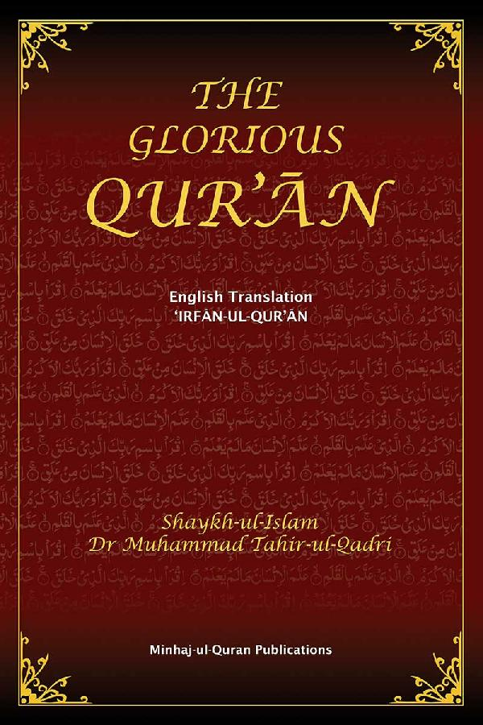
Introduction

Slide 4
1.Macro Text Features Occurrence

Slide 5
2. Types of Quranic Sentence Occurrence

Slide 6
Examples about sentence Occurrence
2.1. Occurrence of Sentences once
Qur’an, as in sentence 89 of (Surat Taha), which is the only sentence in the Qur’an that starts with the interrogative phrase (afalā yarawna – did they not see?). Sentence 95 of (Surat AL-Anbiya) is the only sentence in the Qur’an which starts with the verb (wa ḥarā mun – and there is prohibition).

Slide 7
Examples about sentence Occurrence
2.2. Occurrence of Sentences twice
There are sentences that have occurred only twice in the Qur’an, as in sentences (Surat AL-Baqara: 274–275) in which the relative pro- noun (alladhī na – those who) occurs in sentence-initial position in sentences immediately after each other only twice in the Qur’an. The pronoun (huwa – He (God)) occurs in sentence-initial position in sentences immediately after each other only twice in the Qur’an, as in (Surat AL-Imran: 6-7).

Slide 8
Examples about sentence Occurrence
2.3. Occurrence of Formulas twice
Occurrence of formulas twice: The phrase formula (inna lil-muttaqīna – indeed, for the righteous) occurs sentence-initially only twice in the Qur’an, as in (Surat AL-Qalam:24) and (Surat AL-Naba':31).

Slide 9
Examples about sentence Occurrence
2.4. Occurrence of Syntactic Patterns twice
The syntactic structure: inna + subject noun → (inna rabbakum allā hu – Indeed, your Lord is God) occurs in sentence-initial position only twice in the Qur’an, as in (Surat AL-A'raf:54) and (Surat Yunis: 3).

Slide 10
Examples about sentence Occurrence
2.5. Occurrence of Lexical Items or Sentences three times
The masculine plural active participle noun (sā’ilīn – the needy petitioners) occurs only three times in the Qur’an, as in (Surat AL-Baqara: 177), (Surat Yusif: 7), and (Surat Fusilat: 10). There are only three sentences in the Qur’an which occur consecutively with the initial vocative word (rabbanā – our Lord): (Surat AL-Imran: 192-194).

Slide 11
Examples about sentence Occurrence
2.6. Occurrence of Lexical Items or Sentences four times
The masculine singular active participle noun (sā ’il – the needy petitioner) occurs only four times in the Qur’an, as in (Surat Adh-Dhaariyat: 19), (Surat AL-Ma'arij: 1 and 25) and (Ad-Dhuhaa:10). There are only four sentences in the Qur’an which occur with an initial third person mas- culine plural pronoun (hum – they): (Surat AL-Imran: 163), (Surat Yaseen: 56), (Surat AL-Fath: 25) and (Surat AL-Munaafiqoon: 7).

Slide 12
3. Macro Text Synonyms
They are defined as semantic macro text feature of Qur'anic discourse. The following are many examples taken from the Glorious Qur'an
(yawm al-dīn – the day of recompense) (Surat AL-Fatiha: 4)
(al-yawm al-ā khir – the last day) (Surat AL-Baqara: 177)
(yawm al-bacth – the day of resurrection) (Surat Ar-room)
(yawm al-khulūd – the day of eternity) (Surat Qaaf: 34)
(al-ghā shiyah – the (day of) overwhelming event) (Surat AL-Ghaashiya:1)

Slide 13
4. Macro Text Repetition

Slide 14
4.1. Repetition of Content Words

Slide 15
4.1.1. Examples about Repetition of Content Words

Slide 16
4.2. Repetition of Function Words
The Arabic language also consists of certain elements called (function words). In other words, these words can function in the body of the text and can be of great importance in context but it cannot stand alone because they don't have concrete meaning and they have abstract one only. The diagram designed below explains types of function words found in Arabic in general and the Glorious Qur'an in particular.

Slide 17
4.2. Repetition of Function Words

Slide 18
4.2.1. Examples about Repetition of Function Words

Slide 19
5.Macro Text Formulas

Slide 20
6.Macro Text Epithets

Slide 21
7.Macro Text Leitmotifs
The Qur'anic macro text is also marked by particular sentences whose structural and stylistic features are different but their thematic and conceptual ones are similar . Yet, they are intertextually related to one another.

Slide 22
7.1. Examples about Macro Text Leitmotifs

Slide 23
8.Macro Text Parables
The Qur'anic parables are featured by the followings:
1-They are available in different Suras and Ayas
2- Their lengths are variable.
3-Their styles are different and themes are similar.
4-Their functions on the macro level: intertextuality and cohesion

Slide 24
8.1.Examples about Parables
There are many examples about parables in the Glorious Qur'an. Yet, (Surat Yousif) is the best example where the story of prophet Yousif is mentioned in different styles in the body of the sura. However, they contribute towards making the main theme of his character cohesive.

Slide 25
9. Macro Text Premise and Rebuttal
The Qur'anic macro texts highlight two significant parts. They are Good (Protagonist: Almighty Allah ) and Evil (Devil). This is why, there are argument between AL-Mighty Allah and Evil and these argumentations are functioned by God Great Power.
It is worth noting that there many premises in the Glorious Qur'an such as: monotheism and resurrection. Al-mighty Allah premises of the said points are highlighted but Evil oppose them. Therefore, Al-mighty Allah makes use of his great power to substantiate these matters.

Slide 26
9.1.Examples about Premises

Slide 27
10. Macro Text Deductive Argument
The deductive argument (reasoning scheme) is a major Qur’anic macro text feature. Throughout the Qur’an, we encounter God’s omnipotence details functioning as a deductive argument through which the reader/listener is persuaded and enabled to reach a conclusion that supports God’s premise, as in the following example:

Slide 28
10.1. Example about Macro Deductive Argument

Slide 29
11.Macro Text Shift in the Glorious Qur'an

Slide 30
12. Macro Text Noun-initial Sentences (Aya)

Slide 31
13. Macro Text Mutashabihat
Al-Mutashabihat constructions are defined as expressions found in the body of the Glorious Qur'an, they are stylistically different from each other but thematically and grammatically similar to one another. In other words, they are related intertextually due to the shared (theme)

Slide 32
13.1. Examples about Macro Text Mutashabihat

Slide 33
14. Macro Text Thematic Coherence

Slide 34
Surat AL-Ikhlas Textual Analysis

Slide 35
15. Macro Text Relevance-Based Lexical Item
The Relevance-Based Lexical Item is a semantic macro text feature that recurrently occurs in the Glorious Qur’an. It deals the occurrence of a speciﬁc word due to its relevance and through which coherence and continuity of thought are achieved.

Slide 36
15.1. Examples about Macro Text Relevance-Based Lexical Item

Slide 37
Conclusion
It is concluded that Qur'anic Macro text is concerned with the Qur'anic text as a whole.
The ultimate goal behind the analysis of the Quranic macro text is presented as follows:
Grasping the components of the Qur'anic Marco text as they were explained in the diagrams presented in the PowerPoint.
Helping researchers link the dots and make sense of the structures of the Glorious Qur'an because there are many different structures of many Qur'anic Ayas but their themes and grammar are similar.
Shedding lights on the importance of the theme and the tenets of faith which are defined as the corner stone of Islam.
Comprehending the significance of shifts in the Glorious.
All the above mentioned points also contribute to widening the understanding of translators who deal with the Glorious Quran. In other words, if translators understand the elements of the Quranic Macro text well, they are expected to produce something appropriate in the target language.

Slide 38
References
The Glorious Qur'an
Abdul Raof, Hussein. (2019). Text Linguistics of Qur'anic Discourse An Aanlysis. London: Routledge Publishing House
Al-Hilali and Khan ( nodate ) Interpretation of the Meanings of the Noble Qur’an (online ) , available :,.http://www.quranbrowser.com/cgi/bin/get.cgi

Slide 39
Thank You

