Slide 1
Analysing multimodal source texts for translation
A proposed model

Slide 2
Outline
Key definitions
Assumptions of multimodal studies
Aim and purpose of the model
Dimensions of the model
Multimodal pragmatic meaning
Semantic presentation of multimodal texts
Individual modes
Cluster and phase (space and time)

Slide 3
Key definitions
Mode: A set of socially and culturally shaped resources for making meaning. Modes, rather than fixed, are created through social processes, and thus fluid and context-dependent. In order for a particular resource to be a mode, the community in which it is used needs to recognise it as a mode and share a cultural sense of how this resource can be organised to construct and convey meaning. The choice of mode is a central aspect of interaction and meaning-making. Mode is often contrasted with medium, i.e., the substance through which texts are disseminated, e.g., a printed book or an audio file.
Modal affordance: The term affordance originated in Gibson’s (1977) work on cognitive perception. Kress (1993) uses it to refer to the material and the cultural aspects of modes, i.e., what can be expressed and represented easily with a particular mode. From this perspective, affordance refers to the materially, culturally, socially and historically developed ways in which meaning is made with particular semiotic resources. The affordance of a mode is shaped by its materiality, by what it has been repeatedly used to mean and do, and by the social norms and conventions that inform its use in context.

Slide 4
Key definitions (Cont.)
Semiotic resource: The actions, materials and artefacts we use for communicative purposes – these can be physiological (e.g., our use of muscles to make facial expressions) or technological (as in the use of a pen and paper to produce written texts) – and the ways in which these resources can be organised.
Multimodal ensemble: The term refers to interrelationships between co-present modes. As the resources of different modes are combined, meanings are corresponding, complementary, and dissonant in an integrated whole. Scholars talk about intersemiotic (semantic) relationships between the different semiotic systems within a multimodal text.
Semiotic landscape: The way semiotic resources are used in a specific historical and social-cultural setting. It includes the kinds of resources used, the degree to which they are used, the purposes for which they are used, and the ways in which they are combined into multimodal texts or used separately. Semiotic landscape also includes people’s attitudes towards specific semiotic resources, and the way in which their use is learned and regulated.

Slide 5
Assumptions of multimodal studies
1- It is assumed that communication always involves the use of multiple modes (speech, writing, gestures, images, and others), and their intermodal relationships contribute to meaning-making.
2- Secondly, meaning is constructed through selection and configuration of different modes in interactions.
3- Resources used by interactants are socially shaped over time to create a shared cultural sense of the way in which they can convey meaning. Multimodal expression, thus, is highly context-dependent, with multimodal meanings constructed within specific social and cultural contexts, based on the communicative needs of different communities or cultures.

Slide 6
Analytical Process
The model for analysis of a multimodal ST consists of three dimensions of ranging from general aspect to more specific ones:
Multimodal pragmatic meaning
Interaction of the modes
Meaning in individual modes
The analytical process aims to return a comprehensive, detailed and organised “map” of the perceived meaning of a text in its context of reference. This map serves a double purpose: during its drafting, it is a self-reflection tool guiding the user in raising awareness of their intuitive interpretation of the text, as they pinpoint the salient textual and contextual elements used in their interpretation process;

Slide 7
Textual Map Objective
In its developed form, the textual map objective is to:
Identify potential translation issues;
Ascribe them to one or more specific analytical dimensions (i.e. the role of individual resources, their interaction or inferential meaning);
Estimate the likely impact of these issues on the dimension to which they belong, the other analytical dimensions and the general inter- pretation of the TT in its context of reference;
Consider potential strategies that could be adopted to resolve those issues in the TT, also estimating the impact of any potential changes on the textual organisation in the various dimensions.

Slide 8
Meaning of Multimodal Pragmatic
Pragmatics is always after the implicit meaning (intended by the message sender) or the meaning that could be inferred from the explicit message. These messages as Sperber and Wilson (1995) state are communicated with a presumption of optimal relevance (the producer of a message belief that the form used to convey the message is the most cost-effective for delivering the intended meaning) i.e. the inherent presumption that this is the optimal form for the message to take, for the intended explicit and implicit meanings to be derived from it by the message receiver against a processing effort deemed reasonable for the quality and quantity of information conveyed.

Slide 9
Meaning of Multimodal Pragmatic (Cont.)
These messages cannot be dealt with in the same way as monomodal ones (since grammar provides guidance for interpretation in monomodal texts), as a separate analysis of the different modes in a multimodal text does not satisfactorily account for the message conveyed, as this is to be interpreted as a single entity.
The presumption of optimal relevance suggests that connections between the different modes must exist (unbounded to some grammar but to an inferential basis) and that they are to be identified in order to recognize intentions from a relevance-theoretic perspective.
RT supports the view that explicatures and implicatures (inferential meanings brought about by the use of language in a certain context) are retrieved on the basis of the semantic representation of utterances among other factors.

Slide 10
Semantic Representation of An Utterance
The semantic representation of an utterance is also called its “logical form” in Sperber and Wilson‘s work, so it can be said that a multimodal text must have a semantic representation, amenable to logical processing. Kress and Van Leeuwen (2006) and Van Leeuwen (1999) have successfully argued that images and sounds (like language) also show forms of organisation, although by different means and with different levels of solidity. However, the semantic representation of a multi- modal text is not equivalent to the simple sum of the semantic content of the various modes, but rather it is the product of the interaction of the modes.

Slide 11
 | She caught a cold
- The pointing index what we can call a “visual deictic” - Wearing a uniform defining him as a member of the British Army | Knowing referent of the pronoun “she” is essential to the truth value to the utterance
Completing the semantic representation of an utterance allows the recipient to access further explicit meaning (Sperber and Wilson)

Slide 12
Implicatures
Implicatures, are defined as contextual assumptions which a sender intends to make manifest to the hearer. They are of two types:
Implicated premises are supplied by the recipient (knowledge of the world relevant to the message)
Implicated conclusions are derived from the message, its explicatures and implicated premises (if any). Implicit meanings cannot be considered as developments of the semantic representation of a message, yet their retrieval is connected to the recipient‘s presumption of optimal relevance with respect to the sender‘s message.
Peter: Would you drive a Mercedes?
(b) Mary: I wouldn‘t drive ANY expensive car.

Slide 13
Semantic representation, explicatures and implicatures
The possibility of analysing a multimodal text for translation purposes in terms of its semantic representation, explicatures and implicatures has a strong link with the notion of translation as a case of interlingual interpretive use proposed by Gutt.
In a monolingual context: two utterances interpretively resemble each other in a certain context “to the extent that they share their analytic and contextual features “.
In a translation context: in order to interpretively resemble the ST, a TT needs to share with it a similar analytic structure (semantic representation) and produce similar contextual effects (explicatures and implicatures).

Slide 14
Semantic representation, explicatures and implicatures (Cont.)
A total transfer of a message for a different audience is not always possible, the ST and the TT can often resemble each other only to a certain extent, showing a similar semantic representation producing similar implicatures and explicatures to the extent to which this is possible.

Slide 15
Semantic representation of multimodal texts: Visual-Verbal Relationships
Signs from different semiotic sources interaction to generate meaning provides a picture of how a multimodal text is organised to convey messages (i.e. its semantic representation). This is even more important in a study of multimodality for translation purposes, as the goal in translation is not only to understand the semantic representation of the multimodal ST, but also to be able to replicate it as far as possible in the TT in order to produce a text that interpretively resembles its original.

Slide 16
Semantic representation of multimodal texts: Visual-Verbal Relationships (Cont.)
To illustrate how images and language interact, Martinec and Salway (2005) presented a framework that puts images and verbal content in a double relationship system made up of status and logicosemantic connections.(building on Barthes (1977) and Halliday (1994)) Barthes‘s work identifies three possible visual-verbal relations based on status:
–Anchorage: the verbal content supports the visual content
–Illustration: the visual content supports the verbal content
–Relay: visual and verbal content have equal status (Barthes 1977) Relay : -visual and verbal content are equal and independent - visual and verbal content are equal and complementary

Slide 17
Logico-Semantic Relationships
Martinec and Salway argue that his categorisation can be integrated with Halliday‘s model of logico-semantic relationships to achieve a picture of the links between relationships of status and the meaning they generate. Halliday‘s taxonomy was originally developed as a model of clause relationships, and as such, it applied only to language. Its founding criterion is the type of meaning contribution a clause can add to another clause in logico-semantic terms. The relations described by Halliday are relations of:
- Projection: deals with events previously represented linguistically (one clause is a report of a thought or an utterance, and the other attributes it to an agent)

Slide 18
Logico-Semantic Relationships (Cont.)
Expansion: deals with relations between ‘new’ events, not yet represented linguistically (the clauses describe events and states of affairs, and one clause adds to the other) Halliday describes two possibilities for projection:
Locution: the reported event is an utterance;
Idea: the reported event is a thought. He also identifies three ways in which a clause can expand the content of another clause:
Elaboration: the clause restates the main clause in other words, re- exposing or exemplifying it;
Extension: the expansion is carried out with the addition of new elements, alternatives or exceptions;
Enhancement: the clause embellishes its main clause adding circumstantial features like time, space and causal relations.

Slide 19
Logico-Semantic Relationships (Cont.)

Slide 20
Logico-Semantic Relationships (Cont.)
Martinec and Salway believe that Halliday‘s model of clause relationships can also account for the logico-semantic contributions. Images and language can add to each other. Halliday originally proposed his taxonomy to account for both paratactic and hypotactic relations, and therefore, his taxonomy can apply equally well to anchorage, illustration and relay as the relevant status; indeed, these are the multimodal equivalents to paratactic (relay) and hypotactic (anchorage and illustration) clause relations, due to the difference in status between the contributions made by the different modes to the message.

Slide 21
Logico-Semantic Relationships (Cont.)
The “quantity” of information could be considered as a criterion to determine status, the outnumbered single sign could, from a certain perspective, be claimed to be ‗dominant‘ because of the influence it exerts on a number of other signs in spite of its isolation, yet would not communicate the same full message without the signs it influences, and therefore, it is somewhat dependent on them, again calling dominance into question. The logico-semantic part of Martinec and Salway‘s model, that is, the interpretation of Halliday‘s taxonomy(concerned more with the product, with what is produced) aims to explain what the logico-semantic relations between signs from different modes can be, and its scope is much closer to the intent of understanding the multimodal semantic representation of a text.

Slide 22
Pastra’s framework
Pastra‘s study(2008), aimed to build “a corpus-based framework for describing semantic interrelations between images, language and body movements” from a message-formation perspective. Pastra‘s framework could be seen as to complement Halliday‘s logico-semantic relationships because of its focus on how multimodal texts are formed, where her view about the purpose of semantic analysis matches with what is stated by RT purpose of communication: the identification and recognition of intentions through the use of code as well as inference. The types of relationship described in Pastra‘s work are called ‗cross- media interaction relations‘ (COSMOROE) can be seen as the how that complements Halliday‘s what. Pastra‘s framework is categorised :

Slide 23
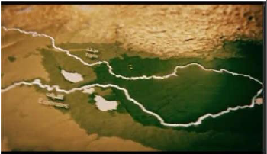
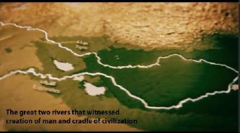
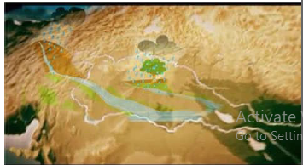
Pastra’s framework (Cont.)
 | Equivalence: The information expressed by the different modes (which she terms “media”) is semantically equivalent, it refers to the same entity
 | - Complementarity: The information expressed in one mode complements the information expressed in another mode
 | -Independence: Each mode carries an independent message, which is, however, coherent (or strikingly incoherent) with the document topic.

Slide 24
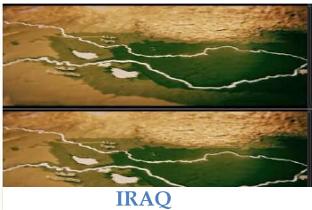
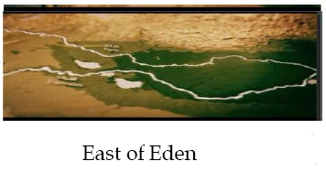
 | The relationship of equivalence is divided into: Token-token: the modes refer exactly to the same entity Type-token: one mode provides the class of the entity expressed by the other
 | Metonymy: Each mode refers to a different entity, but the user‘s intention is to consider the two entities as semantically equal.
 | Metaphor: A similarity is drawn between entities belonging to different domains, and there is a transfer of qualities between them.

Slide 25
Complementarity
The relation of complementarity is divided into two subcategories, according to whether the relationship itself is: essential or non- essential to form a coherent message. Both sets of relationships feature three subtypes:
Exophora: one mode contains a reference whose resolution is provided by another mode, for example, the verbal content says ‗you are here‘ and the visual content shows a map of England pinpointing London.
Agent-object: one mode reveals the subject/object of an action/ event/state expressed by another. for example, a balloon connects the speaker to their utterances in comics.
Apposition: one mode provides additional information on the other— this information identifies or describes something or some- one (2008)

Slide 26
Complementarity (Cont.)
In addition to these three relationships, the “non-essential” cluster of relationships of complementarity features one more relationship:
- Adjunct: one mode functions as adjunct to the information carried by another mode, adding non-essential information. The signature on a painting, for example, could play the role of an adjunct, as it adds information that is not (always) necessary in order to understand the message carried by the painting.

Slide 27
Independence
Lastly, the relation of independence shows three subtypes:
Contradiction: one mode refers to the exact opposite of another, or the two references are semantically incompatible (2008). Contradiction shows the same subtypes as equivalence. An example of contradiction could be a picture of the Parliament tagged ― Iraqi progress‖, since the linguistic and visual meanings are incompatible. Contradiction, is mainly used for humorous/satirical purposes, unless it is the result of a factual mistake.
Symbiosis: one mode provides information and the other shows something thematically related, which, however, does not refer to or complement that information (2008), as is the case of visual decorations to verbal content.
Meta-information: one mode reveals additional information through its means of realisation. This information is independent yet inherently related to the information expressed by the other mode (2008). For example, the font or the style of visual decoration of a text may reveal extra information on the place and time of its production.

Slide 29
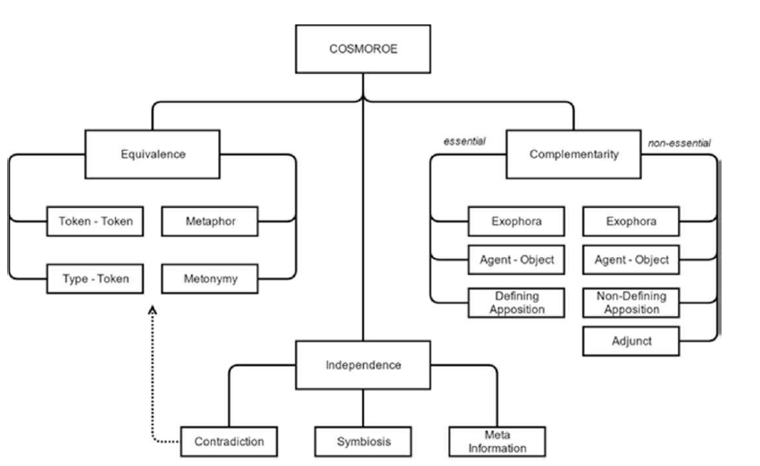

Slide 30
Problems
Halliday‘s categorisation as adapted by Martinec and Salway and the COSMOROE taxonomy seem to be complementary in the explanation of message formation: the former describes what is being done at a communicative level, while the latter looks at how this is done. Yet, there arise problems regarding the interpretive resemblance between ST and TT which can be seen in two categories:
Problems deriving from the translator‘s inability to lead the reader towards the intended interpretation of the semantic representation due to restrictions in the manipulation of textual resources.
Problems deriving from the translator‘s awareness that the target audience is not likely to possess the contextual and/or encyclopedic knowledge to which the textual resources appeal.

Slide 31
Individual modes and pragmatic processes
The various modes have different levels of organisation, being all more or less capable of performing the three Hallidayan metafunctions. Hence the analysis of a multimodal text from the point of view of its linguistic component is to be based on a case-by-case approach which takes into account the language of the ST to be analysed and of the TT to be produced. Machin(2007), objects to Kress and Van Leeuwen‘s view that they have developed a “grammar of images”, claiming that the visual mode does not satisfy the requisites set by Halliday

Slide 32
Individual modes and pragmatic processes (Cont.)
In order to bridge the gap left by the lack of a real grammar to support the interpretation of visual content, Forceville suggests that Kress and Van Leeuwen‘s work should be embedded in a cognitive approach such as the one provided by RT to include recipients under the presumption of optimal relevance in their quest for the sender‘s intention. The semantic representation of visual messages is thus identified by the receiver through both semantic and pragmatic means. This is reflected in the model proposed as the dimensions of analysis go from the “micro” level of the semantic representation of individual modes to the ‗macro‘ level of inferential meanings conveyed through individual modes, multimodal interaction and inference.

Slide 33
Development over space and time: Cluster and Phase
The concept of multimodal text development over space and time is central to Baldry and Thibault‘s work on multimodal transcription and text analysis. These two forms of multimodal text development are based on the concepts of cluster and phase. - a cluster is a local grouping of items.
 | The concept of cluster is particularly relevant to the analysis of static multimodal texts, which only develop over space. Elements belonging to different clusters in the same text are normally separated visually, for example, with a line demarcating the top part of a leaflet

Slide 34
Development over space and time: Cluster and Phase (Cont.)
While elements in a static multimodal text only show item groupings divided spatially (clusters), dynamic multimodal texts (such as films) organise their textual resources both over space (e.g. split screen in the same frame to create two clusters) and in temporal succession (phase) (one frame is presented after the other). The component “textual resources used in the cluster” from Baldry and Thibault‘s model is replaced by “semantic representation of individual modes” and “semantic representation of multimodal text”, as these latter categories also cover the deployment of textual resources, with the addition of inferential meanings.

Slide 38
Purpose of ST Analysis
The purpose of ST analysis is to arrive at an interpretation of the ST sender‘s communicative intention, based on the semantic representation of the text as well as contextual and world knowledge. The application of the model to a large sample of multimodal texts could help identify trends in the difficulties translators encounter in their work on different text types, and be useful in producing generalisations applicable to new texts.

Slide 39
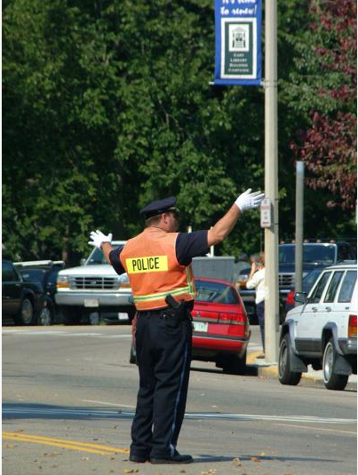
Examples of multimodal texts
 | Gestural mode of multimodal The crossing guard communicates with his hands. Drivers follows his instructions by interpreting his gestures.

Slide 40
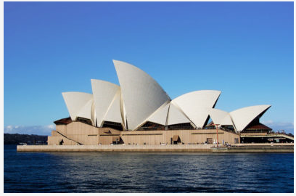
Examples of multimodal texts (Cont.)
 | Spatial mode of multimodal texts The Sydney Opera House is famous for appearing as it were a ship with many sails floating on the water of the harbor

Slide 41
Conclusion
Multimodal analysis offers a wealth of possibilities for the study of intercultural communication. Meanings expressed in different modes are characteristic of communities and cultures that produce them and it is within these social and cultural contexts that multimodal meanings can be analysed. Communities shape the way in which modes are commonly understood and what tools are considered to be modes.
Appropriate selection of multimodal data, data collection process and analysis provides ample opportunity for scholars working in the field of intercultural communication and can shed light on this important, yet still under-researched aspect of communication.

Slide 42
References
Ahmed, H. and Zaytoon, R. (2010). Caricature Images for Religious Profiling:A Multimodal Analysis of Islamophobia in Selected Press Images. An International Journal of English Studies
Baldry, A. and Thibault, P.J. (2006). Multimodal transcription and text analysis Equinox Publishing Ltd
Hussein, I. (2019). Analyzing Political Cartoons in Arabic-Language Media after Trump's Jerusalem Move: A Multimodal Discourse Perspective.International Journal of Cognitive and Language Sciences.Vol:13, No:4, 2019
Forceville, C. (2014). Relevance Theory as model for analysing visual and multimodal communication. In D. Machin (Ed.), Visual communication (pp. 51-70). (Handbooks of communication science; No. 4). De Gruyter Mouton. https://doi.org/10.1515/9783110255492.51
Kress, G., & van Leeuwen, T. (1996). Reading Images: The grammar of visual design. London: Routledge.

