Slide 1
Translation Studies
By
Ibrahim Talaat Ibrahim

Slide 2
Outline
Introduction
Topics addressed
Historical Perspective
Critical Issues and Topics
Current Contributions and Research
Main Research Method
Conclusions
References

Slide 3
Introduction
Translation studies or translatology is described as a discipline concerned with the theory, modelling and description.
Translation is defined as a process and product.

Slide 4
Topics addressed
How translation studies has made use of systematic functional linguistics as a tool for theorizing and modelling translation?

Slide 5
Historical perspective
Halliday and Catford are considered as the first two pioneers who carried out systematic functional linguistic (SFL)-based research in 1950s and early 1960s respectively.

Slide 6
Historical perspective
Halliday’s focus centered around the study of machine translation
Catford highlighted means of creating a general theory of translation with special reference to translation equivalence

Slide 7
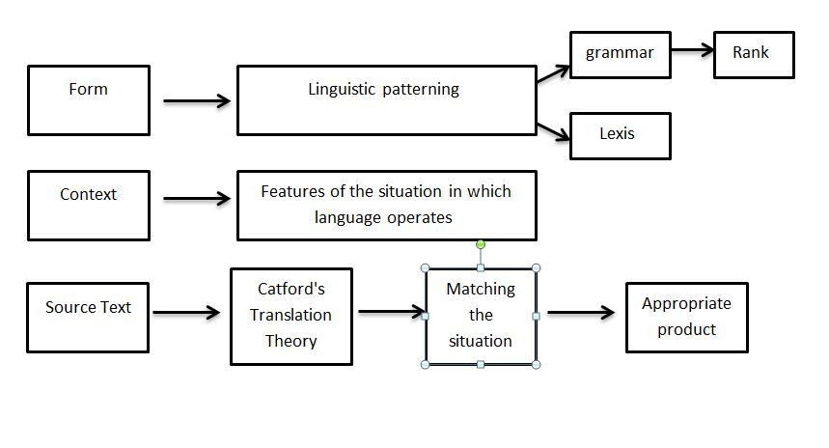
Historical perspective
Catford’s Theory of Translation

Slide 8
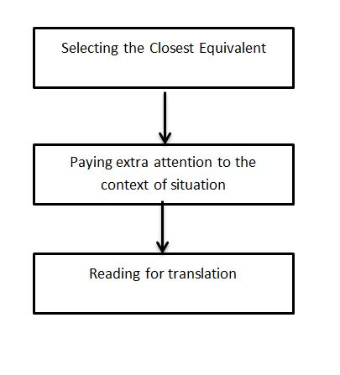
Historical perspective
Halliday’s Theory of Translation

Slide 9
Examples
A Doctor says: I arrived at home yesterday. He was available in the wedding ceremony.
يقول طبيب: وصلت الى المنزل البارحة. اذ كان حاضرا في حفل زفاف.
Catford system
Speaker: Doctor
Event: Arrival
Prior Event: Wedding ceremony

Slide 10
Critical Issues and Topics
Why the notion of register is so successful in translation studies?
Providing a framework for combining micro-analysis (lexical, grammatical, textual features with interpretation in sociocultural context).
Acting as an instrumental tool in marking the boundaries between: theoretical, descriptive and applied translation studies

Slide 11
Critical Issues and Topics
Hatim and Mason (1990) are the earliest scholars who invested the notion of register for translation studies in their book whose title is
Discourse and Translator:
It is concerned with placing translation in a wider context of language variation including:
User related variation (dialect)

Slide 12
Critical Issues and Topics
House (1997) Translation Quality Assessment (TQA). She counted on the notion of function in context. Her work is divided into the following:
Overt Translation:
Covert Translation:

Slide 13
Current Contributions and Research
SFL notion’s of register is of special significance in TS because scholars use it to describe the variation between SL and TL.
House uses TQA by comparing SL and TL in terms of field, tenor and mode.
Steiner enters into discussion on the degree of register variation between SL and TL saying that the TLs are registers of their own.

Slide 14
Current Contributions and Research
SFL notion’s of register is important:
1-The identification of intra-lingual variation shows Translation Studies (TS) in terms of systematic knowledge about register variation in translation relevant registers.
Ex:
Arabic Instruction Manual of Heater
Arabic Political Speech
Although both of the abovementioned texts are written in Arabic, you may find similar terms in both texts but they are translated differently due to the intra-lingual variation.

Slide 15
Current Contributions and Research
SFL notion’s of register is important:
2-The identification of inter-lingual variation presents that the equivalent functions may be instantiated in different languages by grouping of different features.
Ex:
Lexical repetition and syntactic parallelism could be available in the persuasive register in SL, whereas imperative and positive lexis might be preferred in the TL.

Slide 16
Current Contributions and Research
The empirical approaches with the employment of SFL model and quantitative method present an insight towards the relation between register and translationese, it assumes that translation and originals differ in the use of various linguistic features.

Slide 17
Current Contributions and Research
Translation Universals:
Translated Texts are often more explicit than source texts.
They are simpler than source texts.
Translated texts often exaggerate in use of TL features.

Slide 18
Current Contributions and Research
Grammatical metaphor is concerned with the fact that a given meaning in a language has different lexicogrammatical forms. It is employed to highlight the local shifts between SL and TL as conscious or unconscious translation procedure.

Slide 19
Current Contributions and Research
The textual domain:
Halliday and Hasan notion of cohesion has been employed in shift and translation study.
Blum-Kulla (2004) says that explicitation on the level of cohesion is described as a general strategy in translation and this is backed by Baker’s hypothesis at a linguistic level.

Slide 20
Current Contributions and Research
Cohesive Explicitation results:
changes from reduced cohesive devices such as (pronouns, proper nouns etc.) into fully lexical phrases
Ex:
Arabic: ترأس الكاظمي اجتماع مجلس الوزراء.
English: Iraqi Prime Minister Mr. Mustafa AL-Kadhmi Presided Council of Ministers Meeting.

Slide 21
Current Contributions and Research
Interpersonal domain
Appraisal: it is the linguistic reflection of socio-cultural meaning
It refers to speaker’s evaluation and stance in a text by which social interaction with the reader.
It is used to examine the shift in the speaker’s position from SL to TL and interpret them in terms of explanatory background. Such methods: overt vs. covert or translation scope: deals with target text readership translation brief.

Slide 22
Current Contributions and Research
Munday (2012) depends on Martin and White (2005) model:
Different types of appraisal (attitude, graduation and engagement) are found in both SL and TL. He applies a quantitative-qualitative method where translators tend to neutralization in translation. In other words, the evaluative force will be lost completely in the in TL

Slide 23
Main Research Methods
SFL mainly focuses on product-oriented researches.
If the analysis is carried on small samples of texts and translations, the qualitative research will be the answer.
If a collection of articles, essays, books and their translations.. Etc. are selected for analysis, then the quantitative research will be the appropriate choice.

Slide 24
Main Research Methods
Corpus-based researches:
The design of the appropriate corpora for translation studies depends on the research question. And the suitable corpora employed in translation studies are presented below:
Comparable corpora:
Texts: monolingual.
Contents: sub-corpus of original texts and sub-corpus of translations into the same language or SL or several SLs.
Function: Study features of lexicogrammar and cohesion that are specific to translations as compared to source language.

Slide 25
Main Research Methods
Translation Corpora
Texts: Bilingual.
Contents: Original corpora in a given language and their translation in different languages.
Function: study of the translation equivalence, translation patterns and shifts

Slide 26
Main Research Methods
Parallel Corpora
Texts: Multilingual
Contents: Translation corpora and comparable corpora
Function:
Contrast between original texts in two languages.
Contrast between original texts and translations in the same language

Slide 27
Conclusions
Translation studies has made use of systematic functional linguistics (SFL) as a tool for theorizing and modelling translation in different aspects. They are follows:
1-It is found in the earliest studies with regard to linguistics, translation and cohesion.
2-It is employed with the notion of register.
3-It plays an integral role on textual and interpersonal levels
4- It is also crystal clear in corpus-based translation researches

Slide 28
References
Baker, M. (1993). Corpus Linguistics and Translation Studies: Implications and Applications. In G. Francis, m. Baker and E. tonini Bonelli (eds) Texts and Technology. In honour of Sinclair. Holland: Amsterdam: John Benjamins.
Blum-Kulla (2004). Shifts in Cohesion and Coherence in Translation. In L. Venuti (ed.) The Translation Studies Reader. London: Routledge.
Catford, J.C. (1965). A Linguistic Theory of Translation. Oxford: OUP.
Colina, Sonia (2015). Fundamentals of Translation. UK. Cambridge: Cambridge University Press.
Halliday, M.A.K. (1962). Linguistics and Machine Translation. In A. Mclntosh and M.A.K. Halliday (eds) Patterns of Language: Papers in General, Descriptive and Applied Linguistics. London: Longman.
Hatim, B. and I. Mason (1990). Discourse and Translator. London: Longman.
House, J. (1997). Translation Quality Assessment. A model Revisited. Tubingen: Nar.

Slide 29
Thank You

