Slide 1
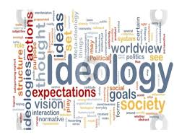

Slide 2
CDA Translation and Ideology
Discourse Analysis
Tutor’s Name: Prof. Dr. AHMED QADOURY ABED
By: Essam T.Muhammed
PhD Student
2020-2021

Slide 3
Outline
•Lefevere’s Definition of Ideology
•Political Discourse “an Introduction”
•The Intervention of Interpreters
•Revisiting the Role of the Interpreter
•Pöchhacker’s Triangulated Model of Mediation
•Van Dijk’s Model of Manipulation
•Ideology in Translation
• Hatim and Mason’s Model
• The Ideology of Translating
• The Translation of Ideology

Slide 4
• Halliday’s Linguistic Tools
• Hatim and Mason’s Modified Model
• Evaluation and Ideology in Translation
• Evaluation, Stance , and Appraisal
• Appraisal
• Reading Positions • Martin and White’s Map • Conclusions
• References

Slide 6
Political Discourse an Introduction
The discourse of political speeches is a highly intentional form, geared to maximize audience constituency. Consequently, a range of rhetorical and communicative devices tends to characterize such discourse, their particularity and frame of reference sharpened, very often by professional speech-writers, to be delivered at certain times, in certain places and directed to an identified group of people.

Slide 7
The Intervention of Interpreters
Intervention is ‘a manipulation of the source text beyond what is linguistically necessary” House (2008: p.16) .It is, of course, through the processes of translation and interpreting that speakers’ ideas, beliefs, and points of view are reflected to their foreign audience. In order to fulfil this function, such speakers prefer to assume that the filtering process of interpreting is as transparent as possible, a clear window onto speakers’ intentions. In fact, interpreter renditions involve both conscious and unconscious intervention, which, whatever the motivation may be, affects the communication both of intentions and the devices that frame and communicate those intentions. Thus, aspects of the speaker’s intentions ,particularly at the level of ideology, are modified and, indeed, at times excised by the interpreters. By applying discourse analysis to both interpreter intervention and the source speeches, we can examine how live simultaneous interpreters negotiate, adapt and, at times, violate the ideological positions that are framed within those speeches.

Slide 8
Revisiting the Role of the Interpreter
As a consequence of interpreting having established itself as a subdiscipline within translation studies, the role of the interpreter is increasingly considered to have shifted from the mere instrumental task of rendering linguistic messages (i.e. a bilingual re-speaker) into being an active participant in the act of cultural exchange that operates within the gap between cultures (Katan1999). In this respect, Pöchhacker and Schlesinger (2002:3) point out that interpreting is an ‘interlingual, intercultural oral or signed mediation’; in other words, the interpreter is the interlingual and intercultural mediator who controls the conditions of communication between participants( SL&TL) audience.

Slide 9
•Pöchhacker’s Triangulated Model of Mediation
Besides the previously mentioned two types of mediation by the interpreter , Pöchhacker (2008) suggested a third type of mediation, which he terms ‘contractual mediation’, one that underlines the broader relationship in which the communicative event between participants takes place. He further emphasizes the cognitive dimension of mediation, leading him to propose a triangulated model of mediation, consisting of cognitive, contractual and intercultural dimensions as its three corners

Slide 10
cognitive
Triangulated Model of Mediation
contractual
Pöchhacker
intercultural

Slide 11
However, it should be noted that while Pöchhacker’s influential account of the importance of the cognitive dimension is of high value, it is not wholly new. Hatim and Mason (1997:122) hypothesize that translators (and interpreters) as mediators ‘intervene in the transfer process, feeding their knowledge and beliefs into the processing of a text’. In other words, the interpreter’s intervention stems from his/her ideology or the ideologies imposed on him/her.

Slide 12
Van Dijk’s Model of Manipulation
Van Dijk’s (2006) suggested a model of manipulation that offers an important clarification in terms of how one’s knowledge and beliefs, the building blocks of ideology, are composed. He proposes another triangulated framework, this time of manipulation involving discourse, cognition, and society. The manipulator is assigned a particular social position that is different-privileged-from that of his recipients (whether dominated or clients), expressing power or abuse of power through text and oral communication or even visual messages. Crucially, s/he engages in communication and interaction with the recipients of the interpreting event to affect their mental models (experiences). In Van Dijk’s model, it is evident that the interpreter is at first manipulated and then becomes a manipulator.

Slide 13
Discourse
Speaker/writer
Cognition Society
Translator/Interpreter
Manipulated/Manipulator
Audience
Manipulated
Van Dijk’s Model

Slide 14
Ideology in Translation
By the end of the twentieth century, a variety of fundamental contributions to our understanding of the nature and influence of ideology on translation had emerged. Principal among these are:
1. Lefevere (1992b), who argues for the role of the translator as a rewriter of texts, motivated by his or her ideology or poetics.
2. Niranjana (1992) focuses on the geopolitical frame that conditions interpretation, emphasizing the effect of colonialism in the construction of images of the East.
3. From the perspective of gender, Simon (1996) introduces feminist concerns in translation theory.

Slide 15
Hatim and Mason’s Model
Such studies, as Hatim and Mason maintain have helped to ‘advance our understanding of the way ideology shapes discourse and the way discourse practices help to maintain, reinforce or challenge ideologies’. Their conclusion, the basis for their on-going analysis, is that there is an undeniable connection between ideology and discourse. They see ideology as‘the tacit assumptions, beliefs and value systems which are collectively shared by asocial group’ while discourse is, they write, ‘institutionalized modes of speaking and writing which give expression to particular attitudes towards areas of socio-cultural activity’. The implication is that to trace ideology is to carry out an analysis of discourse .

Slide 16
They proceed to outline the model that they will use to discern and track ideologically-generated variations in translation that carefully differentiates between the ideology of translating and the translation of ideology. In the former aspect, translation decisions are examined to identify the overriding translational strategy (i.e. foreignization or domestication) while, in the latter, translator mediation is put under scrutiny to assess how it ranges between low and high degrees of mediation in order to affect the transfer of ideologies. In both aspects, they conclude that ‘the translator’s mediation is in itself an ideological issue’

Slide 17
The Ideology of Translating
Translator choice, therefore, even at base, has always implied a certain ideology. To choose between apparently essential strategic positions - for example, free vs. literal, formal vs. dynamic, or communicative vs. semantic - in practice, implies choices that reveal ideological positions. Hatim and Mason (1997:120) review these critical functions of ideology, acknowledging that Venuti is the first scholar to demonstrate ‘the ideological consequences of this choice’ through what they consider to be the dichotomy he establishes between foreignizing and domesticating translation. Venuti, of course, draws heavily on the German philosopher Friedrich Schleiermacher who sees translation strategy as serving a critical ideological function within the receiving audience . Foreignization is seen as ‘an ethnodeviant pressure while domestication is characterized as ‘an ethnocentric reduction of the foreign text to target language cultural values

Slide 18
The Translation of Ideology
In this context, the focus of analysis centres on the modification of ideologies in and
through the act of translation .Hatim and Mason (1997:120-134) investigate a number of linguistic features that account for the translator intervention, including recurrence, parallelisms, overlexicalization, transitivity, style shifting, and cohesion to identify shifts in ideology wherein they identify three degrees (minimal, maximal, and partial) of translator mediation. Hatim and Mason relate translators’ interventions to their role as mediators, where mediation refers to ‘the extent to which translators intervene in the transfer process feeding their knowledge and beliefs into the processing of texts’ . In this sense there are two manipulators, the first being the speaker, who intends to practice a kind of influence on his recipients, the second being the translator or interpreter who, consciously or not, absorbs these manipulations (including ideologies) and portrays them according to what we have termed his or her mental models, in which modification or replacement is an ever-present likelihood.

Slide 19
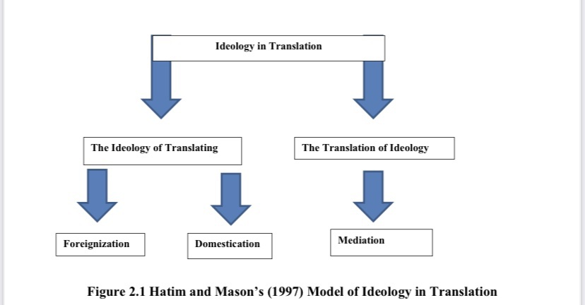
Ideology in Translating

Slide 20
Halliday’s Linguistic Tools
SFL provides a complete account of the set of linguistic tools used in the analysis of language, . An account in which linguistic choices are not arbitrary. there is a certain function that this choice fulfils. According to Halliday (2004), language is used to express three functions or – as he prefers to call them – metafunctions namely the ideational, interpersonal and textual. In the ideational metafunction, language is used to express our experiences of the real world as well as of one’s own consciousness, i.e. reflecting both outer and inner worlds through making use of transitivity and voice. Within the interpersonal metafunction, personal and social relationships are enacted concurrently. Language here helps the individual to communicate with society as well as to give him/her the opportunity to express and develop his/her personality, where mood and modality provide useful tools. Finally, within the textual metafunction, language helps to create coherent texts as well as providing the users of such texts with the ability to identify dislocations, such as vague or unrelated sentences.

Slide 21
Martin and White’s Criticism to Halliday’s Interpersonal Metafunction
According to Haliday ,the interpersonal metafunction exclusively focuses on mood and modality as the only categories that show how the writer/ speaker expresses his or her attitudes. This has been criticized for being too grammatical in nature and solely narrow in scope. Unconvinced by Halliday’s account, and working with colleagues in the early 1990s, Martin and White (2005) note that they ‘began to develop a more-lexically based perspective, triggered in the first instance by the need for a richer understanding of interpersonal meaning in monolingual texts’. The outcome was promising and has resulted in providing a framework termed ‘appraisal’ that centres on the study of evaluation – that is, conveying the speaker’s attitudinal meanings and stance(s).
Thompson and Hunston (2000) support such attempts and accept that ‘appraisal’ is used to refer to the expression of attitudinal meaning while acknowledging that it is an expansion of Halliday’s original account.

Slide 22
Hatim and Mason’s Modified Model
Hatim and Mason’s model has to be modified both in terms of the areas covered and tools used due to the following reasons:
Firstly, because of the impact exercised by manipulation on the translator/interpreter, his/her role will shift from that of a communicator who mediates between two languages (and cultures, of course) for the sake of maximizing understanding into that of an interventionist who, consciously or not, reflects his/her own ideology to the audience as though it were that of the writer/speaker. Secondly, since it is more likely that intervention takes place at the interpersonal level than the ideational and textual ones, then the best evidence of this kind of intervention is mainly provided by an appraisal framework because it represents the most-up-to-date version of the interpersonal tools Moreover, because translation/ interpretation involves the ‘reframing of narrative’, it is useful to focus on the deletion, addition and substitution of appraisal resources more than any other linguistic tool, reveal the translator’s/ interpreter’s (de)selectivity.

Slide 23
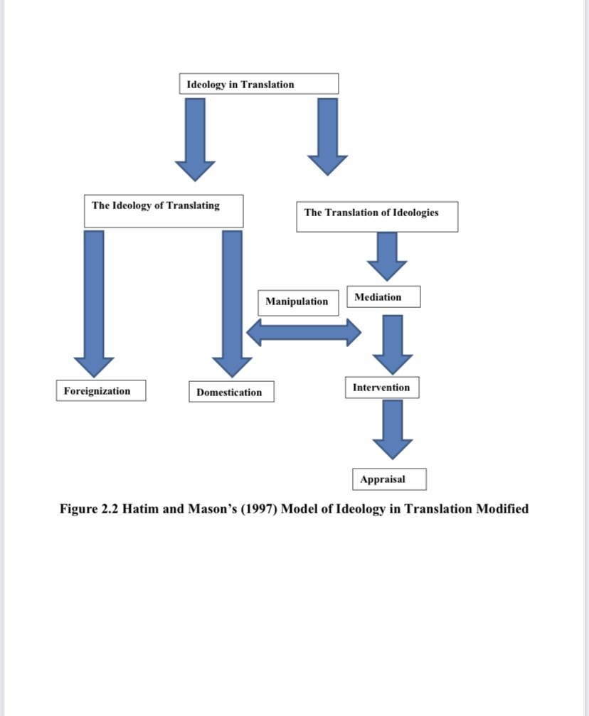

Slide 24
Evaluation and Ideology in Translation
The significance of the study of evaluation in language should not be underestimated simply because evaluation is an integral part of meaning. They – that is, evaluation and meaning - cannot be considered in isolation because ‘each element in a living utterance not only has a meaning but also has a value’ (Volosinov 1973:105). Writers/speakers use language to communicate with the world; to reflect these values and, moreover, as Halliday (2002:199) shows, they ‘intrude’ into the communicative situation where they express their ‘attitudinal’ meaning or ‘intersubjective’ position. Translation/interpreting involves the substitution, and sometimes the deletion, of a lexical item or more and this will lead to a difference in values promoted. Even within the same language . Volosinov (1973:105) accentuates that any ‘change in meaning is, essentially, always a reevaluation: the transposition of some particular word from one evaluative context to another’ .In this respect, evaluation and ‘reevaluation’ definitely take place in the process of translating/interpreting. Therefore, since appraisal’s primary task is to express as well as to show the writer’s/speaker’s interposition, it is helpful to apply the interpersonal network of appraisal tools to the translator’s/interpreter’s work in order to identify where in the translated/interpreted text ‘reevaluation’, which, in turn, entails certain degree of violating the writer’s/speaker’s ideology, actually takes place.

Slide 25
Evaluation, Stance , and Appraisal
‘Evaluation, stance, and ‘appraisal are among the most common terms that are currently used to refer to the linguistic study of evaluation. They share one common characteristic - that is, their focus on the functionality of language in use . Appraisal is preferred for the following reasons: 1. Firstly, ‘appraisal’ deals with modality as an independent system where both, of course in addition to mood, compose the interpersonal level of meaning. ‘Evaluation’ and ‘stance’, on the other hand, cover both modality and attitudinal meaning .This makes the process of sourcing attitudes and their intended recipient more difficult; the application of ‘appraisal’ makes these elements easier to identify since it distinguishes among positive or negative attitudes towards people (‘affect’), their behaviour (‘judgement’), as well as the valuation of things (‘appreciation’)

Slide 26
2. Secondly, in each of its subsystems, ‘appraisal’ provides elaborative sets of parameters such as ‘affect’, which classifies feelings in terms of ‘un/happiness’, ‘in/security’, ‘dis/satisfaction, and ‘dis/inclination’. This detailed categorization helps to identify the kind of attitude conveyed and facilitates analysis of their relation to the types of evaluations reflected therein. ‘Evaluation’ and ‘stance’ do not offer the same detailed branching of parameters. On the contrary, ‘evaluation’ for instance, is confined to one single, if essential parameter, that is, good-bad, to which the other three (certainty, expectedness, and importance) ‘can be seen to relate

Slide 27
3.Appraisal’ proposes a network of semantic resources that expresses and inspects how attitudes are amplified (either sharpened or softened) as well as how strongly the writer/speaker is aligned to these attitudes, under the subsystems ‘graduation’ and ‘engagement’ respectively (Martin and White 2005:92-94). The adjustment of attitudes and the degree to which the writer/speaker supports or opposes the value positions promoted in a text - i.e. his/her stand - are of great significance, particularly in tracing even the pieces of information that can contribute to his/her overall textual evaluations - i.e. ideologies. But neither ‘evaluation’ nor ‘stance’ enables such full expression and investigation of amplification or engagement as ‘appraisal’ does.

Slide 28
Appraisal
Appraisal theory is a framework used to describing and explaining the way language is used to evaluate, adopt stances, construct textual personas, and manage interpersonal positioning and relationships (White, 2002) .It focuses on how speakers express feelings, how they amplify them, and how they may incorporate additional voices in their discourses (Martin & White, 2005)
Appraisal, therefore, stems from and accounts for the interpersonal function of language. In its early stages, it was focused on writing in the workplace and secondary school under the literacy project Write it Right at the University of Sydney. But with time, the results that it provided motivated researchers to extend its scope to include other fields and contexts, such as literature (e.g. Rothery and Stenglin 2000), academic writing (e.g. Hood 2004), and media discourse (e.g. Bednarek 2006).

Slide 29
Aspects of Appraisal
Appraisal is concerned with the following aspects:
1. The interpersonal aspect in language, with the subjective presence of writers/speakers in texts as they adopt stances towards both the material they present and those with whom they communicate. 2. How writers/speakers approve and disapprove, enthuse and abhor, applaud and criticise, and how they position their readers/listeners to do likewise. 3. The construction by texts of communities of shared feelings and values, and the linguistic mechanisms for the sharing of emotions, tastes and normative assessments. 4. How writers/speakers construe for themselves particular authorial identities or personas, how they align or dis-align themselves with actual or potential respondents, and how they construct for their texts an intended or ideal audience.

Slide 30
Reading Positions
Martin and White, confine the writer’s/speaker’s reading positions to three types, in terms of whether s/he adopts the same position - i.e. ideology - conveyed by a text, opposes it, or concentrates on a single aspect that neither rejects or accepts the text as a whole - positions that are characterized as ‘compliant’, ‘resistant’, and ‘tactical’ respectively. The same goes for the translator / interpreter - that is, s/he can reflect the same position of the source text, oppose it, or a combination of both. Nevertheless, one cannot generalize the preference for any one of these responses unless a linguistic analysis throughout the use of appraisal semantic resources is carried out in both the source and target texts to see whether they, roughly speaking, correspond or not in terms of the ideology intended by the speaker/writer as compared to the one depicted by the translator / interpreter.

Slide 31
Martin and White’s Map
Martin and White put an exhaustive, and interrelated, map through which appraisal enables the systemic expression, and identification, of evaluation in texts First and foremost, appraisal differentiates between positive and negative attitudes towards people, issues, situations and so forth. These attitudes are either feelings, judgments of human behaviour or evaluations of things or natural phenomena. As can be noticed in Figure 2.3 below, within the category of attitude (original emphasis), there are three main sub-resources namely affect, judgement, and appreciation:

Slide 32
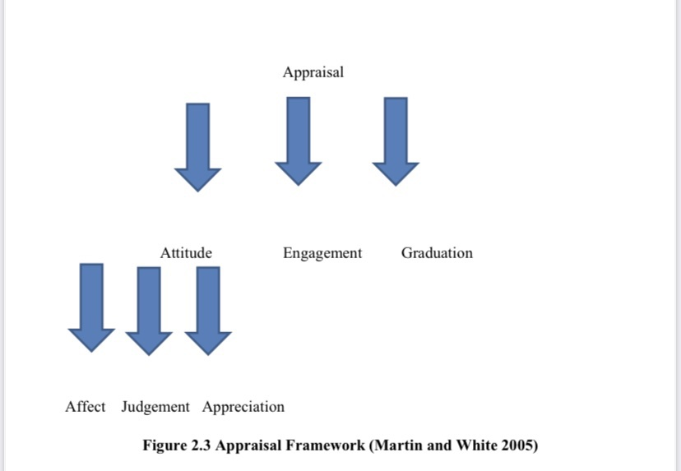

Slide 33
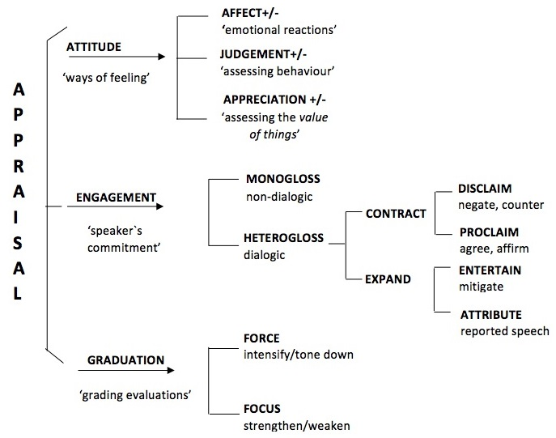

Slide 34
As for affect, it is fundamentally concerned with ‘emotional reactions’. Moreover, depending on the surge of feeling, affect is then classified into four variables which are ‘un/happiness’, ‘dis/satisfaction’, ‘in/security’, and ‘dis/inclination’
See, for example, Bill Clinton’s use of the word ‘remorse’ to express his feeling of ‘unhappiness’ which he intensifies through another appraisal indicator ‘profound’: Mere words cannot fully express the profound remorse I feel for what our country is going through and for what members of both parties in Congress are now forced to deal with (Clinton, I am profoundly Sorry, December 11, 1998).

Slide 35
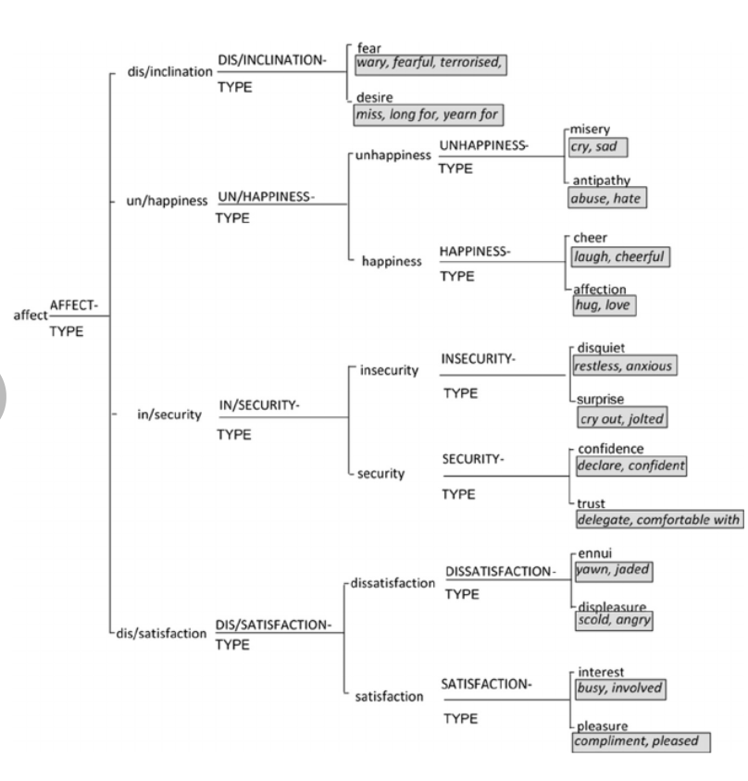

Slide 36
Judgement, the second sub-type of attitude, evaluates people’s behaviour in relation to ‘social esteem’: their ‘normality’, ‘capacity’ and ‘tenacity’, and ‘social sanction’: their ‘veracity’ and ‘propriety’. In the following extract, for instance, especially through the underlined words, George W. Bush evaluates Saddam’s actions by relying heavily on the parameter of ‘social sanction’ of negative ‘prosperity’ in particular toget Americans’ support to launch war on Iraq: …a murderous tyrant, who has already used chemical weapons to kill thousands of people. This same tyrant has tried to dominate the Middle East, has invaded and brutally occupied a small neighbor, has struck other nations without warning, and holds unrelenting hostility towards the United States (Bush, Speech to America, July 9, 2002)

Slide 37
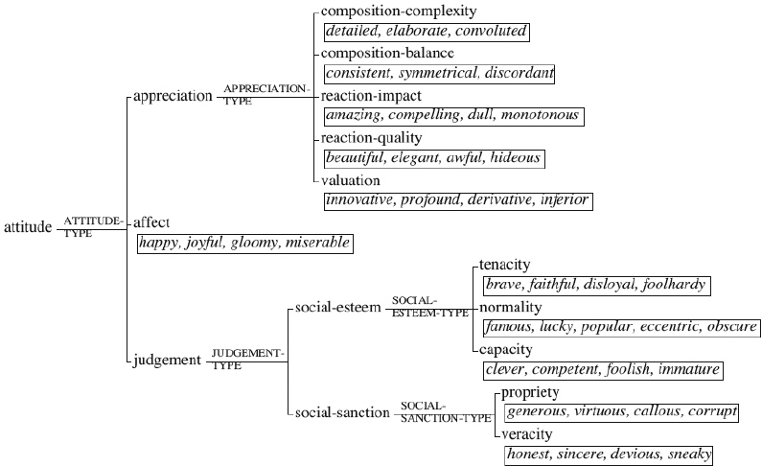

Slide 38
Thirdly, appreciation conveys our estimation of things or natural phenomena according to three variables, which are ‘reaction’, ‘composition’, and ‘valuation’. Ronald Reagan’s evaluation of Berlin is a good example that shows the use of the three variables; ‘reaction’ in (beauty), ‘composition’ in (place of freedom), and ‘valuation’ in (feeling of history) as can be seen below:
We come to Berlin, we American presidents, because it's our duty to speak in this place of freedom. But I must confess, we're drawn here by other things as well: by the feeling of history in this city, more than 500 years older than our own nation; by the beauty of the Grunewald and the Tiergarten; most of all, by your courage and determination (Reagan, Tear Down this Wall, June 12, 1987).
In fact, the speaker/writer adopts a particular stance towards each of the kinds of attitude set out above. These stances are crucially revealed to the audience using lexico-grammatical choices that strategically designed to drive him/her take a similar, contrary or undecided position.
:

Slide 39
This second domain of meaning is termed engagement, of which there are four possibilities of alignment: disclaim (‘denial’ or counter-expectancy’), proclaim (‘concurring’, ‘pronouncement’, or ‘endorsement’), attribute (‘acknowledgement’ and ‘distancing’), and entertain. One clear example of disclaim is that of George W. Bush, who rejects the views that ‘War on Terror’ should be confined to Americans because they are the ones who are threatened. This firm stand is revealed below through words such as ‘not’, ‘however’, and ‘just’: This is not, however, just America's fight. And what is at stake is not just America's freedom. This is the world's fight. This is civilization's fight. This is the fight of all who believe in progress and pluralism, tolerance and freedom (Bush, Address to Congress, September 20, 2001).

Slide 40
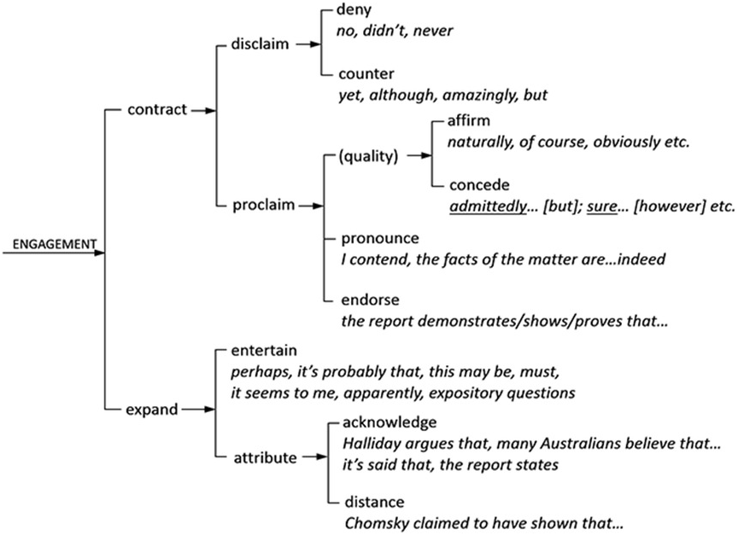

Slide 41
The final sub-system of appraisal is graduation. It is concerned with grading. It is divided into force and focus depending on whether the graduated resource, which is either an attitude or a stance, is gradable or non-gradable. Within force, moreover, the degree of evaluation is adjusted in terms of either ‘intensification’ or ‘quantification’. In the example below, William Jefferson Clinton plays on both the intensity and quantity of negative feelings to maximize the impact of his evaluations:
You have lost too much, but you have not lost everything. And you have certainly not lost America, for we will stand with you for as many tomorrows as it takes (William Jefferson Clinton, Oklahoma Bombing Memorial Prayer Service Address, April 23, 1995)

Slide 42
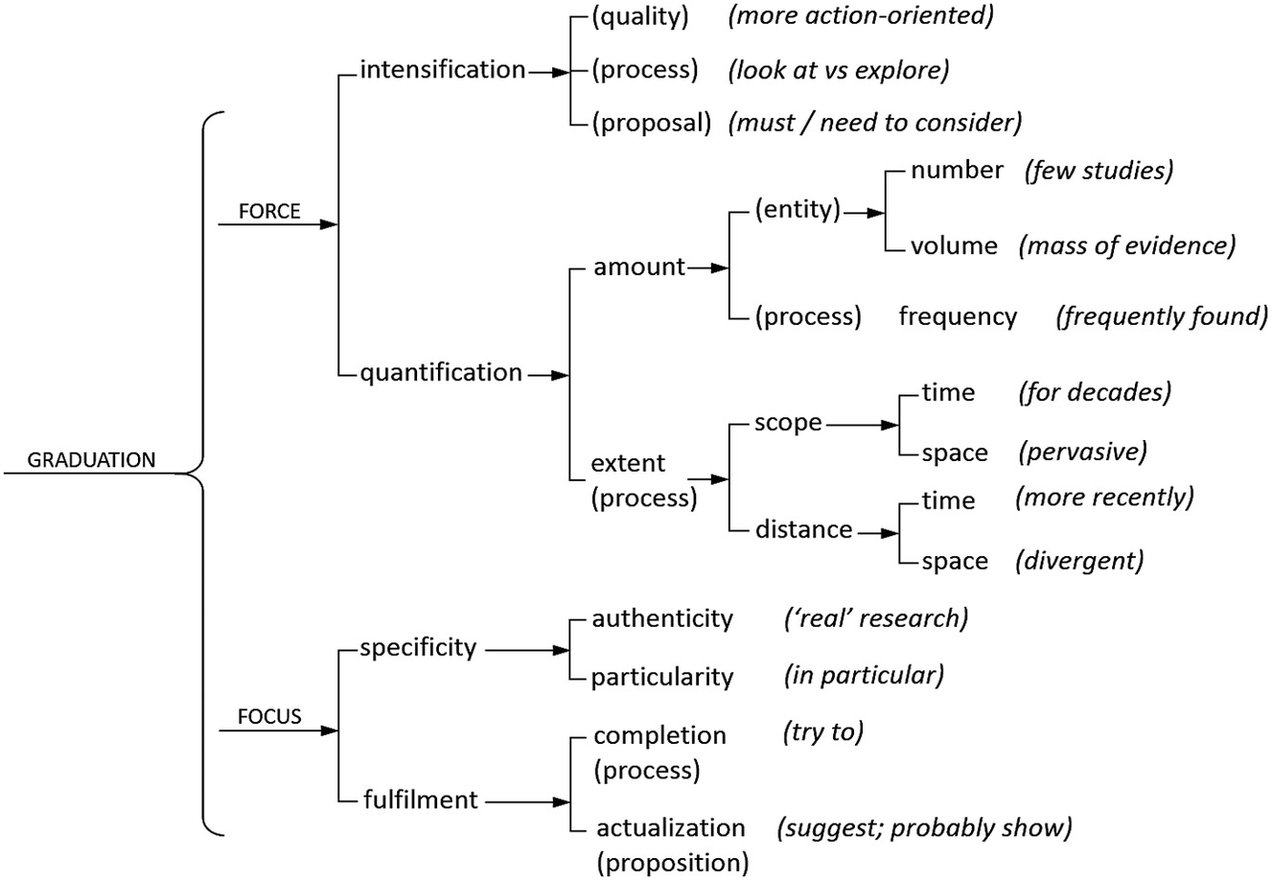

Slide 43
Conclusions
1.The appraisal theory is designed to describe the different components of a speaker’s attitude, the strength of that attitude (graduation) and the ways that the speaker aligns him/herself with the sources of attitude and with the receiver (engagement). 2.This theory is embedded within Halliday’s Functional Grammar which locates lexicogrammatical choices within a framework that examines the function of different choices 3. Appraisal theory particularly relates to what is known as the interpersonal function of language that deals with the relationship between the writer and the reader.

Slide 44
References
Halliday, Michael A. K. (1978) Language as Social Semiotic: The Social Interpretation of Language and Meaning, London: Arnold.
Hatim, Basil and Ian Mason (1997) The Translator as Communicator, London and New York: Routledge.
House, Juliane (2008) ‘Beyond intervention: universals in translation?’, Trans-Kom 1.1: 6–19.
Martin, James R. and Peter R. R. White (2005) The Language of Evaluation: Appraisal in English, London: Palgrave.
White, Peter R. R. and Elizabeth Thomson (2008) ‘Analysing journalistic discourse’, in Elizabeth Thomson and Peter R. R. White (eds) Communicating Conflict: Multilingual Case Studies of the News Media, London: Continuum, 1–23.

Slide 45
Thank You

