Slide 1
Meaning relations and rules of inference

Slide 2
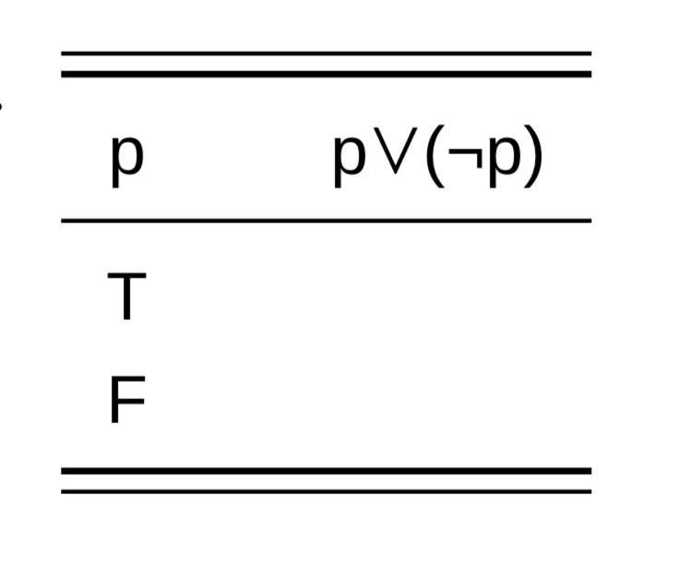
Meaning relations and rules of inference
In addition to its usage to define logical operators, we can also use truth tables to evaluate more complex logical formulae
(1) a.
1- To begin with a very simple example, the formula p∨(¬p) represents the logical structure of sentences like Either you will graduate or you will not graduate. Sentences of this type are clearly tautologies, and we can show why using a truth table:
We start by putting the basic proposition (p) at the top of the left column and;
the formula that we want to prove (p∨(¬p)) at the top of the last right column, as shown in table (1, a)
We can also fill in all the possible truth values for p in the left column.

Slide 3
Meaning relations and rules of inference
(1) b.
The proposition we are trying to prove (p∨(¬p)) is an or statement; that is, the highest operator is ∨. The two propositions conjoined by ∨ are p and ¬p. We already have a column for the truth values of p, so the next step is to create a column for the corresponding truth values of ¬p, as shown in (1. b).

Slide 4
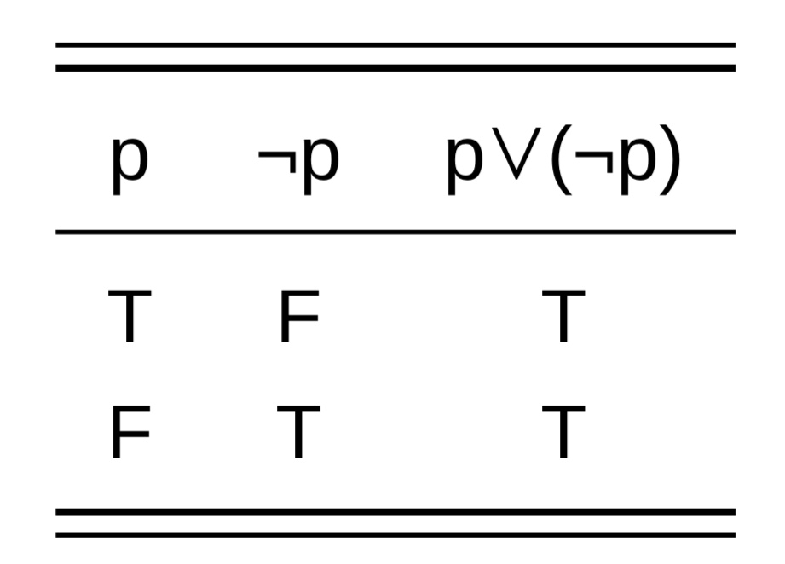
Meaning relations and rules of inference
The final step in the proof is to calculate the possible truth values of the proposition p∨(¬p), using the truth table that defines the ∨ operator. The result is shown in (1. c).
We notice that both cells in the right-most column contain T. This means that the formula is always true, under any circumstances; thus, it is a tautology. The truth of this tautology does not depend in any way on the meaning of p, but only on the definitions of the logical operators ∨ and ¬.
Propositions which are necessarily true just because of their logical structure (regardless of the meanings of words they contain) are sometimes said to be “logically true”.
(1) c.

Slide 5
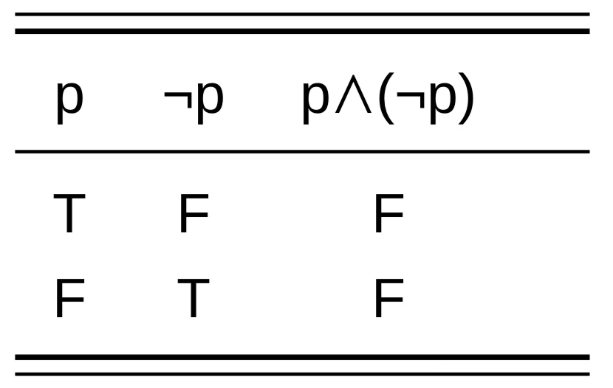
Meaning relations and rules of inference
(2)
When changing the or in the previous example to and. This would produce the formula p∧(¬p), which corresponds to the logical structure of sentences like You will graduate and you will not graduate. It is hard to imagine any context where such a sentence could be true, and using the truth table in (2) we can show why this is impossible. Sentences of this type are contradictions; they are never true, under any possible circumstance, as reflected in the fact that both cells in the right-most column contain F.

Slide 6
Meaning relations and rules of inference
(3)
((p∨q) ∧ (¬p)) → q.
To construct a truth table, we begin by putting the basic propositions p and q in the left-hand columns (1 & 2). We put the complete formula that we want to prove in the far right column (6). We introduce a new column for each constituent part of the complete formula and calculate truth values for each cell, building from left to right. First, columns 1 & 2 are used to construct column 3, based on the truth table for ∨. Next, column 4 is calculated from column 1. Columns 3 & 4 are used to construct column 5, based on the truth table for ∧. Finally, columns 2 & 5 are used to construct column 6, based on the truth table for →. every cell in the right-most column contains T. This means that the formula is always true, under any circumstances; it is a tautology.

Slide 7
Meaning relations and rules of inference
The truth of the tautology does not depend in any way on the meanings of the propositions p and q, but only on the definitions of the logical operators. The previous tautology predicts that whenever a proposition of the form ((p∨q) ∧ (¬p)) is true, the proposition q must also be true. For example, it explains why the sentence (Either Joe is crazy or he is lying, and he is not crazy) must entail Joe is lying. A similar entailment relation will hold for any other pair of sentences that have the same logical structure.
It is helpful to check the predictions of the logical formalism against our intuition as speakers by “translating” the formulae into English or some other human language (i.e., replacing the variables p and q with sentences hat express propositions). We noted that when we hear the sentence Either Joe is crazy or he is lying, and he is not crazy, we reach the conclusion Joe is lying automatically and without effort. It takes a bit more effort to process a formula like ((p∨q) ∧ (¬p)), but its truth table shows that the logical implication of this formula matches our intuition about the corresponding sentence.

Slide 8
Meaning relations and rules of inference
The above table represents the biconditional formula (p∨q) ↔ ¬((¬p) ∧ (¬q)).
Once again we see that every cell in the right-most column contains T, which means that this formula must always be true, purely because of its logical form. The biconditional operator in this formula expresses mutual entailment, that is, a paraphrase relation. This formula explains why the sentence Either he is crazy or he is lying must always have the same truth value as It is not the case that he is both not crazy and not lying. The first sentence is a paraphrase of the second, simply because of the logical structures involved.

Slide 9
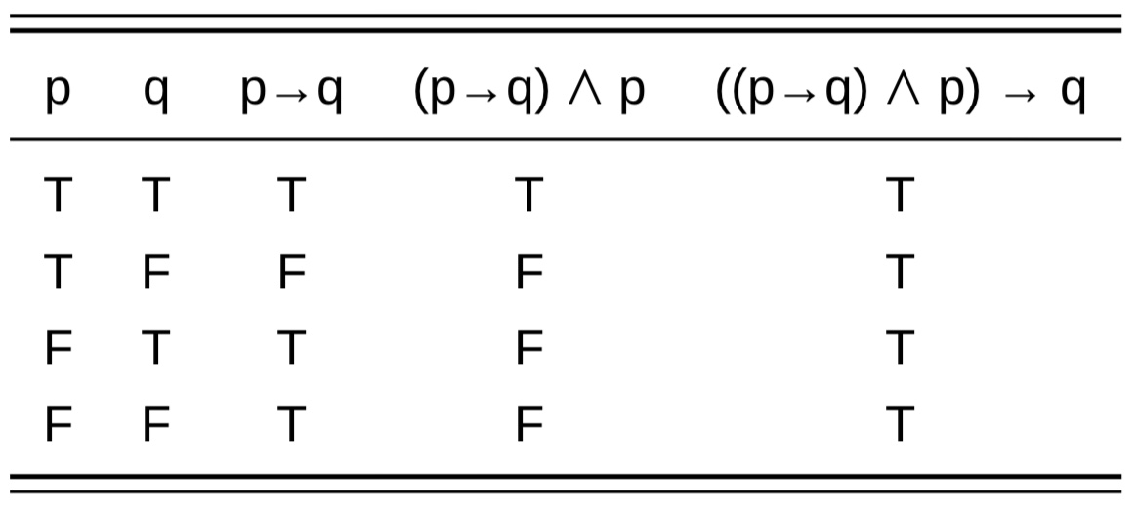
Meaning relations and rules of inference
Logical tautologies: are not very informative because they make no claim about the world. But for that very reason, these logical tautologies can be extremely useful because they define logically valid rules of inference. A few tautologies are so famous as rules of inference that they are given Latin names, below are some types of tautologies:
One of these is called Modus Ponens ‘method of positing/ affirming’, also called ‘affirming the antecedent’: ((p→q) ∧ p) → q. The proof of this tautology is presented in the table.

Slide 10
Meaning relations and rules of inference
Modus Ponens defines one of the valid ways of deriving an inference from a conditional statement. It says that if we know that p→q is true, and in addition we know or assume that p is true, it is valid to infer that q is true. An illustration of this pattern of inference is presented as a syllogism below:
Premise 1: If John is Estonian, he will like this book. (p→q) Premise 2: John is Estonian. (p)
———————————————————————————————
Conclusion: He will like this book. (q)
Modus Ponens guarantees a valid inference but does not guarantee a true conclusion. The conclusion will only be as reliable as the premises that we begin with. Suppose in this example it turns out that John is Estonian but hates the book. This does not disprove the rule of Modus Ponens; rather, it shows that the first premise is false, by providing a counter-example.

Slide 11
Meaning relations and rules of inference
Another valid rule for deriving an inference from a conditional statement is Modus Tollens ‘method of rejecting/denying’, also called ‘denying the consemquent’: ((p→q) ∧ ¬q) → ¬p.
This rule was illustrated in example below, It says that if we know that p→q is true, and in addition we know or assume that q is false, it is valid to infer that p is also false.
Premise 1: If dolphins are fish, they are cold-blooded. (p→q) Premise 2: Dolphins are not cold-blooded. (¬q)
———————————————————————-
Conclusion: Dolphins are not fish.

Slide 12
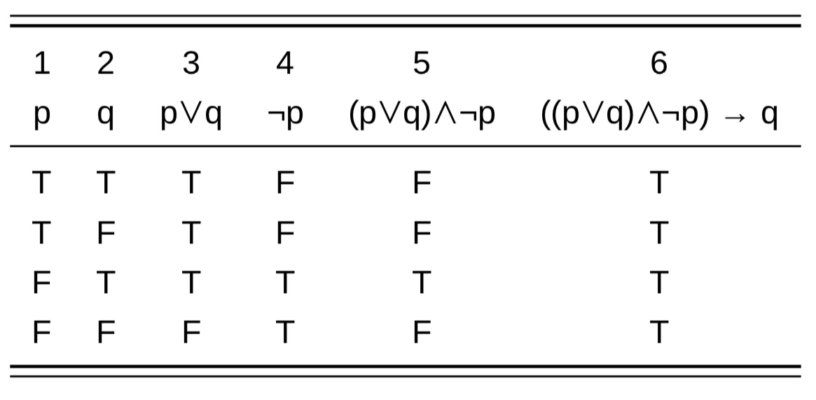
Meaning relations and rules of inference
The tautology which we previously proved in (3) is known as the Disjunctive Syllogism: ((p∨q) ∧ (¬p)) → q.
(Either Joe is crazy or he is lying, and he is not crazy) must entail Joe is lying.
Another example which illustrates this pattern of inference is provided below.
Premise 1: Dolphins are either fish or mammals. (p∨q)
Premise 2: Dolphins are not fish. (¬p).
Conclusion: Dolphins are mammals. (q)

Slide 13
Meaning relations and rules of inference
Finally, the tautology known as the Hypothetical Syllogism is given below ((p→q) ∧ (q→r)) → (p→r)
Premise 1: If Mickey is a rodent, he is a mammal. (p→q)
Premise 2: If Mickey is a mammal, he is warm-blooded. (q→r)
Conclusion: If Mickey is a rodent, he is warm-blooded. (p→r)

Slide 14
Predicate logic
Unlike propositional logic, predicate logic gives us a way to include information about word meanings in logical expressions. Consider the simple sentences below:
a. Mary snores.
John is hungry.
c. John loves Mary.
d. Mary slapped John.
Each of these sentences describes a property, event or relationship. The words hungry, snores, loves, and slapped express the predicates in these examples. The individuals of whom the property or relationship is claimed to be true (John and Mary in these examples) are referred to as arguments. As we can see from the example, different predicates require different numbers of arguments: hungry and snore require just one, love and slap require two. When a predicate is asserted to be true of the right number of arguments, the result is a well-formed proposition, i.e., a claim about the world which can (in principle) be assigned a truth value, T or F.

Slide 15
Predicate logic
In our logical notation we will write predicates in capital letters and without inflectional morphology. We follow the common practice of using lower case initials to represent proper names. For predicates which require two arguments, the agent or experiencer is normally listed first. So the simple sentence John is hungry would be translated into the logical metalanguage as
HUNGRY(j),
while the sentence John loves Mary would be translated LOVE(j,m).

Slide 16
Predicate logic
a. Henry VIII snores. SNORE(h)
b. Socrates is a man. MAN(s)
c. Napoleon is near Paris. NEAR(n,p)
e. Jocasta is Oedipus’ mother. MOTHER_OF(j,o)
f. Abraham Lincoln was tall and homely. TALL(a) ∧ HOMELY(a)
g. Abraham Lincoln was a tall man. TALL(a) ∧ MAN(a)
h. Joe is neither honest nor competent. ¬ (HONEST(j) ∨ COMPETENT(j))
As these examples illustrate, semantic predicates can be expressed grammatically as verbs, adjectives, common nouns, or even prepositions. They can appear as part of the VP, or as modifiers within NP as in (g). We have seen examples of one-place and two-place predicates; there are also predicates which take three arguments, e.g. give, show, offer, send, etc. Some predicate, including verbs like say, think, believe, want, etc., can take propositions as arguments:
a. Henry thinks that Anne is beautiful. THINK(h, BEAUTIFUL(a))
b. Susan wants to marry Ringo. WANT(s, MARRY(s,r))

Slide 17
Quantifiers (an introduction)
Quantifier is a special kind of determiner, The italicized phrases in below are examples of “quantified” NPs; they contain quantifiers:
All students are weary.
Some men snore.
No crocodile is warm-blooded.
Sentence (a) makes a universal generalization. It says that if you select anything within the universe of discourse that happens to be a student, that thing will also be weary. The phrase seems to express a kind of inference: if a given thing is a student, then it will also have the property expressed in the remainder of the sentence.

Slide 18
Quantifiers (an introduction)
Some men snore.
Sentence (b) makes an existential claim. It says that there exists at least one thing within the universe of discourse that is both a man and snores. Actually, this sentence says that there must be at least two such things, but that is not part of the meaning of some; it follows from the fact that the noun men is plural.
c.crocodile is warm-blooded.
Sentence (c) is a negative existential statement. It says that there does not exist anything within the universe of discourse that is both a crocodile and warm-blooded.

Slide 19
Quantifiers (an introduction)
a. Universal Quantifier: ∀x[x+x = 2x]
b. Existential Quantifier: ∃y[y+4 = y/3]
Standard predicate logic makes use of two quantifier symbols: the Universal Quantifier ∀ and the Existential Quantifier ∃. As the mathematical examples above illustrate, these quantifier symbols must introduce a variable, and this variable is said to be bound by the quantifier. The letters x, y or z are normally used as variables that represent individuals. (We can read “∀x” as ‘for all individuals x’, and “∃x” as ‘there exists one or more individuals x’.)

Slide 20
Quantifiers (an introduction)
a. Universal Quantifier: ∀x[x+x = 2x]
b. Existential Quantifier: ∃y[y+4 = y/3]
Quantifier words must be interpreted relative to the current universe of discourse, that is, the set of individuals currently available for discussion. For example, in order to decide whether sentences like All students are female or No student is wealthy are true, we need to know what the currently relevant universe of discourse is. If we are discussing a secondary school for economically disadvantaged girls, both statements would be true. In other contexts, either or both of these statements might be false.
In the same way, variables bound by one of the logical quantifier symbols are assumed to be members of the currently relevant universal set, i.e., the set of all elements currently available for consideration. In mathematical contexts, universal set is often a particular class of numbers, e.g. the integers or the real numbers. Thus, (a) can be interpreted as follows: “Choose any real number. If you add that number to itself, the sum will be equal to that number multiplied by two.” The equation in (b) can be interpreted as follows: “There exists some real number which, when added to four, will be equal to the quotient of that same number divided by three.”

Slide 21
Quantifiers (an introduction)
The universal and existential quantifier symbols allow us to translate the previously mentioned sentences into logical notation, as shown below:
Notice that all is translated differently from some or no. The universal quantifier is paired with material implication (→), while the existential quantifier introduces an and statement. We might interpret the formula in (a) roughly as follows: “Choose something within the universe of discourse. We will temporarily call that thing ‘x’. Is x a student? If so, then x will also be weary.” This long-winded paraphrase seems to describe the same state of affairs as the original sentence All students are weary.
a. Universal Quantifier: All students are weary.
∀x[STUDENT(x) → WEARY(x)]
b. Exstential Quantifier: Some men snore.
∃x[MAN(x) ∧ SNORE(x)
c. Negative Existential: No crocodile is warm-blooded.
¬∃x[CROCODILE(x) ∧ WARM-BLOODED(x)]
However, if we replace → with ∧, we get the formula below, which means something very different:
∀x[STUDENT(x) ∧ WEARY(x)]
‘Everything in the universe of discourse is a student and is weary.’

Slide 22
Quantifiers (an introduction)
. When we translate a sentence containing a quantified NP into logical notation, the quantifier always comes at the beginning of the proposition which it takes scope over, even when the quantified NP is functioning as direct object, oblique argument, etc. Some examples are presented below. Indefinite NPs are often translated as existential quantifiers, as illustrated in (b–c).
a. John loves all girls.
∀x[GIRL(x) → LOVE(j,x)]
b. Susan has married a cowboy.
∃x[COWBOY(x) ∧ MARRY(s,x)]
c. Ringo lives in a yellow submarine.
∃x[YELLOW(x) ∧ SUBMARINE(x) ∧ LIVE_IN(r,x)]

Slide 23
Quantifiers (an introduction)
The patterns of inference below illustrate two basic principles that govern the use of quantifiers. The first principle, which is called universal instantiation, states that anything which is true of all members of a particular class is true of any specific member of that class. This is the principle which licenses the inference shown in (a). The second principle, which is called existential generalization, licenses the inference shown in (b).
a. All men are mortal. ∀x[MAN(x) → MORTAL(x)]
Socrates is a man. MAN(s)
Therefore, Socrates is mortal MORTAL(s)
b. Arthur is a lawyer. LAWYER(a)
Arthur is honest. HONEST(a)
Therefore, some (= at least one) ∃x[LAWYER(x) ∧ HONEST(x)]
lawyer is honest.

Slide 24
Scope ambiguities
When a quantifier combines with another quantifier, with negation, or with various other elements, it can give rise to ambiguities of scope. In (a) for example, one of the quantifiers must appear within the scope of the other, so there are two possible readings for the sentence.
a.Some man loves every woman.
i. ∃x[MAN(x) ∧ (∀y[WOMAN(y) → LOVE(x,y)])]
ii. ∀y[WOMAN(y) → (∃x[MAN(x) ∧ LOVE(x,y)])]
b. All that glitters is not gold.
i. ∀x[GLITTER(x) → ¬GOLD(x)]
ii. ¬∀x[GLITTER(x) → GOLD(x)]
The quantifier that appears farthest to the left in the formula gets a wide scope interpretation, meaning that it takes logical priority; the one which is embedded within the scope of the first quantifier gets a narrow scope interpretation. So the first reading for (a) says that there exists some specific man who loves every woman. The second reading for (a) says that for any woman you choose within the universe of discourse, there exists some man who loves her.

