Slide 1
Denotative meaning and translation issues
Presentation by: Farah jaafar Coures Touter: Prof. Ahmed Q. Abed

Slide 2
Meaning of words
vs

Slide 3
Denotative meaning and translation issues
Translation is concerned with meaning. But, as has already become very clear, the term ‘meaning’ is 1- elastic and 2- indeterminate, especially when applied to a whole text.
This elastic and indeterminate of the meaning is true even of denotative meaning
Notes:
Case ----- box ,, case ----- lawsuit ,, case ---- nominative

Slide 4
Denotative meaning
denotative meaning also known as ( cognitive, propositional or literal meaning)
Denotative meaning :- is that kind of meaning that relates directly to the range of ‘things’ (whether physical, emotional or more abstract) that are conventionally referred to by a word or phrase in a particular sense.
e.g
‘window’ ---> by convention refers to a particular kind of aperture in a wall or roof is a matter of denotative meaning.

Slide 5
So denotative meanings that are the central feature of dictionary definitions. In fact, words may, and typically do, have more than one denotative meaning.
plain
Obvious
( it is a plain case of forgery )
Clear
( a plain sky )
Unadorned
( a plain paper bag )
وقف
وقف على المسألة (ارتاب فيها )
وقف على الكلمة ( نطق بها ساكنة )

Slide 6
The situation in which a word has more than one different and distinct denotative meaning – or, more technically, more than one sense – is known as polysemy.
Note :-
There are sometimes problems in deciding between cases where two uses of a word represent more than one sense – that is, cases of polysemy – and where the two uses in question are merely ‘variants’ of a single overall sense. These need not concern us here, as they are not typically of great importance for translation.

Slide 7
2. There are also problems in deciding between what constitutes two senses of a single word and cases where two words happen to sound the same, This latter situation is known as homonymy.
Bank
side of a river
institution for the investment and borrowing of money
Again, these are not of great importance for translation

Slide 8
Synonymy
Word or phrase that means exactly or nearly the same as another word.
To define a denotative meaning is to specify a ‘range’ covered by a word or phrase (in the relevant sense) in such a way that one knows what items are included in that range or category and what items are excluded.
It is helpful to visualize denotative meanings as rectangles, because rectangles can represent intersections between categories.

Slide 9
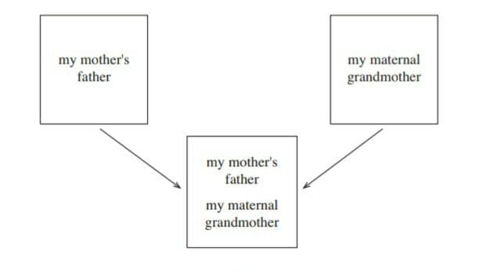
e.g
The expressions ( my mother’s father & my maternal grandmother )
may be represented as two separate rectangles. The two ranges of denotative meaning, however, coincide perfectly: that is, in every specific instance of use, ‘my mother’s father’ and ‘my maternal grandmother’ include and exclude exactly the same referents.
This can be visualized as sliding the two rectangles on top of each other and finding that they are the same size and cover each other exactly.

Slide 10
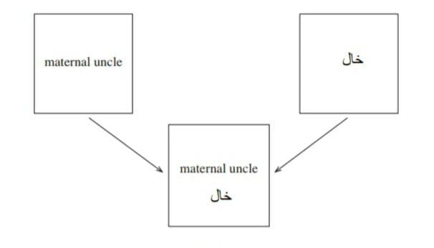
Note :-
Comparison of denotative meanings can also be made among expressions from two or more different languages.
e.g
‘maternal uncle’ and خال
(Is one sense of the word (
خالcover exactly the same range of meanings and are therefore fully synonymous

Slide 11
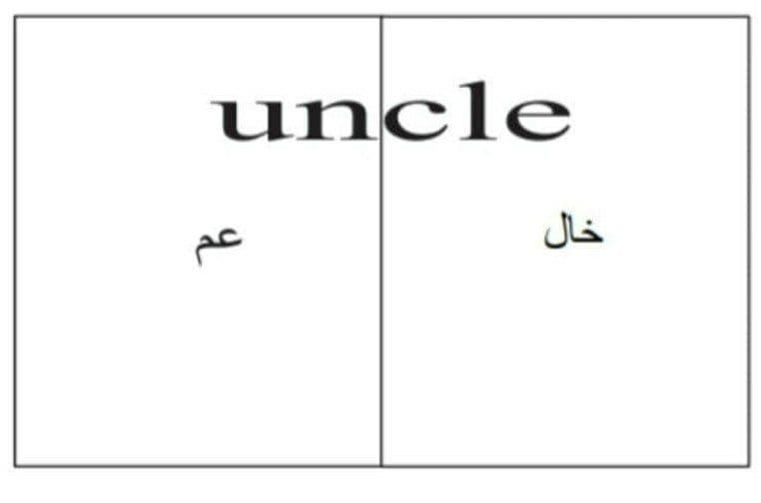
Hyperonymy-hyponymy
* full synonymy is exceptional, both intralingually and interlingually.
Even the nearest semantic equivalent for translating the denotative meaning of an ST expression usually falls short of being a full TL synonym. A simple example of this kind of failure is provided by a comparison between ‘uncle’ in English and عم and خال in Arabic.
e.g
‘uncle’
might be a typical translation equivalent of the Arabic عم , خال
Uncle in English lacks the ‘technical’ associations of ‘paternal uncle’ and ‘maternal uncle’ and would therefore be preferred in many contexts in translating عم or خال , regardless of the translation loss involved.
Notes:
I saw my uncle beside the bridge

Slide 12
From the point of view of denotative meaning, however, ‘uncle’ has a greater range of meanings than عم or خال ,as ‘uncle’ includes both paternal uncle and maternal
Uncle
* It means that when there is no full TL synonym for a given ST expression (e.g. ‘uncle’), the translator must look for an appropriate TL hyperonym or hyponym.
Uncle
Hyperonymy-hyponymy ( superordinate)
hyponymy
عم
خال
Notes:
Uncle – عم , خال , زوج العمة , زوج الخالة

Slide 13
The relationship between ‘uncle’ and عم and between ‘uncle’ and خال is known as hyperonymy-hyponymy.
An expression with a wider, less specific range of denotative meaning is a hyperonym (or superordinate) of one with a narrower and more specific meaning.
An expression with a narrower, more specific range of denotative meaning is a hyponym of one with a wider meaning. Thus عم and خال are both hyponyms of ‘uncle’.

Slide 14
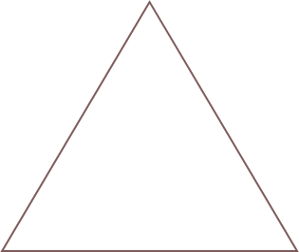
Particularizing translation and generalizing translation
Translating by a hyponym implies that the TT expression has a narrower and more specific denotative meaning than the ST expression, We shall call this ‘particularizing translation’, or particularization for short .
In translating from Arabic to English, TT ‘uncle’ is more general than ST عم) orخال ,(omitting particulars given by the ST. We shall call this ‘generalizing translation’, or generalization for short.
Uncle
Particularizing translation
generalizing translation
عم
خال

Slide 15
Another example
1- where the context implies something that is typically referred to in more specific terms in the TL than in the SL
thus, an إنذار issued by a military commander is likely to be an ‘ultimatum’ rather than simply a ‘warning’
or غارات in the context of NATO raids on Kosovo is likely to be ‘strikes’ or ‘air strikes’ rather than ‘attacks’.

Slide 16
2- ومهما تكون المشاكل القانونية المترتبة على تدخل حلف الناتو و التي كنت نفسي قد اشرت اليها منذُ ايام قليلة.
Whatever the legal problems linked to NATO intervention, to which I myself have recently referred
*‘recently’ is preferred to the denotative equivalent ‘a few days ago’ mainly because it results in a less wordy overall phrase. ‘Recently’ also allows the translator to use the present perfect ‘have . . . referred’, which adds a sense of immediacy and relevance to the statement; ‘a few days ago’ would require the use of the past simple ‘referred’, which suggests more detachment.

Slide 17
Semantic overlap and overlapping translation
when a word or phrase overlap in its meaning with another word.
e.g
لقد وصف الكاتب البريطاني المرموق روبرت فيسك حفلة غناء في بلغراد.
The distinguished British writer Robert Fisk recently described a concert in Belgrade.

Slide 18
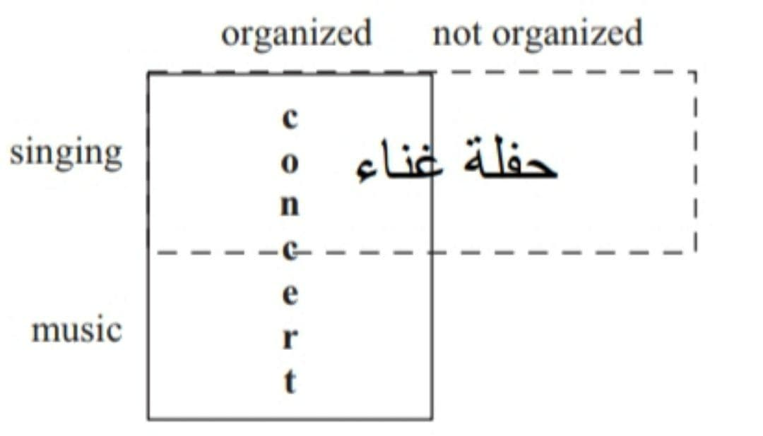
the meaning of حفلة غناءoverlaps with that of ‘concert’.
Some concerts are examples of حفلة غناءthose in which there are singing.
Similarly, some cases of حفلة غناءare examples of concerts; those that are organized in a formal way with musical players and audience.
However, some concerts are not examples of حفلة غناء those in which there is no singing.
Similarly, some cases of حفلة غناء are not examples of concerts; those, for example, in which the حفلة is not organized in a formal way with musical players and audience.
Notes:
A performance of music by one or more musicians and singers

Slide 19
Note :- We shall call it partially overlapping translation, or partial overlap for short.
Partial overlap is common and often unavoidable. It can apply to single words as well as to phrases or whole sentences.
e.g
a poem by the Syrian poet نزار القباني contains the line
طاردوها كعصفور ربيعي الى ان قتلوها
“They attacked her like a young sparrow until they killed her”

Slide 20
ربیعي here overlaps in meaning with ‘young’.
Some but not all ‘spring sparrows’ are young, and some but not all young sparrows are ‘spring sparrows’ (one could have a sparrow that was born in summer).
‘Spring sparrow’, however, is a problematic phrase in English; it does not have a clear meaning, and there is nothing in this overall context to make the intended meaning clearer in the English.

Slide 21
Near-synonymy and translation
Near-synonymy is a case not of synonymy but of hyperonymy-hyponymy or semantic overlap, which comes near to being synonymy.
e.g
( thin ) vs ( skinny )
‘She’s thin but not skinny’
‘She’s skinny but not thin’
we assuming the reasonableness of a statement
we can't assuming the reasonableness of a statement

Slide 22
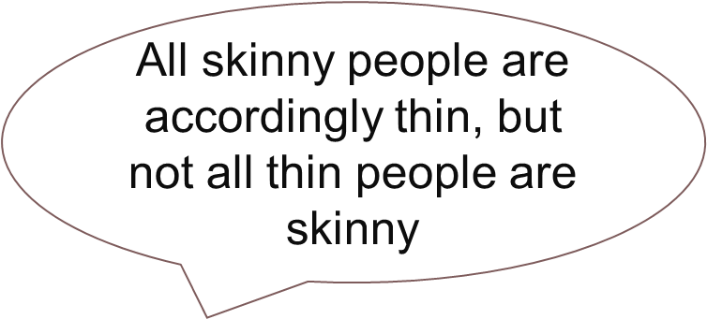
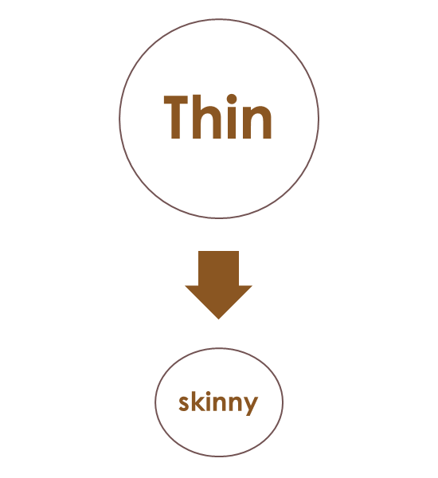
There is a very significant overlap between ‘thin’ and ‘skinny’ such that thin people are typically also skinny. ‘Thin’ and ‘skinny’ can accordingly be regarded as near-synonyms in English.

Slide 23
An example of near-synonymy involving a hyperonym-hyponym
زعلان translated as ‘angry’
where the definition of the Standard Arabic usage of زعلان reflects the definition of the colloquial usage of زعلان , means not just angry but angry with a degree of sadness . (i.e. ‘sadly angry’).
Arabic زعلان is thus technically a hyponym of English ‘angry’ (as it excludes those cases of anger that do not also involve sadness). زعلان is, however, close enough to the meaning of ‘angry’ to be considered a near-synonym of ‘angry’.

Slide 24
Arabic زعلان is thus technically a hyponym of English ‘angry’
(as it excludes those cases of anger that do not also involve sadness).
زعلان is, however, close enough to the meaning of ‘angry’ to be considered a near-synonym of ‘angry’.
Angry
Angry
hyponym
Sadness
Not sadness
Sadness , زعلان

