Slide 1
The Scope of linguistics?

Slide 2
Overview
The Scope of Linguistics
Core of Linguistic fields
Other Linguistic subfields

Slide 3
Scope of Linguistics
Linguistics is a discipline that covers a wide range of topics; this makes its boundaries (with other neighboring disciplines) difficult to define.
A diagram in the shape of a wheel gives a rough impression of the range covered by the core linguistic levels and its sub-disciplines.

Slide 4
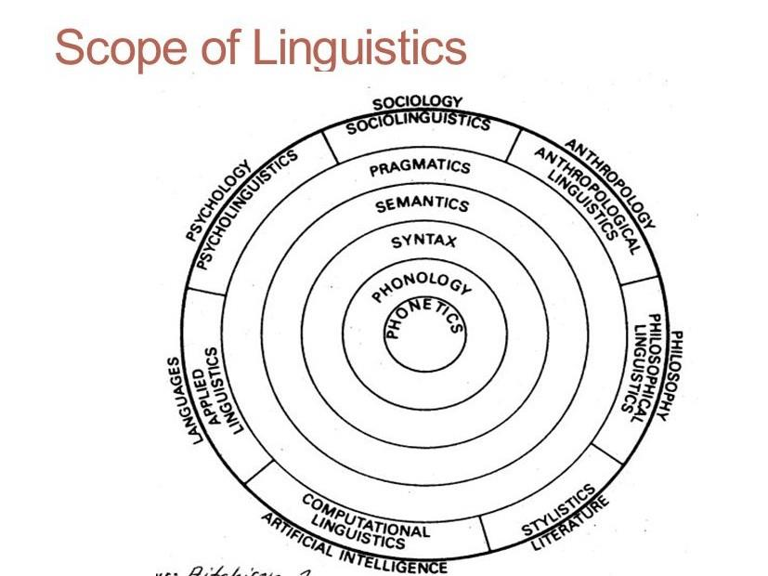

Slide 5
Scope of Linguistics
Phonetics studies how speech sounds are produced, transmitted and perceived.
Phonology is a subfield of linguistics that deals with the classification, distribution and function of speech sounds in a language.
Syntax is a subfield of linguistics that deals with how words are arranged to form phrases and sentences.
Semantics is a subfield of linguistics that deals with linguistic meaning.

Slide 6
Scope of Linguistics
Pragmatics is a subfield of linguistics that deals with deals with how speakers use language in ways which cannot be predicted from linguistic knowledge alone.
Sociolinguistics is a subfield of linguistics that deals with language is social context.
Anthropological linguistics is a subfield of linguistics that deals language in across-cultural settings.
Philosophical linguistics is a subfield of linguistics that deals with the reaction between language and through.

Slide 7
Scope of Linguistics
Stylistics is a subfield of linguistics that deals with the use of language in literary text
Computational linguistics is a subfield of linguistics that deals with the use of computer software in analyzing texts.
Applied linguistics is a subfield of linguistics that applies linguistic insights in language teaching.
Psycholinguistics is a subfield of linguistics that deals the relation between language and mind.

Slide 8
Scope of Linguistics
There are two important aspects of linguistics which cannot be shown in the diagram above:
Historical linguistics, the study of language change from a synchronic or diachronic perspective.
Linguistic typology, the study of different language types. The study of linguistic typology cannot be fitted in the diagram, because it spreads over several layers of the diagram, covering phonology, syntax and semantics.

