Slide 1
MAWADDA RAHEEM KOKAZ MEDIA AND DISCOURSE
Discourse analysis assignment
7-4-2020

Slide 2
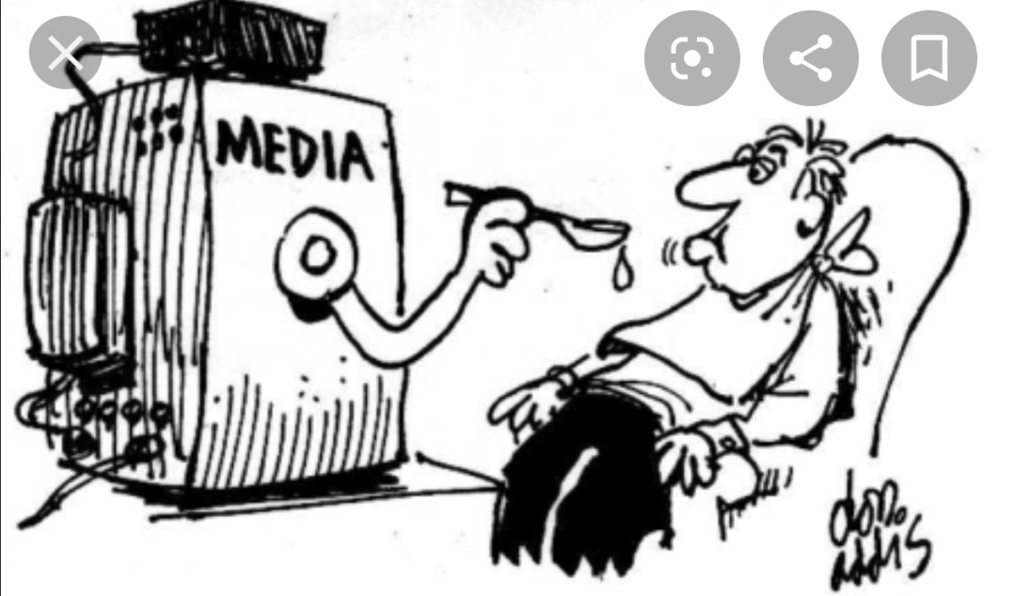
What is media discourse ?
Media discourse refers to interactions that take place through a broadcast platform , whether spoken or written , in which the discourse is oriented to a non-present reader , listener or viewer . Though the discourse is oriented towards these recipients , they often can’t make instantaneous responses to the producers of the discourse , yet this is changing with the advent of new media technology . So media discourse is neither private nor off the record .

Slide 3
Why do we study media discourse ?
Very few are unaffected by media discourse , the importance of the media in modern world is incontrovertible . For some sections of society ,media have largely replaced older institutions ( churches , trade unions ) as the primary source of understanding of the world . Since discourse plays an important role in constituting people’s realities , the implications of the power and influence of media discourse are clear .

Slide 4
How have print media been studied ?
Linguistic analysis of the newspaper media is very often sceptical, and linguists sometimes see themselves as policing the subtle manipulation of language to distort reality. White (1997) claimed that by ‘severely’ circumscribing subjective interpersonal features in hard news reports, journalists can, through ‘objective’ language, purport to be neutral, essentially where formal language provides the veneer of neutrality. White personal register is to put ‘a rhetorical stratagem to aid the obfuscation of a reporter’s subjectivity’ .

Slide 5
The most comprehensive from a linguistic perspective come from Reah (2002)and Bednarek (2006). Reah (2002) comprehensively characterizes what newspapers are, as well as providing a detailed treatment of newspaper headlines and their ‘manufacture’ through what is left in and what is left out and how words are ordered. Reah also takes a detailed look at newspaper audiences and their role and relationship with and for newspapers . Linguistically, Reah looks bottom-up at the impact of both lexical choice and syntax and discourse on the building and manipulation of meaning, using case studies from the press.

Slide 6
How have spoken media been studied?
Conversation analysis (CA) has been the prevailing methodology in the study of spoken media discourse, that is, radio and television. CA is a research tradition that has grown out of ethno-methodology, an area within sociology rather than linguistics. The influential work of Sacks , Schegloff and Jefferson has contributed to and strongly influenced research into spoken media discourse .
CA takes a ‘bottom-up’ approach to the study of the social organization of conversation, or ‘talk-in-interaction’, by means of a detailed inspection of recordings and transcriptions (Have, 1986). That is, it focuses in on how conversations are structured and organized locally turn by turn, and from this it makes inductive comments about social organization.

Slide 7
Media discourse and social media
The social networking sites them- selves have the potential to connect with larger audiences than some television, radio or news- paper articles. Facilities such as twitter allow individuals to generate broadcast thoughts to which others can respond to. So we can say that the reader is no longer reading an article in protracted isolation; s/he can comment on it via a website, email it to a friend, post it on a social network for others to discuss it. Journalists and commentators often respond to the comments posted in reaction to their articles, thus creating an extension of the (process–product–process–(product–process

Slide 8
the audience is no longer a passive recipient or eavesdropper in the case of radio and television; its members can very often text the program and have that text read out, they can join a chat with each other, they can post a link to the program on a social network or blog and have others listen/view it and comment. They can take part in audience opinion polls via text messages .
the ephemerality of the spoken and written media is lessened by the ripple effect that email, websites and social networks can have; when a consumer reads/listens to/views something that s/he or she wants to react to, s/he can spread it around over time to others, who will then consume it, possibly comment on it at a later date and pass it on further .

Slide 9
Analyzing media images
When looking at an image , you have to consider
the following :
-Initial reaction
*what is your first impression ?
*what captures your attention ?
*what does this work bring to mind ?
*how does this work make you feel ?
*what does this work remind you of ?
``You also should keep in mind that once you see an image , you see the surface meaning immediately , yet images have deep meanings just like writers.

Slide 10
What does the subject and its positioning tell us about the image?
If there is more than one subject in the photo , how do the subjects relate to each other ? Do we see the entire subject , or only a portion of it ?
All the above mentioned questions should be kept
in mind before analyzing any image.
*The next image has more than one subject

Slide 11
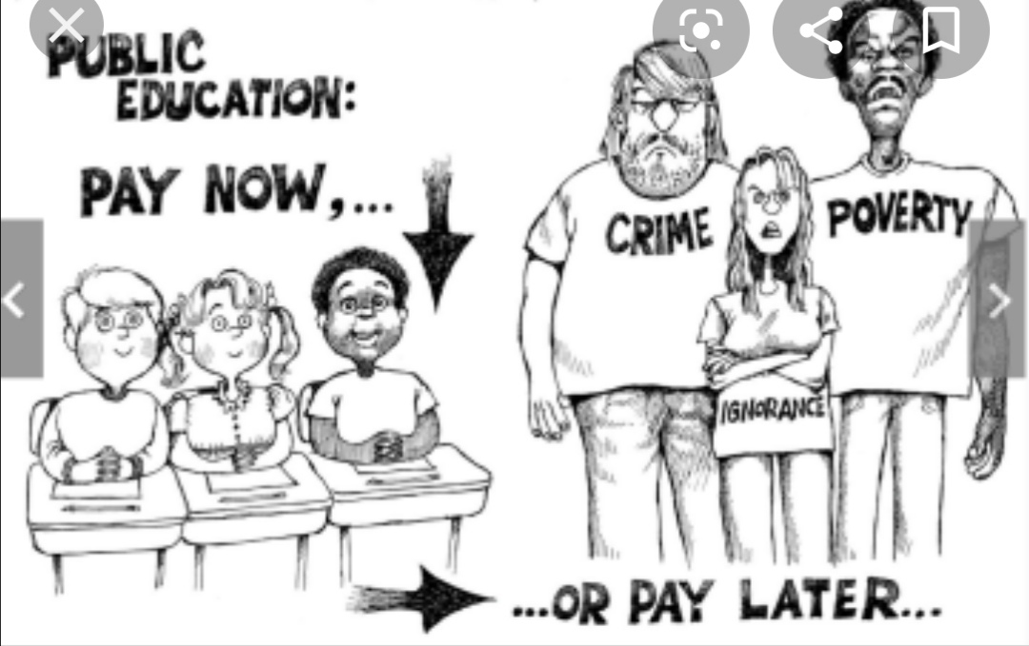
As we can see in this image there is a focus on more than one subject ,each of which can be related to the other ; the first one is about the importance of education and how it is essential in order to prevent all other subjects : poverty , crime, and ignorance .
We can also consider it as an ad for public education encouraging people to forget about the private one
It includes a verbal process consisting of the speaker ( the painter ) as the sayer , and the receiver ( the people who see the image ) and the verbiage which is the whole idea of the importance of education

Slide 12
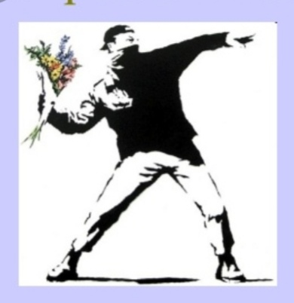
This image includes a surface meaning , which is the meaning that you may see as soon as see this image , which is throwing flowers on the enemy instead of violent things in order to defend himself . yet there is , of course , a deep meaning behind this image which is "peace" the idea of throwing flowers instead of anything else is a reminder that you may beat your enemy by flowers without causing any destruction
.
It includes a material process ,
consisting of the actor ( the boy )
and the recipient ( the enemy ).

Slide 13
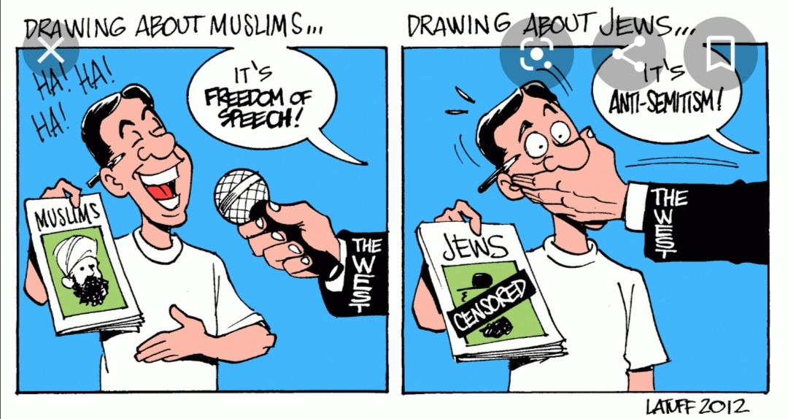
As we may see in this image that there are two subjects explained , which show us the contradiction the two subjects , it also shows that the term " freedom of speech " is a lie when it comes to many subjects that are similar to this one
It includes a verbal process , consisting of the speaker ( the man who make sarcastic paintings ) as the sayer , and the people who see his paintings and criticize him as the recipient

Slide 14
What we concluded is :
Media discourse is manufactured, we need to consider how this has been done – both in a literal sense of what goes into its making and at an ideological level. One important strand of research into media discourse is preoccupied with taking a critical stance to media discourse, namely critical discourse analysis.
It is important that we continually appraise the messages that we consume from our manufactured mass media. The fact that media discourse is public means that it also falls under the scrutiny of many conversation analysts who are interested in it as a form of institutional talk, which can be compared with other forms of talk, both mundane and institutional. The fact that media discourse is on record makes it attractive for discourse analysts and increasingly so because of the online availability of newspapers, radio stations, television programs and so on .

Slide 15
Thank you !

