Slide 1

Feminists Discourse Analysis
Presented by: Noor Riyadh Rahim
Course tutor : prof A. Qaduri, Ph. D

Slide 2

outlines of the presentation
DISCOURSE
Discourse Analysis
Feminisms

Slide 3

Discourse
According to Collins dictionary, discourse is “verbal communication; talk or conversation “
Discourse Analysis
According to Fasold (1990) discourse analysis is “the study of language in use”

Slide 4

‘it is in discourse that power and knowledge are joined together”(Foucault, 1978).
Thus, discourse, power and knowledge are inextricably linked in structuring our sense of reality, as well as our sense of self (Mills, 1997).
Building on this work, we understand discourses in the plural sense to be dynamic constellations of words and images that reflect and reproduce particular points of view (Fairclough, 1995; Mills, 1997; Weedon, 1997; Allan, 2003; Allan et al, 2010).
Discourse Theory

Slide 5

It is through discourse that we come to interpret the physical and social aspects of the world in which we live, and also our sense of self in relation to these realities (Mills, 1997). For example, schooling is often described through two predominant, yet divergent discourses. One discourse represents schooling as a force of empowerment and liberation for individuals and society, while the other frames it as an effective means of training good citizens and maintaining a well-ordered and controlled society (Allan, 2003). As evidenced by this example, discourses are never neutral; they always ‘reflect ideologies, systems of values, beliefs and social practices’ (Hicks, 1995).

Slide 6

According to Luke (1995), people construct meaning on the basis of their ‘available stock of discursive resources’. However, in any society, some discourses are taken up and supported more readily than others. These dominant discourses tend to be reaffirmed through their institutionalization (Mills, 1997; Allan et al, 2010). Dominant discourses can be identified most easily by the way in which they have become taken for granted or naturalized. As such, even though alternative discourses exist, they are often not apparent.

Slide 7

According to Fellabaum (2011, p.130), the ‘intelligibility of our daily acts depends on whether our [gender] performances can be recognized as socially appropriate’. The ‘discursive frameworks’, Mills (1997, p.18) notes, ‘demarcate the boundaries within which we can negotiate what it means to be gendered’. As a result, it comes to be seen as normal or natural for women and men to perform in ways that fall within these discursive boundaries (Allan, 2007).
For instance, the dominant discourses of masculinity and femininity provide parameters for acceptable or normative behavior on the part of women and men in a particular context (Walkerdine, 1989; Weedon, 1997).

Slide 8

Ideology
An ideology is a discursively produced construction of certain practices or parts of the world that has a role in creating and upholding relations of power and domination (Chouliaraki and Fairclough, 1999:27; Fairclough, 2003:9; Wodak and Meyer, 2009:7). Ideologies are sense- making practices that we see as ‘the way things are’ or ‘common sense’ (Hennessy, 1993:14; Routledge, 2015:3). The ideologies that CDA explores appear natural and generally go unchallenged, making them an important part of maintaining relations of power and hegemony, a state which FCDA seeks to counteract, specifically in relation to gender ideology (Chouliaraki and Fairclough, 1999:24; Lazar, 2007; Wodak and Meyer, 2009:8).

Slide 9

Gender
gender is seen as an ideological structure that is embedded and reproduced in discourse (Lazar, 2007). The general conception of gender as a phenomenon largely based on and determined by biological sex hierarchically categorizes people into two classes: men and women. Different contexts, divided by space and time, ascribe different traits and roles to these two groups, however the hierarchy of patriarchal domination is similar throughout the world (Lazar, 2007:148). While the ‘naturalness’ of these gender categories has been shown to be socially constructed (Butler, 1993) the material effects and gendered social practices that result from this constructed categorization are salient.

Slide 10

What is meant by Feminism?
Feminism is a social movement and ideology that fights for the political, economic and social rights for women. Feminists believe that men and women are equal, and women deserve the same rights as men in society. The feminist movement has fought on various times, for many different causes, such as the right for women to vote, the right to work and the right to live free with out man control.

Slide 11

Feminism has generally been defined as every theoretical or practical effort aimed at revision And the questioning or modification of the prevailing system in social structures, which makes men the center, and it is Man and woman have a second or other gender in a lower status, and it imposes limits and restrictions on them, preventing them from developing, giving, developing, and expressing themselves, only because they are a woman, and on the other hand, underestimating their experiences and characteristics that are distinguished by them only because they are feminine, so that civilization appears in its most comprehensive aspect as an achievement Male affirms and consolidates a man's power and subordination or marginalization of women. (Sheferd,2004)

Slide 12

Feminism has been the most influential political and social movement that has affected the field of social research. The feminists do not believe that women are naturally inferior to men. What is distinctive about feminism is the particular political positioning of theory, epistemology and ethics that enables the feminist researcher to question existing truths and explore the relationship between knowledge and power (Ramazanğolu & Holland, 2002).

Slide 13

Feminist writing was born to achieve the identity and existence of women, as it is a modernist vision of the world within a new enlightening creative vision, aimed at denouncing the manifestations of slavery, backwardness, injustice and oppression Against women.

Slide 14

According to (Al-Qatirji, N. 2018)The term feminism in the literary scene only took interest in the late 1980s and 1990s In the twentieth century AD where real interest in the feminist movement in the Arab world began because of the United Nations adopts family programs that have caused a lot of intellectual controversy about the relationship between men and women or between male and female, and this is why female literature interest in women’s writings present and history. Invitations grew out of the word history in English and replaced with a word her story.
Thus, rewriting history from a female point of view. Some of these women even created it Magazines and publishing books in which they rewritten some historical stories.

Slide 15
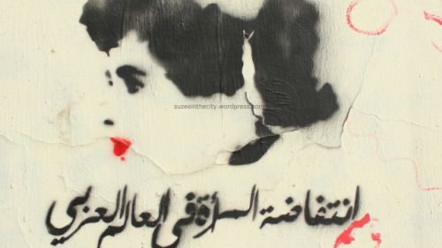
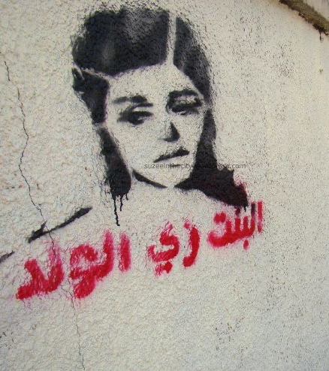
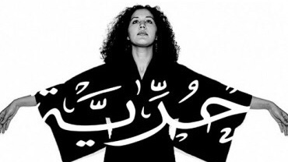

Slide 16

Feminist writing in the Arab countries went through three different stages, the first being a stage The simulation of the prevailing literary forms, and its dominant traditions, and was called the feminine stage, and the second is the stage of rejection and objection to these values, and it was called the feminist stage, and the third stage emerged from the woman’s awareness of her social status, in a way that expresses the discovery of herself as a legal person in society with a status and presence, and worthy of recognition His condition and ability to compete with the other, away from marginalization and contempt, and was called the feminine stage (1). This last stage of the development of feminist writing expresses cultural specificity, and it has been called women's cultural specificity, because it exists Being aware of the concept of privacy, it is a demonstration of a different presence via a different text.

Slide 17


Feminist literature raises a set of differences in form and content, as there are those who see. There is a difference between the literature presented by women from what men offer, and most of these discussions are about the biological side, which is what men mainly use to keep the woman in his crucible and the place he wants, but some representatives of the women's movement are based on biological characteristics, as a source of women's superiority, for women Do not look at things as a man looks and expresses about them her feelings about the man in what is important or not important

Slide 18

The writing of women came as a linguistic emergency and as a new event on culture, her traditions and customs were rooted according to the rules of virility, and women found no need to write as the man did. So that She can follow in his footsteps and make use of his symbols and metaphors, this will enable the woman to occupy a position fundamentally in the writing industry, and all that you will realize from this is to be like a man, equal to, compete with or challenge him, but according to the male model and based on it. (Al-Ghaghami,2015)

Slide 19
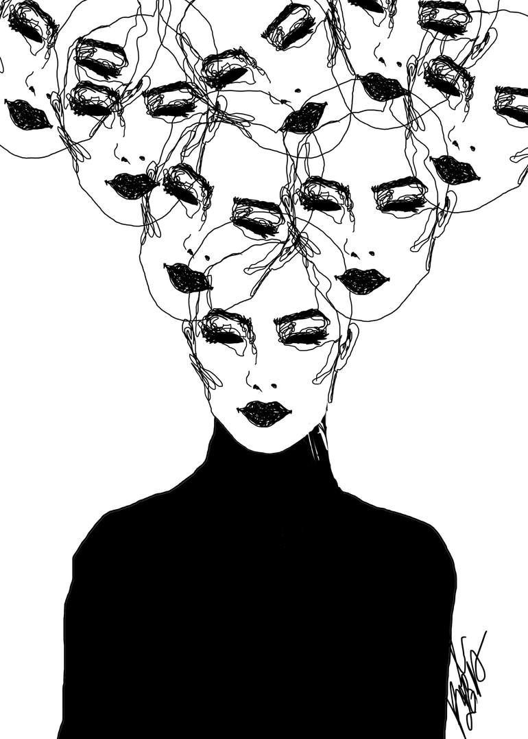
Through what mentioned by Al-Ghathami on a woman’s language and style in literary rendering makes her equal and closely related to men in his writings, and even distinguishes him, and gives her a specificity in the nature of her language, because the language is built On the rules of virility, not homosexuality.

Slide 20

The entry of Iraqi women into the narrative world in its beginnings was narrow and limited due to the restrictions in social, political and economic forces imposed on her and restricted her creativity, but with the entry of women to education, she had the opportunity to contribute effectively in the various fields of novel and writing, after what was exclusive to the man (Wadi, 1980).
The feminist component had a prominent role in the literary movement in Iraq, and a large number of creative women appeared, who invaded the cultural movement and distinguished creative that cannot be overlooked and indifferent product in the field of culture and literature.

Slide 21
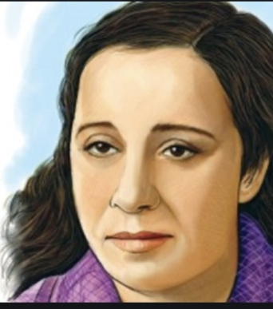
Among the Arab and Iraqi female figures who had a role in the modern era Nazik Al-mala’ka, as she is a poet, critic, narrator, musician, and translator, she studied art in acting and music, and she loved English literature, and her poetry touched the reality of people, especially the tragic side, and she wrote a collection of books; a book “Social disadvantages for the life of Arab women,” and the book, “The fragmentation in Arab society,” in which she criticized the position of women in society and deprived them of their rights. In 1952, she gave a lecture at the Film Club, criticizing the conditions of the present Arab woman, and calling for her liberation from backwardness and restrictions.

Slide 22

Feminist discourse analysis has evolved out of linguists' particular concern with text and talk as gendered interactions, and feminist scholars' particular concern with discourse as an apparatus of patriarchy, to become, today, a wide‐reaching approach for understanding and critiquing the power of language and the language of power in many incarnations and contexts.

Slide 23
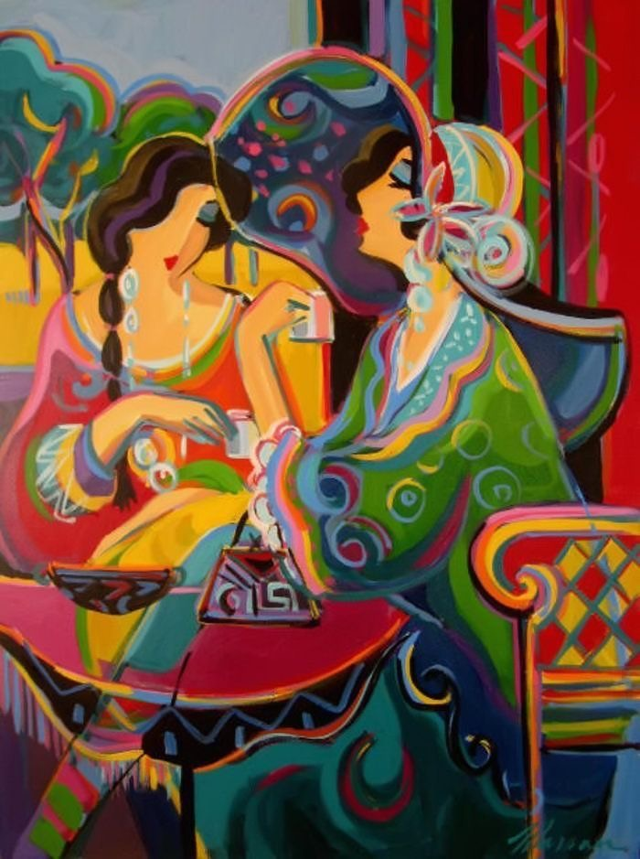
Feminist discourse analysts understand discourse as establishing categories of inclusion and exclusion that are related to patriarchy as an “omnirelevant” schema but also see these gendered categories intersecting with a wide range of other hierarchical conceptualizations of difference that structure social institutions and interactions. They examine these various manifestations of difference, and the power they accrue or withhold, in media texts, conversations, advertisements, novels, films, political speeches, meeting minutes, interview transcripts, or wherever they may occur, through close attention to structures of representation such as themes, frames, grammatical features, and modes of address.....

Slide 24

Thank you

