Slide 1
Feminist discourse analysis
Discourse analysis
course tutor Prof . Ahmed Q. Abed
Presented by Sura Jarjees

Slide 2
What is feminism ?
Feminism is a range of social movements, political movements, and ideologies that aim to define, establish, and achieve the political, economic, personal, and social equality of sexes. Feminism incorporates the position that societies prioritize the male point of view, and that women are treated unfairly within those societies. Efforts to change that include fighting gender stereotypes and seeking to establish educational and professional opportunities for women that are equal to those for men.

Slide 3
Gill's view of the use discourse analysis by feminists
Gill's view is that 'discourse analysis ' has an enormous amount
to offer feminism. it offers principled and coherent means by
which feminists can study talk and texts of all kinds.
Gill is more equivocal. although, she sees great potential for
the use of discourse analysis by feminists , she follows Burman
(1992) in distinguishing between the application of discourse
analysis and the theory itself , and goes on to suggest that it
is precisely those features of discourse analysis's theoretical
commitments making it so productive for feminists , that makes
it deeply problematic.

Slide 4
Squire
Squire presents the benefits of doing discourse analysis for feminist psychologist as (at least) threefold :
a) As instrumentalist (it provides a respectable institutional front).
b) As pragmatic ( it offers some help in answering questions about method and theory that block their work' qualitative yet systematized method)
c) And as political (it offers hope for a radicalization of the discipline).

Slide 5
The stress laid by discourse analysis on simple diversity masks power differences, its notion of multiple, fragmented subject positions can lead to the denial of any single identity around which to organize , its emphasis on the micro-politics of power downplays , macro-structural inequalities ; and – most importantly – its commitment to relativism disavows the grounds for feminist politics.
It is difficult to identify fundamental premises or techniques which are specific to discourse analysis , not only because of the breadth and conceptual / methodological 'fuzziness of the term , but also because of the common ground it shares with other critical approaches in social science (e.g. social constructionism , the study of rhetoric , ideology , textuality , critical ethnography – and qualitative methods more generally).

Slide 6
“ignoring the constitution of science within political desires, values and interests will somehow increase the reliability of accounts of nature and social life”
Rose (1985:3) says: as a feminist, I found this standpoint increasingly incompatible with my commitment to the improvement of woman's position in science and society, and with my experience as a menstruating woman and female research.

Slide 7
Feminist post-structuralist discourse analysis (FPDA)
is a method of discourse analysis based on Chris Weedon’s theories of feminist post-structuralism, and developed as a method of analysis by Judith Baxter in 2003. FPDA is based on a combination of feminism and post-structuralism- While it is still evolving as a methodology, FPDA has been used by a range of international scholars of gender and language to analyze texts such as: classroom discourse (Castañeda-Peña 2008; Sauntson 2012), teenage girls' conversation (Kamada 2008;2010), and media representations of gender (Baker 2013⁾. FPDA is an approach to analyzing the discourse of spoken interaction principally.
The poststructualist part of FPDA views language as social practice and considers that people's identities and relationships are 'performed' through spoken interaction.

Slide 8
Examples
Man pointing his finger angrily at the woman telling her that
“You feminists hate men! That is why you all want to get rid of all men!”
This what people or men who are against feminism say
And when she replays “Mm-hmmm. Very accurate, You're right.”
Then he gives the exact meaning of “feminism”
So they understand and know the meaning of feminism but they just act like feminism is wrong and in their opinion it means that woman is against man.

Slide 9
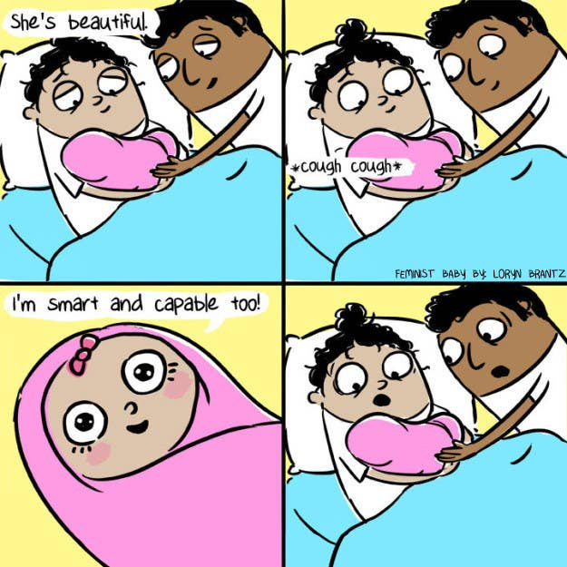
The picture is showing that being a girl is not only about being beautiful but also about being smart and to have a role in the society (this would be the answer of the feminist baby as mentioned in the picture)

Slide 10
A discourse analysis approach enables us to examine the implications of language in details, including the full consequences of using the terminology if disease and the way in which we position our selfies in the narratives we produce .the concepts we use and the ways in which use them are equally important , since they shape what we (can say ) and do about woman's relationship to food and eating .
A number of feminists in psychology and cultural studies have adopted poststructuralist forms of discourse analysis in their work on (Anorexia nervosa) AN and 'eating disorders' .American Susan Bordo located AN in specific cultural , political and historical contexts, rather than searching for the cause of AN in individual woman. Bordo is less concerned with the causes of AN , in the traditional sense , than the complex possibilities of multiple cultural readings of the phenomena.

Slide 11
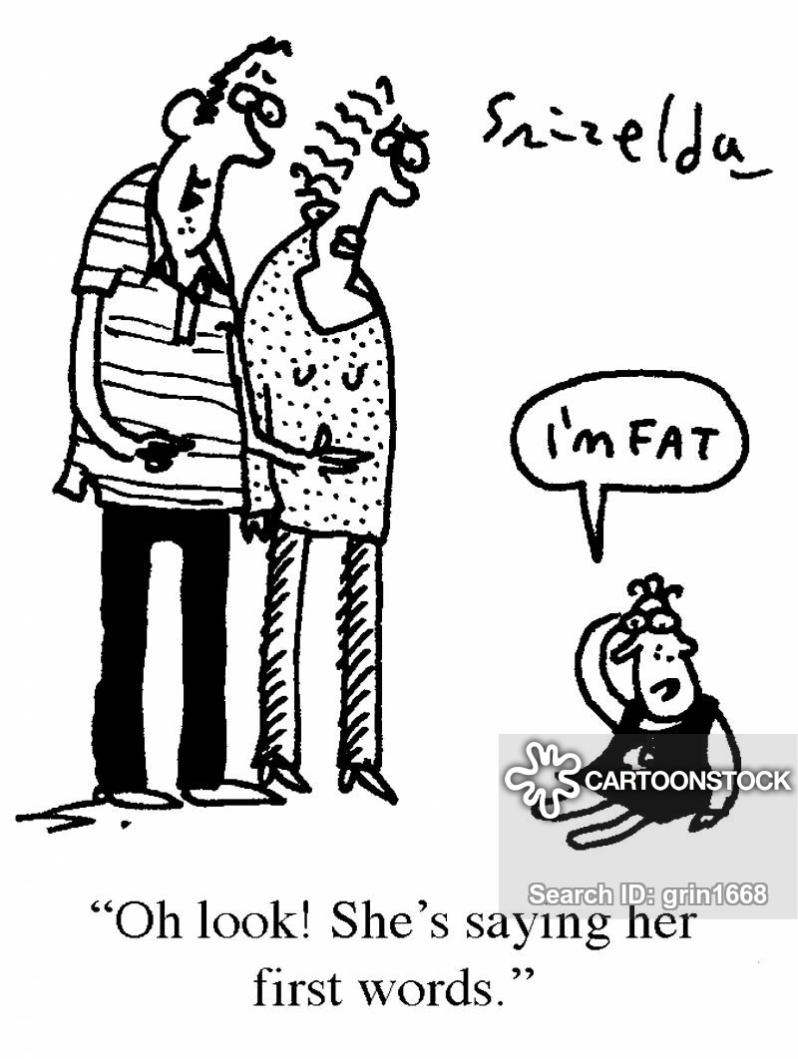
Example
Anorexia nervosa an eating disorder, characterized by low weight, food restriction, fear of gaining weight, and a strong desire to be thin. Many people with anorexia see themselves as overweight even though they are.
Specially girls and women who are always afraid to be fat and gain weight.

Slide 12
Romantic discourse and feminist analysis
Wetherell reviews some of the distinctive features of discourse theory as it 'takes on' romantic talk and writing and also highlight some of the dilemmas confronting this approach to cultural representations which have certainly troubled feminist discourse analysts.

Slide 13
Romantic discourse and feminist analysis

Slide 14
These premises (the relatively global premises characteristic of discourse work, found also in studies of rhetoric and in social constructions movement within social psychology as a whole) concern the constitution if identity and subjectivity, the nature of experience and communication , ideology and the role of representation in social life.

Slide 15
Example
This drawing which presented woman in the 25th iraqi revolution (ideology and the role of representation in social life)

