Slide 1
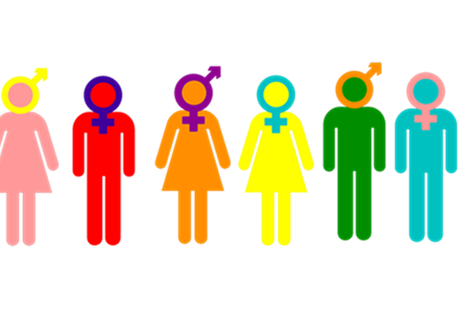
Discourse and gender
Prepared by
Ashraf Abdulrasool Alkaabi

Slide 2
Discourse and gender Gender is inescapably a biological construct. Each of us is born with his or her gender. “However, institutions still play an important part in establishing the nature of that gendered identity, even if they do not establish the identity itself.

Slide 3
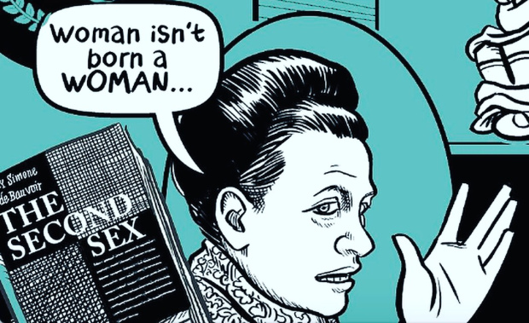
Simone de Beauvoir famously said in her book ( the second sex )‘ one is not born, but rather becomes a woman’.

Slide 4
Earlier works have talked about discourse and gender in terms of biological category of sex but the present research talks in relation to the socially constructed category of gender.

Slide 5
There are two main approaches that determine the relationship between discourse and gender:
Dominance Approach
This approach maintains that there are clear differences in the use of language as a result of male dominance over the female.

Slide 6
The cultural approach
This approach believes that boys and girls live in different sub-cultures in the way that people from different social and ethnic backgrounds might be described as being part of different sub cultures.

Slide 7
from the moment a female child is born and someone says ‘It’s a girl!’ that child learns how to do being a girl in the particular society and culture,
The way she talks
The way she walks, smiles, dresses and combs her hair

Slide 8
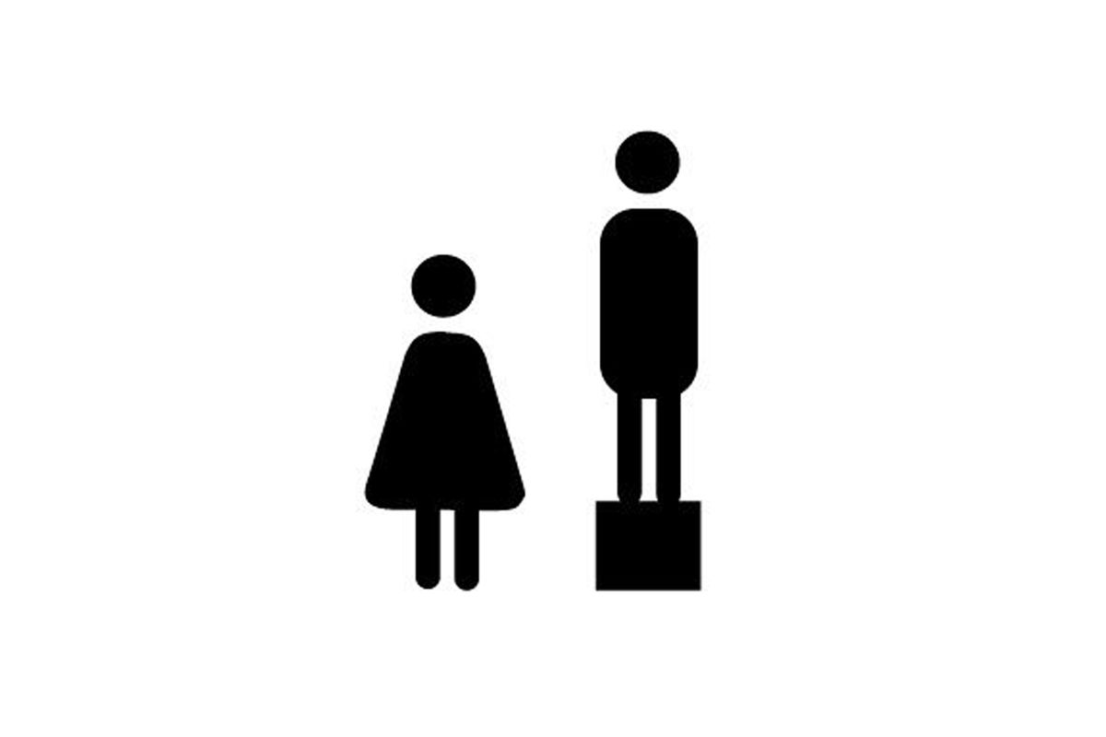
Gender and Discourse fall broadly into three types of approach:
-The way language itself is gendered or has become gendered.
-The way women and men, girls and boys are represented in discourse;
-The way men and women interact in discourse and whether or not there are differences in their style of talk.

Slide 9
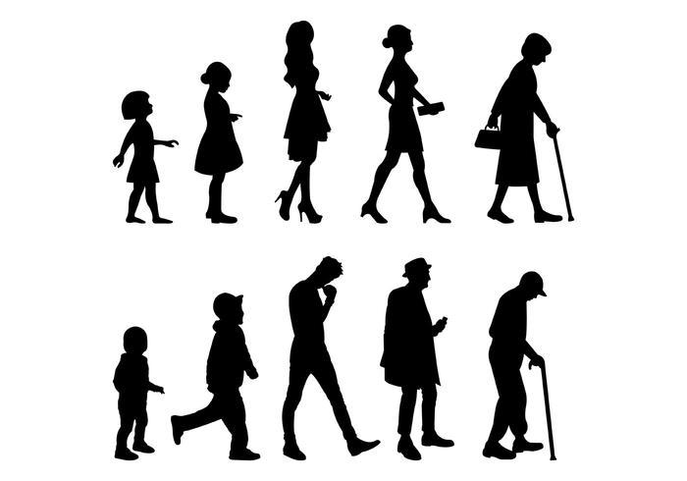
Gender, is not just a natural and inevitable consequence of one’s biological sex, It is, a part of the routine, ongoing work of everyday, mundane, social interaction.

Slide 10
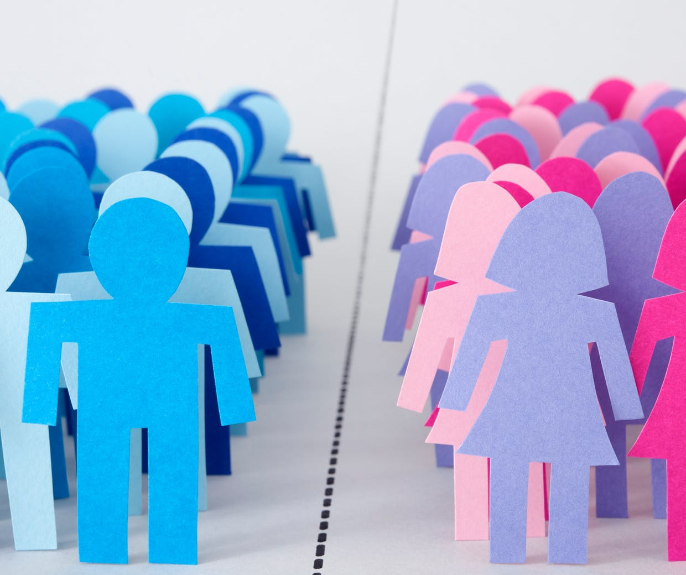
Gender is inescapably a biological construct. Each of us is born with his or her gender. “However, institutions still play an important part in establishing the nature of that gendered identity, even if they do not establish the identity itself.

Slide 11
Identity is constructing discursively . This aspect of identity stresses that identity is not essential but constructed, modified and consolidated through discourse, the sort of language that used to construct some aspect of reality from a particular perspective

Slide 12
Difference models Stress on the differences between the language used in male and female discourse and hence used to construct female and male gender identity.

Slide 13
Interesting research tackled by M. Goodwin (1980) stressed that groups of girls do not tend to be hierarchical; decisions are taken in common, they often use ‘we’ and epistemic modality. Boys are seen as socializing in gangs which are hierarchical in which competition is present.

Slide 14
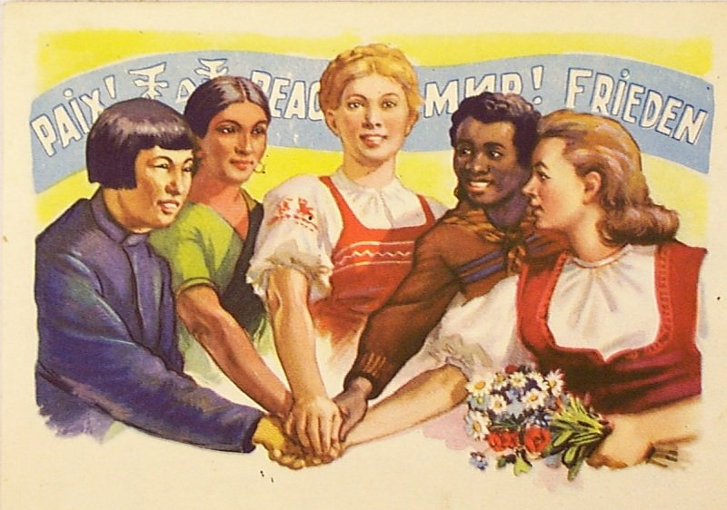
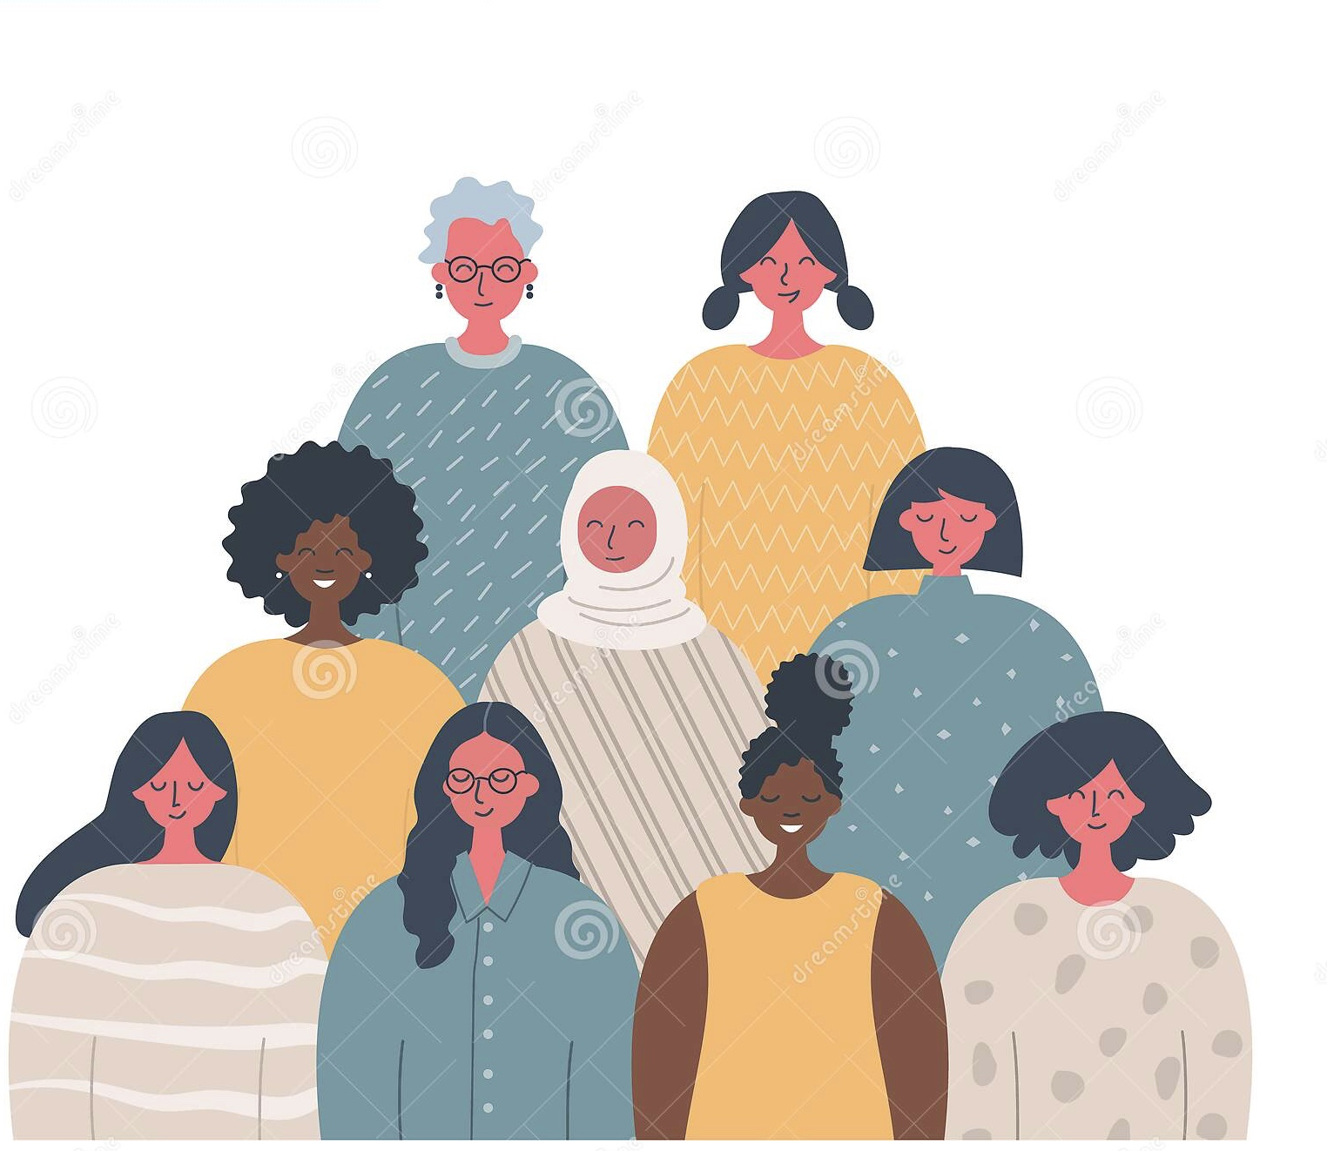
On the basis of Goodwin’s research , men and women socialize in different cultures and this division is expressed in different ways of interacting. Male interactions are characterized by displays of power , female communication by displays of solidarity.

Slide 15
Male discourse has the role of transmitting information in such a way as to communicate competence. Men tend to listen less and are inclined to impose their opinion , showing that they are more competent in presenting an argument.

