Slide 1
Media discourse
By: Farah Raad Al-Mawla

Slide 2
Media Discourse: Media discourse refers to interactions that take place through a broadcast platform, whether spoken or written, in which the discourse is oriented to a non-present reader, listener or viewer.
Two primary types :
Written: of written texts include newspapers and magazines
Spoken: Radio and television, News broadcasts, Drama

Slide 3
• Immediacy: Specific actions and events • Drama: Violence, crisis or conflict, extremist beha viors, outrageous acts • Simplicity: Clear-cut opinions, images, major personalities, two-sided conflicts. • Ethnocentrism: ‘Our’ beliefs, myths and symbols, ‘Our’ suffering, the brutality of some ‘Oth.
Media Focus:
In NEWS:
• Government conflicts
• Disagreements
• Decisions
• Proposals
• Functions
• Protests
• Crimes, scandals
• Investigations and disasters.

Slide 4
In newspaper:
• Based on the editor’s own experiences,
attitudes, and expectations.
• Journalists sometimes follow their personal
agenda that influences on the content.
• The selection or rejection of stories.

Slide 5
Discourse Influences on Micro and Macro Levels
Micro Level Influences:
• Personal characteristics, professional background, personal attitudes and professional role, conception of media workers are micro level influences that affect upon media content.
Macro Level Influences:
• Individuals, organizations, interest groups, public relations practitioners, government etc macro level influences that affect upon media content.
• Sources that provide news to media organizations sometimes withhold information or lie.

Slide 6
• When a presenter or guest or interviewee interact
on television or radio they do so with the knowledge
not only that they have been over heard but also they
are having a conversation in front of audience.
• Involvement of audience.
• Institutional setting
• Turn taking rights
• Includes host, interviewer, interviewee,
presenter, guests and callers

Slide 7
Exchange structures
Both media interaction and casual talk
comprise:
• speaker turns
• make up exchange structure
Two types of exchange:
1. initiation and response
2. initiation, response and feedback
In media discourse but two way exchange method
is more common i.e. initiation and response.

Slide 8
Pragmatics markers:
Discourse markers
• Pragmatic markers can be described as those constructions, such as you know,
I mean, you see, well, yeah, that are present in speech to support interaction but do not generally add any specific semantic meaning to the message.
• In media discourse these are use widely to explain certain points
• Discourse marker is a word or phrase that is relatively syntax-independent and
does not change the truth conditional
meaning of the sentence. • For example:
“oh", "well", "now", "then", "you know", and "I mean", and the connectives "so",
"because", "and", "but", and "or".
Hedging
Vague Language
• We use hedges to soften what we say or write.
• an important part of polite conversation.
• They make what we say less direct
• It involves:
• tense and aspect,
• modal expressions
• modal verbs and adverbs
• vague language such as sort of, any kind of, like and some verbs.
• It means one is not using precise language. Vague language is basically unclear and not giving a full picture • For example: You write
(I walked across the road). This is vague. Precise would be
(I sprinted/trotted/trudged/jogged across the road).
Response tokens
• Response tokens are the interjection that an addressee makes in response to the speaker utterances. • Examples are mm, ummhmm, yeah, o really, wow, that’s right, absolutely

Slide 9
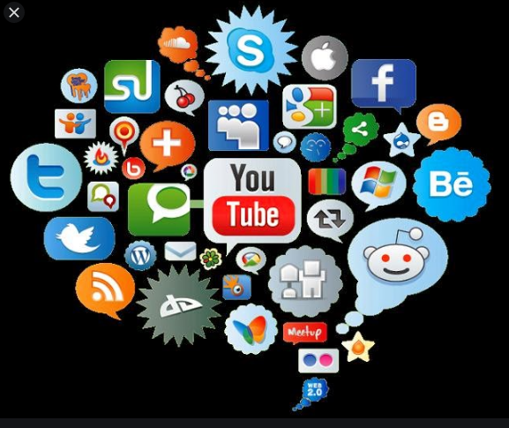
Electronic Media Discourse
• Electronic media are media that use electronics or
electromechanical energy for the end user to access
the content.
Criteria of electronic media discourse
• Form:
-external appearance of a clearly defined area
• Content:
-the subjects or topics covered
• Technique:
- method of performance; way of accomplishing .

Slide 10
Genre in Electronic media discourse
• Drama
• Talk shows
• Songs
• news

Slide 11
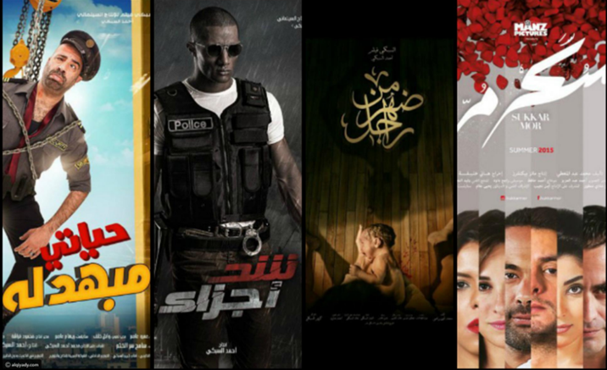
DRAMA
• Depiction of society
• Represent whatever audience wants to
hear and watch
• Likeness differ on the basis of gender,
age and social class.
•Females – musicals, love story/romance
• Kids– Animations, animals etc
• MALES- action/adventure, gangster, war
THEMES

Slide 12
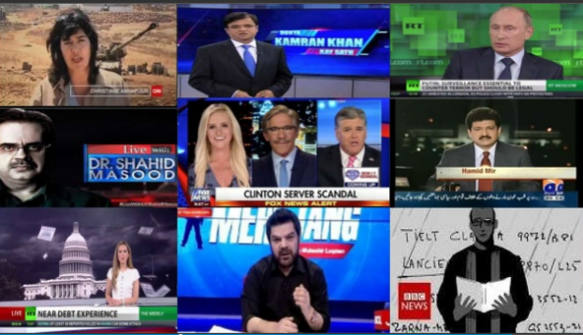
Talks show
Talks shows deal with :
◆ Political mostly .
◆ Violence .
◆ Police , military .
◆ Social affairs .
◆ Corruption.
◆ Religion .
◆ Wars.
.

Slide 13
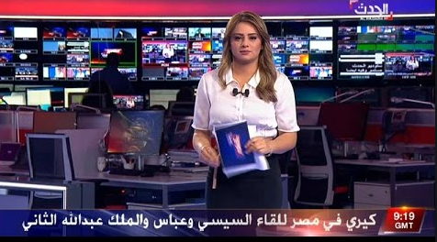
News
• The topics of news on TV channels are
mostly deals with:
1. inner city news
2. gang culture
3. drugs
4. guns
5. violence
6. political affairs and international news
The headlines of news are burning and anchor speak in a very satirical tone.
Titles stand alone; no explanation is given

Slide 14
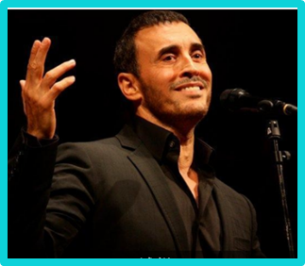
MUSIC
the theme of music are
Love
marriage
pleasure
fun

Slide 15
Print Media
◆ Print Media Deals Same as like Electronic media but the Level of newspaper authenticity is higher than the electronic media Because is in written and it couldn't be changed as early
as electronic media could changed their
statements if tis wrong.

Slide 16
Thank you

