Slide 1
‏• Grammar : the organisation of language Chomsky : grammar hard - wired into brain ; vS Halliday : Ontogeny recapitulates phylogeny ; language acquisition is an interplay between nature & nurture ; Learning a language is learning how to mean ( Halliday , 1975 ) ; a child learns structures that reflect the functions required to serve his / her life . Systemic functional grammar or systemic grammar is a grammar model developed by Michael Halliday (1985) with his Introduction to Functional Grammar based on the model of language as social semiotic.
Systemic Functional Grammar
SFG

Slide 2
Functional Grammar
Functional grammar describes the relationship between grammatical structures and meanings it focuses on language
In Functional Grammar, the essential word group are :
1. Noun Group
2. Adjective Group
3. Adverb Group
4. Verb Group
5. prepositional Phrase

Slide 3
‏BASIC CONCEPTS IN FUNCTIONAL ANALYSIS
Rank
- Rank refers to the different levels of organisation in the description of grammar .
-We could talk about our analysis at word level or we could talk about it at sentence level .
Units
-Units are the word groups that can be strung together to give meaning .
Clauses
-A clausal structure contains a verb form . It may be a complete sentence or it may be a group of words that serve as a modifier .

Slide 4
Examples :
He goes to the movie. (one clause)
Ahmed bought a pen and Sam bought a book.(two clause)

Slide 5
‏A clause may be a finite clause or a nonfinite clause
A finite clause contains a finite verb such as
- He goes to the antique shop in Malacca .
- She went to Port Dickson with her friends .
A nonfinite clause may contain a verb form which is not affected by tense agreement or number as in :
- Having transport problems , Kong Beng decided to stay in the hostel at Sekolah Sri Kota.

Slide 6
Noun Groups
The noun group is another grammatical feature that needs explication as it is a group that occupies an essential slot in most of our utterances.
He goes to the gym.
Structure of a Noun Group
In understanding how nouns function, we could examine the constituents in the group. The group may be just one word or several words. The focus in the noun group is the head and a premodifier may precede while a postmodifier may follow the head.
Example
Premodifier head postmodifier
The headmaster of sri Gombak

Slide 7
VERB GROUPS
‏
A verb group is an expanded verb . An example is the following sentence :
She should have written the letter .
Structure of a Verb Group The head of the verb group is written . It represents the experiential meaning of the process . Such verbs are known as lexical verbs . The elements that precede the head are auxiliary verbs or auxiliaries . They are sometimes regarded as premodifiers
In a verb group, four types of auxiliaries can precede a head verb. The head verb is the lexical verb.
He would have been seen by the guide.
He is going to school.
She has been promoted.
modal auxiliaries will , would , may
perfect auxiliaries have , has , had
continuous / progressive auxiliaries is , am , are
passive auxiliaries is , am , are

Slide 8
Action processes
In functional grammar, the term for the configurations of participants associated with different processes is known as transitivity.
Action processes
circumstance
Participant
(Goal)
Participant
(Actor)
Action

Slide 10
What, than, are the functions of language?
Halliday’s 3 metafunctions :
Interpersonal metafunction
Textual metafunction
Experiential metafunction

Slide 11
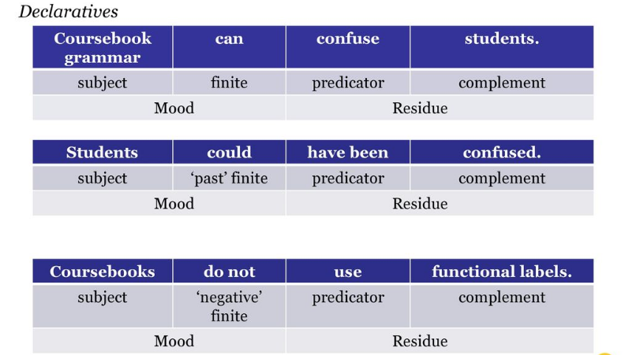
1-Interpersonal metafunction
The Clause as Exchange

Slide 13
The subject carries the responsibility for the validity of the clause .
The finite carries the validity of the proposition . Together , the subject and the finite ( the mood ) represent the point of view of the speaker while the residue carries the actual content .
Manipulating the mood enables us to
- indicate polarity ( negative or positive ) ,
- indicate time
- indicate modality
- make interrogatives and imperatives
make question tags

Slide 14
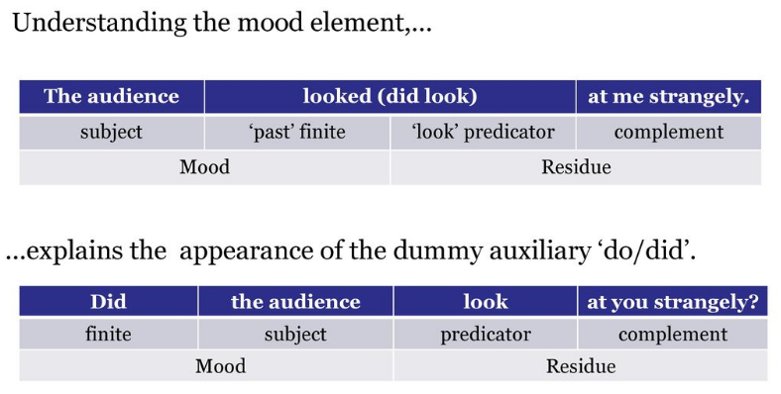
In fact, the finite is the core bandied about in exchanges.
A- you didn”t teach the students any real grammar.
B- Yes, I did !
A- No, you didn’t !
B- Did !
A- Didn’t !

Slide 15
2-Textual metafunction
The clause as a message

Slide 16
3-Experiential metafunction
The Clause as Representation
Who does what to whom ?
The clause represents the content of our experiences
Grammatical system of transitivity
Different functional labels for Participants ( realized by nominal groups ) Processes ( realized by verbal groups ) Circumstances ( realized by prepositional phrases or adverbials)

Slide 18
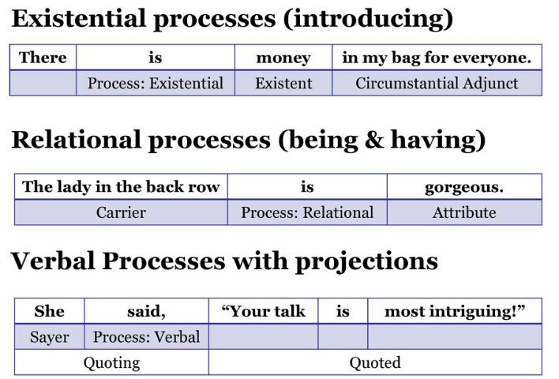

Slide 19
By Farah Raad Al-Mawla
Thank you for your attention

