Slide 1
Welcome

Slide 2
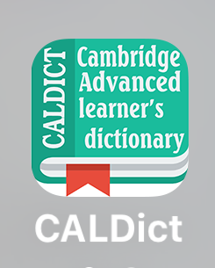

Slide 3
Introduction to the Book

Slide 4
Course Name: Morphology
Course Text Book: An Introductory English Grammar
Authors: Norman C. Stageberg
Publishing Year: © 1981

Slide 5
Description
This course introduces students to the study of word structure.
Topics to be covered are basic concepts in morphology, derivational and inflectional morphology and parts of speech

Slide 6
Course Requirements
At the end of the course, students will have practical skills and knowledge relating to words and word formation.

Slide 7
This course requires active participation.
Students will read the assigned chapters during the class. They will answer the practice exercises related to what they have read.

