Slide 1
The Changes in the Political Realm
The Gradual Assassination of Democracy And the Establishment of the Totalitarian System

Slide 2
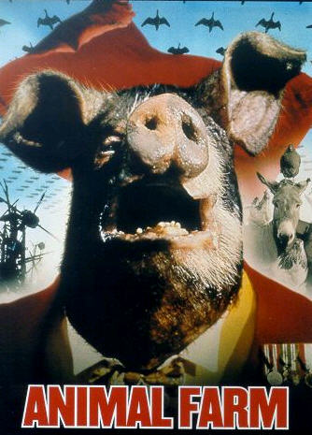
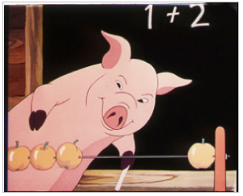
Power Conflict between the most prominent political Figures in Animal Farm

Slide 3
The Plot against democracy takes the form of a number of steps. They are
The Expulsion of Snowball by the fierce looking dogs
Establishment of special Security Forces (Napoleon thugs, Dirty dozens, personal guards)
Cancellation of the Sunday Meetings and the vote.
Establishment of a special Committee of Pigs presided by Napoleon
Keeping the formalities: saluting the flag, sing The Beast of England and receive orders delivered by Squealer.
Rule of oligarchy, the rule of the few.
Suppression and silencing of all dissent voices like the four pigs and the starvation of the nine hens. This is called political purges.
Creating scapegoats and external enemies to shift the responsibility of every thing wrong in the Animal Farm to them, prevalence of conspiracy theory
Heavy reliance on propaganda to defame the enemies particularly Snowball who is presented as traitor, wicked, thief, dangerous, and as Mr. Jones’s agent who plot to attack and destroy the Animal Farm.
Violation of the spirit of Animalism.
Holding Show Trials in which animals voluntarily confess their alleged crimes and offenses like the confession of the hens, geese, sheep, and cows.
Public execution of animals which result in pile of corpses and the prevalence of the smell of blood.

Slide 4
This leads to the establishment of the Totalitarian system
Totalitarianism is a political system in which the state holds total authority over the society and seeks to control all aspects of public and private life wherever possible. It is characterized by
Having a dictatorship
Employing only one ruling party
Rule through fear and terror
Censorship of media and strict surveillance system
Propaganda in media, government speeches and through education
Criticism of the state is prohibited
Secret police forces
Targeting of specific religious or political populations
Development of a nationalist party, so the state is
Highly centralized, autocratic, authoritarian, and the matrix of domination is from top to down.

Slide 5
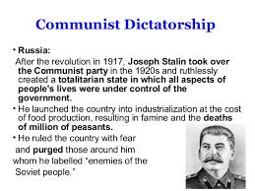
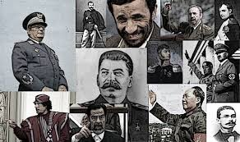
Examples

Slide 6
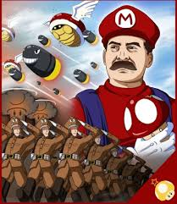
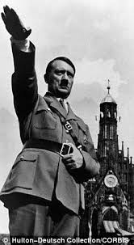
The Personality Cult

Slide 7
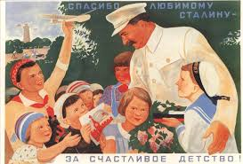
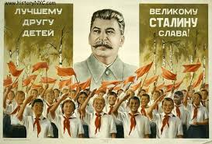
Examples

Slide 8
What is A Personality Cult?
A cult of personality arises when an individual uses mass media, propaganda, or other methods, to create an idealized, heroic, and at times, worshipful image, often through unquestioning flattery and praise. It is similar to divinization, except that it is established by mass media and propaganda usually by the state, especially in totalitarian states.
Napoleon is a good example who translates in his actions in Animal Farm the obsession with personality cult. He establishes a personal life-style to which all the everything in the animal farm must contribute.

Slide 9
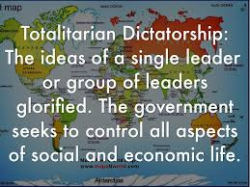
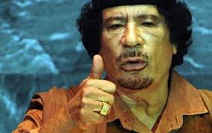

Slide 10
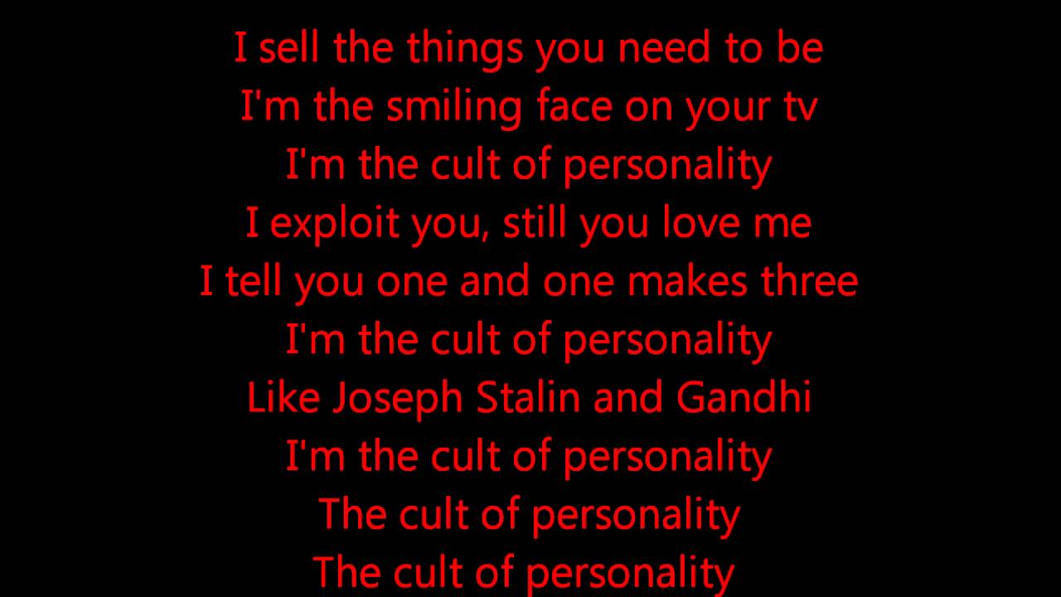
The Personality Cult

Slide 11
Changes in the economic system
After the revolution, the animals enjoy a short period of good work and economic conditions. They have better food, living spaces, less work hours, no one exploits them, they work for themselves and their kids. The idea of collective ownership is put into practice. As a result, all the animals except the pigs (the leader class), Mollie and the cat work hard and happily. It seems that Socialism substitutes the vicious Capitalist system of Mr. Jones. the However, things gradually change in the Animal Farm. Under the dictatorship of Napoleon, a new economic system takes place in which:
Animals do not need sugar and ribbons: they are not staple food.
Pigs take control of Milk and apple.
Engagement in laborious, time consuming and futile projects such as building and rebuilding of the windmill.
Economic crisis: shortage of paraffin oil, nails, string, irons for horses’ shoes, seed, artificial manures, and machinery for the windmill.

Slide 12
Changes in the economic system2
Shortage of food: Reduction of the corn and potato ration.
Trade with the human beings in the other farms : sell of hay and eggs to obtain money.
The animals are cold and hungry and sometimes they feel that their present life is not different from theirs under Jones’s rule.
The animals should be sacrifice all the time.
Napoleon takes control of the main natural resources: the timber which he sells to Fredrick and the agricultural and animal products.
Austerity measures are taken: official actions taken by the government, during a period of adverse economic conditions, to reduce its budget deficit using a combination of spending cuts or tax rises.
Belt-tightening: a reduction in spending : changes that are made in order to save money

Slide 13
This makes the State of the Animal Farm
A rentier State: is a state which derives all or a substantial portion of its national revenues from the rent of indigenous resources to external clients. The term rentier state has been used since the 20th century. It is most frequently applied to states rich in highly valued natural resources such as petroleum but can also include states rich in financial instruments such as a reserve currency.
Kleptocracy, ("rule by thieves") is a form of political and government corruption where the government exists to increase the personal wealth and political power of its officials and the ruling class at the expense of the wider population, often with pretense of honest service. This type of government is generally considered corrupt, and the mechanism of action is often embezzlement of state funds.

Slide 14
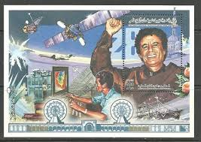
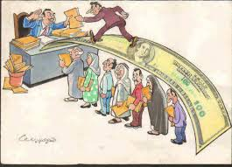
Examples

Slide 15
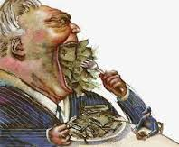
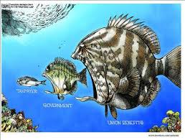
Emaples

Slide 16
The social and psychological aspects
The animals have no social lives of their own.
national rituals become an ever more common part of the Animals’ social life.
The animals are not allowed to communicate with the outside world. As a result, they live in complete isolation.
Since the animal farm is a police state, the animals usually live in a state of constant fear and terror.
The animals are oppressed and psychologically terrified by the mass killing and show trials and the false confessions of other animals.
Napoleon is not interested in teaching and educating the animals since ignorance allows him to tighten his grip on them.
The animals lack freedom of speech and live in an atmosphere where rumors, corruption, demoralization, and crookedness reign supreme.

Slide 17
The social and psychological aspects
Maintenance of strict class structure (the pigs separate themselves and the emergence of class tyranny. They are the brain thinkers or political, social and economic elite while the animals are the masses or the proletariat.
The animals generally are increasingly disillusioned, depressed, alienated and hopeless.
Some members of the oppressed class become themselves oppressors (The Pig)
The animals develop what is known in psychology the Stockholm Syndrome.
After the genocide of the four pigs, the animals suffer post trauma stress disorder.

Slide 18
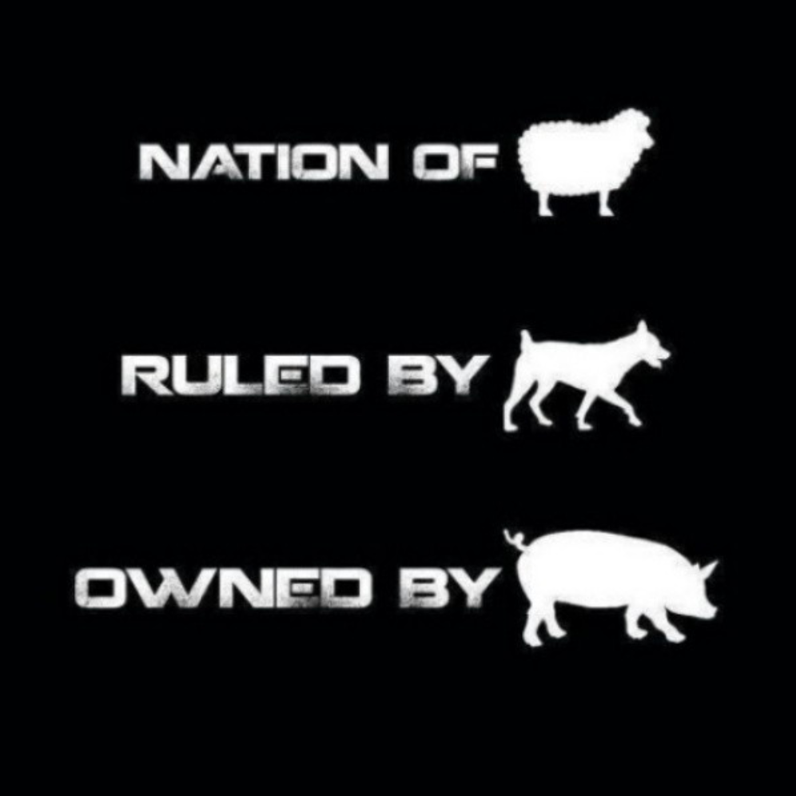
This makes Animal Farm

Slide 19
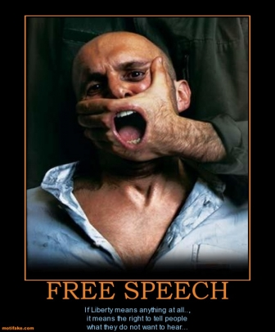
Where there is no freedom of speech

Slide 20
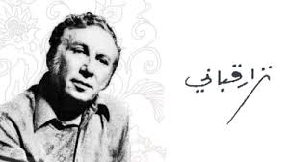
The Power Representations in Literature

Slide 21
نشيد حكام العرب
أيها الناس:
أنا الأول والأعدل
والأجمل من بين جميع الحاكمين
وأنا بدر الدجى، وبياض الياسمين
وأنا مخترع المشنقة الأولى، وخير المرسلين
كلما فكرت أن أعتزل السلطة، ينهاني ضميري
من ترى يحكم بعدي هؤلاء الطيبين ؟؟؟
من سيشفي بعدي الأعرج، والأبرص، والأعمى ؟؟؟
ومن يحيي عظام الميتين ؟؟؟
من ترى يخرج من معطفه ضوء القمر ؟؟؟
من ترى يرسل للناس المطر ؟؟؟
من ترى يجلدهم تسعين جلدة ؟؟؟
من ترى يصلبهم فوق الشجر ؟؟؟
من ترى يرغمهم أن يعيشوا كالبقر ؟؟؟
ويموتوا … كالبقر ؟؟؟
كلما فكرت أن أتركهم
فاضت دموعي كغمامة
وتوكلت على الله
وقـررت أن أركـب الشــعب
من الآن … الى يوم القيامه

Slide 22
حاكم اسمه عنتره
هـذي البـلادُ كلُّهـا مَزرَعَـةٌ شخصيّـةٌ لعَنـترَهْ …
سـماؤهـا .. هَواؤهـا … نسـاؤها … حُقولُهـا المُخضَوضَرَهْ …
كلُّ البنايـات – هنـا – يَسـكُنُ فيها عَـنتَرَهْ …
كلُّ الشـبابيك علَيـها صـورَةٌ لعَـنتَرَهْ …
كلُّ الميـادين هُنـا ، تحمـلُ اسـمَ عَــنتَرَهْ …
عَــنتَرَةٌ يُقـيمُ فـي ثيـابنـا … فـي ربطـة الخـبز …

Slide 23
نشيد حكام العرب
و فـي زجـاجـة الكُولا ، وَ فـي أحـلامنـا المُحتَضـرَهْ ...
مـدينـةٌ مَهـجورَةٌ مُهَجّـرَهْ …
لم يبقَ – فيها – فأرةٌ ، أو نملَـةٌ ، أو جدوَلٌ ، أو شـجَرَهْ …
لاشـيء – فيها – يُدهشُ السّـياح إلاّ الصـورَةُ الرسميّـة المُقَرَّرَهْ ..
للجـنرال عَــنتَرَهْ …
فـي عرَبـات الخَـسّ ، و البـطّيخ …
فــي البـاصـات ، فـي مَحطّـة القطـار ، فـي جمارك المطـار..
فـي طوابـع البريـد ، في ملاعب الفوتبول ، فـي مطاعم البيتزا …
و فـي كُلّ فئـات العُمـلَة المُزَوَّرَهْ …
فـي غرفَـة الجلوس … فـي الحمّـام .. فـي المرحاض ..
فـي ميـلاده السَـعيد ، فـي ختّـانه المَجيـد ..
فـي قُصـوره الشـامخَـة ، البـاذخَـة ، المُسَـوَّرَهْ …

Slide 24
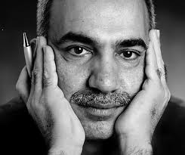
عدنان الصائغ: العبور الى المنفى

Slide 25
العبور الى المنفى
حيث الوطن
يبدأ من خطاب الرئيس
.. وينتهي بخطاب الرئيس
مروراً بشوارع الرئيس، وأغاني الرئيس، ومتاحف الرئيس، ومكارم الرئيس ، وأشجار الرئيس ، ومعامل الرئيس، وصحف الرئيس، وإسطبل الرئيس، وغيوم الرئيس، ومعسكرات الرئيس، وتماثيل الرئيس، وأفران الرئيس، وأنواط الرئيس، ومحظيات الرئيس، ومدارس الرئيس، ومزارع الرئيس، وطقس
ستحدّق طويلاً
في عينيّ المبتلتين بالمطر والبصاق
وتسألني من أي بلادٍ أنا...

Slide 26
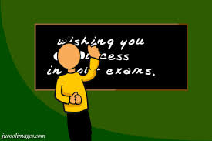
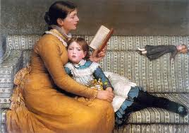
Thank you My dear students

