Slide 1
What Is Propaganda?
Definition and Types

Slide 2
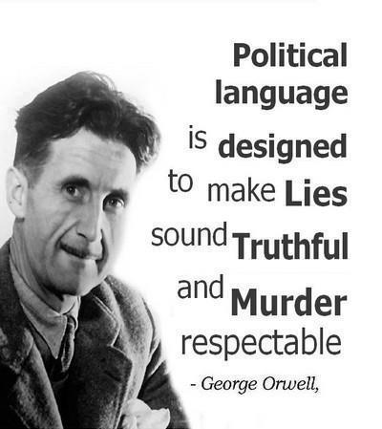
George Orwell (1903-1950)
Arthur Eric Blair

Slide 3
Propaganda is Defined as
Propaganda is a form of communication aimed towards influencing the attitude of a population toward some cause or position. Propaganda is information that is not impartial and used primarily to influence an audience and further an agenda, often by presenting facts selectively (perhaps lying by omission) to encourage a particular synthesis, or using loaded messages to produce an emotional rather than a rational response to the information presented.
While the term propaganda has acquired a strongly negative connotation by association with its most manipulative and jingoistic examples, propaganda in its original sense was neutral and could refer to uses that were generally positive, such as public health recommendations, signs encouraging citizens to participate in a census or election, or messages encouraging persons to report crimes to law enforcement.

Slide 4

What is propaganda doing?

Slide 5
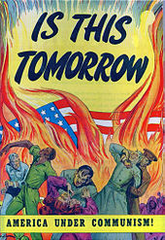
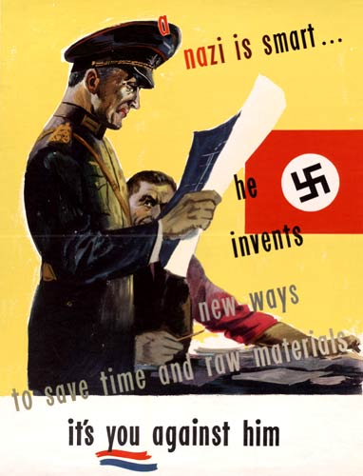
Examples of propaganda

Slide 6
Propaganda in the 20th Century
During the 20th century, the term acquired a thoroughly negative meaning in western countries, representing the intentional dissemination of often false, but certainly "compelling" claims to support or justify political actions or ideologies. This redefinition arose because both the Soviet Union and Germany's government under Hitler admitted explicitly to using propaganda favoring, respectively, communism and Nazism, in all forms of public expression. As these ideologies were repugnant to liberal western societies, the negative feelings toward them came to be projected into the word "propaganda" itself.

Slide 7
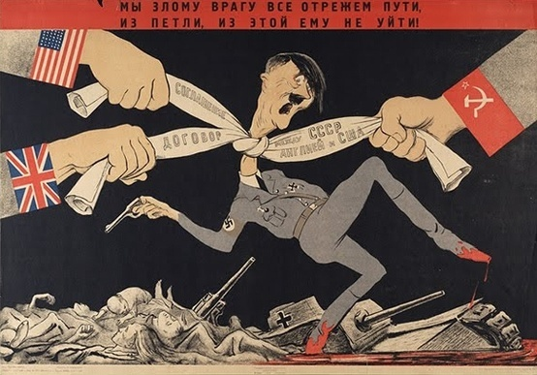

Examples of propaganda

Slide 8
Propaganda in the War
Propaganda is a powerful weapon in war; it is used to dehumanize and create hatred toward a supposed enemy, either internal or external, by creating a false image in the mind. This can be done by using derogatory or racist terms, avoiding some words or by making allegations of enemy atrocities. Most propaganda wars require the home population to feel the enemy has inflicted an injustice, which may be fictitious or may be based on facts. The home population must also decide that the cause of their nation is just.

Slide 9
Types of propaganda
There are three types of Propaganda: White, Black, and Grey. In Orwell’s Animal Farm, Black Propaganda is used extensively by both conflicting parties: Mr. Jones and the other farmers on the one hand and the Pigs on the other. This kind of propaganda is mainly used to dehumanize, demonize, and defame the enemy while aggrandizing and overstating one’s own actions and achievement.

Slide 10
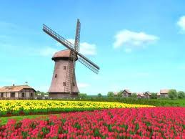
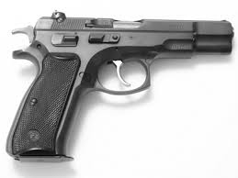
Propaganda in Animal Farm:
Snowball’s Windmill and Napoleon’s Gun

Slide 11
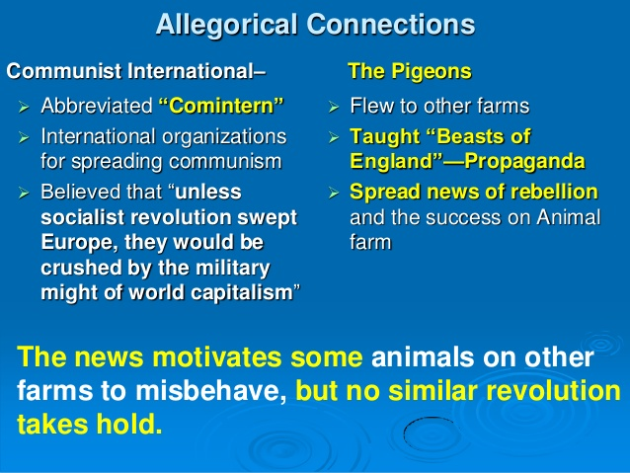
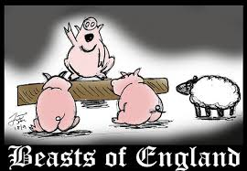
Song of England and News of the Revolution

Slide 12
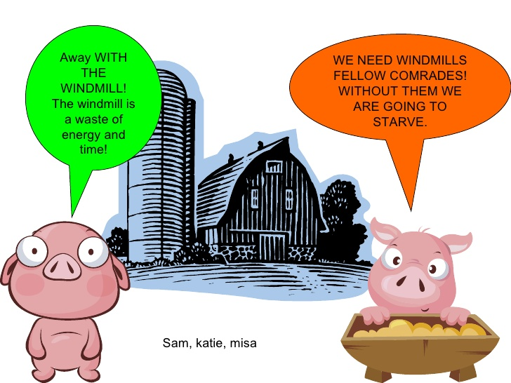
The two pigs/Rivals

Slide 13
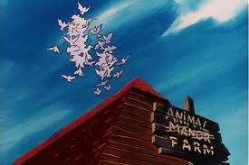
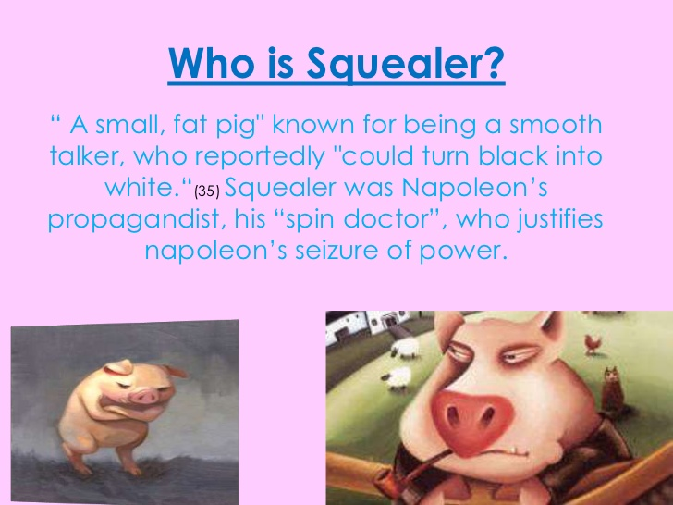
The animals who are responsible for the propaganda campaigns

Slide 14
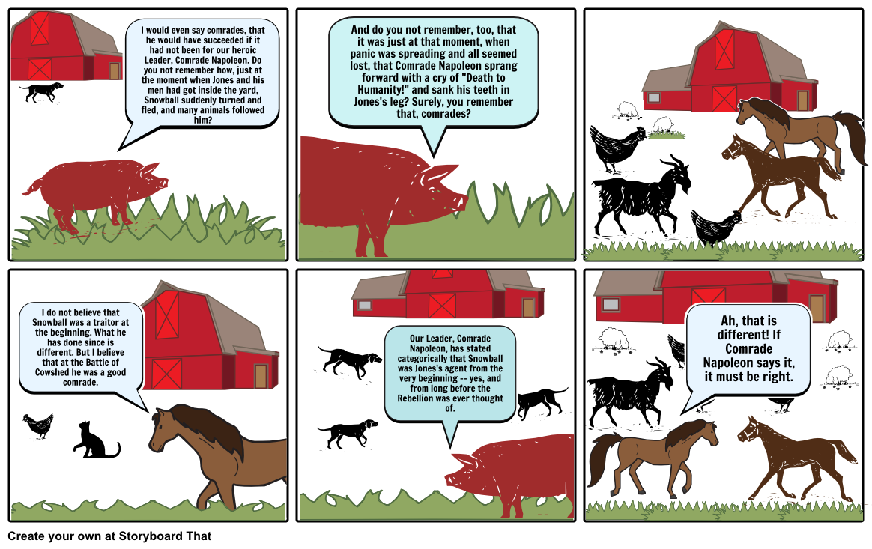
What is Squealer Doing?

Slide 15
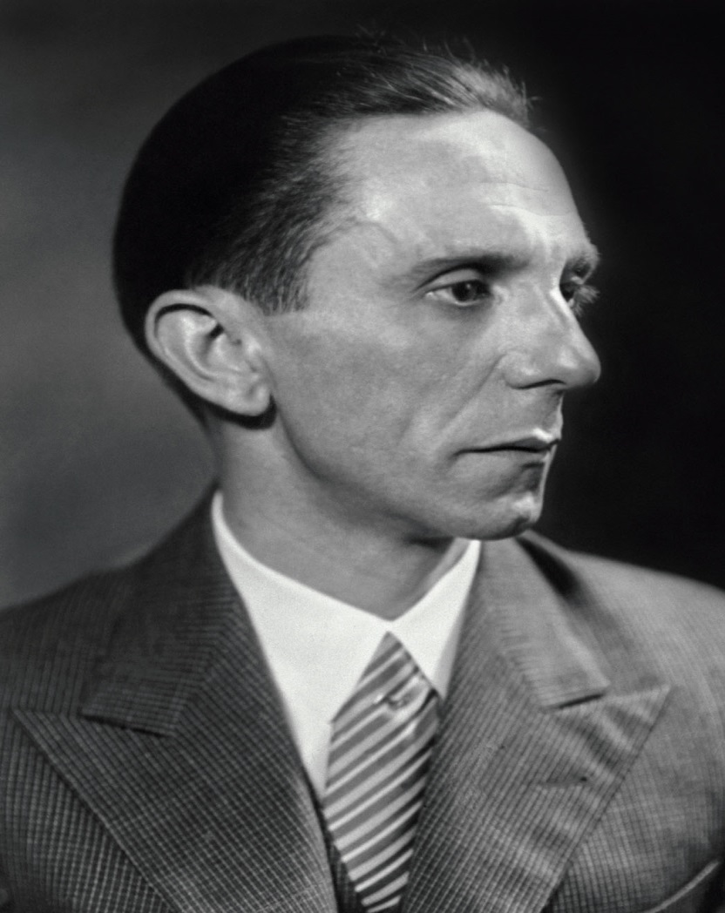
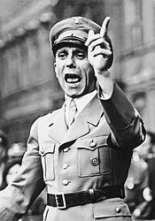
Joseph Goebbles (1897-1945)
The German Propaganda Minister

Slide 16
Examples of black Propaganda
The Pigs’ campaign
Mr. Jones’ Campaign
Man is Evil, Wicked, irresponsible, Exploiter, Bad-mannered, selfish, careless, unreliable, untrustworthy, self-seeking and abusive.
The only good Man is the dead one.
The animals are tormenting, perpetually fighting each other. They are starving to death. They are practicing cannibalism, and they have their females in common.
That is the result of rebelling against the Natural Law.

Slide 17

Good Luck

