Slide 1

References by: Dania Abbas M. Ali

Slide 2
reference
The term reference is traditionally used in semantics to define the relationship between a word and what it points to in the real world, but in Halliday and Hasan’s (1976) model it simply refers to the relationship between two linguistic expressions.
Reference as an act by which a speaker (or writer) uses language to enable a listener (or reader) to identify something.

Slide 3
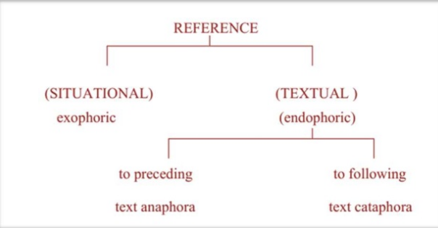

Slide 4
Exophoric Reference
(Looking outward- outside the text). The referent is not in the immediate context but is assumed by the speaker/writer to be part of a shared world, in terms of knowledge and experience.
E.g., For he's a jolly good fellow and so say all of us.
As outsiders, we don’t know who the he is, but, most likely, the people involved in the celebration are aware of the he that is being referred to, and therefore, can find texture in the sentences.

Slide 5
References to elements in the text are called Endophoric references.
Endophoric referencing can be divided into two areas:
Anaphoric: refers to any reference that “points backwards” to previously mentioned information in text. Usually items such : as he/she or them ,it, this , can be decoded without major difficulty.
Ex: *Tom likes ice cream but Bill can’t eat it.
*The teacher asked Ahmad to read so he read.
Cataphoric: Refers to any reference that “points forward” to information that will be presented later in the text.
Ex: When I met her, Mary looked ill
Here is the news. The Prime Minister . .

Slide 6
Types of cohesive references
Comparative
Personal
Demonstrative

Slide 7
Types of cohesive reference
Personal reference keeps track of function through the speech situation using noun, pronouns like “he, him, she, her”, etc. and possessive determiners like “mine, yours, his, hers”, etc.
Ex: The prime minister has resigned. He announced his decision this morning.
Demonstrative reference keeps track of information through location using proximity references like “this, these, that, those, here, there, then, and the”.
Ex: I always buy a lot of books when I am in England. There are many lovely bookshops there.
Comparative reference keeps track of identity and similarity through indirect references using adjectives like “same, equal, similar, different, else, better, more”, etc. Adverbs like “so, such, similarly, otherwise, so, more”, etc.
Ex: A similar view is not acceptable.
We did the same.
So they said.

Slide 8
Thank you

