Slide 1
How to Write MA Thesis

Slide 2

The Good News
You only have to write ONE thesis
  Except you French and Germans who have to do a habilitation
At the end, you can add “Assistant lecturer” to your name
  Good for upgrades on planes

Slide 3

The Bad News
Writing a thesis is hard, painful work
  You’ve already done the fun part (the research)
It’s unlike any other document
  Thesis writing is not a marketable skill

Slide 4
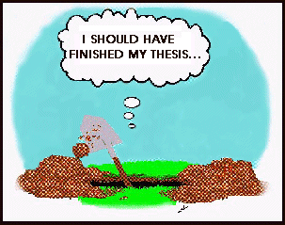
The Bad News
Some people never manage to write one
  99% perspiration
  1% inspiration?
If you’re lucky, your thesis will be read by:
  Your supervisor
  Your committee

Slide 5
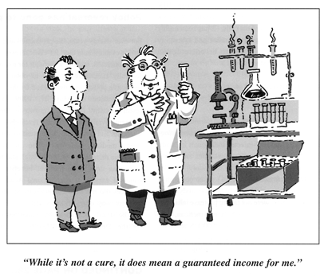
Why write a thesis?
It’s the union card for academia
  You all have to suffer like we did!
In the procces, you will learn
  How to research
  How to write

Slide 6
Why write a thesis?
It’s the union card for academia
  You all have to suffer like we did!
In the procces, you will learn
  How to write
    Shorter conference & journal papers will be easy!

Slide 7
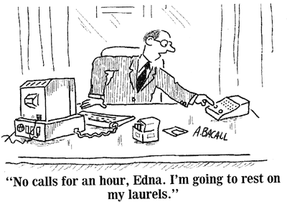
Why write a thesis?
You get to add “MA in Translation” to your name
  Great aunts, husband, children etc. are most impressed
It will introduce you/your research to a wider audience
  Thesis committee
  …

Slide 8
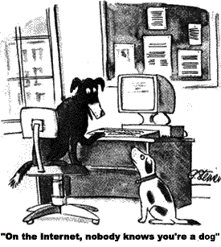
Why write a thesis?
It will make you famous
  Unlikely
  Look at the statistics
It will radically change science
  Unlikely
  Look at the statistics

Slide 9
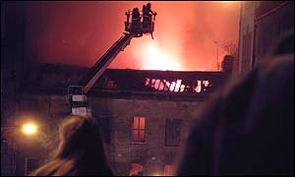
Why write a thesis?
It will advance our knowledge
  Just a little
  Main benefit is in teaching you to research
It will be read by others
  Your thesis committee
  If unlucky, it will suffer the same fate as my thesis!
Edinburgh, 7th December 2002

Slide 10

Ok, when do I start?
So I’m motivated
When do I actually start writing my thesis?
  12 months before the end of my study in the Dept?

Slide 11
Ok, when do I start?
So I’m motivated
When do I actually start writing?
  12 months before the end of my study?
  No, the day you start your MA
  Write it all down!

Slide 12
Ok, when do I start?
So I’m motivated
When do I actually start writing?
  6 months before the end of my grant?
  No, the day you start your PhD
  Write it all down!
    Don’t worry, it’s never too late to start

Slide 13

What a thesis isn’t?
What I did in the library/internet over the last 3 years
  I first read the background material
  I then consulted my teachers
  I ran some literature review
  …
A thesis is a logical reconstruction
  Not a historical narrative

Slide 14
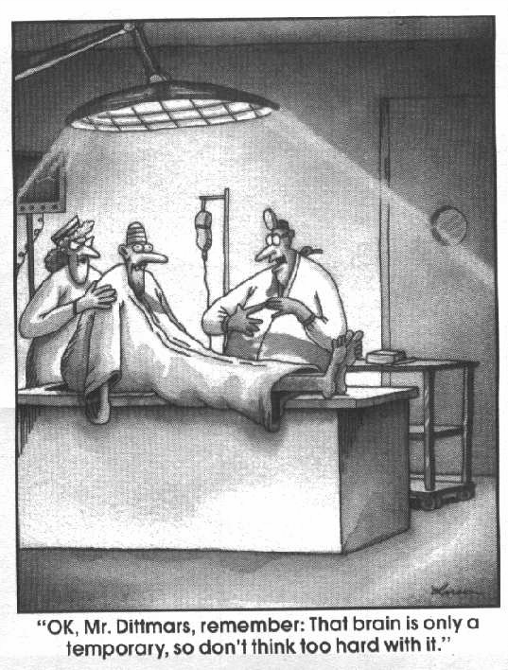
What a thesis isn’t?
A brain dump of everything you’ve done
  You get to leave out the dead-ends
  But you have to fill in any obvious gaps!
A thesis is a logical reconstruction
  With a single coherent message

Slide 15
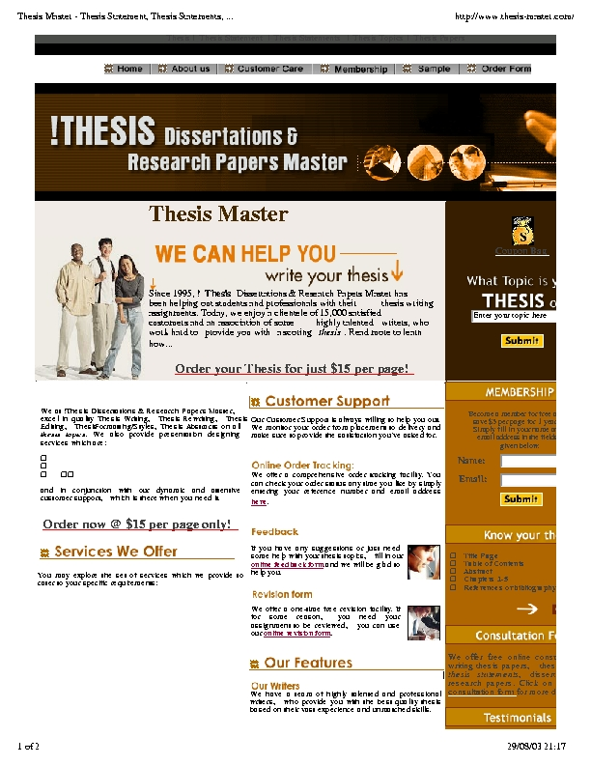
What a thesis isn’t?
Available to buy
  Even if www.thesis-master.com offer you one at $15/page
  Local offices near your university ready to write for payment
  Teachers ready to help you for payment
  Taken illegally from other theses

Slide 16

What is a thesis?
Demonstration of an understanding of the state of the art
  Critical appreciation of existing work
A novel contribution
  Evaluated systematically

Slide 17
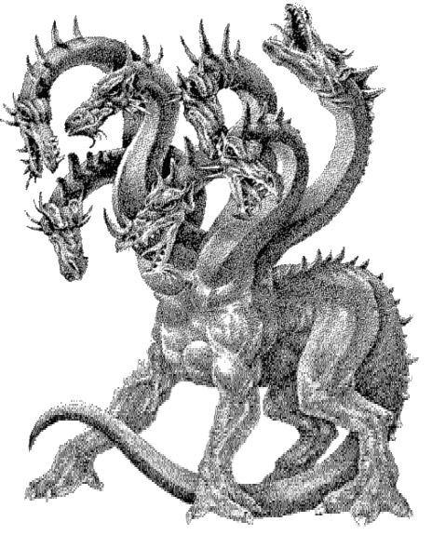
Read some theses?
Good way to get a feel for the beast
  Ethos- thesis
  Alkafeel.net thesis
  E-theses pdf

Slide 18
MA thesis
Opens a ‘new’ area
Provides unifying framework
Resolves long-standing question
Thoroughly explores area
Contradicts existing knowledge, if possible
Analytically validates theory
Presents ambitious analysis
Provides statistical data
Validates or refutes hypotheses
Develops new methodology, if possible
Develops new translation assessment
Produces conclusions/ results

Slide 19
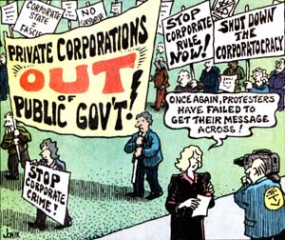
So, how do I start?
Write a thesis message
  1 sentence
  1 paragraph
  1 page

Slide 20
So, how do I start?
Write a thesis message
  1 sentence
  1 paragraph
  1 page
Everything you write should be directed at this
  Thesis (noun).
    1. A proposition maintained by argument
    2. A dissertation advancing original research

Slide 21
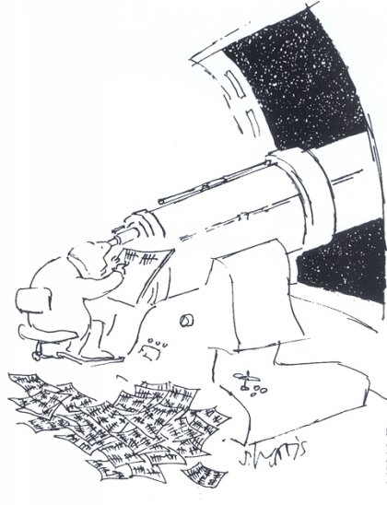
Thesis problem
You’re tackling an important research problem
  E.g. ideology in ISIS
You’ve made an important contribution to its literature
  E.g. the manipulation of ideology of translators in rendering Iraqi officials’ speeches

Slide 22

What next?
So, I’ve got a good thesis problem
What do I do next?

Slide 23
What next?
So, I’ve got a good thesis message
What do I do next?
  Write the table of contents
  Logical structure of your thesis

Slide 24

Table of Contents
Introduction
  Thesis problem
Background
  Context, defs, lit review
Theoretical perspective
Data
Analysis
Discussion
Conclusions

Slide 25
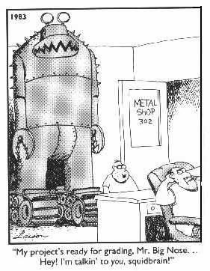
Table of Contents
Background & related work overlap
  Need to discuss related work at start to set scene
  Need to discuss related work at end to demonstrate your contribution

Slide 26
What next?
So, I’ve got a good thesis prroblem
And a table of contents
What do I do next?

Slide 27
What next?
So, I’ve got a good thesis message
And a table of contents
What do I do next?
  Make a timetable
    Targets to meet
    Light at the end of the tunnel
  Prepare your sources and data

Slide 28
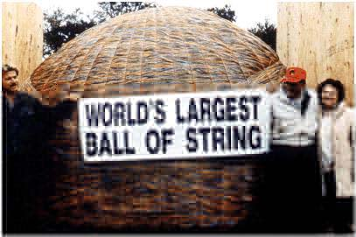
Timetable
How long will it take?
Depends on many factors
  How much you’ve written as papers
  …
Heavy-tailed distribution
  Min = 2 months (v. rare)
  Max = infinity
  Mean = infinity
  Median = 6-9 months
How long is a piece of string?

Slide 29
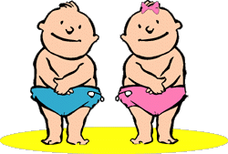
Timetable
“Your thesis is your baby”
  Give it 9 months
    Write it up
    Fill in gaps, analysis…
“You have to know when to let it go”
  Put a fence around what you’ve done

Slide 30
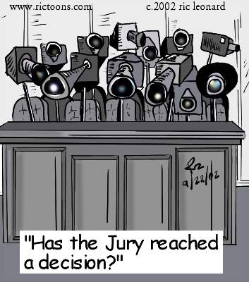
Thesis committee
Who should be on your audiance?
  Ideally you and your supervisor will come to a mutual decision
Important, well-known researchers
  People ready to help
  You’ll get good feedback
  They may employ you
  They may recommend you to others

Slide 31

Thesis committee
Why decide your other researchers before you start writing?
  You can target your thesis at them
  They’re busy people
    Even busy people have open dates in their diaries a year ahead
    They’ll still manage to schedule other events on the day of your viva

Slide 32
What next?
So, I’ve got a good thesis problem
And a table of contents, timetable and researchers
What do I do next?

Slide 33
What next?
So, I’ve got a good thesis message
And a table of contents, timetable and committee
What do I do next?
  Work to your timetable!

Slide 34
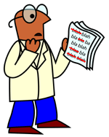
Writing each chapter
Don’t start with the Introduction or Conclusion
Start where you feel happiest
  Typically a middle chapter
  Write outwards
  Finally Conclusions and end with the Introduction
Write everything with your thesis problem in mind

Slide 35
Writing each chapter
Get feedback before you write too much
  One person to read each chapter as it is written
  Another person to read thesis in order
  People local and global
  Research groups in social media
  Likedin
  Researchgate
  Google scholar

Slide 36
Writing each chapter
You’ll discover holes in your research
  Hypotheses you haven’t proved
  Analyses you didn’t run
    Different problems or data
Mix writing with more research

Slide 37
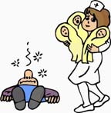
Rule of Three
Within each chapter, repeat yourself 3 times
  Intro. We will show ..
  Body. Show them ..
  Concl. We have shown ..
Within thesis, repeat your contributions 3 times
  Intro chapter
  Main chapters
  Conclusion chapter
But don’t bore reader
  E.g. in introduction be brief, in conclusions be broader

Slide 38
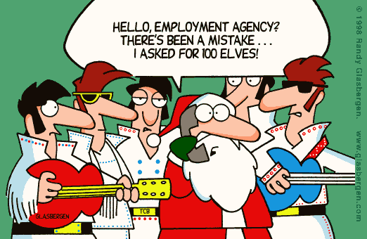
Common mistakes
Informal text
  Examiners will jump on imprecision
Opinions
  “.. The main problem in translation is rendering..”
  A thesis is an argument!

Slide 39
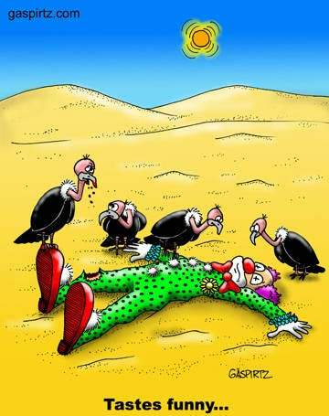
Common mistakes
Complex sentences full of long words
  A thesis should be a simple, convincing argument!
Entertainment or humour
  Joke footnote

Slide 40
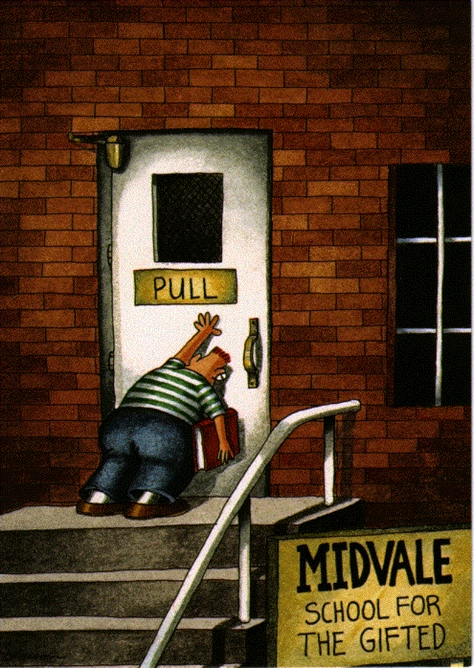
Common problems
It’s never possible to cover all issues
  So you will never finish?

Slide 41
Common problems
It’s never possible to cover all issues
  So you will never finish?
  It’s sometimes enough to identify the issues
  Examiners greatly appreciate you identifying limitations

Slide 42
Common problems
It’s never possible to cover all issues
  So you will never finish?
  It’s sometimes enough to identify the issues
  Examiners greatly appreciate finding a few mistakes

Slide 43

Common problems
Much of your thesis is joint work
  Identify some work that is yours alone
  Include a statement at the start of your contributions:
  Include recommendations and suggestions

Slide 44
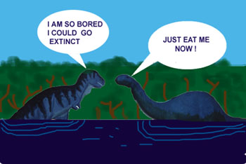
Common problems
Ideas become obvious to you
  You stop writing to a sufficient level of detail
  Especially hurts the opening chapters as they are often written last

Slide 45
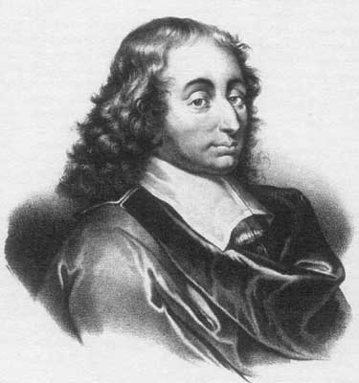
Common problems
Writing too much
  There are rules about maximum length
  But rarely rules about the minimum
Nash’s PhD thesis
  27 pages long
  Won him a Nobel prize
Je n'ai fait celle-ci plus longue que parce que je n'ai pas eu le loisir de la faire plus courte. Blaise Pascal, 1657

Slide 46
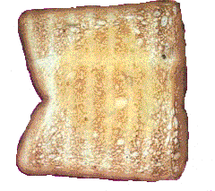
Common problems
At some point, your brain will surely become toast
  Take a break
  Eat properly, exercise, sleep …
Toasted brain is only temporary
  Just look at me?

Slide 47
What to expect from your advisor?
Your not in this on your own
Your supervisor is on your side
  Your success is their success

Slide 48
What to expect from your advisor?
Intellectual support
  Quality assurance
  What standard a thesis should reach
  Indication of when to stop
Emotional support
  Encouragement
  Constructive atmosphere

Slide 49

What not to expect from your advisor?
Smiles
  If draft chapters contain simple spelling mistakes and typos
Mind-reading skills
  Motivation dipping
  Absence = illness

Slide 50
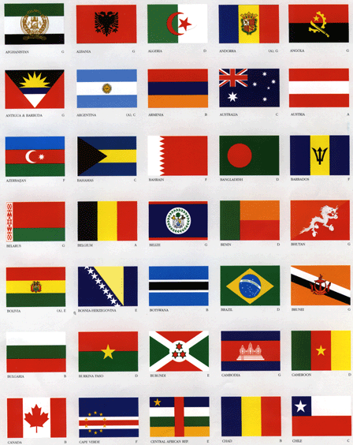
Defending your thesis
Needs
Good mind
Good organization
Patience
The committee to enrich
Increase not decrease
Different minds = different viewpoints

Slide 51

Defending your thesis
Don’t panic
  You’re probably the world’s expert on this topic by now!
Your examiners are human
  They’ve sat in your seat
  They will help you find what changes (if any) are needed to make this the required quality

Slide 52

Defending your thesis
Enjoy it
  You’ve the Dept’s experts in the room
  They want to talk about your work
  How often will that happen in the future?
If you want, have a practice
  Get your supervisor to set up a “dummy” jury
  Prepare your opening statement

Slide 53
What are examiners looking for?
Review of literature
  Is the literature relevant?
  Is the review critical or just descriptive?
  Is it comprehensive?
  Does it link to the methodology in the thesis?
  Does it summarize the essential aspects?
Methodology
  Is there a clear hypothesis?
  Are precautions taken against bias?
  Are the limitations identified?
  Is the data collected appropriately?
  Is the methodology justified?

Slide 54
What are examiners looking for?
Presentation of results
  Have the hypotheses in fact been tested?
  Are the results shown to support the hypothesis?
  Is the data properly analysed?
  Are the results presented clearly?
  Are patterns identified and summarized?
Discussion and Conclusions
  Are the limits of the research identified?
  Are the main points to emerge identified?
  Are links made to the literature?
  Is there theoretical development?
  Are the speculations well grounded?

Slide 55
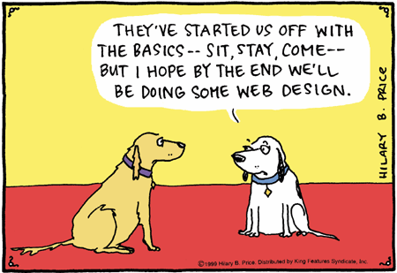
It’s all over
You’ve finished writing & defending your thesis
What do you do next?

Slide 56
It’s all over
You’ve finished writing & defending your thesis
What do you do next, if you like?
  Turn it into a book
  Publish some journal articles around it
  Make copies for your parents, …
  Make a copy for yourself
    Or end up like me!

Slide 57
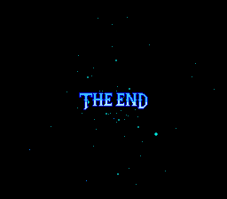
It’s all over
You’ve finished writing & defending your thesis
What do you do next?
  Just think, you’ll never have to do it again!

Slide 58
It’s all over
You’ve finished writing & defending your thesis
What do you do next?
  Just think, you’ll never have to do it again!
  Unless you’re intended to translate it!

Slide 59

Good Luck!

