Slide 1
Differences between written and spoken discourse analysis
Presented
By
Sanar mohamed
Notes:
This template is provided by http://www.free-power-point-templates.com/

Slide 2
Discourse analysis: is the study of language in its written and spoken form

Slide 3
There are many ways to classify discourse analysis :
Written-spoken
According to register
According to gemre
Monologic

Slide 4
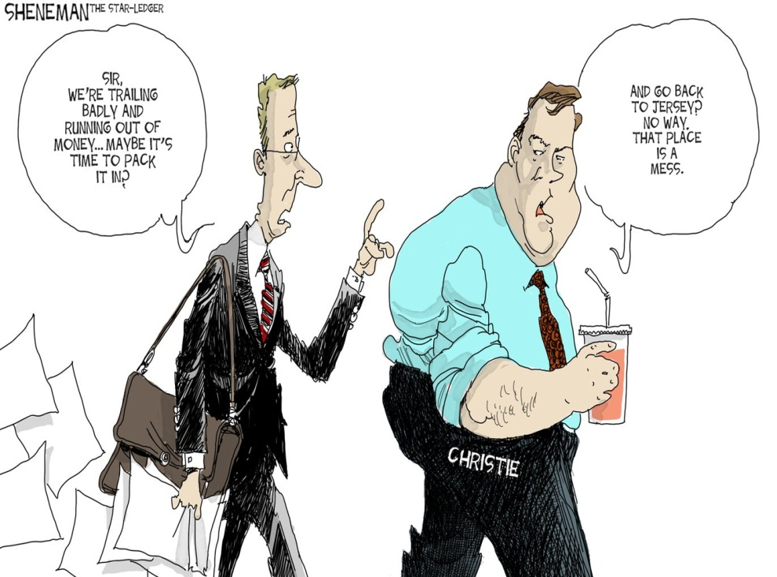
Spoken discourse analysis: on going situated interpretation of speakers communicative intention of which the addressee’s expected and actual reactions are an integral part
Written discourse analysis: is a growing field of study it allows researchers to follow different lines of investigation

Slide 5
Differences between spoken and written discourse analysis
Grammatical intricacy and structure
Lexical density
Nominalization
Explicitness
Contextualization
Spontaneity
Repetition, hesitation and redundancy
Vocabulary

Slide 6
Grammatical intricacy and structure
Written discourse is more structurally and more elaborate then spoken discourse.
Lexical density
lexical density in spoken discourse is less than written discourse

Slide 7
Nominalization written discourse tends to have longer noun groups than spoken discourse Explicitness written discourse analysis is more explicit than spoken discourse analysis but it is not absolute

Slide 8
Contextualization written discourse analysis is more decontextualized than spoken Spontaneity written discourse analysis is more organized than spoken one

Slide 9
Repetition, hesitation and redundancy spoken discourse contain more repetition , hesitation and redundancy than written one Vocabulary spoken discourse using slang and more simple words written discourse slang avoided and using formal words

