Slide 1

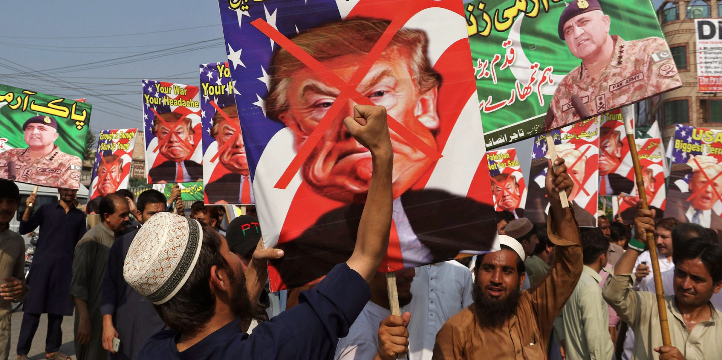
Blow to Pakistan: US cuts military training programmes

Slide 2
US military institutions are struggling to fill the 66 slots they had kept aside for officers from Pakistan for the next academic year, as the Trump administration refused to provide funds for their training, official sources said.

Slide 3
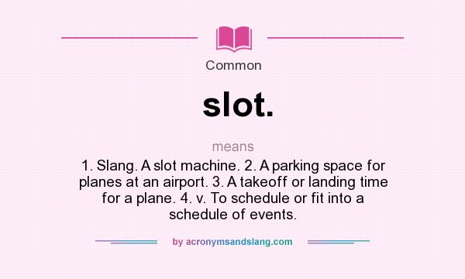

Slide 4
The fund for training Pakistani officers came from the US government’s International Military Education and Training Programme (IMET) but no funds were made available for Pakistan for the next academic year.

Slide 5
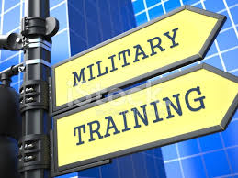

Slide 6
The Pentagon and the Pakistani military did not comment directly on the decision or the internal deliberations, but officials from both countries privately criticized the move.

Slide 7
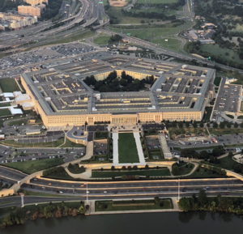

Slide 8
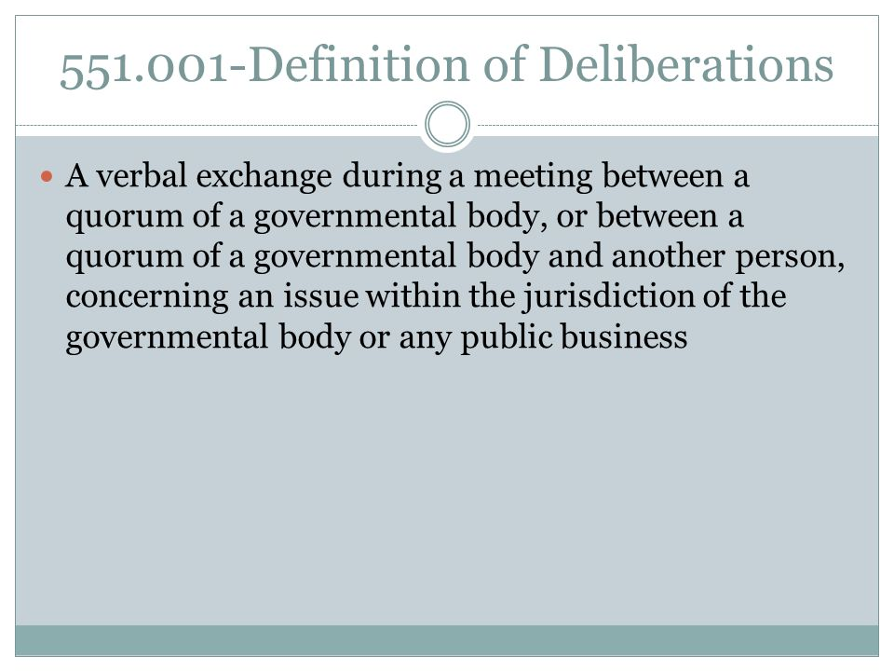

Slide 9
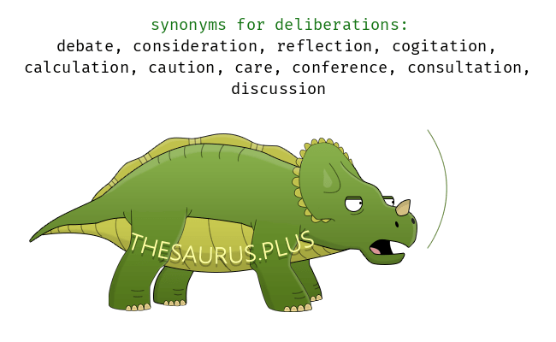

Slide 10
U.S. officials, speaking to Reuters on the condition of anonymity, said they were worried the decision could undermine a key trust-building measure.

Slide 11

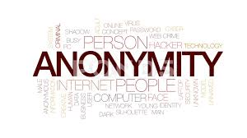

Slide 12
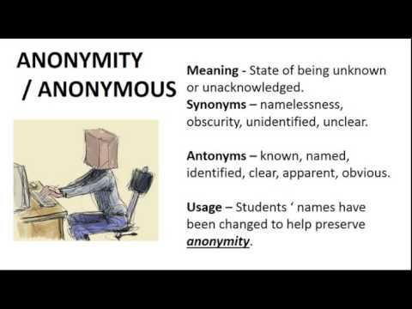

Slide 13
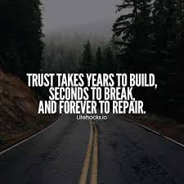
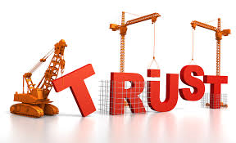

Slide 14
Pakistani officials warned it could push their military to further look to China or Russia for leadership training.

Slide 15
Dan Feldman, a former U.S. special representative for Afghanistan and Pakistan, called the move “very short-sighted and myopic”.

Slide 16
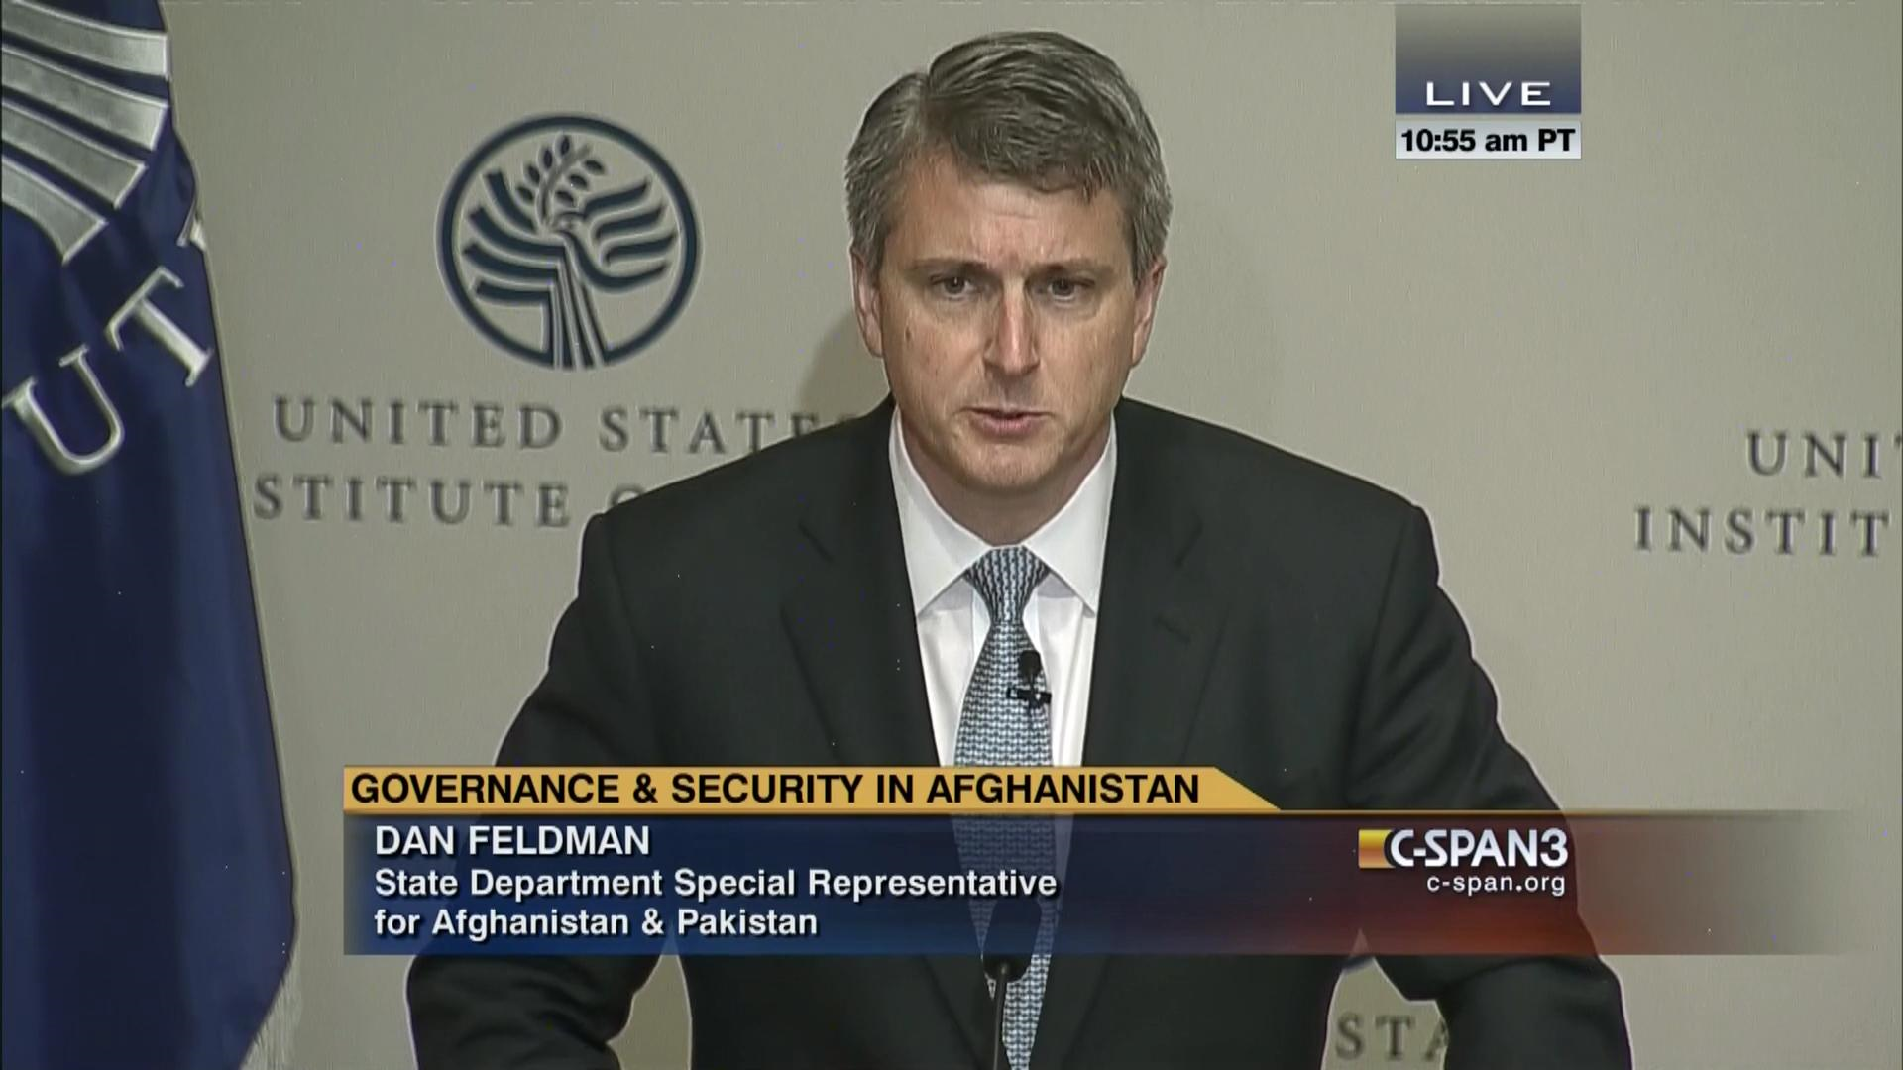

Slide 17
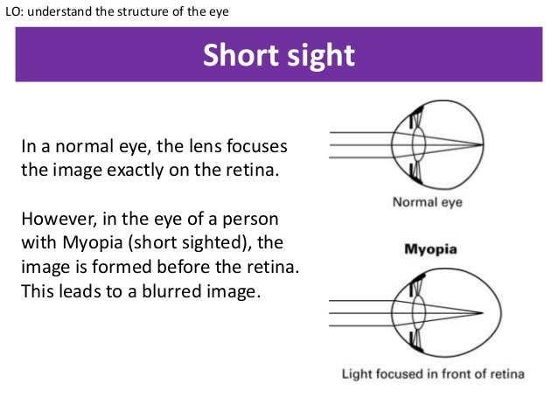

Slide 18
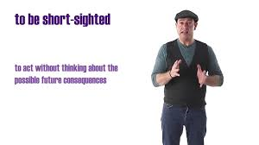

Slide 19
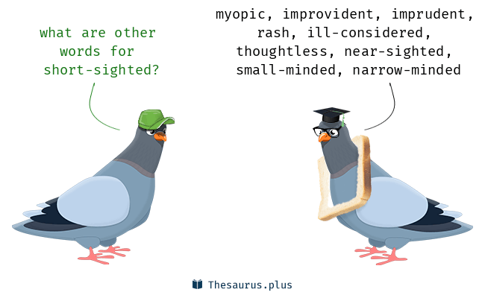

Slide 20
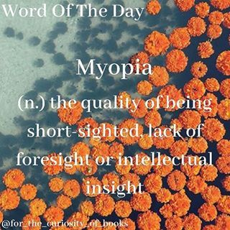

Slide 21
The State Department spokesperson, speaking on the condition of anonymity, said the IMET cancellations were valued at $2.41 million so far. At least two other programs have also been affected, the spokesperson said.

Slide 22

a man or woman who speaks for or represents someone or something

Slide 23
Pakistani Senator Mushahid Hussain, chairman of the Senate Foreign Affairs Committee, told Reuters that a U.S. decision to cut off such exchanges would be counter-productive and push Pakistan’s military towards other countries.

Slide 24
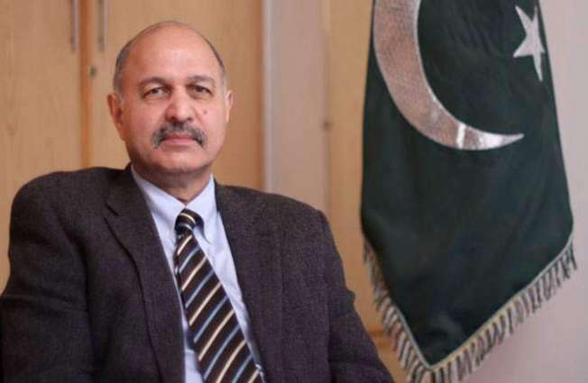

Slide 25
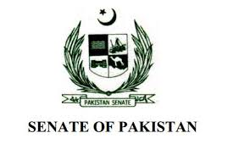

Slide 26
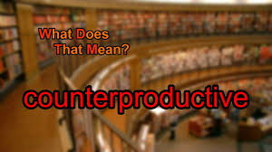
having an effect that is opposite to the one intended or wanted

Slide 27
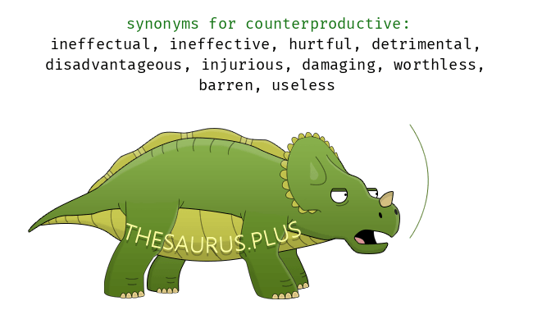

Slide 28
Russia and Pakistan signed an agreement earlier this week that would allow for Pakistani military officers to train at Russian institutes.

Slide 29
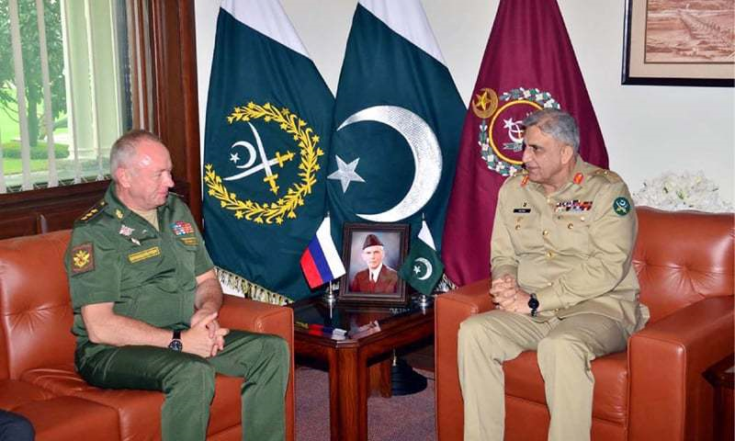

Slide 30


