Slide 1
US Cuts Pakistan’s Access to Military Training Programs

Slide 2
The United States has started cutting Pakistani officers from training and educational programs which were a key aspect of US-Pakistan bilateral relations that have lasted for more than a decade, US officials told Reuters.

Slide 4
An international news agency founded in London in 1851 by Paul Julius Reuter (1816–99). The agency pioneered the use of telegraphy, building up a service used today by newspapers and radio and television stations in most countries.

Slide 5
Reuters transmits news in English, French, German, Italian, Spanish, Portuguese, Russian, Urdu, Arabic, Japanese, Korean, and Chinese

Slide 6
The move is one of the first major impacts of Donald Trump’s announcement that the US would cut security aid to Pakistan to compel the country to crack down on Islamic terrorists living on Pakistani soil.

Slide 8
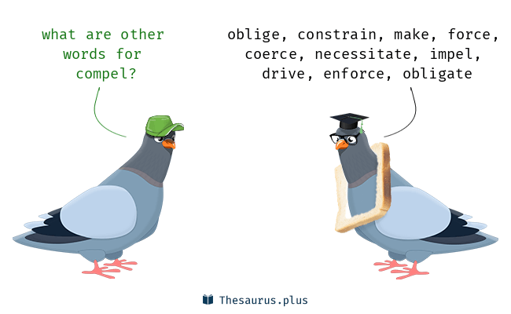

Slide 9
an action by an authority to stop something

Slide 11
Reuters cited anonymous US officials as stating that they were worried the decision could undermine US-Pakistan relations further, compelling the country to turn to Russia or, more likely, China for assistance.

Slide 13
China has already extended several loans to Pakistan for the $60 billion China Pakistan Economic Corridor.

Slide 14
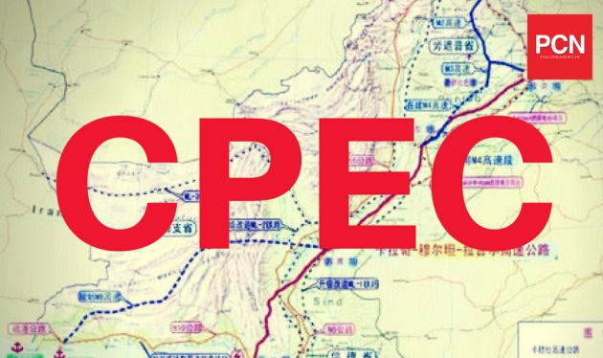

Slide 15
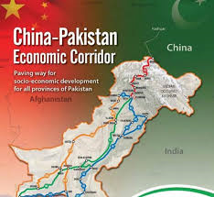

Slide 17
A US State Department official told Reuters that the US government's move to cut Pakistan from the United States’ International Military Education and Training Programme (IMET) would close off 66 spots that had been allocated for Pakistani officers in 2018.

Slide 18
International Military Education and Training (IMET) funds provide training and education on a grant basis to students from allied and friendly nations.

Slide 19
The official added that the spots would either be left vacant, or be allocated to officers from other nations.

Slide 21
In fact, US President Donald Trump’s first tweet of 2018, targeting Pakistan, had caused ripples in international diplomatic circles, especially on the Twitter timelines of Pakistan government officials.

Slide 22
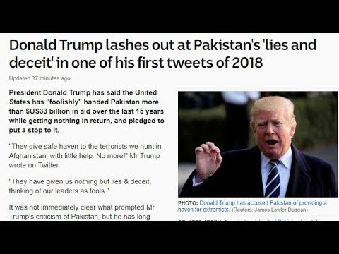

Slide 23
a small wave on the surface of water

Slide 24
a sound or feeling that spreads through a person or group of people, gradually increasing and then becoming smaller

Slide 25
a line that shows the time and the order in which events have happened
​
a plan that shows how long something will take or when things will happen
​
the part of a social media website where items that have been added by you, or that relate to you, are shown

Slide 26
In his tweet, the US called Pakistan a ‘safe haven’ for terrorists and said that the “United States had foolishly given more than 33 billion dollars in aid to Pakistan over the last 15 years.”

Slide 27
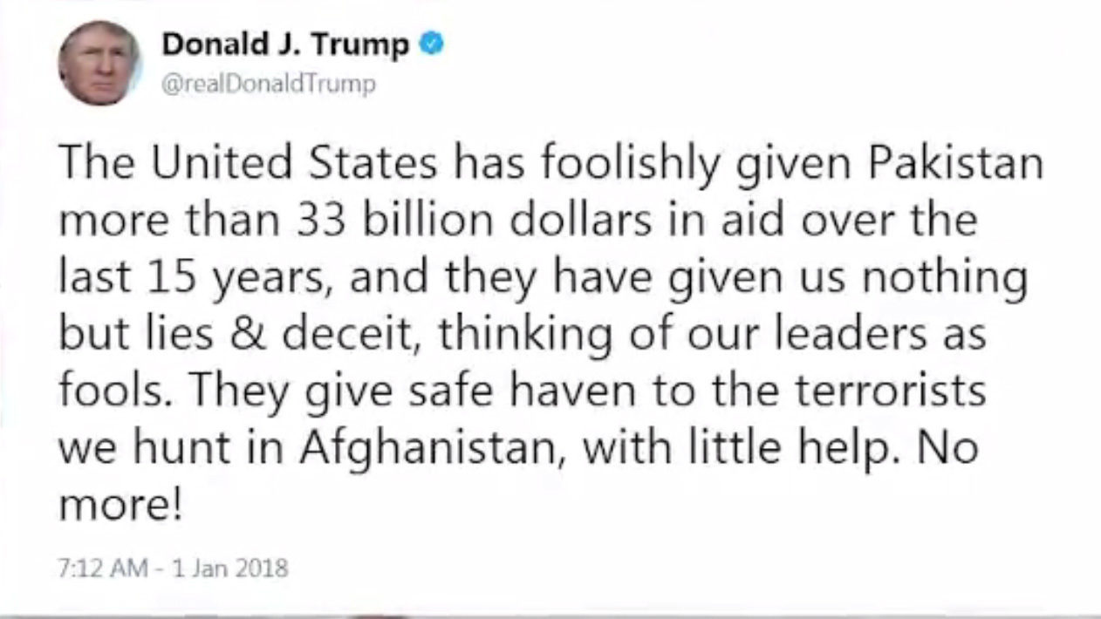

Slide 29
Pakistan had been the largest recipient of IMET between 2003 and 2017, according to the Security Assistance Monitor which tracks U.S. assistance.

Slide 31
to follow the development or progress of something

