Slide 1
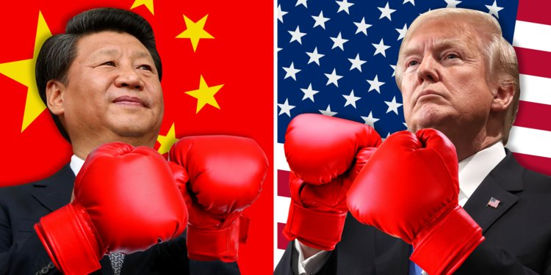
Trump threatens more tariffs on China imports as Beijing reportedly cancels trade talks

Slide 2
US President Donald Trump has threatened to impose even more tariffs on Chinese goods if Beijing dares to impose tit-for-tat measures in response to Washington's latest package of levies on US$200 billion of Chinese exports.

Slide 3
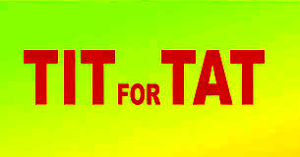

Slide 4
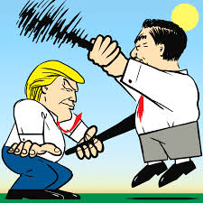
the infliction of an injury or insult in return for one that one has suffered.

Slide 5
an amount of money, such as a tax, that you have to pay to a government or organization

Slide 6
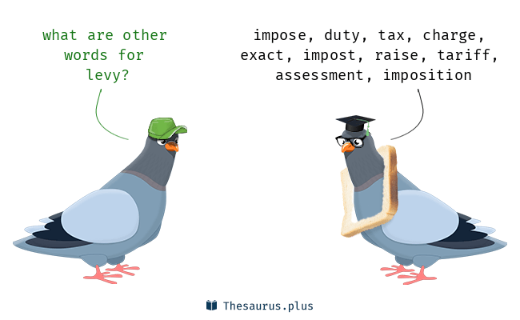

Slide 7
Saying that the US has "more bullets", Trump cautioned the world's second-largest economy to think twice before engaging in a trade war with the largest.

Slide 9
Washington had announced on Monday (Sept 17) that the US will begin to levy new tariffs of 10 per cent on US$200 billion of Chinese products starting on Sept 24, with the tariffs to go up to 25 per cent beginning 2019.

Slide 10
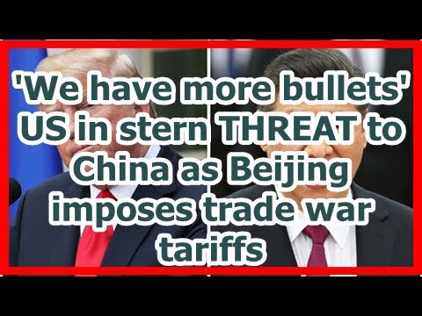

Slide 11
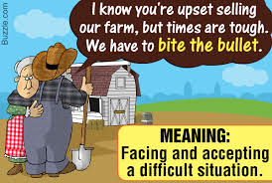

Slide 12
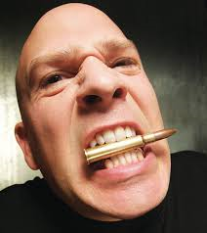
To bite the bullet means to face a hardship straight on, to bear something either physically or psychologically painful with bravery. Related phrase are bites the bullet, bit the bullet, biting the bullet. Biting the bullet is a cliché of the American Old West, cowboys are often depicted as biting the bullet when undergoing medical procedures without anesthetic. Bullets are made of lead, a soft metal, and biting a bullet was a distraction designed to stop a patient from crying out.

Slide 13
Trump has threatened duties on a further US$267 billion of made-in-China goods, which would hit almost all other consumer products including mobile phones, shoes and clothes.

Slide 14
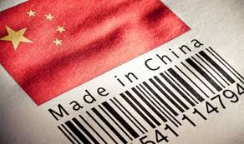

Slide 15
On Tuesday, China hit back, saying it would levy tariffs on US$60 billion worth of US goods effective from Sept 24.

Slide 16
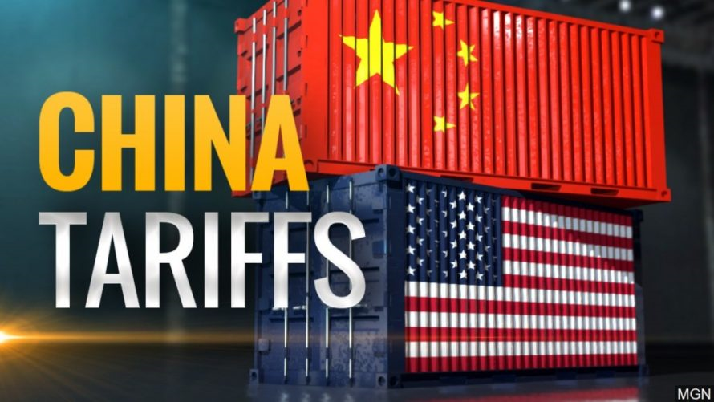

Slide 17
China also cancelled trade talks with the US and abandoned plans to send Vice-Premier Liu He to Washington next week, the Wall Street Journal reported on Friday, citing people familiar with the matter.

Slide 18
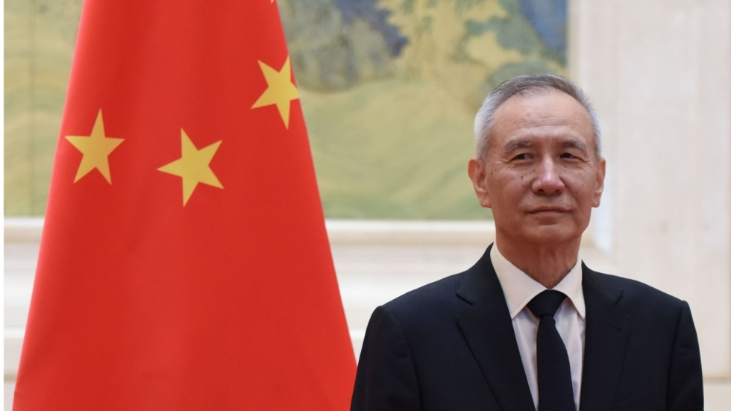
Vice Premier of the People's Republic of China

Slide 19
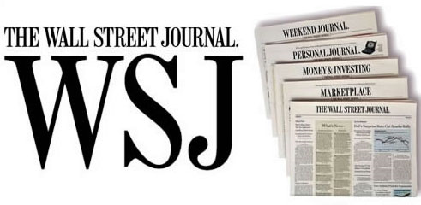

Slide 20
The Wall Street Journal is a U.S. business-focused, English-language international daily newspaper based in New York City. The Journal, along with its Asian and European editions, is published six days a week. The newspaper is published in the broadsheet format and online. The Journal has been printed continuously since its inception on July 8, 1889

Slide 21
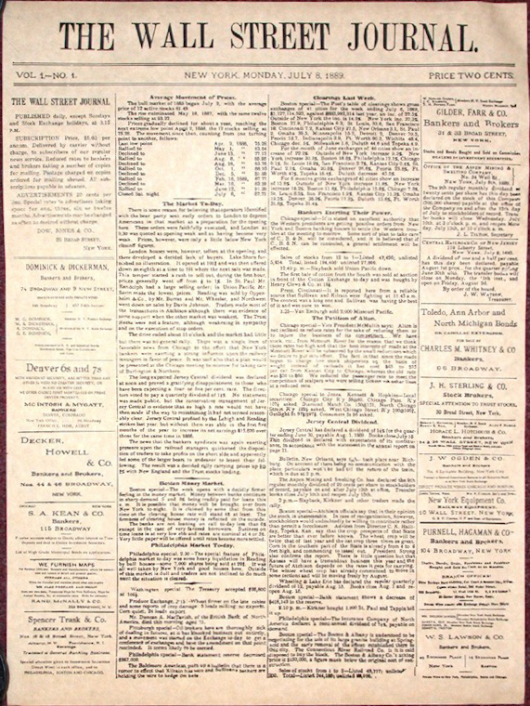
Front page of the first issue of The
Wall Street Journal, July 8, 1889

Slide 22
US Treasury Secretary Steven Mnuchin sent an invitation to Liu, President Xi Jinping’s economic czar, two weeks ago asking for a fresh round of talks this month.

Slide 23
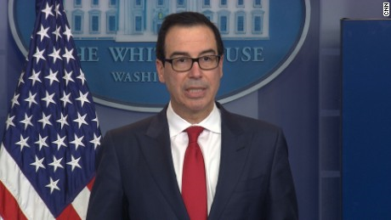
US Treasury Secretary Steven Mnuchin

Slide 25
Tsar, Tzar, Csar and Czar are various Latin alphabet spellings of the same Slavic word, the title of a Russian, Bulgarian or Serbian monarch. It is derived from the word caesar, much like kaiser and keizer

Slide 26
a person appointed by government to advise on and coordinate policy in a particular area.

Slide 27
Previous negotiations had ended without any breakthroughs. China's Ministry of Commerce and the Ministry of Finance didn’t respond to faxes inquiring about the matter on Saturday (Sept 22).

Slide 28
The Ministry of Commerce of the People's Republic of China (MOFCOM)

