Slide 1
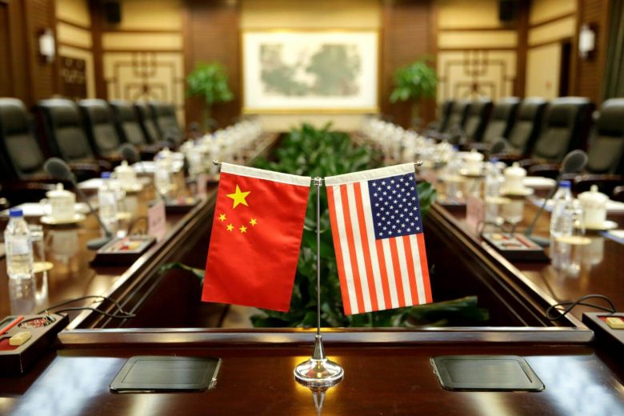
China accuses US of 'trade bullyism' as new round of tit-for-tat tariffs kick in

Slide 4
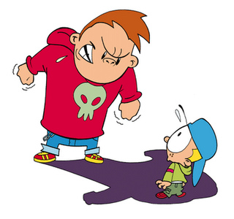
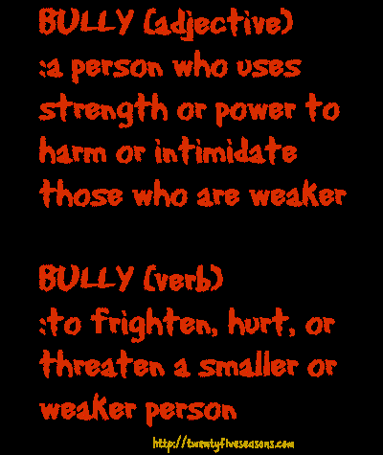

Slide 6
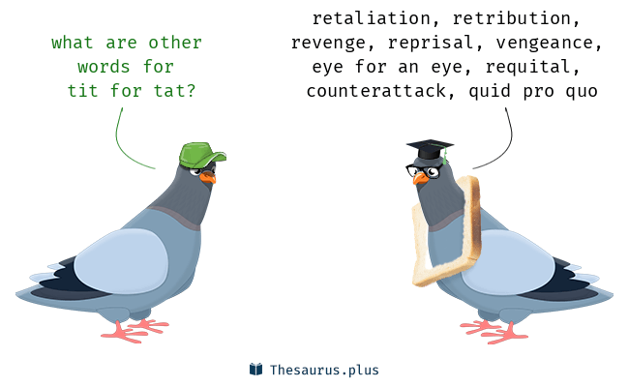

Slide 7
The Trump administration’s tariffs on another US$200 billion in Chinese goods kicked in on Monday (Sept 24), ramping up a trade war between the world’s two biggest economies.

Slide 9
a large increase in activity or in the level of something

Slide 11
The latest round of US duties on US$200 billion (S$273 billion) of Chinese products took effect just after midnight Washington time on Monday (midday in Beijing) on a list of products ranging from frozen meat to television components.

Slide 12
China retaliated with tariffs on US$60 billion in US goods, a move that President Donald Trump has said would spur new duties on another US$267 billion in Chinese imports.

Slide 20
If the president follows through on the escalation threat, US tariffs would cover all goods the nation imported from China last year. The conflict risks descending into a war of attrition that economists warn could undermine the global economy and upend the supply chains of multinational companies.

Slide 22
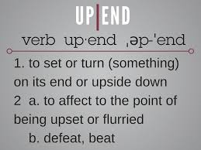

Slide 24
"President Trump has an excellent relationship with President Xi and our teams have been in frequent communication since President Trump took office," Ms. Lindsay Walters, deputy White House press secretary, said in an e-mailed statement.

Slide 25
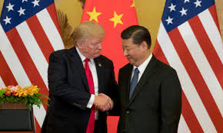

Slide 26
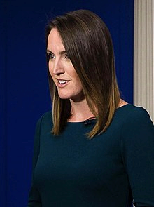
White House Deputy Press Secretary

Slide 27
US Secretary of State Michael Pompeo said on Sunday that Mr. Trump isn't starting a trade war with China, but joining one already under way.

Slide 30
"The trade war by China against the United States has been going on for years," Mr. Pompeo said on Fox News. "To the extent one wants to call this a trade war, we are determined to win it."

Slide 32
Fox News (officially known as the Fox News Channel, commonly abbreviated to FNC) is an American pay television news channel owned by the Fox News Group, a division of Fox. Fox News is provided in 86 countries or overseas territories worldwide. Launched October 7, 1996; 22 years ago

