Slide 1

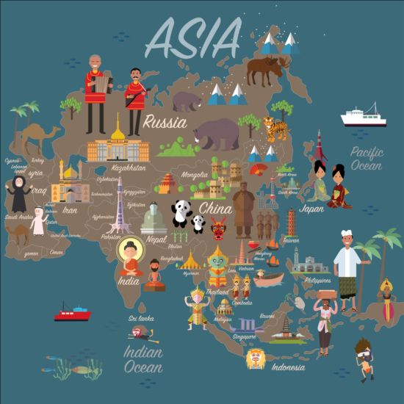
Dangerous drift towards world war in Asia

Slide 2
The relationship between China and Japan has entered a period of détente after years of confrontation.

Slide 3
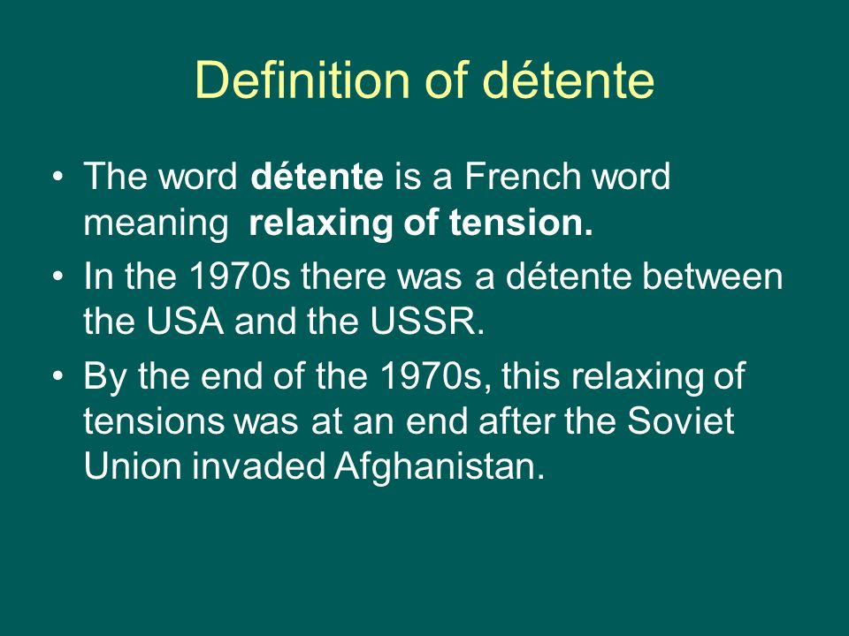

Slide 4
According to Japanese Prime Minister Shinzo Abe, his country’s relations with China have finally returned to a normal track. Meanwhile, Chinese President Xi Jinping speaks of positive momentum in Beijing’s interactions with Tokyo.

Slide 5
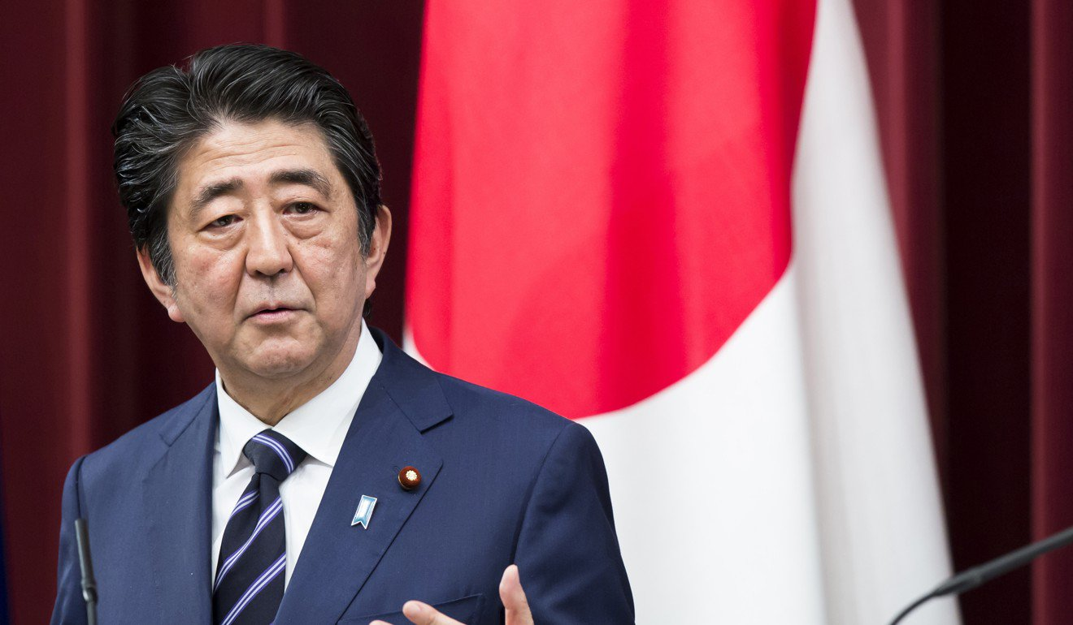

Slide 6
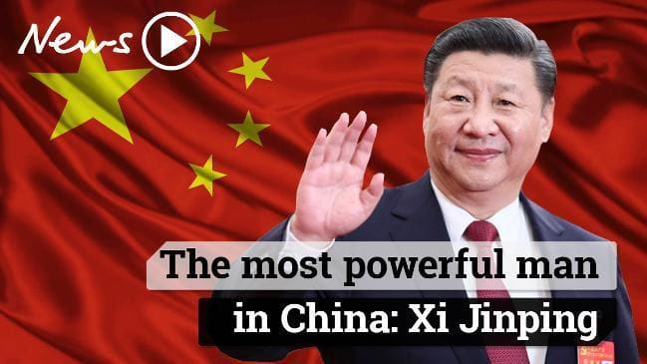

Slide 7
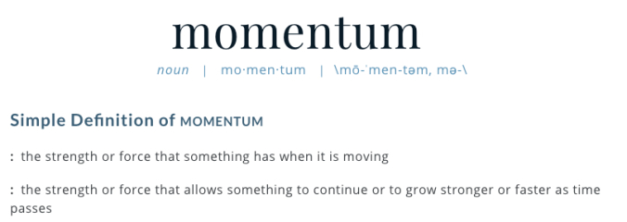

Slide 8
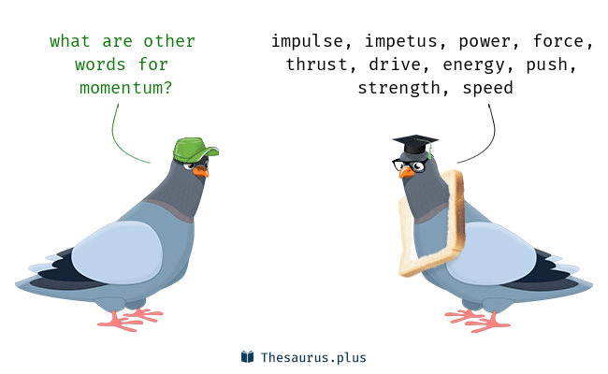

Slide 9
This détente is almost entirely a collateral effect of the Trump administration’s assault on China – a moment of Chinese weakness that Japan has exploited.

Slide 10
A healthier mixture of cooperation and competition between China and Japan would benefit Asia, especially if it is driven by business interests and market considerations.

Slide 11
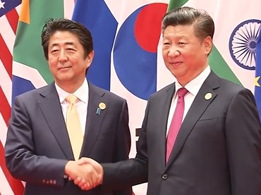
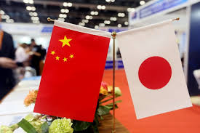

Slide 12
The dispute, over a set of islands controlled by Japan, has not been resolved. But this year, on the 40th anniversary of the Treaty of Peace and Friendship, the two leaders are finding a way to put the two countries’ differences behind them, superficially at least.

Slide 13
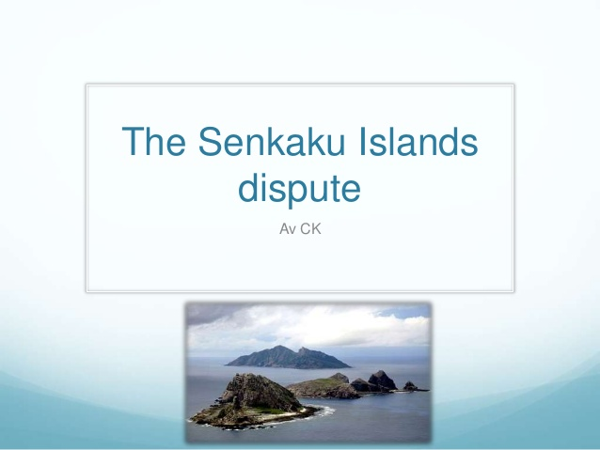

Slide 14
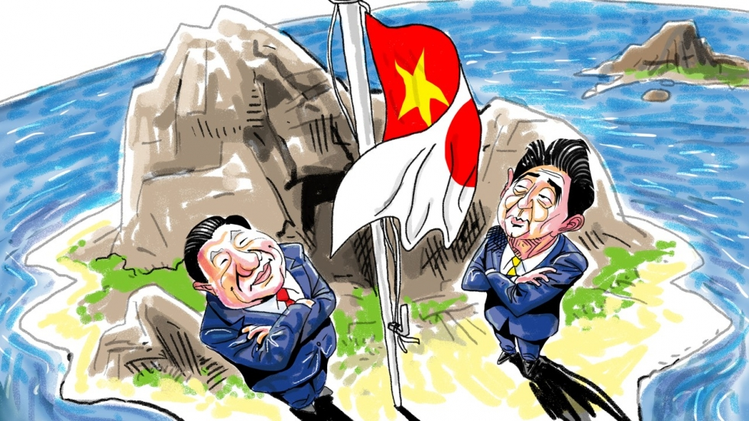

Slide 15
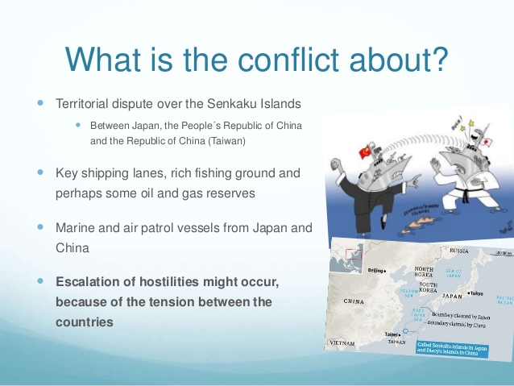

Slide 16
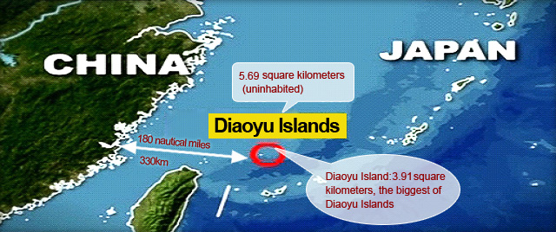

Slide 17
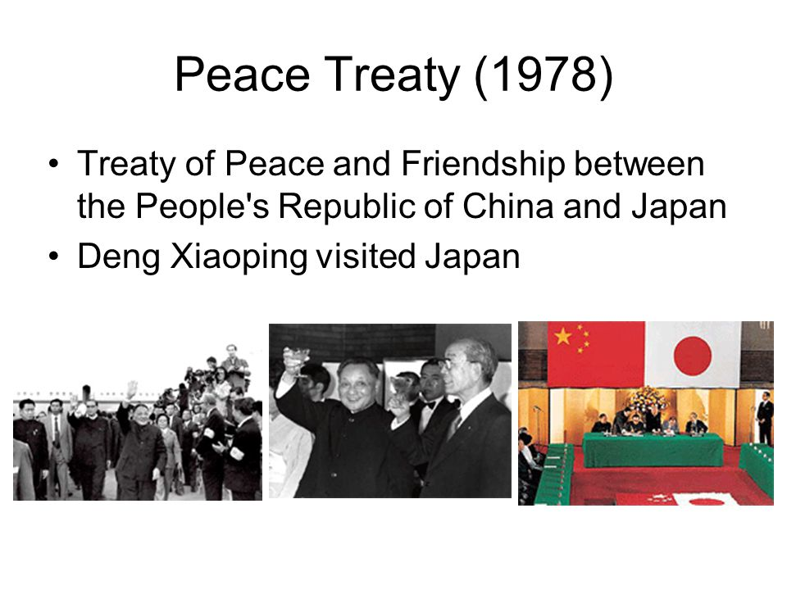

Slide 18
Abe was treated to a full red-carpet welcome by Premier Li Keqiang, inspecting a guard of honor and being celebrated at a reception in the opulent Great Hall of the People.

Slide 19
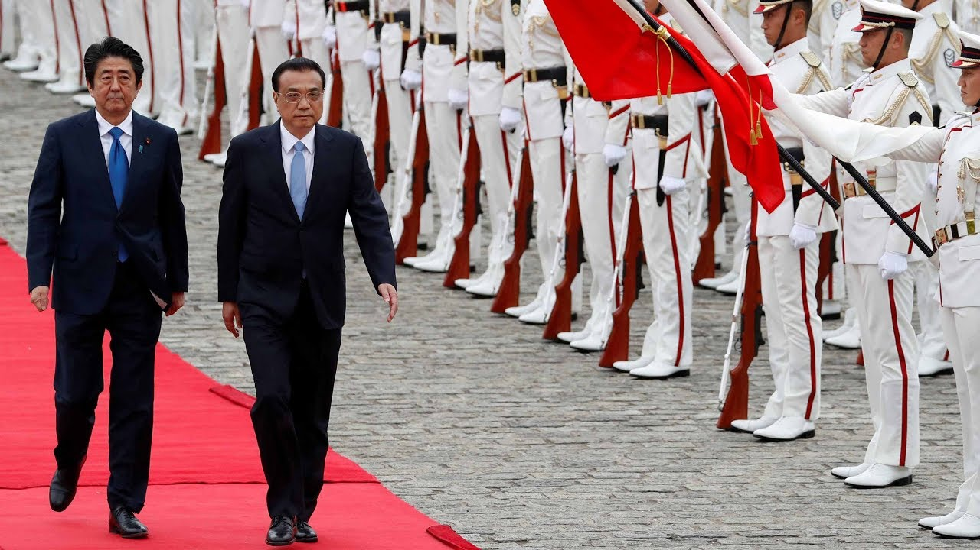

Slide 20
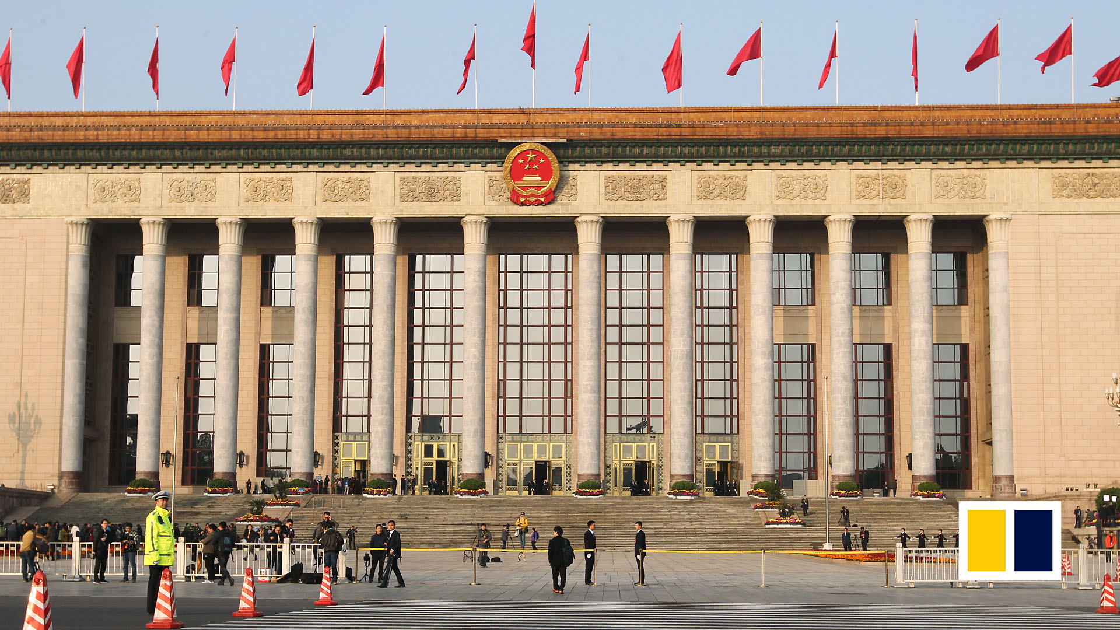

Slide 21
A guard of honour (GB), guard of honor (US), also honour guard (GB), honor guard (US), also ceremonial guard, is a guard, usually military in nature, appointed to receive or guard a head of state or other dignitary, or to attend at state ceremonials, especially funerals.

Slide 22
On the economic front, the relationship between Tokyo and Beijing also tilts toward confrontation.

Slide 23
MEANING OF TILT
Move or cause to move into a sloping position.
no object ‘the floor tilted slightly’
with object ‘he tilted his head to one side’
Change or cause to change in favour of one person or thing as opposed to another.
no object ‘the balance of industrial power tilted towards the workers’

Slide 24
Japan often leads international efforts to restrict China’s acquisition of advanced technology, an area that will define the course of great power competition in the coming years.

Slide 25
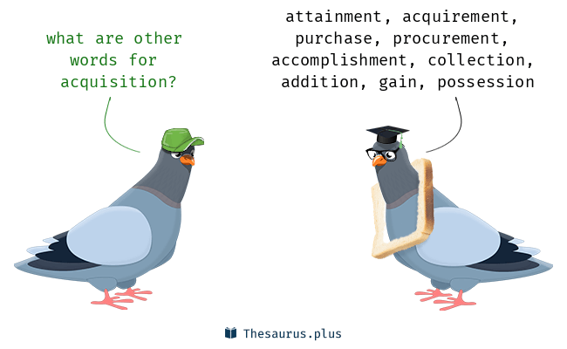

Slide 26
Japan’s approach to this issue involves a mixture of strictly enforced regulations at home and ambitious outreach abroad.

Slide 27
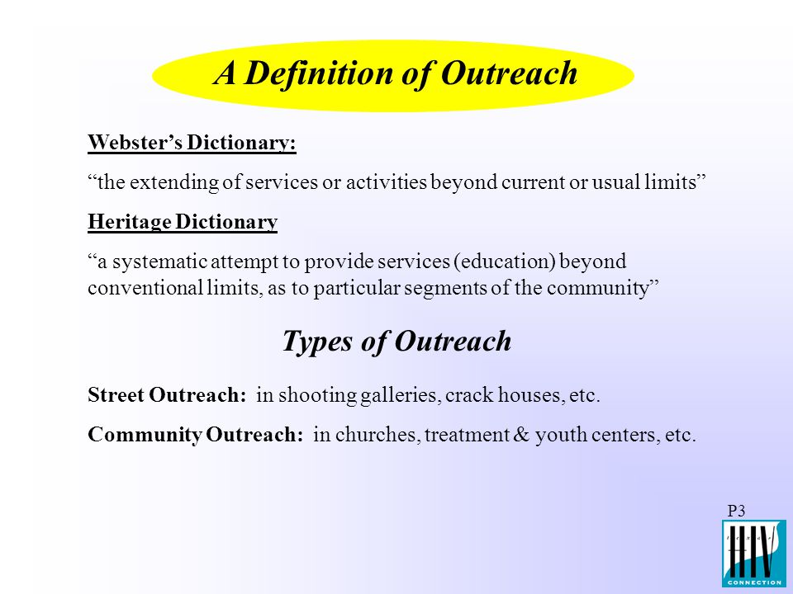

Slide 28
And while trade interests sometimes bring China and Japan together, Japanese Trade Minister Hiroshige Seko recently joined the United States and European Union in signing a statement of concern addressing the “non-market-oriented policies and practices of third countries.” Coordinated countermeasures against China may follow.

Slide 29
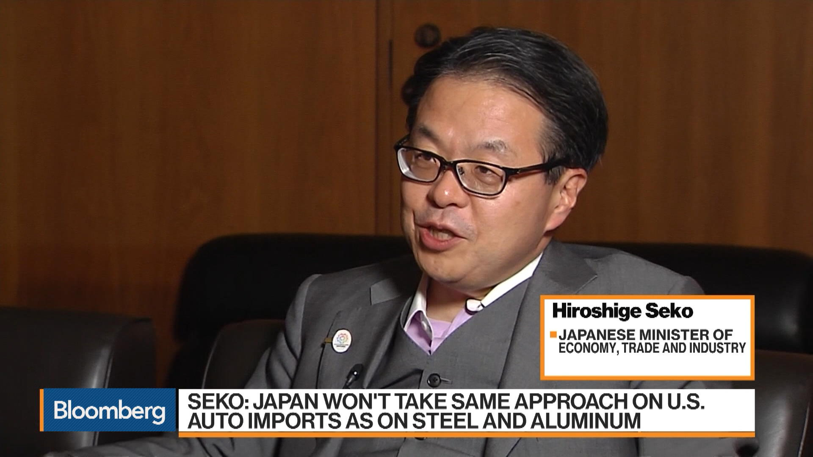

Slide 30
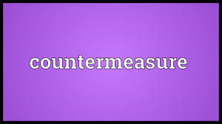
A countermeasure is an action that you take in order to weaken the effect of another action or a situation, or to make it harmless.

Slide 31
Rather than cooperating with China to safeguard free trade and multilateralism, Japan’s priority is trilateral coordination with the United States and Europe.

Slide 32
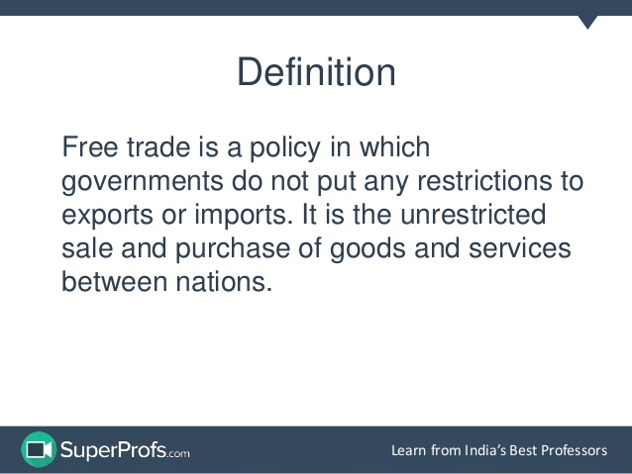

Slide 33
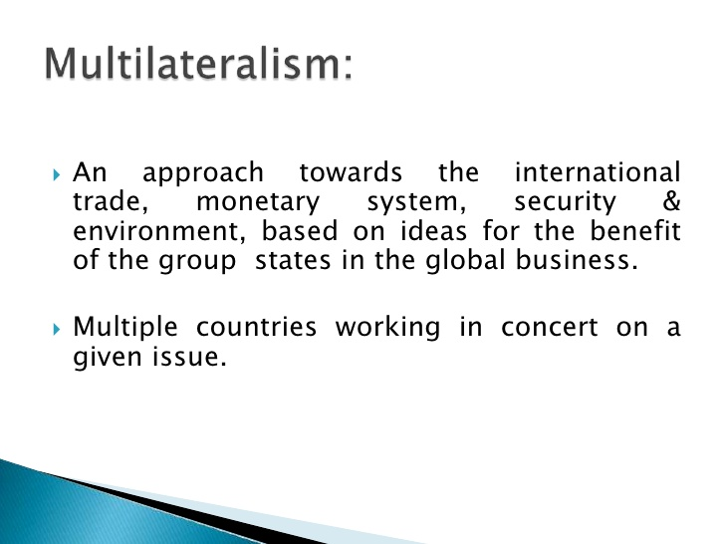

Slide 34

involving three groups or countries/
having three sides or parties

Slide 35
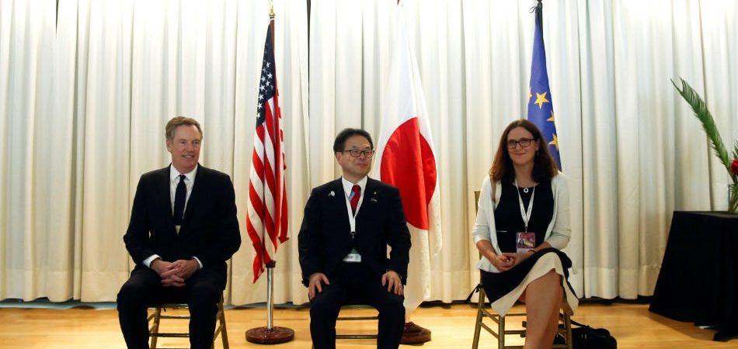

Slide 36
