Slide 1
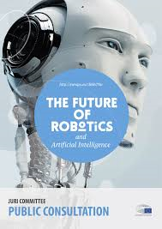
Future of robotics and AI in Europe

Slide 2
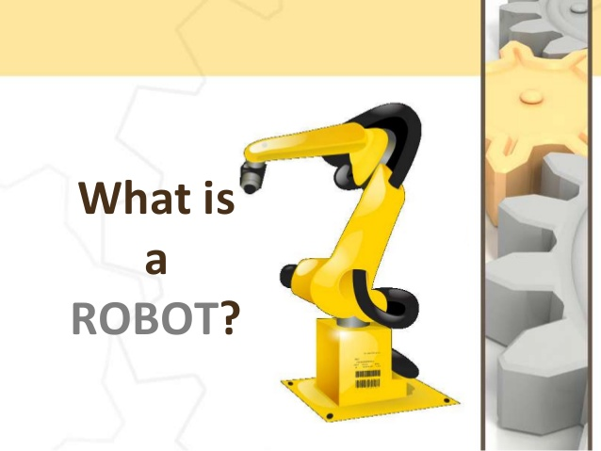

Slide 5
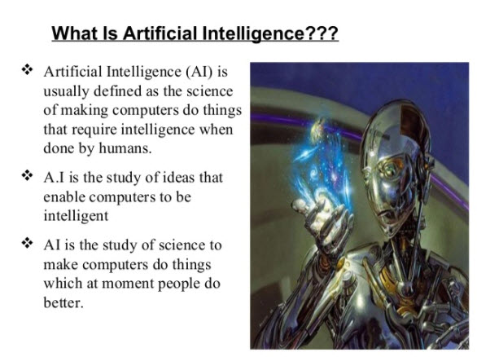

Slide 6
The European Parliament Legal Affairs Committee recently presented a report on civil law rules on robotics. As there is an increasing public debate about the use of robots and artificial intelligence, this initiative comes at the right time and raises important questions for the European Union.

Slide 7
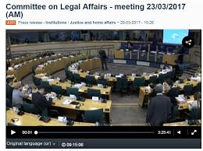

Slide 8
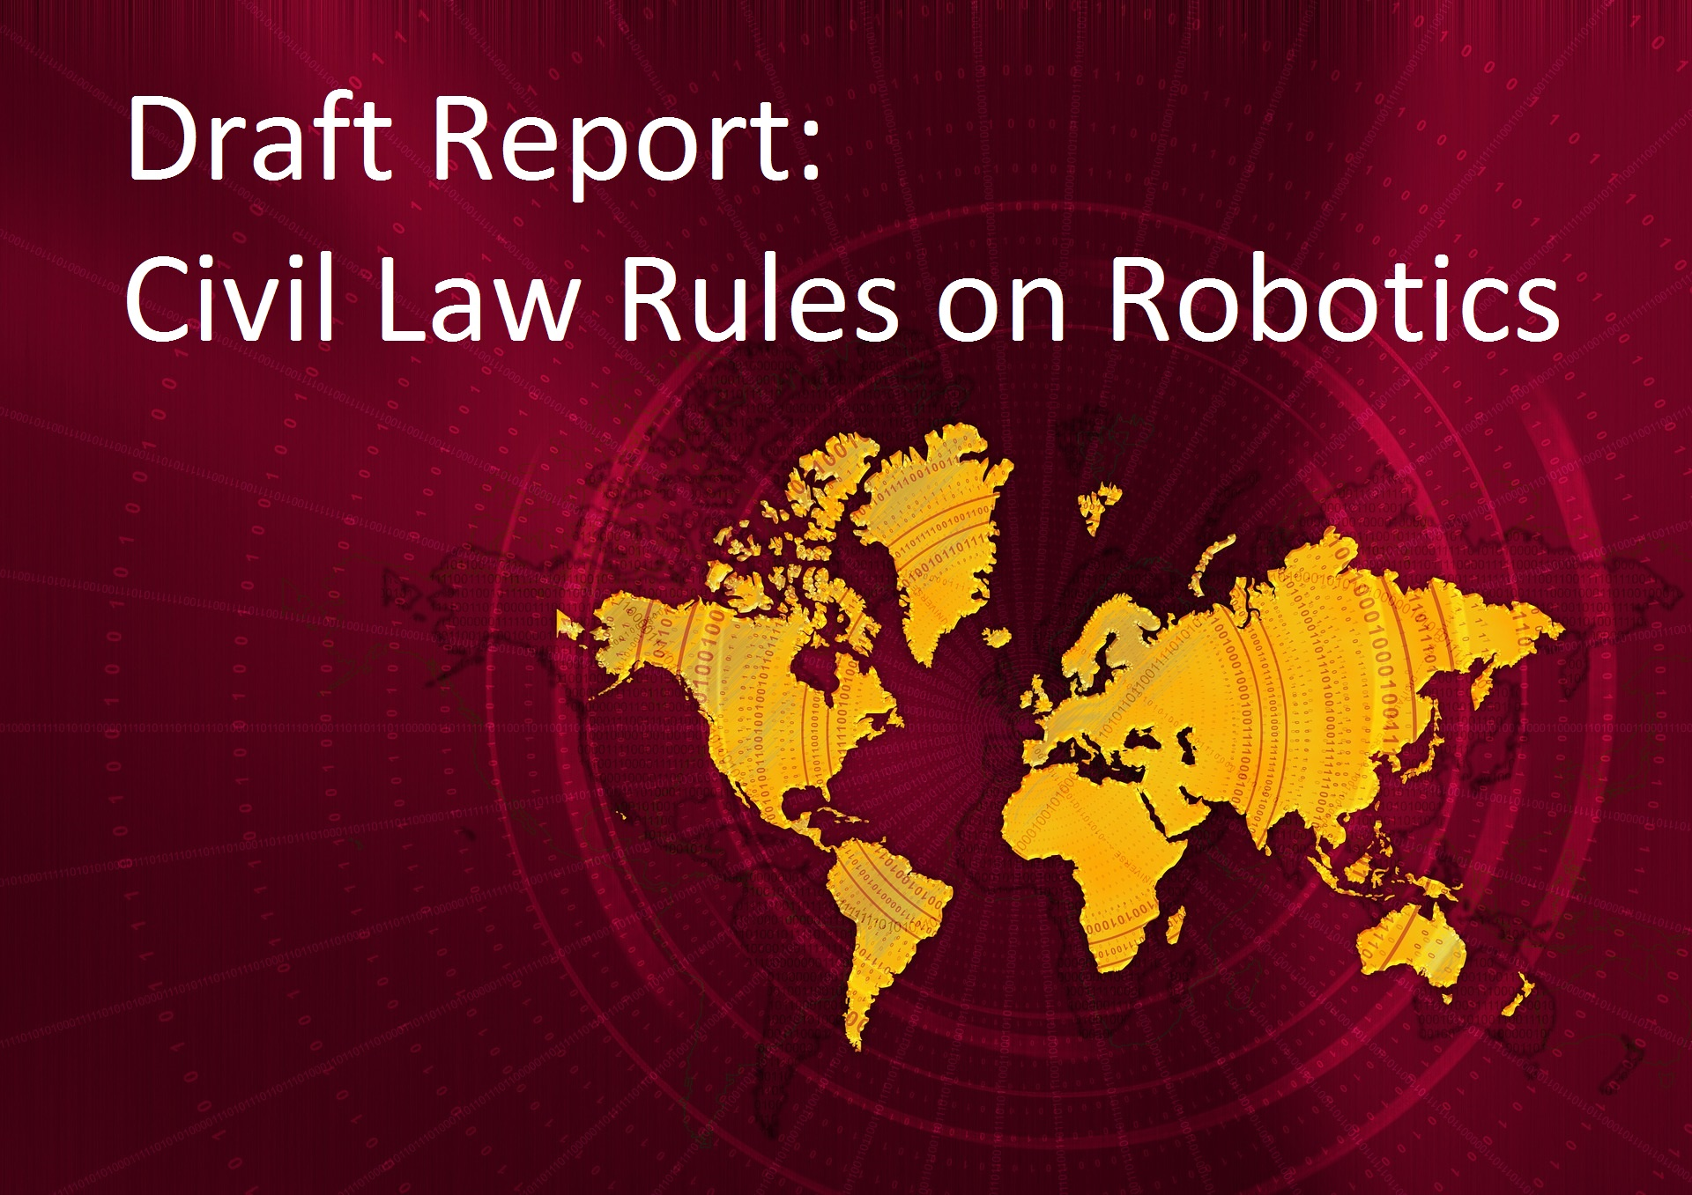

Slide 9
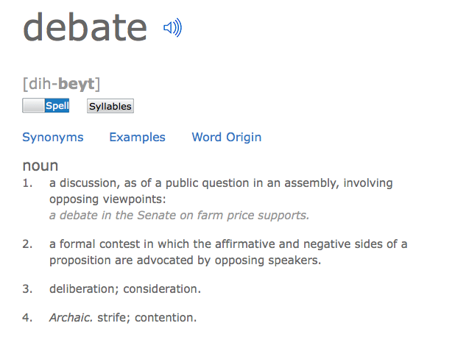

Slide 11
International competition is fierce. Google, Amazon, Facebook – everyone is jumping onto artificial intelligence at the moment.

Slide 14
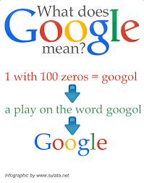

Slide 18
At the same time, Europe is in a strong position, both scientifically and commercially. For example, about a quarter of all industrial robots and half of all professional service robots are produced in Europe, and many recent breakthroughs in AI come out of European labs.

Slide 19
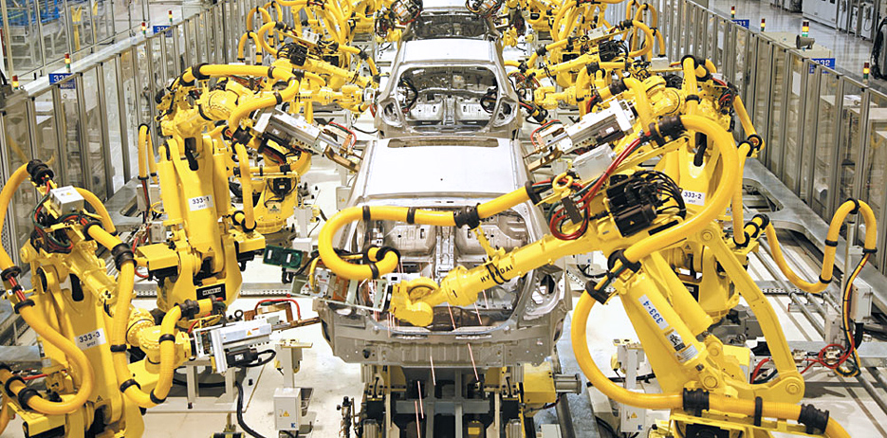

Slide 22
Robots are used in many areas with labour shortages such as healthcare, farming and even manufacturing.

Slide 24
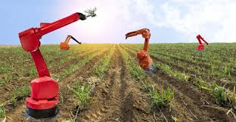

Slide 25
Furthermore, many robots do jobs that are dull, dirty and dangerous for humans such as inspecting oil tanks or welding metal parts. Far from replacing humans, we want robots to help humans so that they can focus on the essentials.

Slide 27
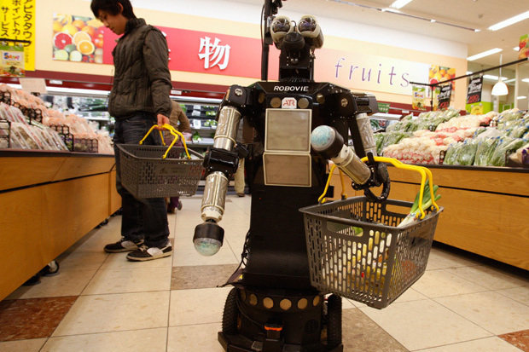

Slide 28
The European Commission puts forward a European approach to artificial intelligence and robotics. It deals with technological, ethical, legal and socio-economic aspects to boost EU's research and industrial capacity and to put AI at the service of European citizens and economy.

Slide 29
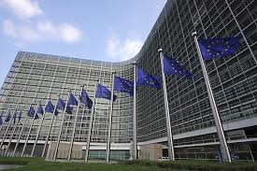

Slide 30
AI has become an area of strategic importance and a key driver of economic development. It can bring solutions to many societal challenges from treating diseases to minimising the environmental impact of farming. However, socio-economic, legal and ethical impacts have to be carefully addressed.

Slide 31
The Commission is increasing its annual investments in AI by 70% under the research and innovation programme Horizon 2020. It will reach EUR 1.5 billion for the period 2018-2020.

