Slide 1
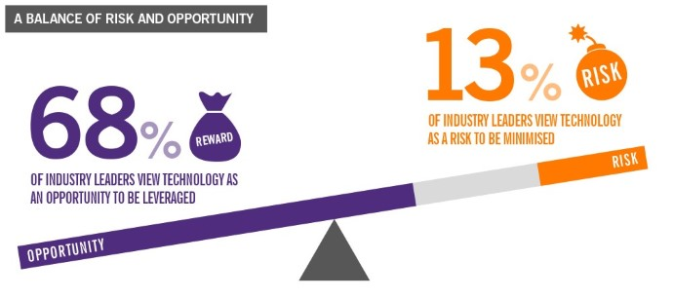
TECHNOLOGY’S POTENTIAL: OPPORTUNITIES AND RISKS

Slide 2
Over the past century there have been many profound technological, economic and social transformations. In OECD countries the full development and diffusion of innovations such as electricity, telephones and automobiles have accompanied the emergence of mass production, mass consumption and mass government.

Slide 6
There are many who, facing the next century, wonder if it will be possible and/or desirable to continue along the path of such prodigious change.

Slide 9
Some worry about the capacity, both technological and social, to continue advancing and inventing new tools, new products and new ways of organising everyday work and home life.

Slide 10
Others worry that the ongoing transition costs may be too high, or that the risks to cherished traditions or the threats to environmental sustainability will, singly or together, be too great to bear.

Slide 13
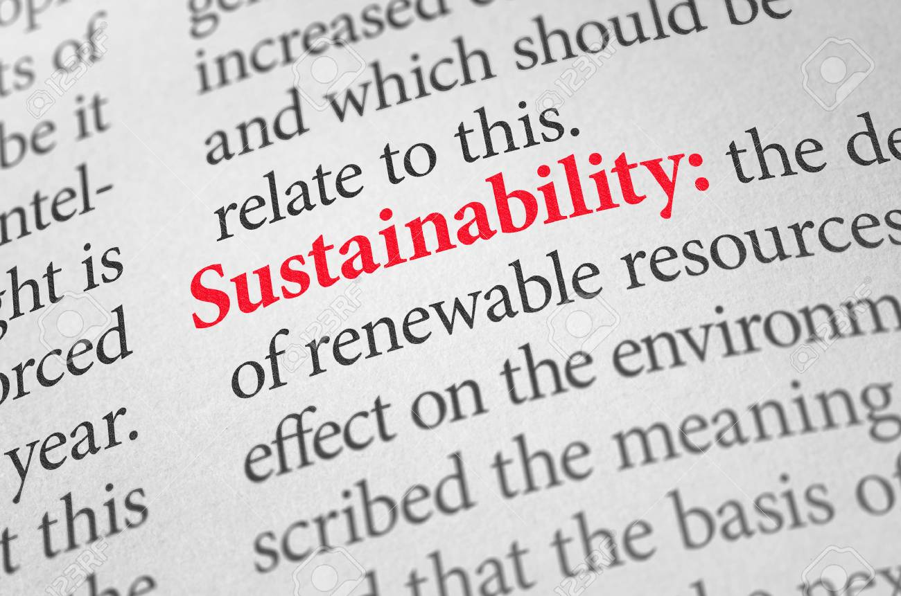

Slide 14
Preservation versus dynamism, incrementalism versus radicalism, these are the polar extremes that, unsurprisingly, haunt many end-of-the-century, future-of-the-millennium debates.

Slide 17
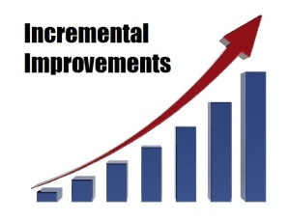
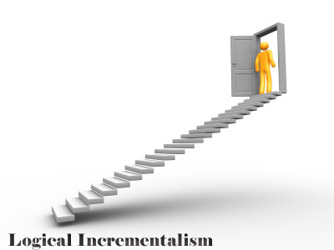

Slide 21
Imagining possible applications of technology two or three decades from now calls for a better understanding of the ways in which performance trends interact with societies’ readiness to embrace economic, social and technical change.

Slide 22
It is crucial to think not only of how technical improvements lead to the substitution of a new generation of tools for existing ones, but also of how entirely new uses, and indeed new needs, might emerge.

Slide 23
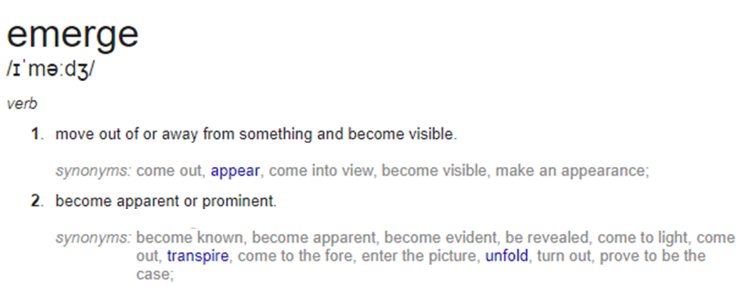

Slide 25
Tomorrow’s technologies contain destructive potential that will be both powerful and difﬁcult to control. They could pose threats to the natural and human environment.

Slide 26
Either by accident or through malevolence, the advances and diffusion of genetic engineering could give rise to unintended, unanticipated diseases, ecological vulnerabilities, and weapons of mass destruction.

Slide 34
The industries and economic drivers of the twenty-first century will arise from the increasingly combined efforts of biology and engineering.

Slide 37
It is this convergence that will help deliver the technological solutions needed to supply enough clean energy, food, and water, as well as better health, to sustain the world’s nine billion people in 2050.

