Slide 1

Can mankind adapt to changes in environment caused by climate change?

Slide 2
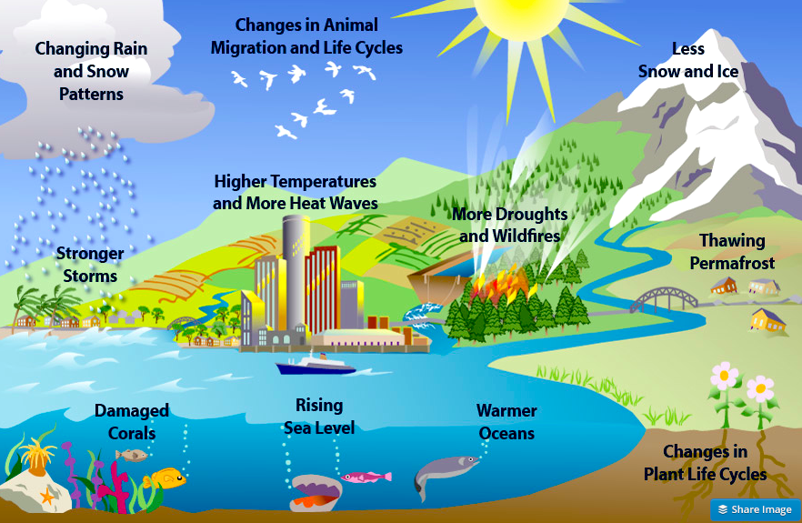

Slide 3
A study published in Nature, a leading scientific journal, provides data that suggest that climate change related phenomena have killed 150,000 people annually for the past 30 years, and that numbers will increase.

Slide 4
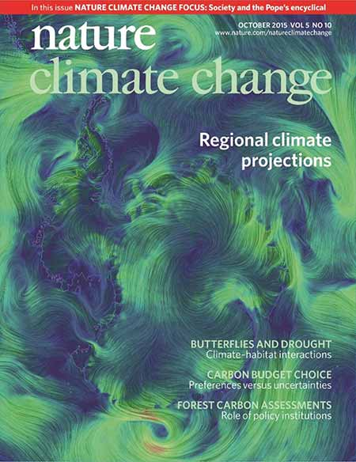

Slide 5
It affects every corner of our planet – from the poles to the tropics, and from the mountains to the oceans. People and nature worldwide are already feeling the effects: water supplies are shrinking, extreme weather events increasing in frequency and intensity, forests burning, and coral reefs dying.

Slide 6
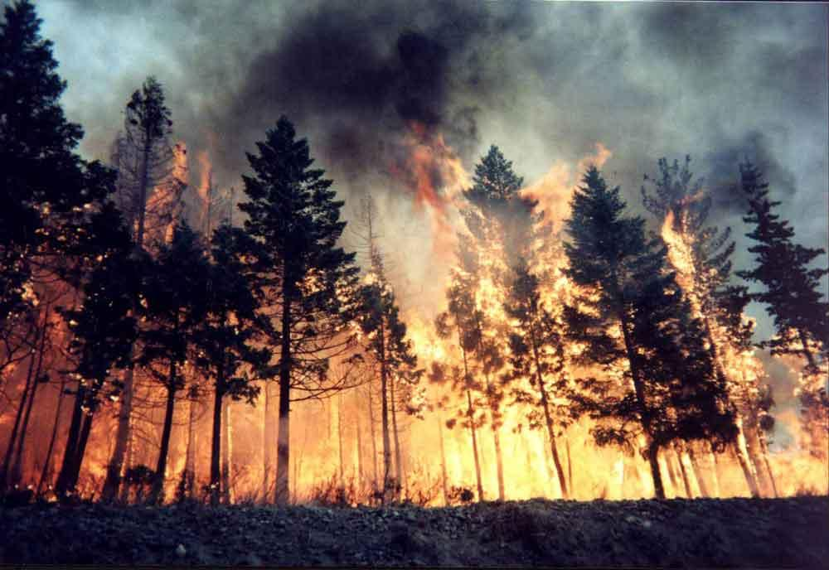

Slide 7
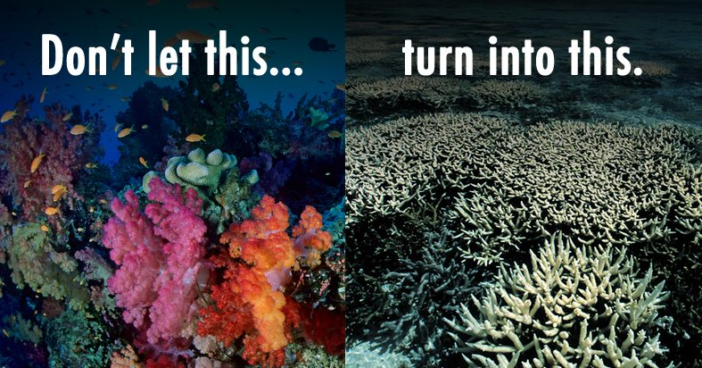

Slide 8
Governments and communities are coming together to act – and we can still escape the worst impacts of climate change, and build a safer future for all.

Slide 9
But we need to do more, and faster. Most importantly, we need to step up efforts to switch from using fossil fuels – the biggest cause of climate change – to clean, renewable energy. And we need to help people and nature adapt to the inevitable changes ahead.

Slide 10
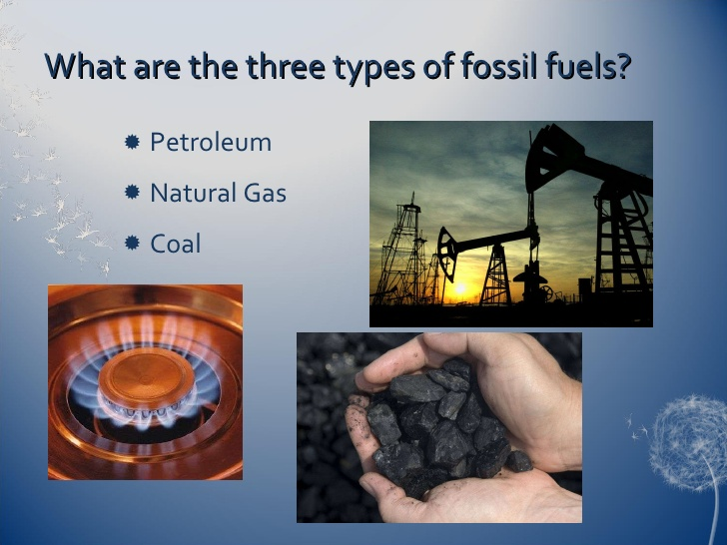

Slide 11
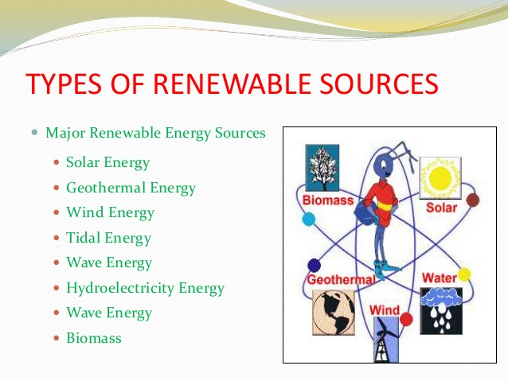

Slide 12
The impacts of climate change are felt everywhere. Average sea level around the world rose about 8 inches (20 cm) in the past 100 years; climate scientists expect it to rise more and more rapidly in the next 100 years.

Slide 13
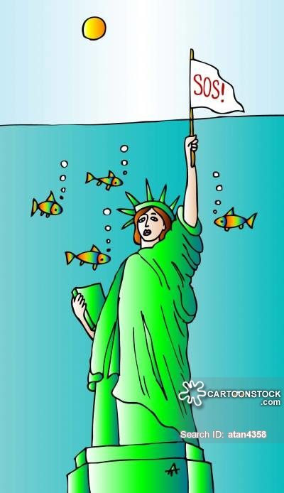

Slide 14
Within the next 100 years, if not sooner, the world’s glaciers will have disappeared, as will the Polar ice cap, and the huge Antarctic ice shelf.

Slide 15
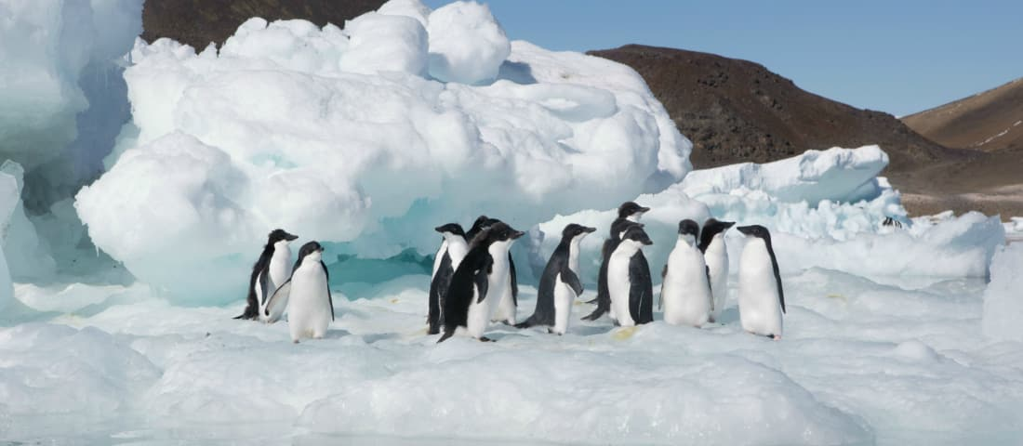
Antarctica:South Pole
Earth's southernmost continent
القارة القطبية الجنوبية

Slide 16


Slide 17
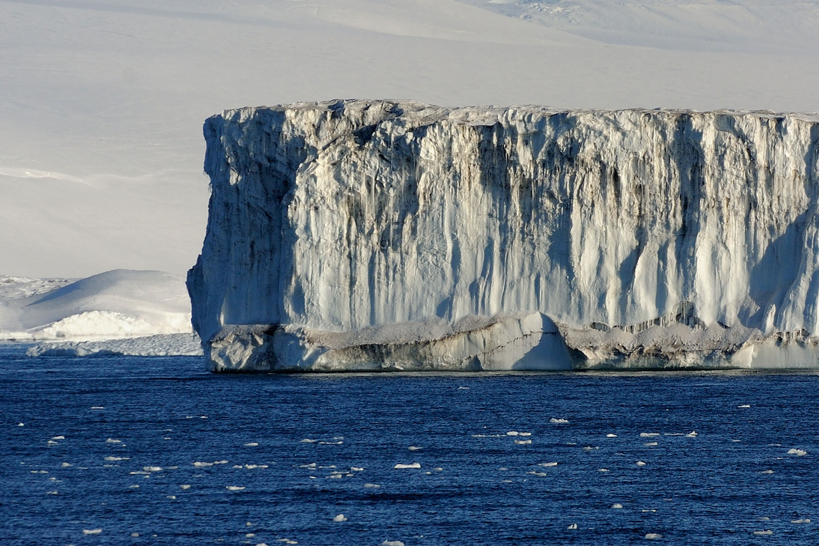

Slide 18
Greenland may be green again, and snow will have become a rare phenomenon at what are now the world’s most popular ski resorts.

Slide 19
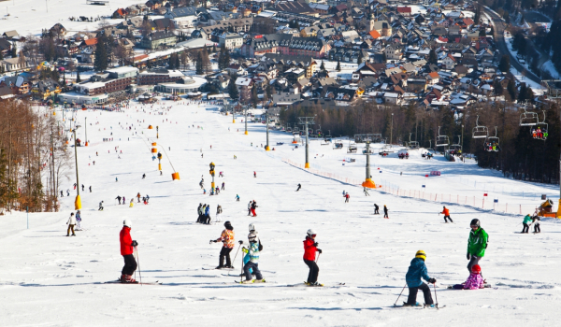

Slide 20
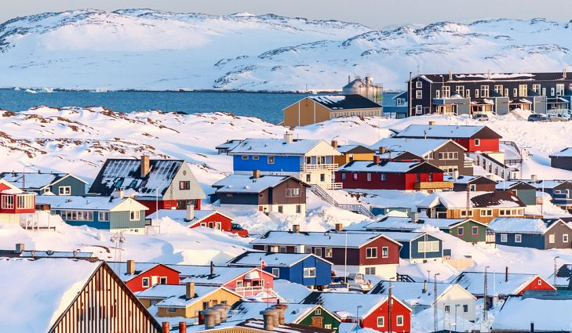

Slide 21
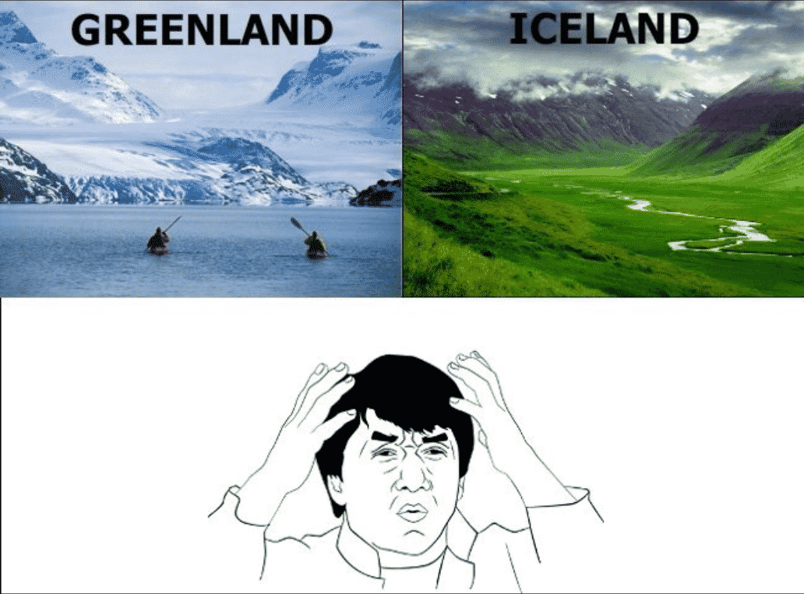

Slide 22
Why Greenland’s name says “green,” and Iceland “ice,” when it’s the opposite

Slide 23


Slide 24
Hurricanes and typhoons will increase in power, and flooding will become more common.

Slide 25
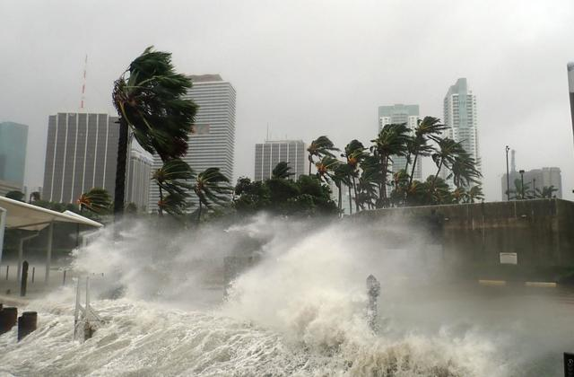

Slide 26
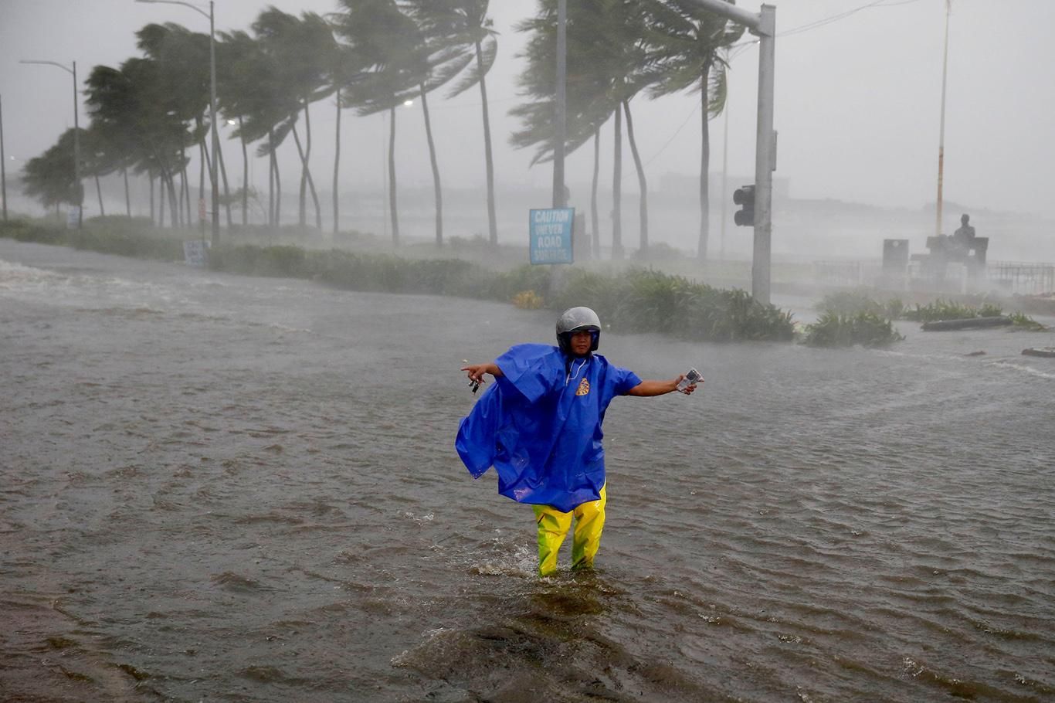

Slide 27
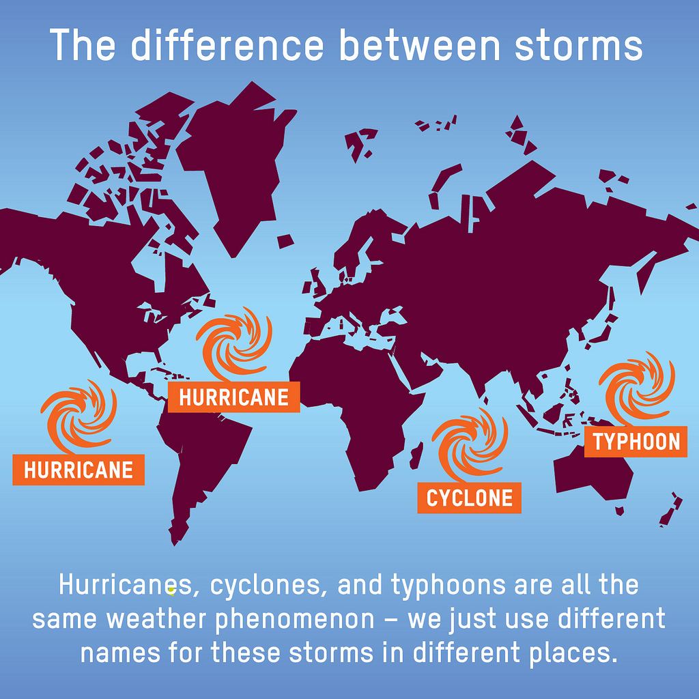

Slide 28
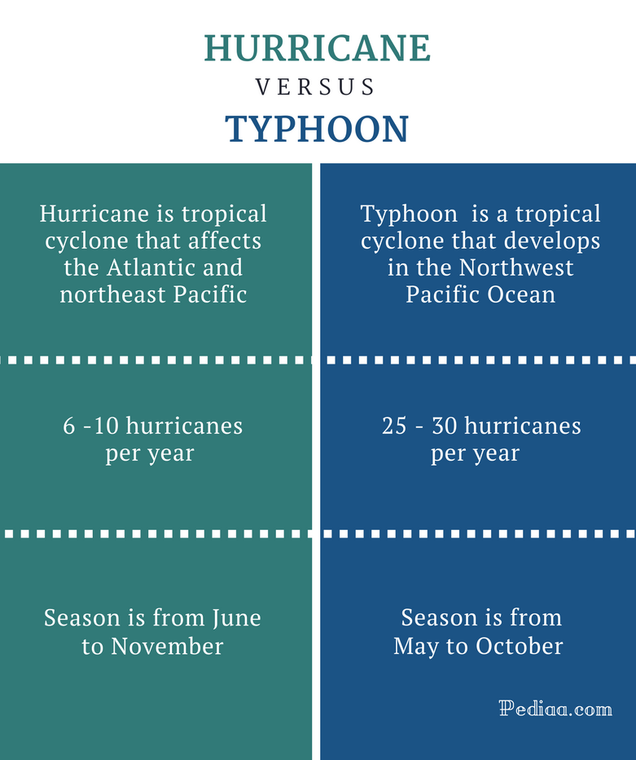

Slide 29
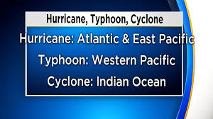

Slide 30
Despite downpours in some places, droughts and prolonged heatwaves will become common.

Slide 31
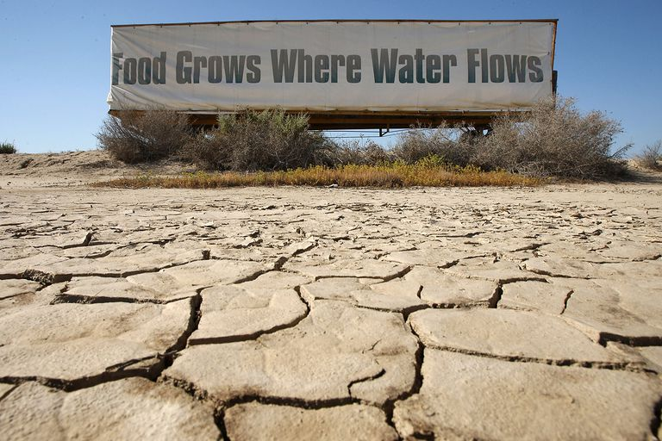

Slide 32
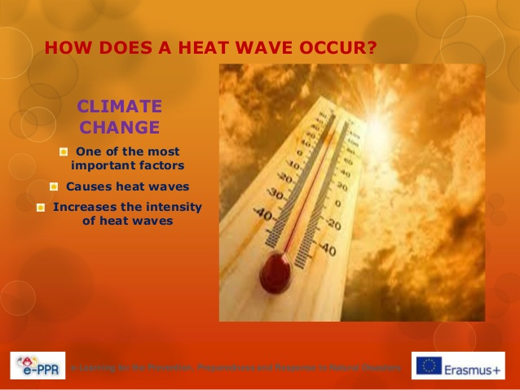

Slide 33
All communities must take action to build long-term resiliency in the face of climate change and the rise of deadly natural disasters. Although humans are the cause of climate warming, they will also be its victims.

Slide 34
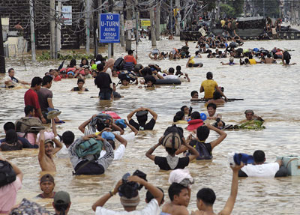

Slide 35
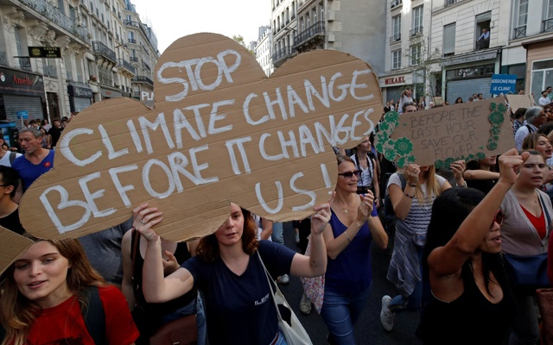

Slide 36


