Slide 1

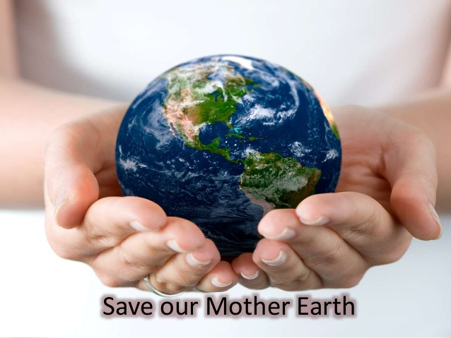
Will mankind be wise enough to protect our planet for future generations?

Slide 2
The more facts that pile up about global warming, the greater the resistance to them grows, making it harder to enact measures to reduce greenhouse gas emissions and prepare communities for the inevitable change ahead.

Slide 3
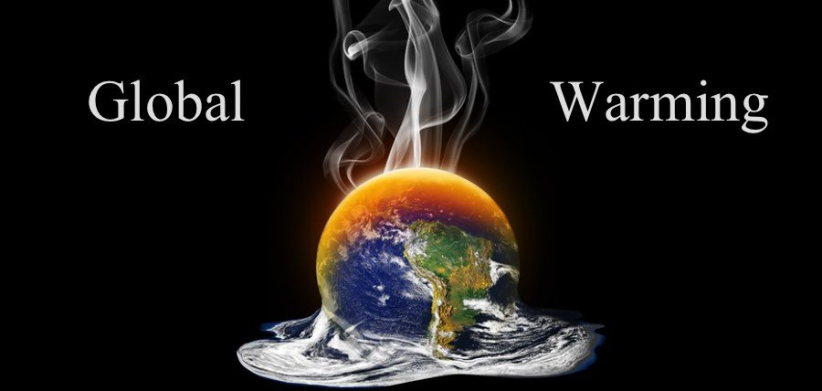

Slide 4
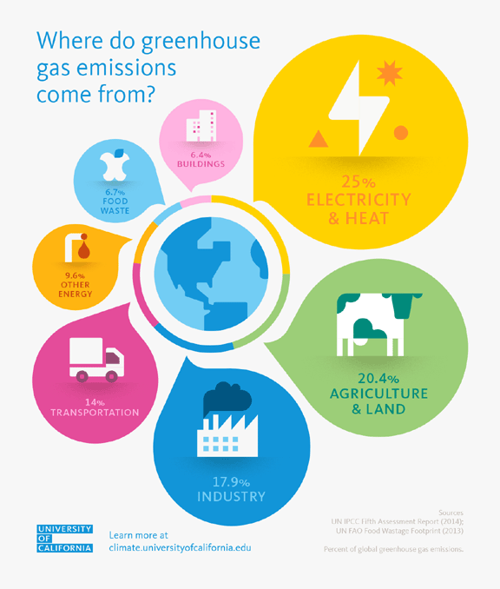

Slide 5
The Arctic ice cap has shrunk by nearly half, coastal storms have become increasingly destructive, and millions of acres of forest in the American West have been killed off by warming-related pest infestations.

Slide 6
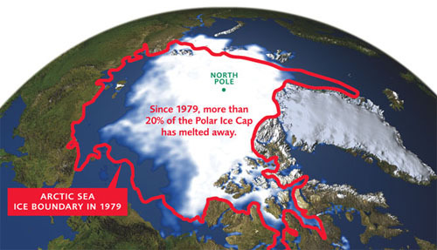

Slide 7
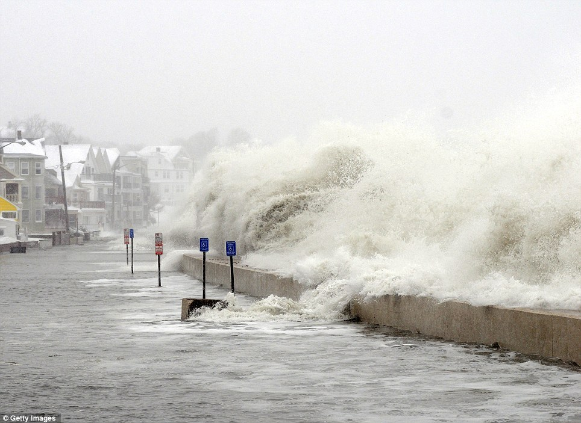

Slide 8
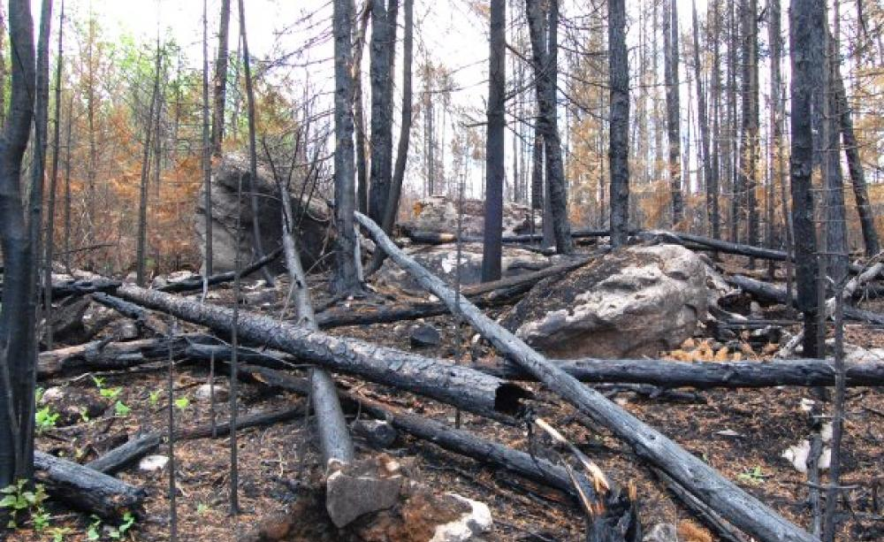

Slide 9
Just a few months ago two groups of scientists separately concluded that a large segment of the West Antarctic Ice Sheet has begun irreversibly to melt away; this will eventually raise global sea levels by four feet.

Slide 10
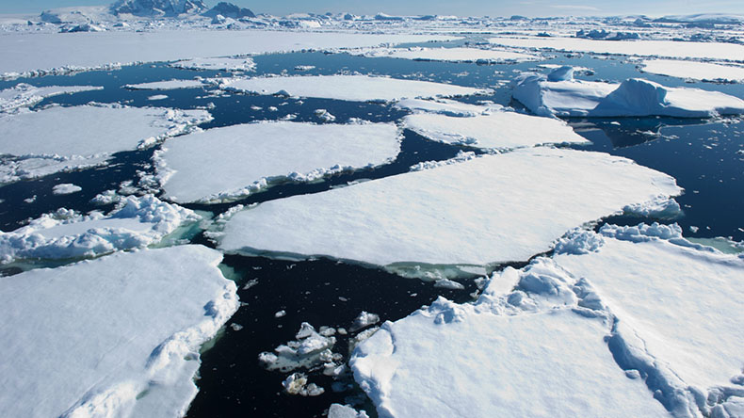

Slide 11
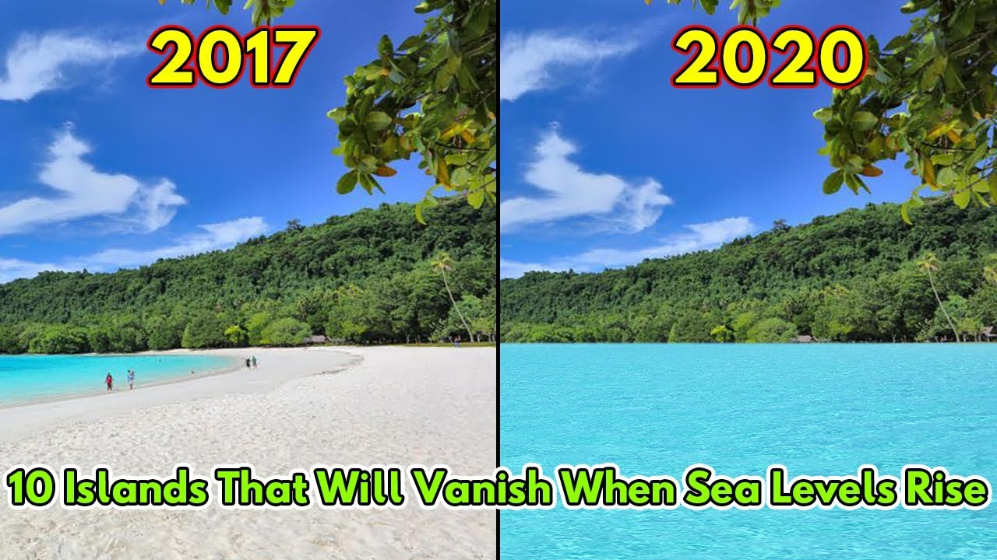

Slide 12
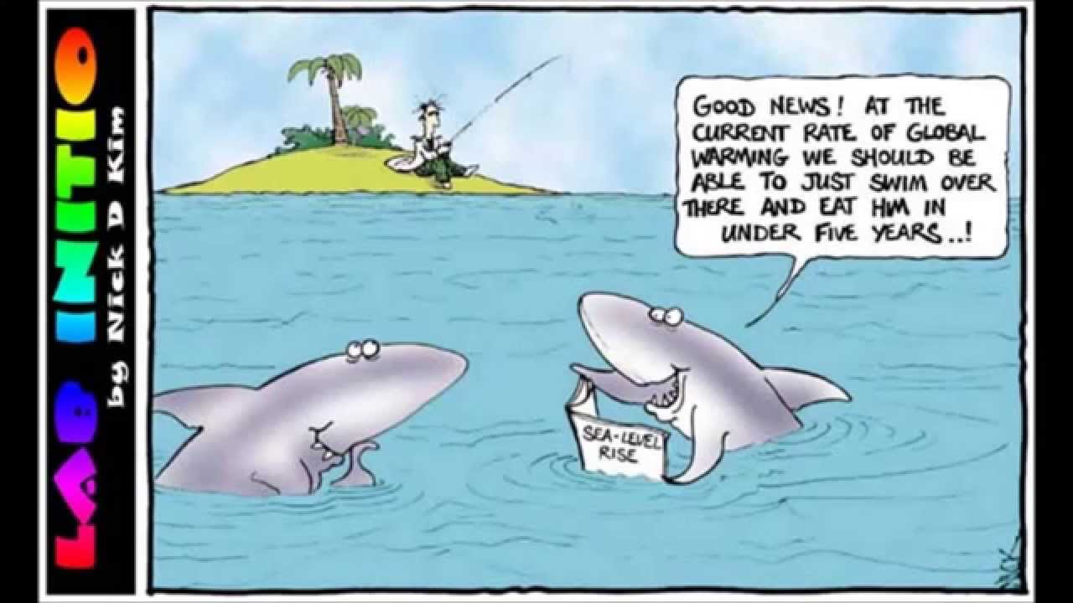

Slide 13
In an effort to track the changing climate, many—perhaps most—species are on the move, and a growing number are threatened with extinction.

Slide 14
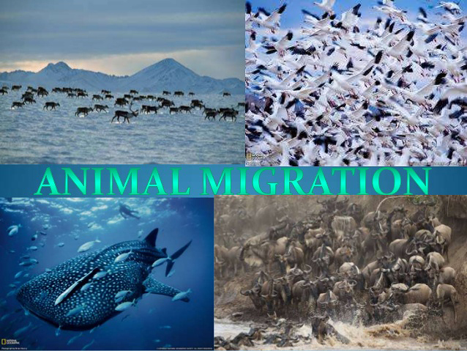

Slide 15


Slide 16


Slide 17
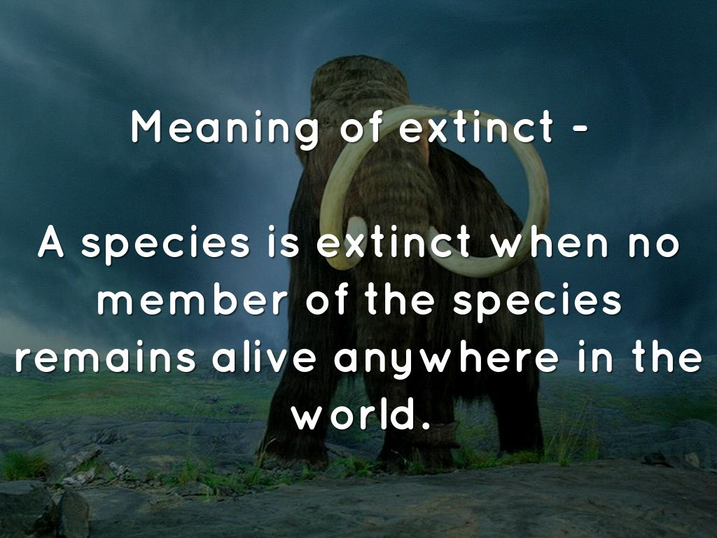

Slide 18
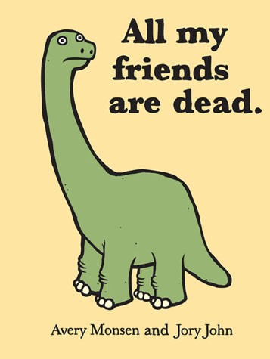

Slide 19
During the same time period, carbon dioxide emissions have soared, from about 18 billion metric tons per year to almost 37 billion metric tons per year.

Slide 20
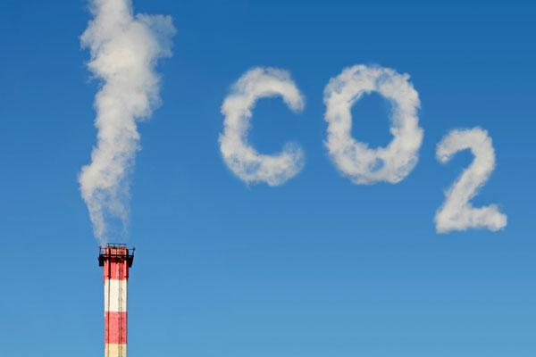

Slide 21
New evidence shows that the climate is shifting so quickly, it’s putting many of the world’s trees in jeopardy.

Slide 22
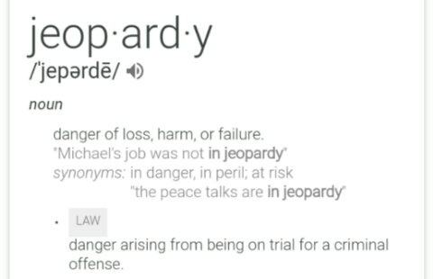

Slide 23


Slide 24
Rising temperatures and increasingly unusual rainfall patterns inflict more frequent drought, pest outbreaks, and fires. Trees are dying at the fastest rate ever seen.

Slide 25
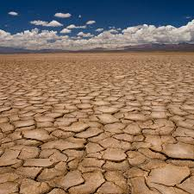

Slide 26
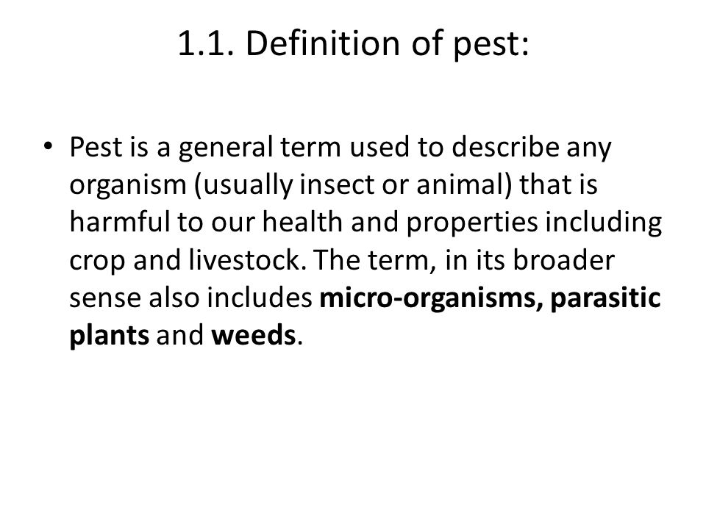

Slide 27
The declining health of trees globally is starting to have profound effects on Earth’s carbon cycle.

Slide 28
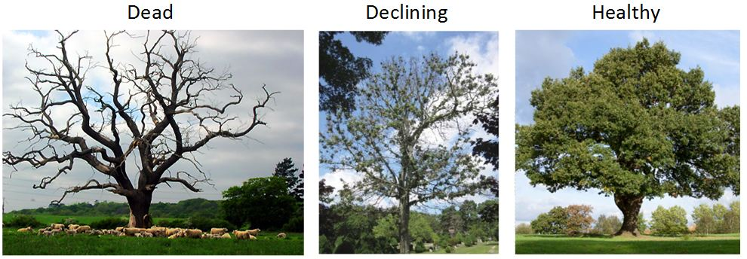

Slide 29
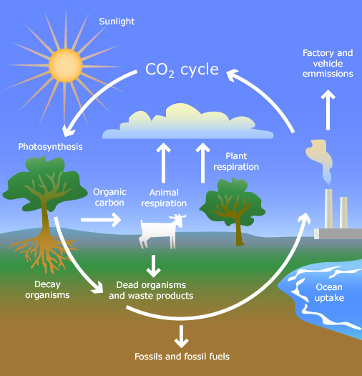

Slide 30
The rise in atmospheric carbon dioxide has been picking up speed over the past few years, even though human CO2 emissions have flattened. The net effect: Climate change is starting to accelerate.

Slide 31
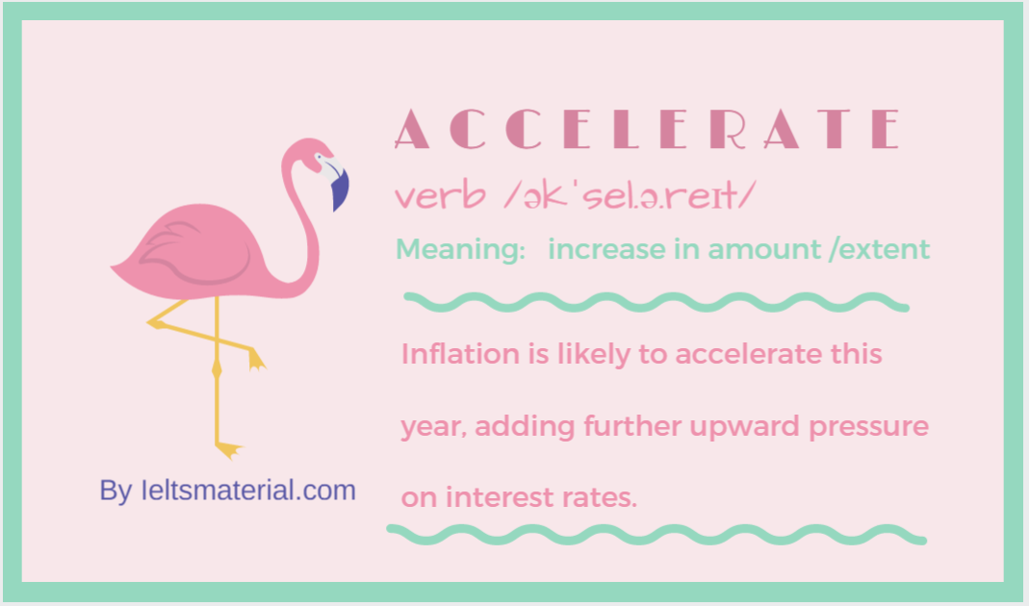

Slide 32
Some tropical forests — in the Congo, the Amazon, and in Southeast Asia — have already shifted to a net carbon source.

Slide 33
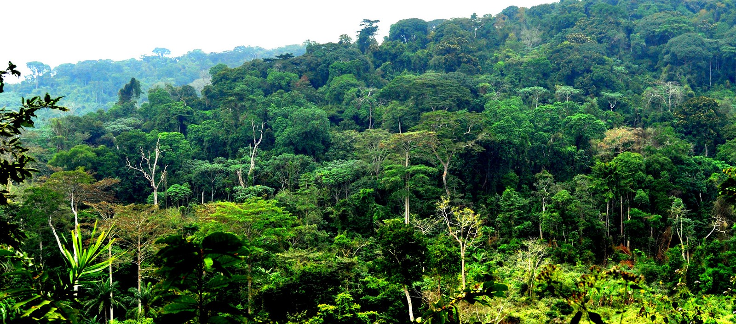

Slide 34
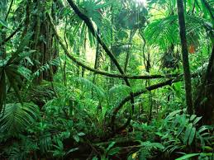

Slide 35
That means they emit more greenhouse gases than they absorb, worsening the climate problem worldwide.

Slide 36
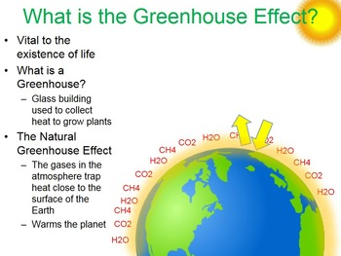

Slide 37
Forests are our last, best natural defense against global warming.

Slide 38
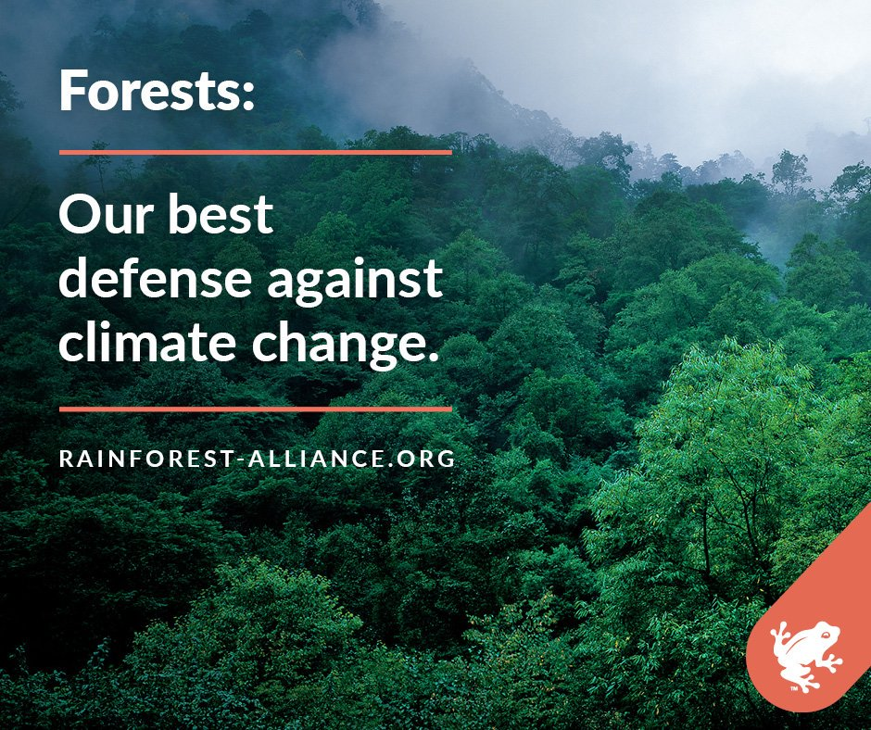

Slide 39


