Slide 1
Will Indian Government be Able to Meet its Renewable Energy Targets by 2022?

Slide 2
India is a power-hungry nation. A recent report by International Energy Agency (IEA) has predicted that India would be the fastest growing energy consumer and market by 2040. The forecast promises a bright scope for the renewable energy sector.

Slide 4
Renewable energy sources now account for 32.2 percent of the total installed capacity in the country, with the renewable installed capacity growing faster than conventional sources in 2017 for the first time.

Slide 5
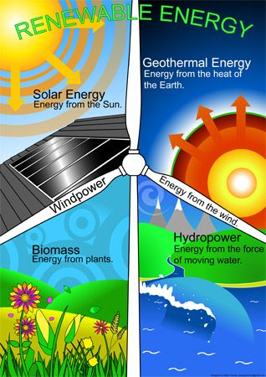

Slide 6
Currently, India stands fifth in terms of renewable energy capacity with an installed capacity of 70 GW while another 40 GW is under tendering or construction and the government claims to be on track for meeting its 2022 targets.

Slide 7
Gigawatt (GW) A unit of power equivalent to one billion watts

Slide 8
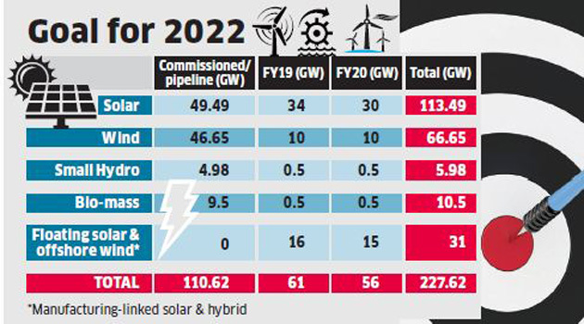

Slide 9
With falling solar and wind tariffs, India stands high chances of making it to the third position among renewable energy countries. But there are concerns of excess capacity, energy demand and implementation of the plan.

Slide 10
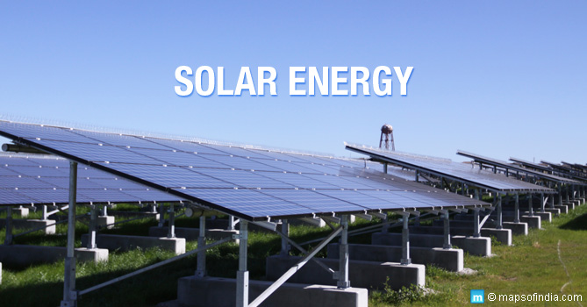

Slide 11
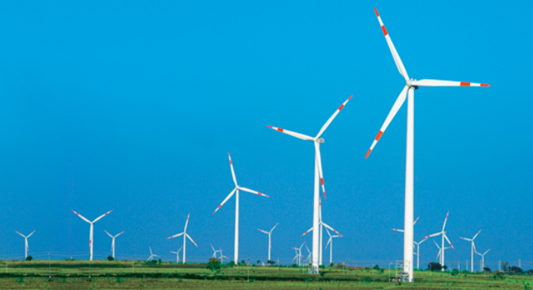

Slide 12
China will continue to be the top renewable energy generator, and the US, despite the declining policy support, is likely to be on the second position.

Slide 13
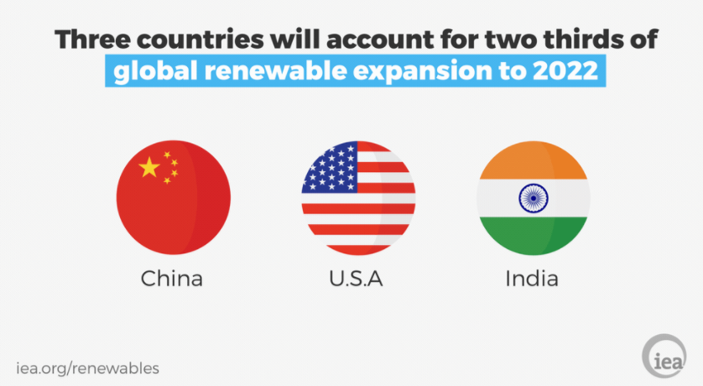

Slide 14
Renewable energy is obviously very compelling due to its low-cost and environmental benefits.

Slide 16
India imposed a 25 percent so-called safeguard duty on solar cells and modules imported from China and Malaysia effective July 30. The duty will fall to 20 percent after a year and 15 percent after 18 months.

Slide 17
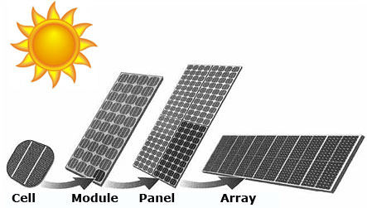

Slide 18
Domestic solar power equipment companies had complained that they were being undercut. After weeks of delays, including court challenges, the tariff was implemented in September.

Slide 19
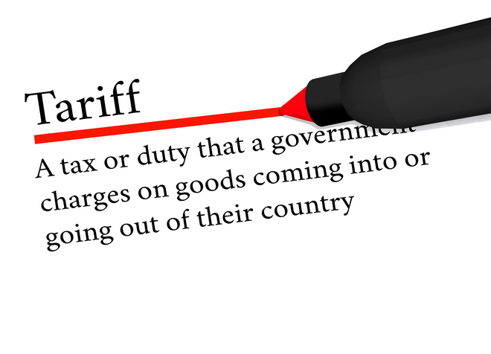

Slide 20
India overtook Japan as China’s biggest solar panel export market last year, buying about 31 percent of Chinese shipments.

