Slide 1
Q: How many types of sentences are there, depending on propositional meaning?

Slide 2
IN TERMS OF PROPOSITION, THERE ARE FIVE KINDS OF SENTENCES:
ANALYTIC SENTENCES
SYNTHETIC SENTENCES
CONTRADICTION
ENTAILMENT
PARAPHRASE

Slide 3
EXAMPLES OF ANALYTIC SENTENCES
Frozen water is ice.
Bachelors are unmarried men.
Two halves make up a whole.

Slide 4
EXAMPLES OF SYNTHETIC SENTENCES
Children wear hats.
The table in the kitchen is round.
My computer is on.

Slide 5
EXAMPLES OF CONTRADICTION
JOHN IS A BACHELOR. JOHN IS MARRIED.
TOM IS A MIDDLE – AGED AMERICAN MAN. TOM IS A CHILD.

Slide 6
EXAMPLES OF ENTAILMENT
ALAN LIVES IN TORONTO. ALAN LIVES IN CANADA.
MARY LOVES ROSES. MARY LOVES FLOWERS.
THE PRESIDENT WAS ASSASSINATED. THE PRESIDENT IS DEAD.
I WILL TURN 28 THIS YEAR. I AM CURRENTLY LIVING.
JOHN OWNS A BLUE SWEATER. JOHN OWNS A SWEATER. JOHN OWNS SOMETHING.
LOBO IS A DOG. LOBO IS AN ANIMAL.

Slide 7
HOW MANY TYPES OF ENTAILMENT ARE THERE?

Slide 8
TWO TYPES:
UNILATERAL
It’s a dog unilaterally entails It’s an animal
BILATERAL
JOHN IS BILL’S FATHER BILATERALLY ENTAILS BILL IS JOHN’S SON.

Slide 9
EXAMPLES OF PARAPHRASE
JOHN WROTE A LETTER TO MARY. JOHN WROTE MARY A LETTER.
A DOG BIT TOM. TOM WAS BITTEN BY A DOG.
HE HAS FIVE KIDS. HE HAS FIVE CHILDREN.
THIS CAR IS TOO SMALL. THIS CAR IS NOT BIG ENOUGH.
THIS NEEDLE IS TOO SHORT. THIS NEEDLE IS NOT LONG ENOUGH.

Slide 10
SENSE AND REFERENCE

Slide 11
By means of reference, a speaker indicates which things in the world
(including persons) are being talked about.

Slide 12
the SENSE of an expression is its place in a system of semantic relationships with other expressions in the language.

Slide 13
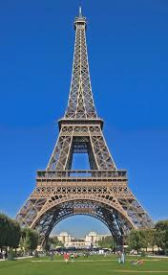
EIFFEL TOWER

Slide 14
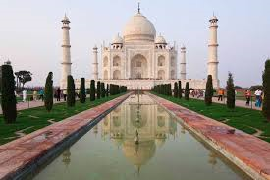
TAJ MAHAL

Slide 15
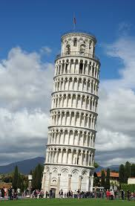
LEANING
TOWER
OF PISA

Slide 16
DENOTATION AND CONNOTATION

Slide 17
Connotation is the emotional and imaginative association surrounding a word.
Denotation is the strict dictionary meaning of a word.

Slide 18
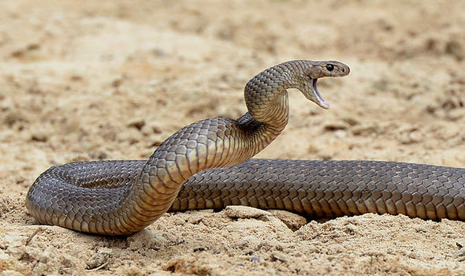
Denotation refers to the literal meaning of a word, the "dictionary definition."¨ For example, if you look up the word snake in a dictionary, you will discover that one of its denotative meanings is "any of numerous scaly, legless, sometimes venomous reptiles having a long, tapering, cylindrical body and found in most tropical and temperate regions."

Slide 19
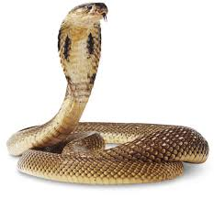
Connotation, on the other hand, refers to the associations that are connected to a certain word or the emotional suggestions related to that word. The connotative meanings of a word exist together with the denotative meanings. The connotations for the word snake could include evil or danger

Slide 20


