Slide 1



Slide 2
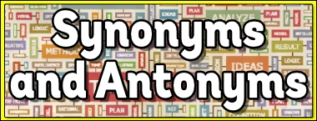
The Semantics of Words (1)

Slide 3
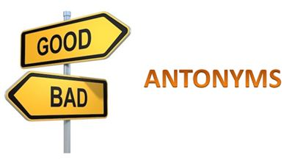
Antonymy the relationship of being "opposite in meaning"

Slide 4
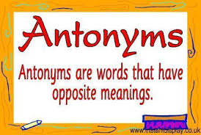

Slide 5
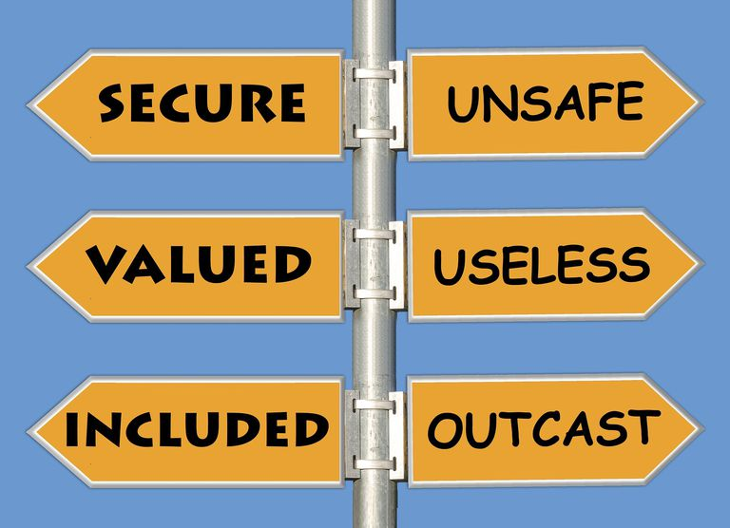

Slide 6
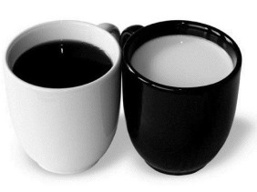
TYPES OF ANTONYMS

Slide 7
There are four basic types of opposites:
Complementary (antonyms)/ Binary Opposites
(Gradable) Antonyms / Opposites
Converses / Converse Terms
Incompatible Sets / Multiple Incompatibles

Slide 8
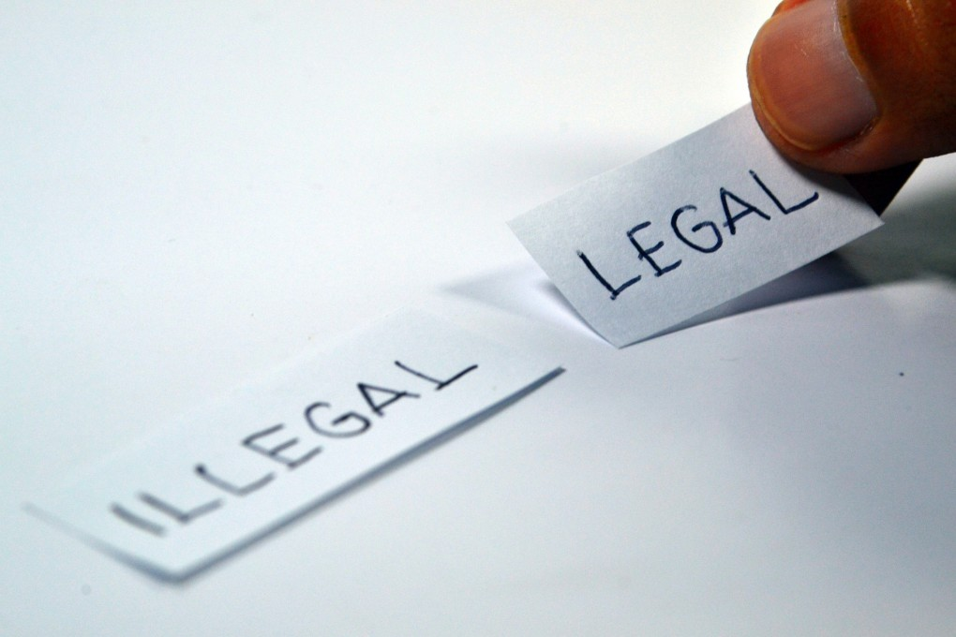
Binary Opposites

Slide 9
If the one of the pairs is applicable, then the other cannot be, and vice versa.
They express an either/or relationship.

Slide 10
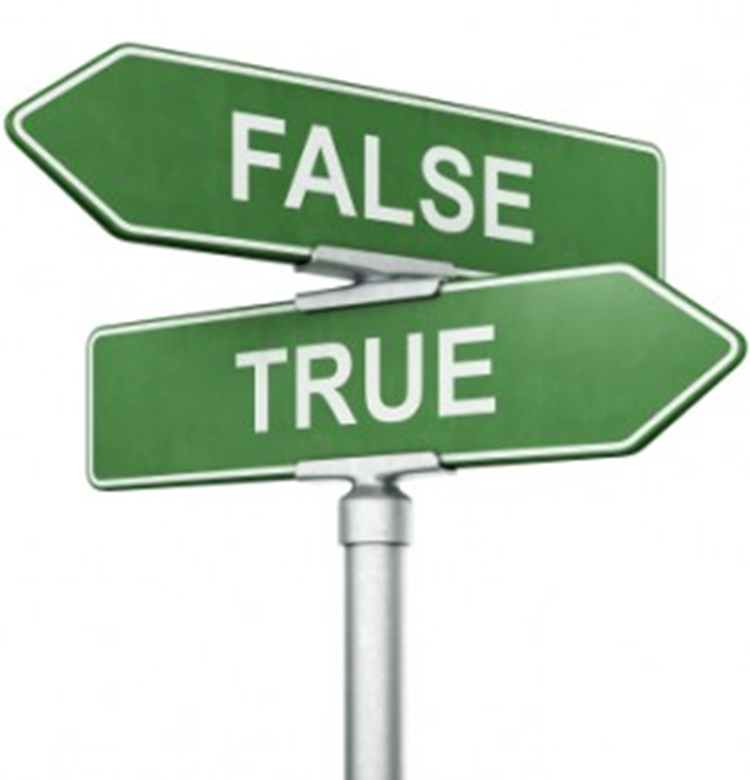
Example: true and false are binary antonyms.
If a sentence is true, it cannot be false. If it is false, it cannot be true.

Slide 11
(Gradable) Antonyms / Opposites:
Expressions are gradable antonyms if they are at opposite ends of a continuous scale of values.

Slide 12
Thus, with gradable antonyms it is possible to be both "not X" and "not Y", but somewhere in the middle.

Slide 13
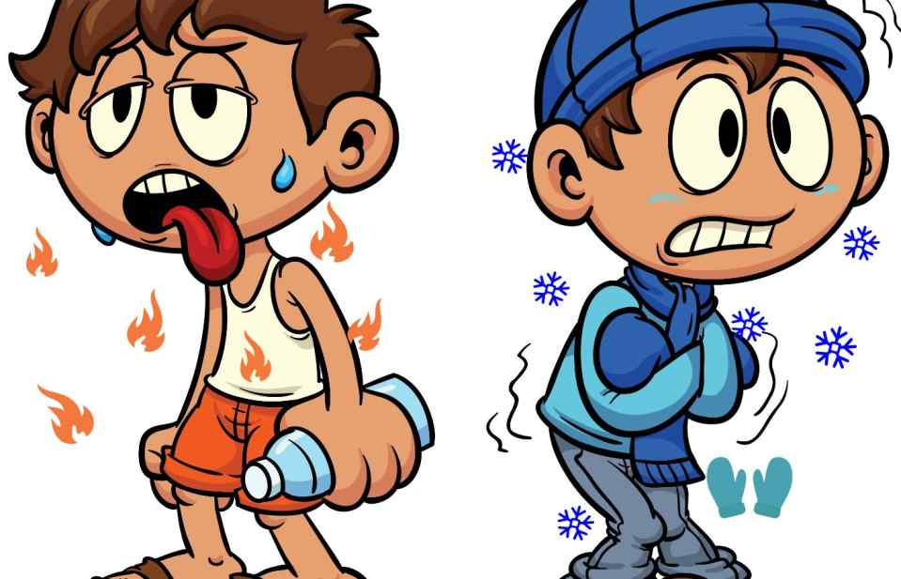

Slide 14
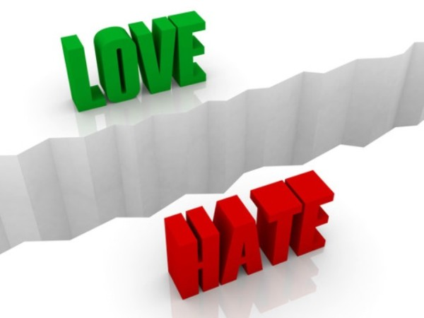

Slide 15
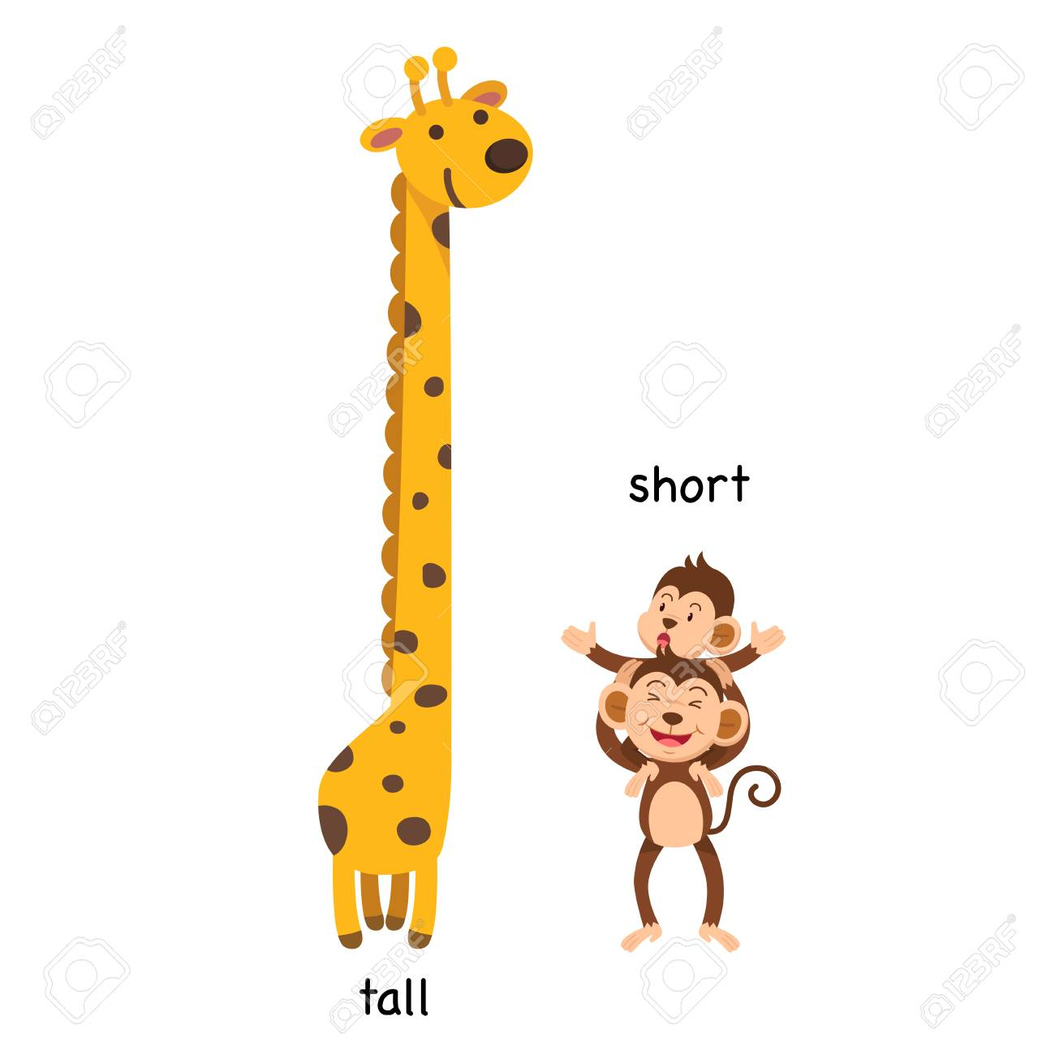

Slide 16
beautiful – pretty – good-looking – plain – ugly

Slide 17
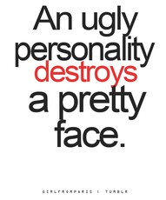

Slide 18
Converses / Converse Terms:
Expressions which express a relationship between two things such that one of the expressions conveys the relationship in one order and the other expression conveys the relationship in the opposite order.

Slide 19


Slide 20
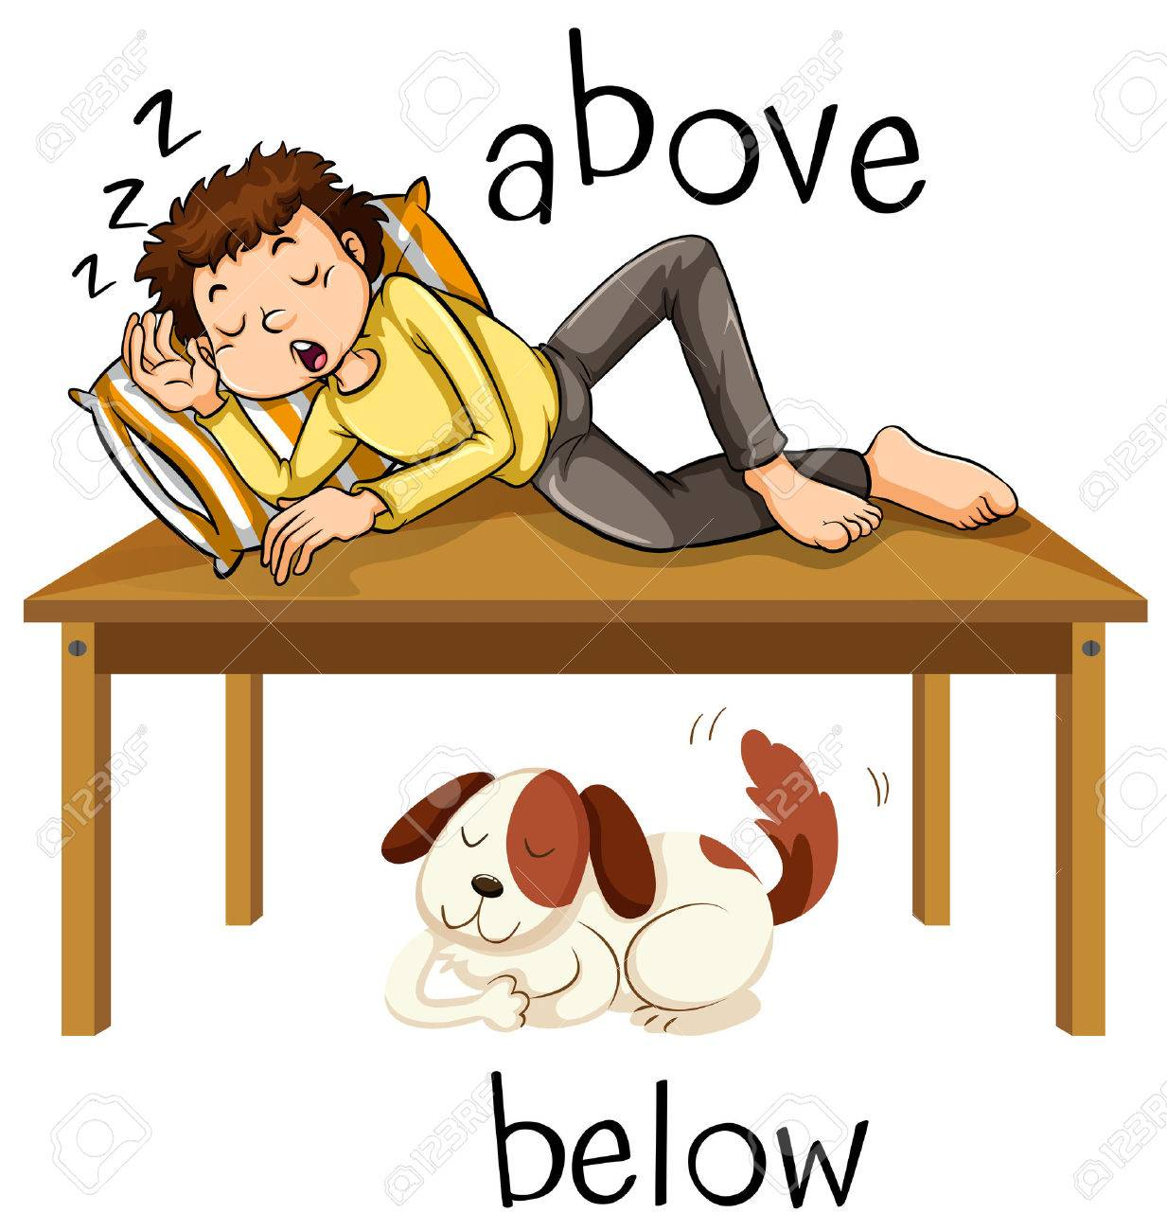

Slide 21
4. Incompatible Sets / Multiple Incompatibles:
Expressions in sets of more than two members which are incompatible in talking about the same thing.

Slide 22
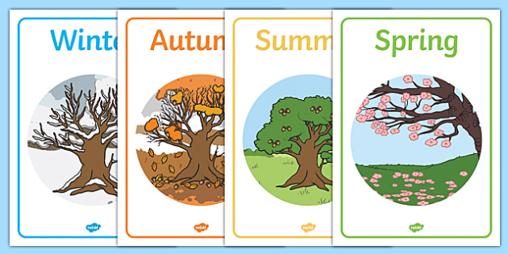

Slide 23
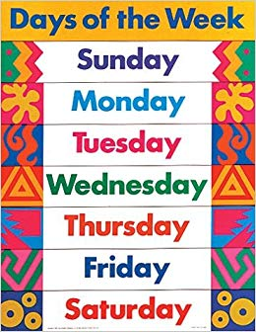

Slide 24
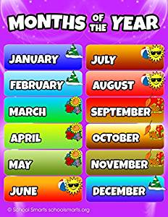

Slide 25
"You forget what you want to remember and you remember what you want to forget."

Slide 26
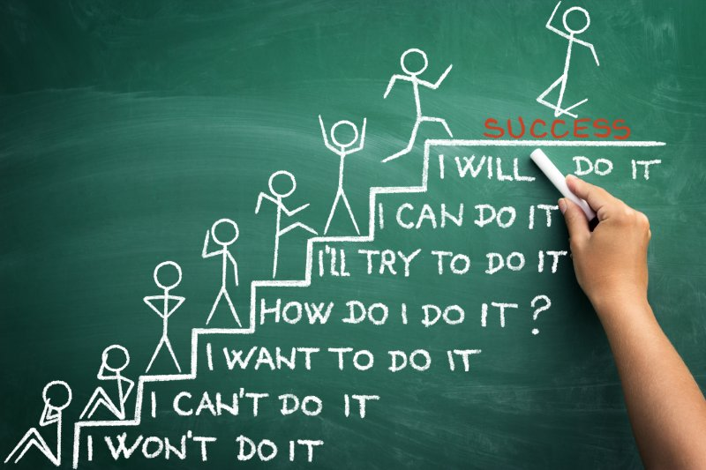
"You always pass failure on the way to success."

Slide 27
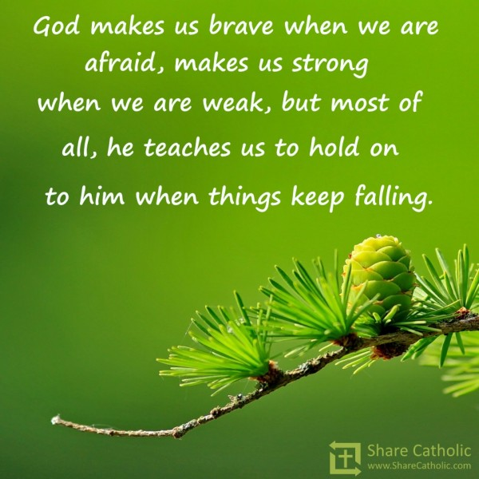
"Some have been thought to be brave because they were afraid to run away."

Slide 28
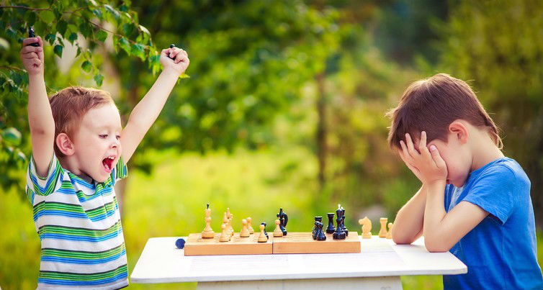
"Winning may not be everything, but losing has little to recommend it.”

Slide 29
"Every day I remind myself that my inner and outer life are based on the labors of other men, living and dead, and that I must exert myself in order to give in the same measure as I have received and am still receiving."

Slide 30
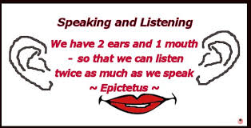
If speaking is silver, then listening is gold."

Slide 31
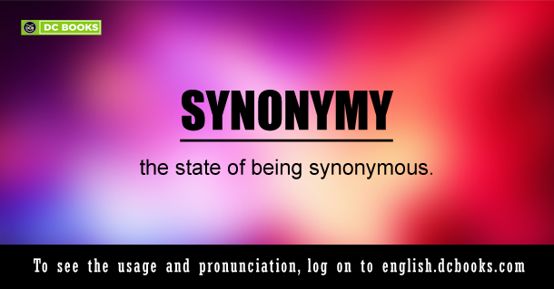
The relationship between two expressions that have the same sense. Synonyms, therefore, are expressions which share a sense; perfect synonyms would share all their senses.

Slide 32
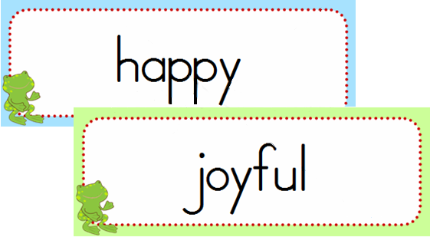

Slide 33
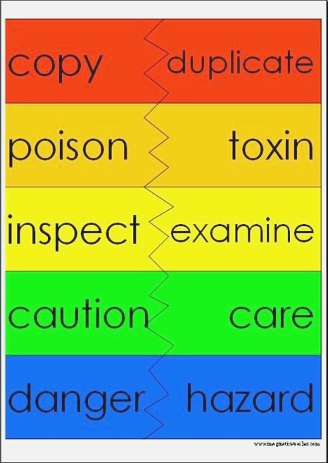

Slide 34
Patterns of Synonyms

Slide 35
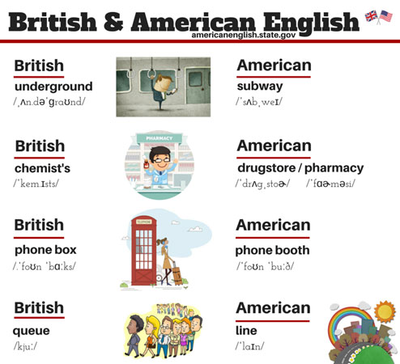
British and American English

Slide 36
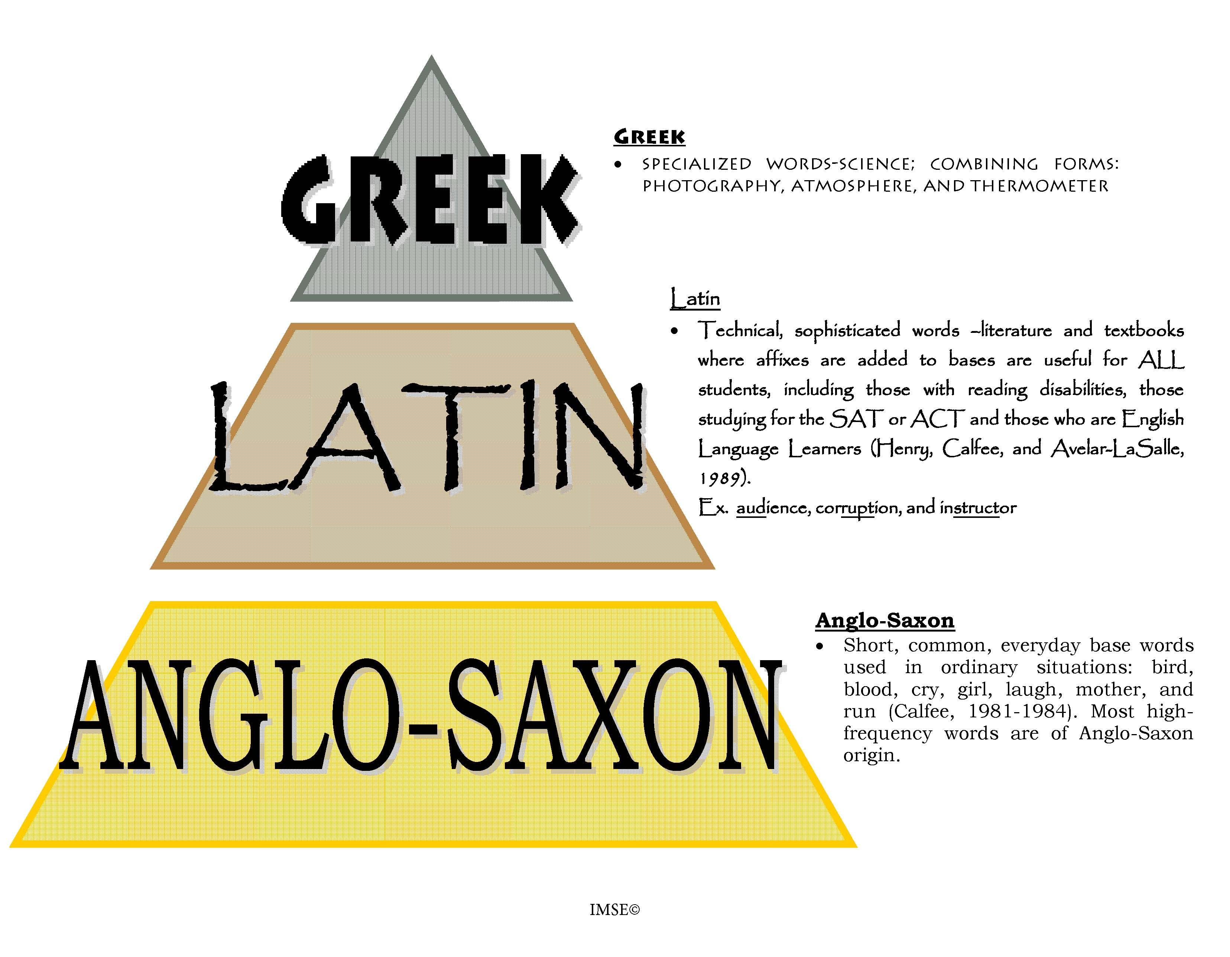
Anglo – Saxon versus Latin or Greek

Slide 37
Emotional Overtones & Evocative Effects:

Slide 38
The words politician and statesman both denote an elected or appointed person who is actively involved in governmental affairs; however, the connotation of each word is very different. Politician connotes a person interested in personal gain who promotes narrow interests, and statesman connotes an individual who is concerned about the long-term interests of all citizens.

Slide 39
conceal carries the implication that there's someone you are concealing it from, and hence the act is somewhat deliberate in nature. conceal is formal.

Slide 40
The box was concealed beneath the rocks for centuries.
The box was hidden beneath the rocks for centuries.
In the first, you understand that it was deliberately hidden, and perhaps required some searching to uncover. In the second, maybe it happened naturally.

Slide 41
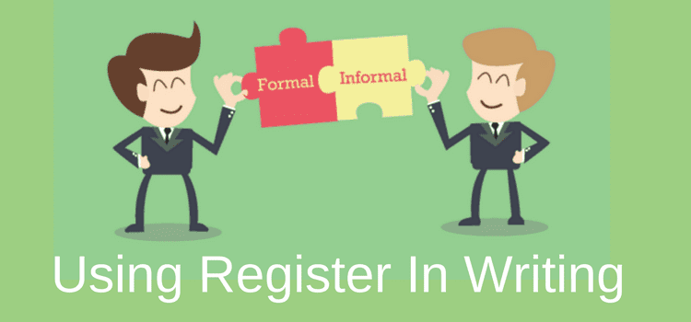
Two Different Registers

Slide 42


Slide 43
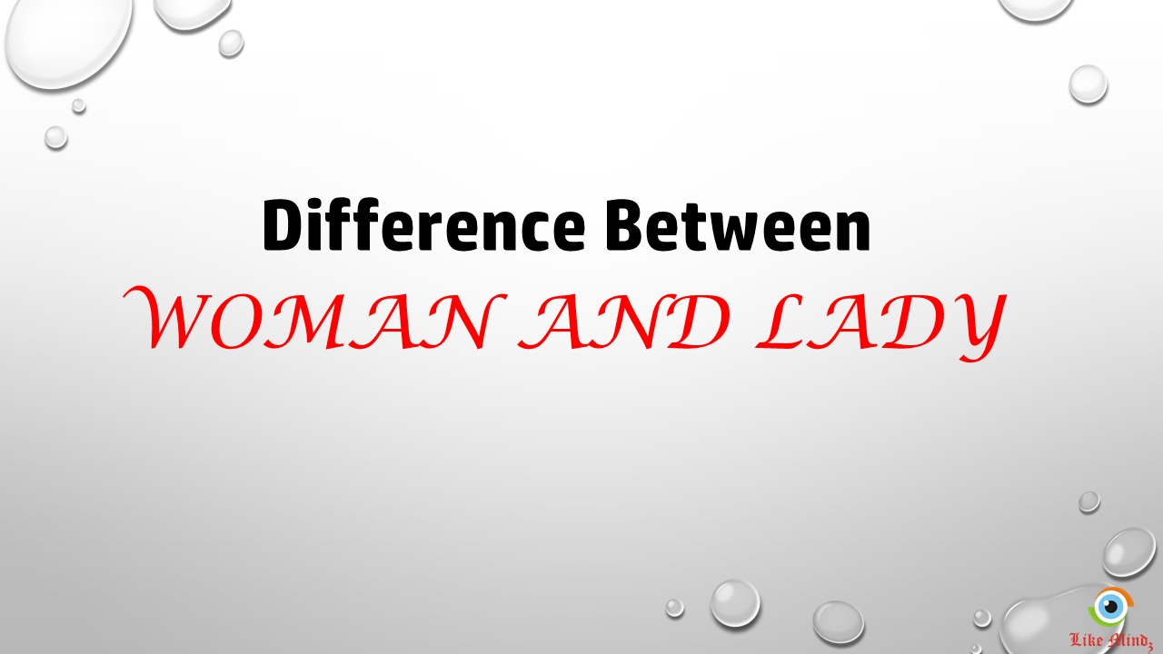

Slide 44
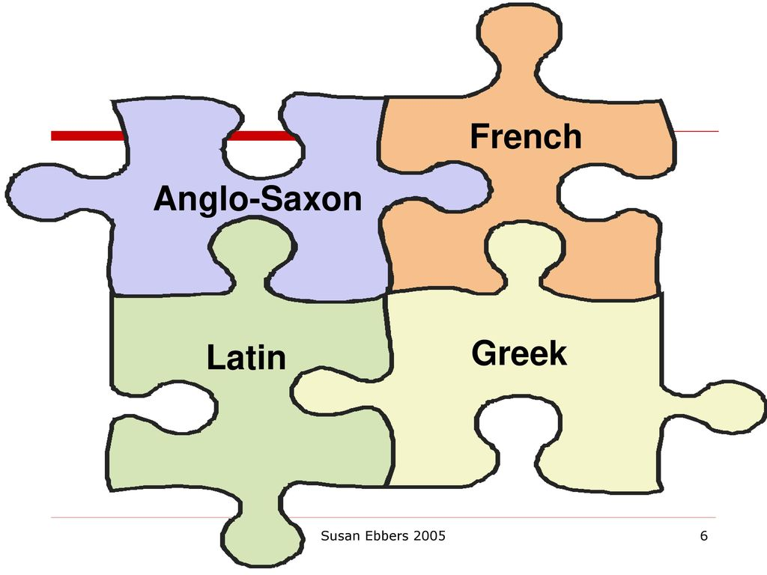

Slide 45
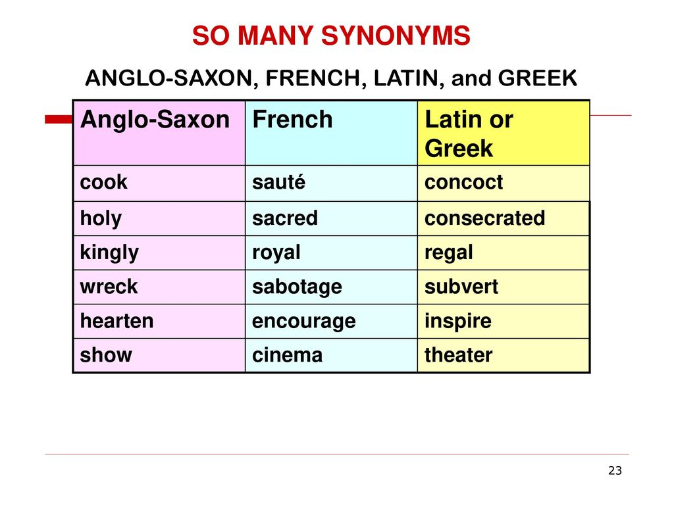

Slide 46
PRACTICE (10)
In the following sentences, do the capitalized pairs of words have the same (or very nearly the same) sense?
(1) The thief tried to CONCEAL/HIDE the evidence.
(2) I’m going to PURCHASE/BUY a new coat.
(3) These tomatoes are LARGE/RIPE.
(4) This is a very LOOSE/SHORT definition.
(5) You have my PROFOUND/DEEP sympathy.
(6) It is a very WIDE/BROAD street.
(7) The house stands at the SIDE/EDGE of the lake.

Slide 47


