Slide 1
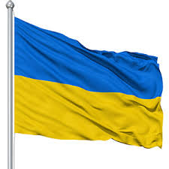
Can Ukraine Win Its War on Corruption?

Slide 2
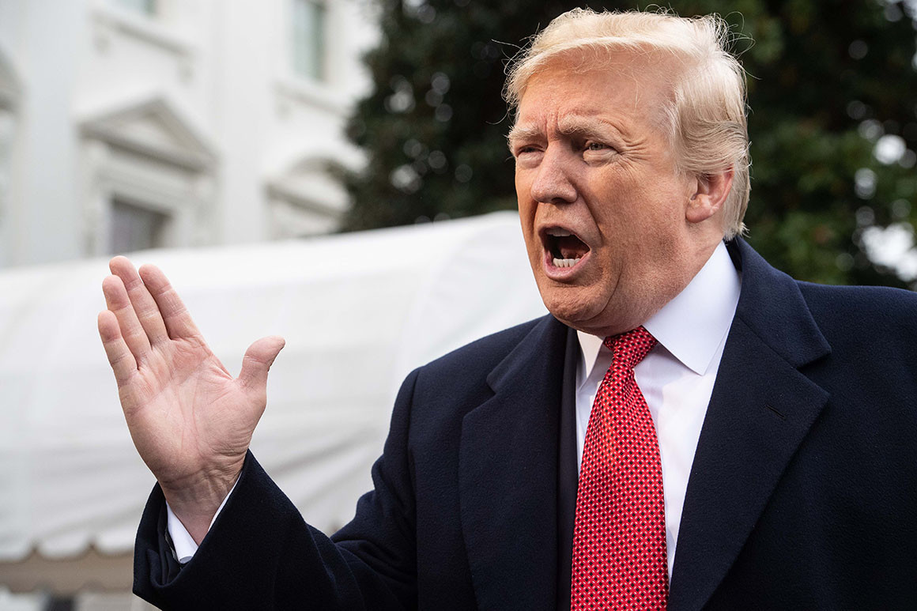
At the recent G-7 summit, U.S. President Donald Trump was reported to have told fellow world leaders that “Ukraine is one of the most corrupt countries in the world.

Slide 3
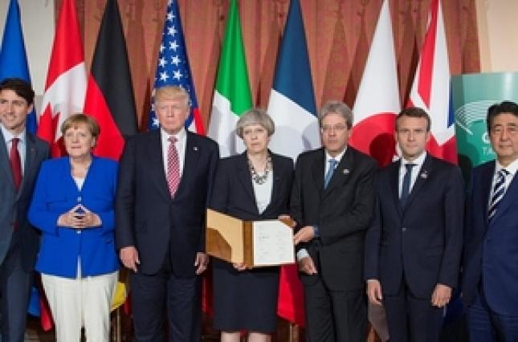

Slide 4
Many Western observers have also ignored the other enormous positive changes that Ukraine has experienced since the Euromaidan revolution of 2013–14, which ousted the corrupt, pro-Russian President Viktor Yanukovych.

Slide 5
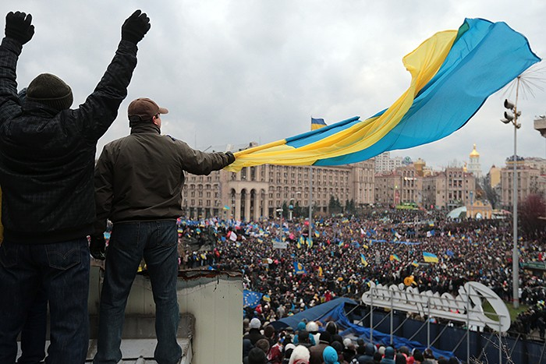

Slide 6
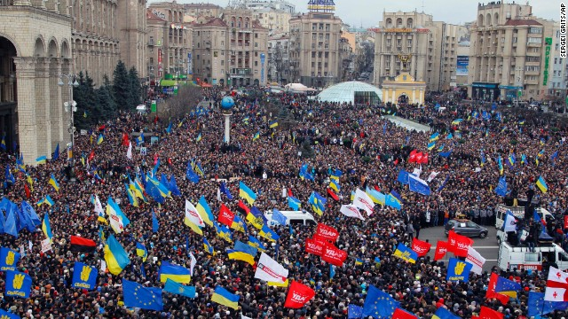

Slide 7
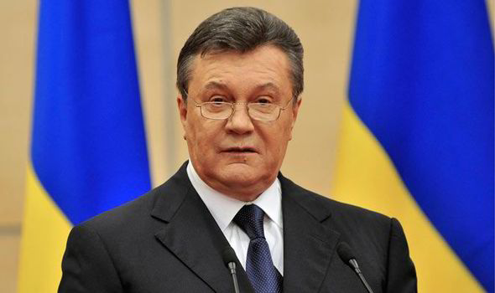

Slide 8
It is no exaggeration to say that, contrary to its image, Ukraine has experienced more positive change and done more things right than any other European state in recent years. In almost every sphere, there is evidence of remarkably successful reforms and development in Ukraine.

Slide 9
The government is now moving to reforms that will be felt by ordinary Ukrainians. Ukraine has advanced in a number of important and demanding reforms over the past year, including healthcare, pensions, decentralisation, public administration, and the environment. Since 2014, Ukraine has launched and enacted more reforms than during the preceding twenty-five years.

Slide 11
The government has established brand new institutions such as the patrol police and reformed old ones like the Supreme Court.

Slide 12
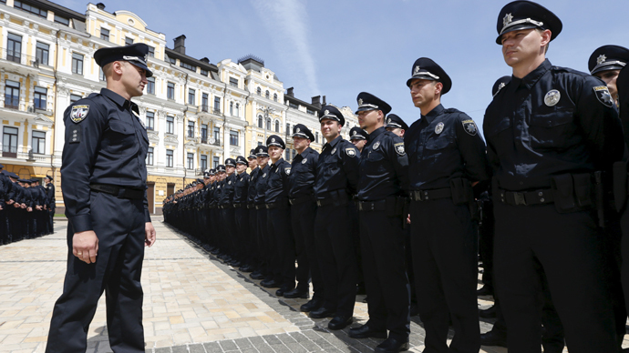

Slide 13
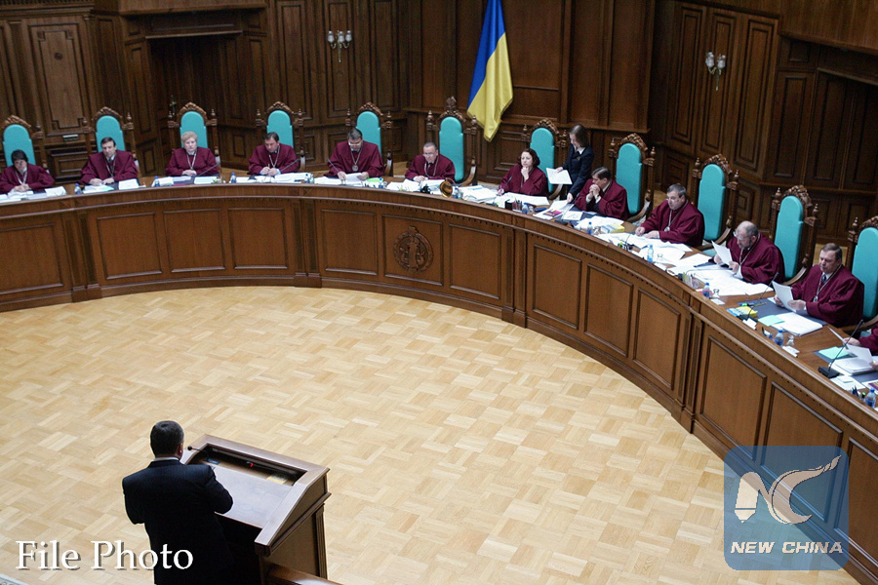

Slide 14
The military has undergone a substantial overhaul. Ukraine makes important progress in its reforms but more needs to be done in particular on the judiciary and fight against corruption.

Slide 15
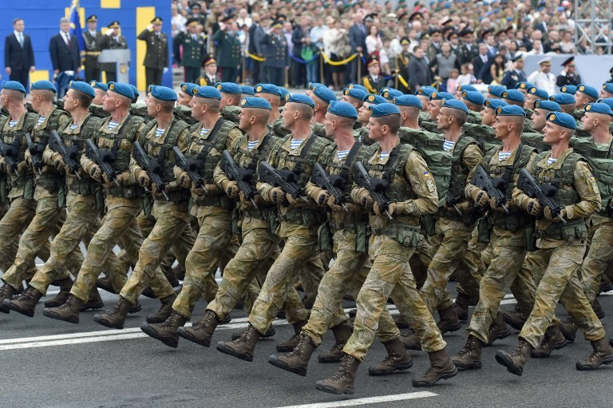

Slide 17
But reform has been slow in coming. To be fair, President Petro Poroshenko faces a Herculean task: protecting Ukraine from Russia’s ongoing aggression in the east while reforming the country in a way that is in keeping with the ideals—democracy, transparency, and rule of law.

Slide 18
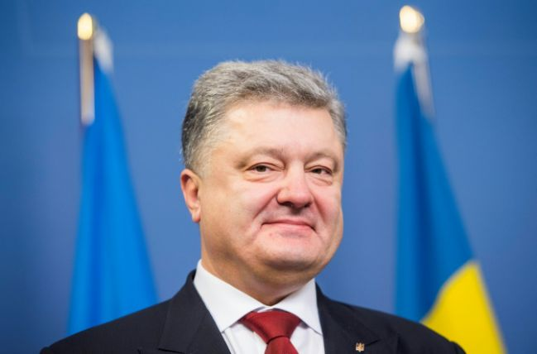

Slide 22
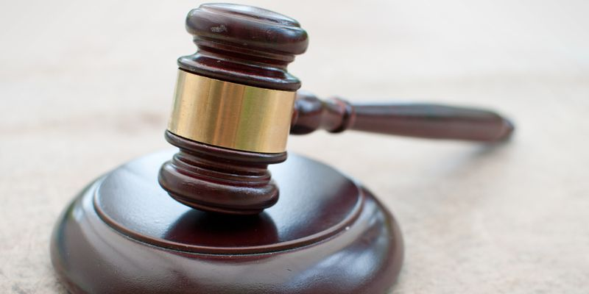

Slide 23
Over the past four years, on President Petro Poroshenko’s watch, Ukraine has achieved macroeconomic stabilization and reformed or established several important institutions, such as the police, the Supreme Court, and new anticorruption agencies. Yet major structural problems remain. There is still a long way to go.

Slide 25
Afghanistan's Young Liberal Elites Challenge the Taliban

Slide 26
Afghanistan is one of the world's poorest countries, wrecked by decades of conflict which led to the rise of the Islamist fundamentalist movement, the Taliban.

Slide 27
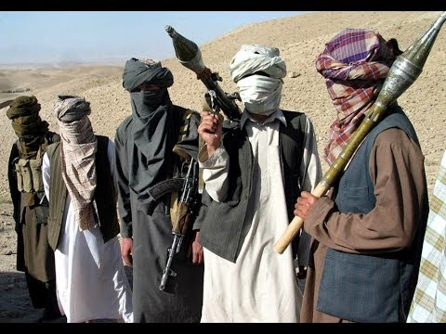

Slide 28
Talented Afghan students are coming to the university of Erfurt to learn about public policy. They hope to go back to their country armed with the skills to take up leading positions in ministries or in non-governmental organizations.

Slide 30
The young elite opposes the culture of violence and is fighting for fundamental changes in the country. During the last decade and half, Afghanistan has made significant progress towards rebuilding its institutions and political systems.

Slide 31
The young Afghans are carrying the weight of their home country on their shoulders. They feel the pressure, but they are ambitious and hopeful about the future.

Slide 33
Since the defeat of the Taliban regime in 2001, the country has adopted a new political structure, constitution, organized presidential and parliamentary elections.

Slide 34
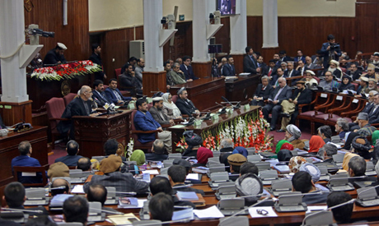

Slide 35
Moreover, in the post-Taliban political order, political participation has increased, especially among women in different parts of the state. These are all the accomplishments that have occurred as a result of the arduous work by the Afghans and their international partners.

Slide 36
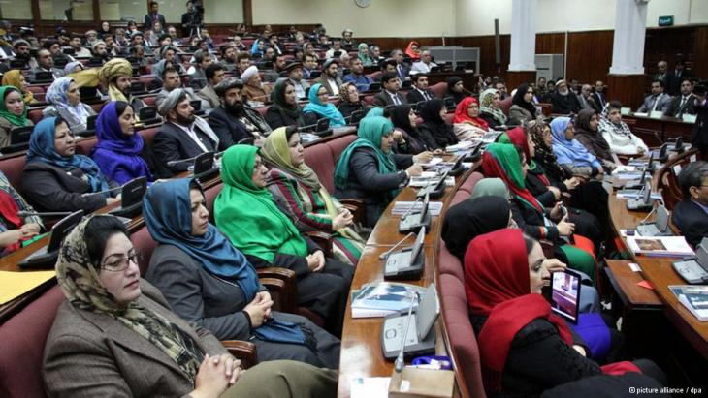

Slide 37
Democratic reform and governance began after the collapse of the Taliban in Afghanistan. The Taliban ruled a brutal and fundamentalist regime from 1996 to 2001.

Slide 38
In the last decade and half which has been free of Taliban control, Afghanistan has made significant improvements in areas, such as good governance, rule of law, women’s rights and freedom of speech.

Slide 41
Despite gains and progress made over the years, the country is faced with a resilient insurgency that constitutes the remnants of Taliban and Al-Qaeda.

