Slide 1
Semantics
Paradigmatic relations of exclusion and opposition
Represented by: Shahad Osama

Slide 2
Outlines of the presentation
1. Incompatibility and co- taxonymy
1.1 Incompatibility
1.2 Co- taxonymy
1.3 Co- meronymy
2. Opposition
2.1 Complementaries
2.2 Antonymy:
2.3 Reversives
2.4 Converses
2.5 Markedness
2.6 Polarity

Slide 3
1-Incompatibility and co- taxonymy
1-1 Incompatibility: It refers to sets of items where the choice of one item excludes the use of all the other items from that set.(Crystal: 2003)
Incompatibility: indicates the following:
-A Superordinate(hypernym) has more than one hyponym
-The resultant hyponyms (set of terms) related to all the others by relation of incompatibility
-Incompatibles: are terms which donate classes which share no members.

Slide 4
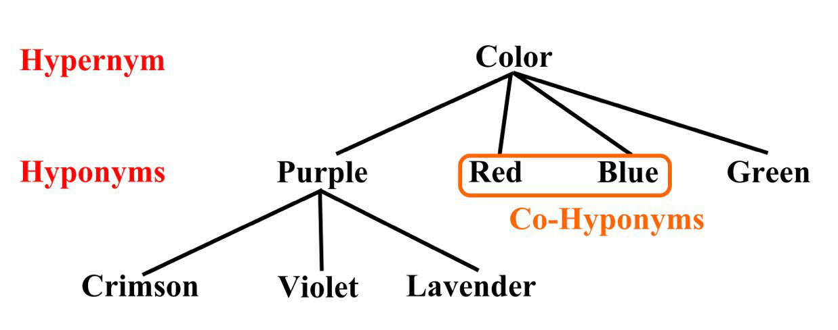
For example:

Slide 5
1-2 Co- taxonymy
-it’s the corresponding conceptual relations.
Its prototypical cases that should be mutually exclusive (can not occur at the same time)
It’s a vital mode of categorization of experience.
E.g. For gender pay gap protest in France, Women came from all walks of life .. Doctors, teacher, solicitors, housewives, student, prostitutes.

Slide 6
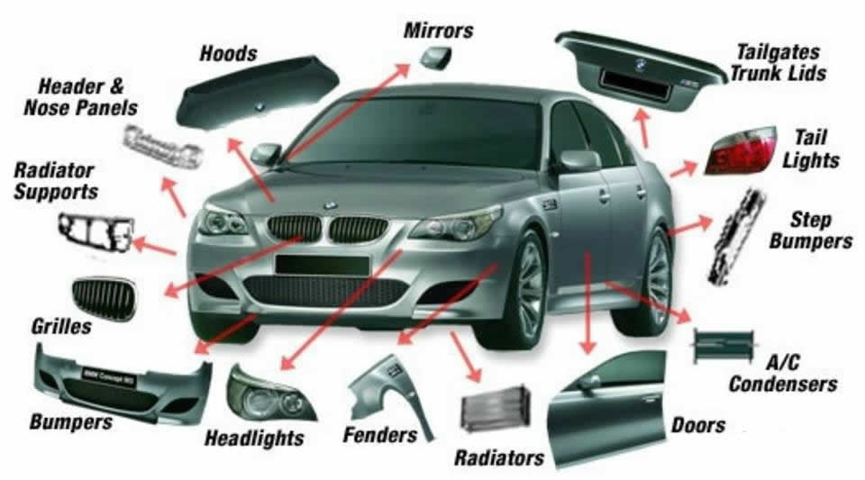
1-3 Co- meronymy
Meronymy: is the relationship which obtains between parts and wholes (Crystal: 2003)
Co- meronyms: are set of meronyms
Co- meronymys: also indicate a relation of exclusion
E.g.

Slide 7
The boundaries of parts often display a degree of Vagueness which destroys the strict logical relationship:
E.g.

Slide 8
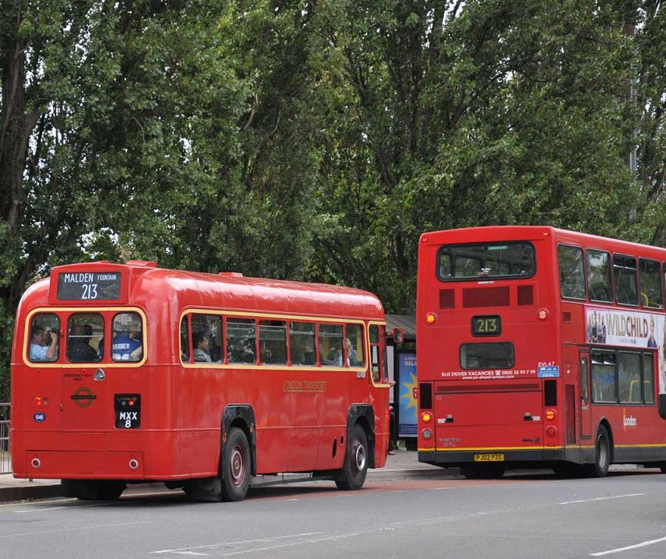


2- Opposites:
Consist of:
A-Binary: Two members of opposites
B-Inherentness :its not accidental (single-deckers: double-deckers)
(Tea: Coffee)
But its inherent binarity (Up/Down)

Slide 9
2- Opposites
Today
C. Patency: The pair should be patent ( Yesterday Tomorrow) rather than latent ( Monday Wednesday )
Tuesday

Slide 10
2.1 Complementaries
Constitute a very basic form of oppositeness (dead: alive/ obey: disobey)
Have no possibility of ‘setting on the fence’
Rarely, have a possibility of exceptional states(abnormalities/ irregularities) fallen between a pair: Dead: Zombie: alive

Slide 11
2.2 Antonymy: is classified into 3 groups:
2.2.1: Polar antonyms
2.2.2: Equipollent antonyms
2.2.3 Overlapping antonyms

Slide 12
2.2.1 Polar antonyms
2.2.1 Polar antonyms : Long: short/ fast: slow/ deep: shallow …etc.
The features of this group are as follows:
A. Both terms are fully gradable unlike complementariness
Very long: very short
They occur in the comparative and superlative degree
Longer, longest: shorter, shortest
They indicate degrees of some objects and unidimensional physical property
They are incompatibilities, but not complementaries
Comparative forms stand in a converse relationship: (John is longer than Marry) entails that (Marry is shorter than John)

Slide 13
2.2.1 Polar antonyms
The comparative forms of both terms are impartial (have no specific average) : (John is longer than Marry) does not denote that Marry is short
Impartial questions can be used: How….. Is he/she/it ?
How long is he?

Slide 14


2.2.2 Equipollent antonyms
2.2.2 Equipollent antonyms : (hot: cold) ( bitter: sweet) …etc.
Do not imply impartiality
have a specific average
Unlike the polar antonyms:
Polar antonyms: e.g. John is longer than Marry, but he is shorter than Tome
Equipollent antonyms: This coffee is hot, but its colder than that one

Slide 15
2.2.3 Overlapping antonyms:
2.2.3 Overlapping antonyms:
One member of the pair yields an impartial comparative and the other one a committed comparative.
We can’t say (John is an excellent tennis player, but he is worse than Tom) because if someone is excellent, he can’t be called (worse)
We can say ( John is a pretty useless tennis player, but he’s better than Tome.
E.g. (John is polite, but he is ruder than Tom) is wrong.
E.g. (Marry is rude, but she is more polite than her friend) is right.

Slide 16
2.3 Reversives
Reversives belong to a broader category of directional opposites, which include a straightforward directions.
For example: up: down, forwards: backwards, into: out of, north: south
Reversives could denote a change in opposite directions between two states: tie: untie, dress: undress….etc..

Slide 17
2.4 Converses
Converses often considered to be a subtype of directional opposites, sometimes they are considered to be a type of synonym
E.g. (above: below)
Converses may be described as two-place (A is above B/ B is below A)
and three-place (A is above B and C/ C is below B and A)
Converses could refer to a relationship from opposite points of view.
E.g. ( Parent: child )
Bill is Tom’s parent/ Tome is Bill’s child .
A
B
C

Slide 18
2.5 Markedness
This notion is often applied to pairs of opposites:
One term is designated as the marked term and the other as unmarked term of the opposition
Lyons (1977) distinguished three major conceptions of Markedness:
A. Morphological Markedness: happy: unhappy, kind: unkind
B. Distributional Markedness: ( one member of a pair has a common usage (unmarked) , unlike the other member ( marked)
E.g. long (unmarked): short (marked )
E.g. this one is ten meters long/ what is its length?/ How long is it ?
C. Semantic markedness: The meaning of the term is what is common to the two terms of the composition. E.g. lion (unmarked): lioness (marked)

Slide 19
2.6 Polarity
It’s a notion of opposition, whereby terms are designed as positive and negative.
The main ways of usage are as follows:
A. Morphological polarity: true: untrue
B. Logical polarity: John is not (not) fat / indicates that John is fat
C. Privative polarity: alive: dead, married: single
D. Evaluative polarity: kind: cruel, safe: danger

Slide 20
References
Cruse, A.(2000). “ Meaning in Language: An Introduction to Semantics and Pragmatics. Oxford. Oxford University Press. “
Crystal, D. (2003). A Dictionary of Linguistics & Phonetics. Blackwell publishing Ltd.

Slide 21
Thank you..

