Slide 1

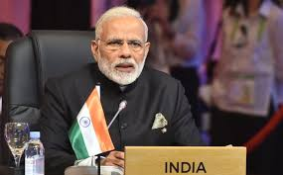
Has Modi's Pakistan Policy completely failed?

Slide 2
Since Prime Minister Narendra Modi came to power, India’s approach to relations with Pakistan has been inconsistent and episodic, typified in the tensions at the recent UN General Assembly.

Slide 3
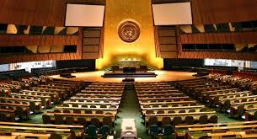

Slide 4
Firstly, he made the haphazard decision to suspend dialogue with Pakistan on the pretext of Pakistan’s ambassador meeting with Hurriyat leaders. That sent a clear message to all relevant parts and the rest of the world that Modi is reluctant about solving the Kashmir problem with Pakistan.

Slide 6
India-administered Kashmir is again in the grip of violence, as protesters clash with security forces. New Delhi claims Pakistan is fueling terrorism in the area, but some say PM Modi's Kashmir strategy is to blame.

Slide 7
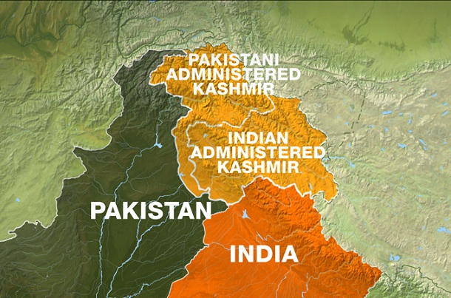

Slide 8
At certain times, India has engaged in talks with Pakistan on various bilateral issues. At other times, it has adopted a hardline approach and canceled talks, stating that Pakistan had not demonstrated any sincerity in wanting to end cross-border terrorism against India.

Slide 9
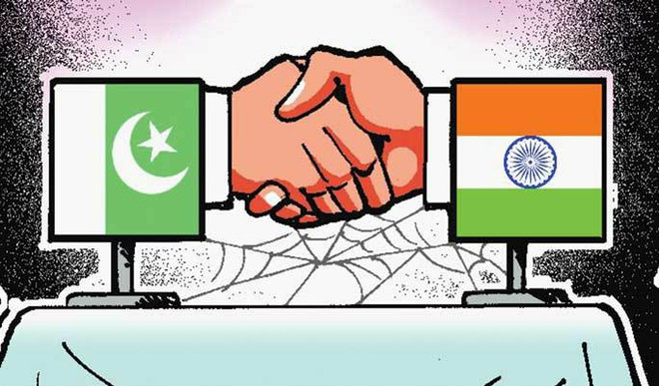

Slide 10
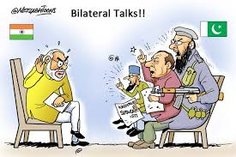

Slide 11
Given this scenario, India’s foreign policy towards Pakistan, which has historically been defensive – offensive, will follow the normal course – from talks to disruption and from disruption to talks.

Slide 12
Reconciliation with Pakistan remains a challenge due to persistent issues that adversely affect ties, namely the Pakistan army’s influence over the country’s foreign policy and meager bilateral economic ties.

Slide 13
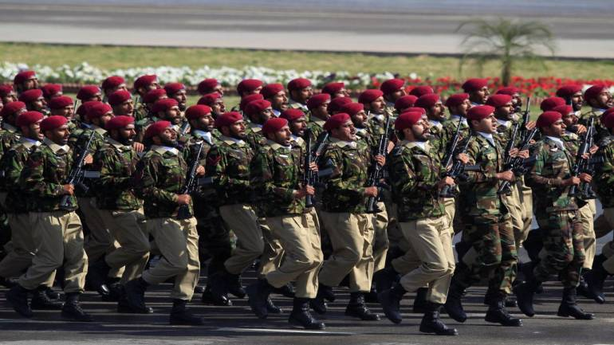

Slide 14
There is no doubt that Kashmir is slipping fast out of India’s hand, but the wrong and half - baked policies of the Narendra Modi government are also gravely harming India's image as a responsible democratic state, which is expected to respect human rights and rule of law.

Slide 15
Related Terms
Pakistan High Commissioner to India / Pakistan’s ambassador to India
المفوض السامي الباكستاني في الهند / السفير الباكستاني في الهند

Slide 16
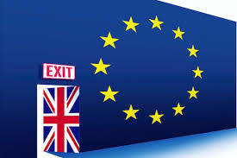
How Brexit threatens to shift the balance of power in the EU

Slide 17
The British referendum on continuing membership of the European Union in June 2016 represented a turning point in the relationship between the UK and the EU.

Slide 18
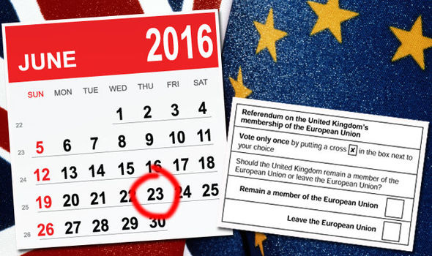

Slide 19
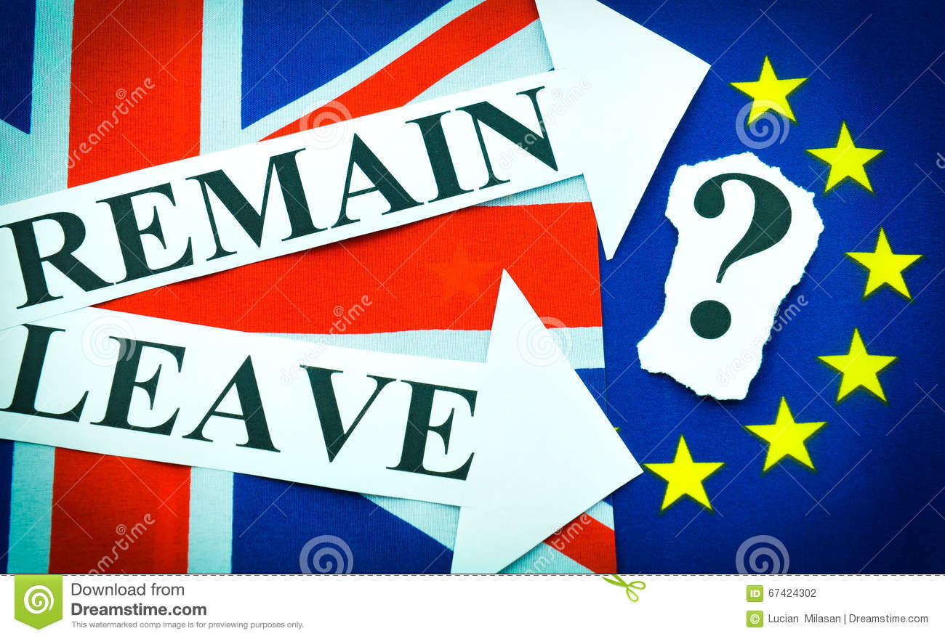

Slide 20
Brexit is probably the biggest challenge yet faced by the EU. Certain parts of Europe—notably Ireland and Germany—could potentially be hit quite hard if the United Kingdom were to leave the EU without a deal. So, those parts of Europe will likely be focused on making sure there is some type of deal, although not necessarily the best deal for all sides.

Slide 21
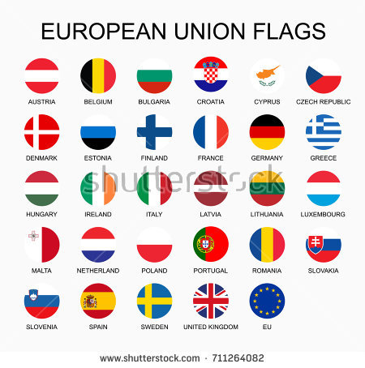

Slide 22
But longer term, we think the United Kingdom’s departure from the EU may start to reveal differences of attitude amongst different factions within the trading bloc. And, it may bring about a switch in the balance of power in the European Parliament towards eurozone countries.

Slide 23
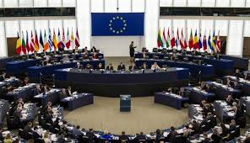

Slide 24
Countries such as Germany and France want to have a more integrated EU, while others, for example in Central Europe, favour a looser grouping that offers them trading benefits while allowing greater control over their sovereignty.

Slide 25
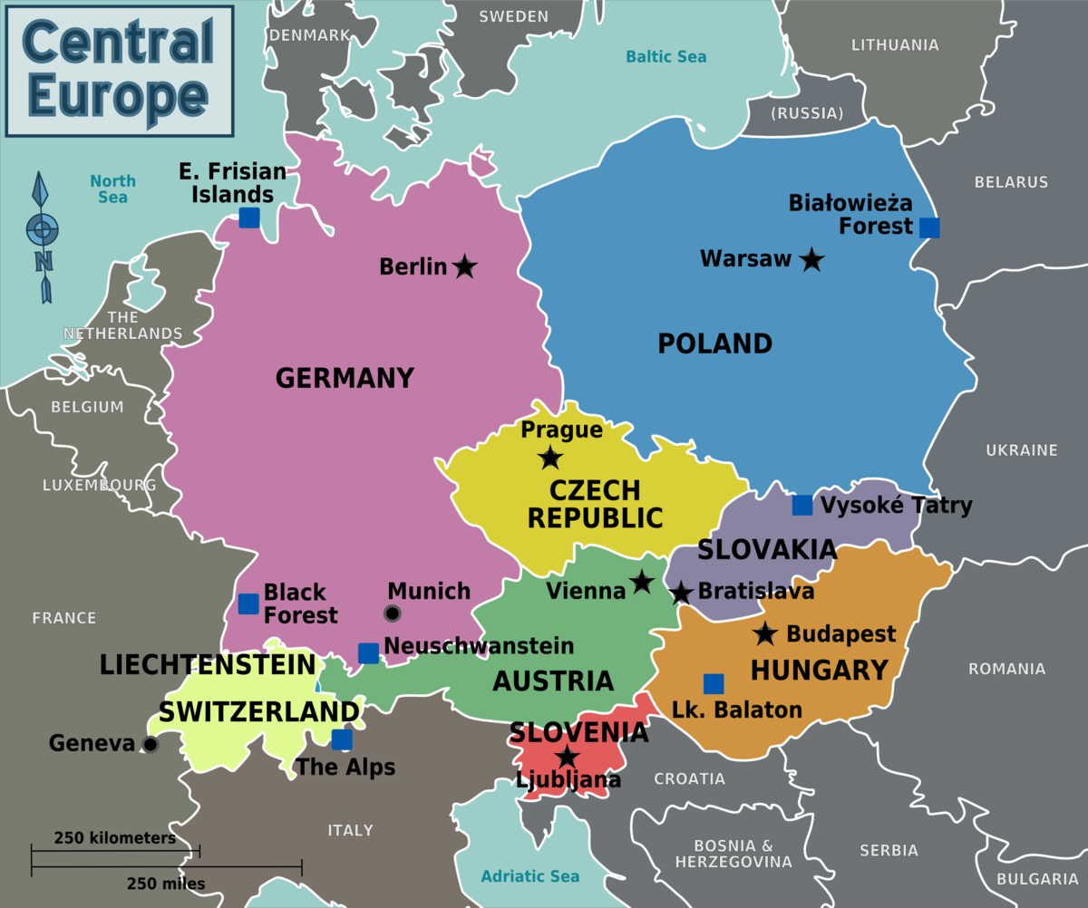

Slide 26
Since Macron won the French elections in the spring of 2017, German and French government officials have quietly been meeting to lay the groundwork for negotiations on the future of the EU. Some think the Franco-German axis will be less powerful than before.

Slide 27
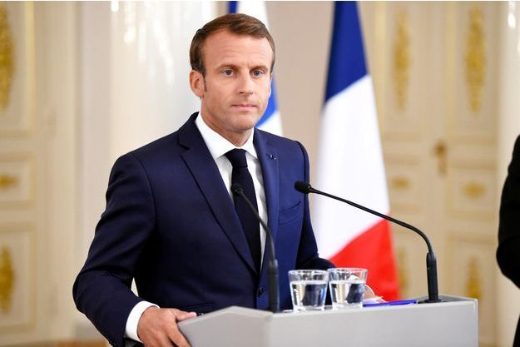

Slide 28
Post-Brexit, the Eurozone will represent 85% of the EU’s GDP and 76% of the EU’s population.

Slide 29
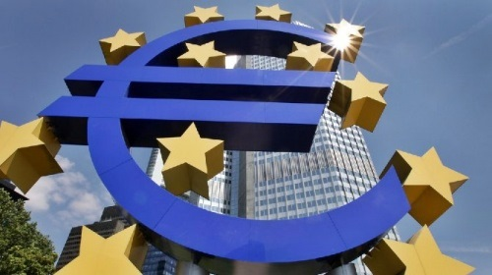

Slide 30
Related Terms tariff-free trade: Trade without any taxes or duties to pay when goods are imported or exported:
التجارة بدون رسوم / تعرفة جمركية
DExEU: The Department for Exiting the European Union: the name of the new UK government department responsible for managing the UK's departure from the EU:
وزارة انسحاب المملكة المتحدة من الاتحاد الاوربي
MEP: Member of the European Parliament:

Slide 31


