Slide 1
What is a consonant cluster?
What are positions of clusters?
What are examples of clusters?

Slide 2
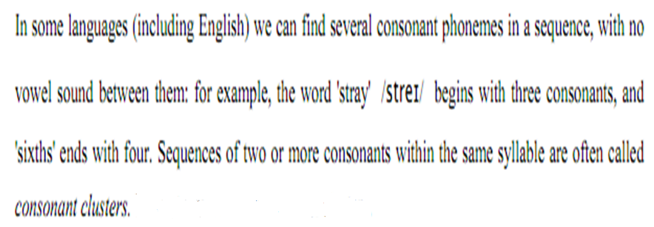
A consonant cluster, a consonant sequence or a consonant compound is “a group of consonants which have no intervening vowels. The groups /spl/ and /ts/ are consonant clusters in the word splits.”
Roach (2002: 14)

Slide 3
Two-consonant Initial Clusters
Cluster
Pre-initial
Initial

Slide 5
Cluster
Initial
Post-initial

Slide 6
Three-consonant Initial Clusters
Initial
Post-initial
Pre-initial

Slide 7
Give examples for the following initial clusters.

Slide 8
Pl

Slide 9
Kl

Slide 10
Bl

Slide 11
Gl

Slide 12
Pr

Slide 13
Tr

Slide 14
Kr

Slide 15
Br

Slide 16
Dr

Slide 17
Gr

Slide 18
Tw

Slide 19
Kw

Slide 20
Dw

Slide 21
Pj

Slide 22
Tj

Slide 23
Qj

Slide 24
Bj

Slide 25
Dj

Slide 26
Fl

Slide 27
Fr

Slide 28
thr

Slide 29
Shr

Slide 30
Mj

Slide 31
Nj

Slide 32
Fj

Slide 33
Vj

Slide 34
Hj

Slide 35
