Slide 1
SEMANTICS
LEXICAL AND GRAMMATICAL
MEANING AND AMBIGUITY

Slide 2
TODAY’S OVERVIEW
Lexical
Meaning
Grammatical
Meaning
Lexical & Grammatical Meaning
Lexical
Ambiguity
Grammatical
Ambiguity

Slide 3
Lexical Meaning
Lexical meaning is concerned with the identiﬁcation and representation of the semantics of lexical items.
Fries draws a distinction between 'lexical and 'Structural' meanings .
Major parts of speech have 'lexical' meaning; and this is given in the dictionary associated with grammar.

Slide 4
((A dog barked))
The meanings of dog and bark are lexical meanings.
They are lexemes.
A lexeme is a minimal unit that can take part in referring or predicating.
The term ‘lexeme’ was proposed by Lyons (1977:18–25) to avoid complexities associated with the vague word ‘word.’

Slide 5
Lexeme
(go)
go
going
went
gone

Slide 6
Grammatical Meaning
((A dog barked))
The sentence has several kinds of grammatical meanings.
The grammatical system of English makes possible the expression of meanings like these:
Did a dog bark.
A dog did not bark.
A dog barks.
Some dogs barked.
The dog barked.

Slide 7
Grammatical meanings are expressed in various ways:
1- By the arrangement of words
2- By grammatical affixes
3- By grammatical words, or function words

Slide 8
Lexical and Grammatical Meaning
Three different kinds of semantic functions are subsumed by Fries under the term ‘grammatical meaning‘. The three different kinds of ‘meaning' are:
Meaning of grammatical item
Meaning of grammatical functions
Meaning associated with notions as declarative, interrogative or imperative sentences

Slide 9
Lexical and Grammatical Meaning
Is there any difference between the meaning of grammatical and lexical items?
To answer this question certain points should be mentioned:
lexical items are traditionally said to have both 'lexical' and 'grammatical meaning‘.
Grammatical items are generally described as having only ‘grammatical meaning’
Grammatical choices have to do with spatial and temporal reference and causation..etc

Slide 10
Lexical and Grammatical Meaning
The second class in the structure of English to which Fries have applied the term ‘structural meaning’ is exemplified by notions as ‘subject’, ‘object’ and ‘modifier’.
Chomsky has suggested that it is the ‘functional’ notions ‘subject-object-of’, ‘predict-of’, and main-verb-of’, which constitute the principal deep-structure relations between lexical items.

Slide 11
Lexical and Grammatical Meaning
He is reading a book
Ordinary object
He is writing a book
Object of results

Slide 12
Projection rules

Slide 13
Lexical and Grammatical Meaning
Many of the relationships between particular classes of lexical items, i.e ‘bird: fly, fish: swim, drive: car, blond: hair’, cannot be stated except by means of an ad hoc set of projection rules, within the framework of transformational syntax outlined by Chomsky.

Slide 14
Lexical and Grammatical Meaning
The third class of meanings which are commonly described as grammatical may be exemplified with reference to the difference between:
Declarative
Interrogative
imperative

Slide 15
Lexical and Grammatical Meaning
In recent transformational theory, there has been a tendency to introduce into the deep-structure phrase-markers of sentences such grammatical elements as 'question-marker' and 'imperative-marker', and then to formulate the rules of the transformational component in such a way that the presence of one of these 'markers' will 'trigger off' the appropriate transformational rule.

Slide 16
Lexical and Grammatical Meaning
We are not concerned here with the syntactic advantages of this formulation of the distinction between various 'sentence-types', but with its semantic implications.
These 'markers' are semantically similar to the lexical and grammatical elements which occur as constituents of the nuclei of sentences. For instance, the 'imperative-marker' would be listed in the dictionary with an entry 'that represents it as having roughly the sense of "the speaker requests (asks, demands, insists, etc.) . But this suggestion rests upon a confusion in the term 'meaning'.

Slide 17
Lexical and Grammatical Ambiguity

Slide 18
Lexical & Grammatical Ambiguity
Ambiguity is a linguistic condition which can arise in a variety of ways. There are three main forms of ambiguity; Phonetic, grammatical and lexical.
1-Ambiguity may result in spoken language from the phonetic structure of the sentence. For example, there was once a noun near meaning kidney but it is not used anymore because it could be confused with an ear.

Slide 19
Lexical & Grammatical Ambiguity
2-Grammatical ambiguity is the result of two possibilities: Ambiguousness of grammatical forms or from the structure of the sentence.
3-The most important type of ambiguity is that due to lexical factors; polysemy and homonymy.

Slide 20
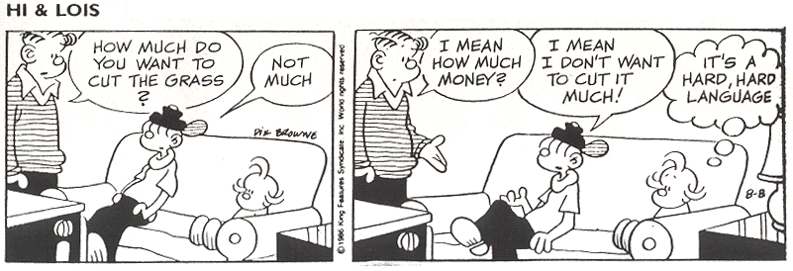

Slide 21
Grammatical Ambiguity
AMBIGUOUSNESS OF GRAMATICAL FORMS
Some prefixes and suffixes have more than one meaning which will lead to misunderstandings; desirable, readable, debatable.
Form-words may also have several meanings which may result in confusion in some contexts.
-Will you join us for dinner tomorrow?
-Do you mean you in the singular or in the plural?

Slide 22
Grammatical Ambiguity
AMBIGUOUSNESS FROM THE STRUCTURE OF THE SENTENCE:
Here the individual words are unambiguous but their combination can be interpreted in two or more different ways.
“I met a number of old friends and acquaintances”

Slide 23
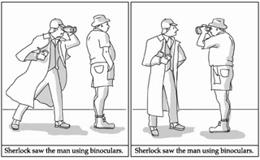

Slide 24
Lexical Ambiguity
In countless cases more than one sense will be connected with the same name:
This polyvalency of our word may take two different forms:
n
s1
s2
s3
POLYSEMY
HOMONYMY

Slide 25


Slide 26
POLYSEMY
Polysemy is a fundamental feature of human speech, which can arise in a multiplicity of ways.
  1- Shifts in application
  our words have a number of different aspects according to the context in which they are used. Some of these aspects are purely ephemeral; others may develop into permanent shade of meaning which may lead to regard them as different senses of the same term.

Slide 27
POLYSEMY
Shifts in application are noticeable in the use of adjectives since these are often change their meaning according to the noun they qualify.
Conduct: Fitting, seemly.
Gallant, brave
Generous, magnanimous.
Sizes, sums: Fair, moderately large. Ample, liberal, munificent.

Slide 28
POLYSEMY
Persons: skilled, clever
proper, fitting, decent
Beautiful, dignity, brave
Concretes: Easy to handle
Of fair size
Beautiful with dignity
Proper
Actions, speech: Appropriate
clever, brave

Slide 29
POLYSEMY
2- Specialization in a social milieu:
“In every situation, in every trade or profession, there is certain idea which is so much present to one’s mind, so clearly implied that it seems unnecessary to state it when speaking”. (Michel Breal)
action
Legal action
Lawyer
action
Military operation
soldier

Slide 30
POLYSEMY
3.Foreign influence:
A way in which language can influence another is by changing the meaning of an existing word.
e.g. Parlement (French word that means parler ‘to speak’), and then came to denote a ‘judicial court’, acquired at a later date, under the influence of English parliament, its modern sense changed ‘legislative assembly’

Slide 31
Polysemy
There are a number of special safeguards which help to mitigate the consequences of polysemy:
The usage of grammatical gender, this can be used to differentiate between meanings of the same word.
The use of inflexion. English brother has two plurals with different senses: brothers and brethren .

Slide 32
POLYSEMY
Word-order may help to discriminate between different senses of the same term. The mobility of adjectives for example.
The meaning of a word is clarified by adding another word to it; fair
fair-sized, fair-minded.
The weakening or destroying the unity of the word, is to distinguish between meanings by slight modification in form; phonetic, graphic. e.g. discreet// discrete.

Slide 33
Homonymy
Two or more different words may be identical in sound.
There are three ways in which it can arises:
1. Phonetic convergence
Two or more words which once had different forms coincide in in the spoken language and sometimes in writing.
Old English melo < meal ’flour’
Old English mǣl < meal ‘repast’
| mi:l |

Slide 34
Homonymy
2.Semantic divergence
When two or more meanings of the same word drift apart to such an extent that there will be no obvious connection between them, polysemy will give place to homonymy and the unity of the word will be destroyed.

Slide 35
Homonymy
Sole ’bottom of a shoe; name of a fish
Sole‘ ‘bottom of a shoe’
Sole ‘name of a fish’

Slide 36
Homonymy
3.Foreign influence:
When a loan-word becomes firmly established in its new surroundings it will be adapted to the local phonetic system and will take part in the normal sound-changes; it thus may coincide with other words in the receiving language.

Slide 37
THANK YOU

