Slide 1
Collocation and idiom

Slide 2
What is collocation ?
Collocation is a word or phrase which is frequently used with another word or phrase, in a way that sounds correct to speakers of the language. For example, heavy rain.
Collocation is essentially a lexical relation and not subject to rules but to tendencies. In Firth’s original insight (1968), collocation is “the company that words keep” or “actual words in habitual company”.

Slide 3
What is collocation ?
For Firth this keeping company was merely part of the meaning of a word. meaning was also to be found in the context of situation and all the other levels of analysis as well.
Firth was concerned only with selecting those characteristics of the linguistic or non-linguistic context that he considered relevant, not with the totality of such contexts.
Its useful to distinguish between
strong collocation (e.g. blond is used to describe hair color)
weak collocation (e.g. the is used with various nouns)

Slide 4
What is collocation ?
The study of linguistic context is of interest to semantics for two reasons.
First, by looking at the linguistic contexts of words we can often distinguish between different meanings.
Nida, for instance, discussed the use of chair in:
(1) Sat in a chair
(2) The baby’s, high chair
(3) The chair of philosophy
(4) Has accepted a University chair
These are clearly in pairs, giving four different meanings of the word. However, this does not so much establish, as illustrate, differences of meaning. Dictionaries, especially the larger ones, quite rightly make considerable use of this kind of contextualization.
(5) The chairman of the meeting
(6) Will chair the meeting
(7) The electric chair
(8) Condemned to the chair

Slide 5
What is collocation ?
Secondly, although in general the distribution of words may seem to be determined by their meaning (rather than vice versa) in some cases, this is not entirely true. We note that rancid occurs with bacon and butter, and addled with brains and eggs, in spite of the fact that English has the terms rotten and bad and that milk is never rancid but only sour. This characteristic of language is found in an extreme form in the collective words e.g. flock of sheep, herd of cows, school of whales, pride of lions.
Collocation is not simply a matter of association of ideas. For, although milk is white, we should not often say “white milk”, though the expression “white paint” is common enough.

Slide 6
What is collocation ?
It would be a mistake to draw a clear distinguishing line between those collocations that are predictable from the meanings of the word that co-occur and those that are not. It could be argued that “rancid” is to be defined in terms of the very specific, unpleasant taste associated with “butter” and “bacon” that is “pretty” describes only a feminine kind of beauty. There is some plausibility in accounting for “dogs bark”, “cats mew” in terms of the kind of noise made, since “bark” can be used by other animals, e.g. squirrels.
It is also the case that words may have meanings that are more specific in particular collocations. Thus we can speak of abnormal or exceptional weather if we have a heat wave in November, but an exceptional child is not an abnormal child, exceptional being used for greater than usual ability and abnormal to relate to some kind of defect.

Slide 7
What is collocation ?
difficulty arises from the fact that a word will often collocate with a number of other words that have something in common semantically.
Thus we may say the rhododendron(kind of roses) died, we shall not say the rhododendron passed away, in spite of the fact that pass away seems to mean die. But equally, of course, we should not use pass away with the names of any shrubs, not even with a shrub whose name we had heard for the first time. It is not very plausible to say that pass away indicates a special kind of dying that is not characteristic of shrubs. It is rather that there is a restriction on its use with a group of words that are semantically related.

Slide 8
What is collocation ?
Cruse explains the problem by saying that pass away requires the grammatical subject to be human and that’s why it cannot be used with a shrub
Cruse emphasizes the semantic arbitrariness of the restriction and calls it collocational restriction. He defines it as “co-occurrence restrictions that are irrelevant to truth-conditions

Slide 9
What is collocation ?
Lyons (1995) speaks about collocational range of an expression, i.e. the set of contexts in which it can occur. He relates it to the condition that two expressions are absolutely synonymous when “they are synonymous in all contexts” . Lyons exemplifies his thesis by big and large. There are many contexts in which these two expressions cannot be substituted without violating the collocational restrictions of one or the other
You are making a big mistake.
*You are making a large mistake

Slide 10
What is collocation ?
The restrictions are, as suggested by A. McIntosh, a matter of range. We know roughly the kind of nouns (in terms of their meaning) with which a verb or adjective may be used. Therefore, we do not reject specific collocations simply because we have never heard them before but we rely on our knowledge of the range.
We can see three kinds of collocational restriction.
First, some are based wholly on the meaning of the item as in the unlikely green cow.
Secondly, some are based on range, a word may be used with a whole set of words that have some semantic features in common. This accounts for the unlikeliness of the rhododendron passed away and equally of the pretty boy (pretty being used with words denoting females).
Thirdly, some restrictions are collocational in the strictest sense, involving neither meaning nor range, as addled with eggs and brains. There may be borderline cases. It might be thought that rancid may be used with animal products of a certain type.

Slide 11
What is collocation ?
Benson, M. (1986) says that collocation can be divided into grammatical collocations and lexical collocation.
Grammatical collocation
Benson defines grammatical collocation as “a dominant word (verb, noun, adjective) followed by a grammatical word, typically a preposition”. Examples are:
Verb-preposition combination (prepositional verbs): account for, aim at, and accuse (somebody) of, look after, and struggle for.
Noun-preposition combination: access to, accusation against, administration for, analogy between (to, with).
Adjective-preposition combination: absent from, accountable to (with) answerable for (to) and -ed participle adjectives, -ing participle adjectives: accompanied by, corresponding to.
Verb-participle combination (phrase verbs). Some verbs need to be followed by specific adverbial particles.

Slide 12
What is collocation ?
Lexical Collocations
Lexical collocations contain no subordinate element; they usually consist of two equal lexical components. The major types of lexical collocations are:
Noun-verb combinations: adjectives modify, bells ring, bees buzz (sting, swarm) birds chirp (fly, sing), blood circulates (flows).
Adjective-noun combinations: a confirmed bachelor, a pitched battle, pure chance, keen competition, grave concern, sincere condolences.
Verb-noun combinations:
Verbs denoting creation-nouns: compile a dictionary, make an impression, compose music, and inflict a wound.
Verbs denoting activation - nouns: set an alarm, fly a kite, launch a missile, wind a watch.
Verbs denoting eradication and/or nullification-nouns: reject an appeal, recall a bid, lift a blockade, invalidate a clause, break a code, eliminate a competitor.

Slide 13
What is collocation ?
Adverb–verb combination: Adverbs usually occur finally, but if we add a special impression or emphasis, we move it before the verb: strongly suggest, barely see, thoroughly plan, hardly speak, deliberately attempt.
Adverb–adjective combination: These are used to emphasize purpose, or when we intend to add a strong feeling or a special kind of behavior to adjectives: totally acceptable (different), extremely odd, completely useless, successfully (barely) finished (noticed).

Slide 14
idioms

Slide 15
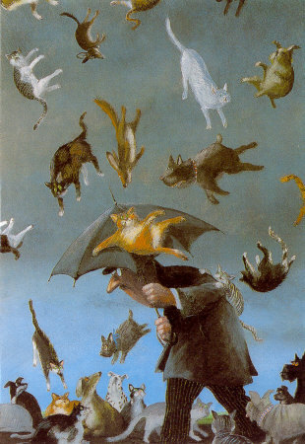
Should You Believe Everything You Read or Hear?
It’s raining cats and dogs

Slide 16
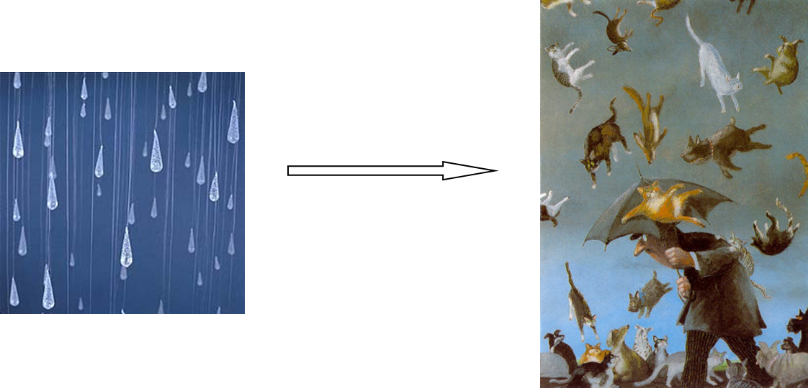
Do you believe that?
But people say it, it has been written in books!
Are they lying?
Do they mean it literally?
The answer is No, they are exaggerating the point by use of Idioms

Slide 17
What are Idioms ?
an expression, word, or phrase that has a figurative meaning that is comprehended in regard to a common use of that expression that is separate from the literal meaning or definition of the words of which it is made. There are estimated to be at least 25,000 idiomatic expressions in the English language.

Slide 18
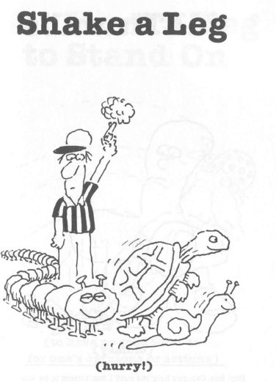
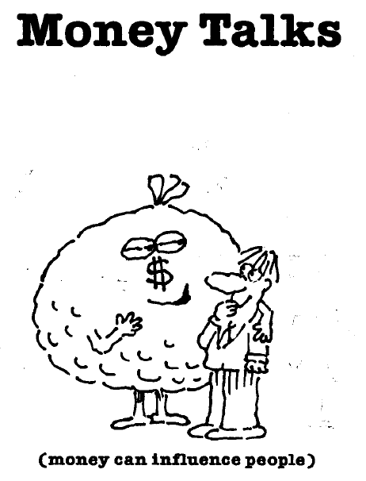
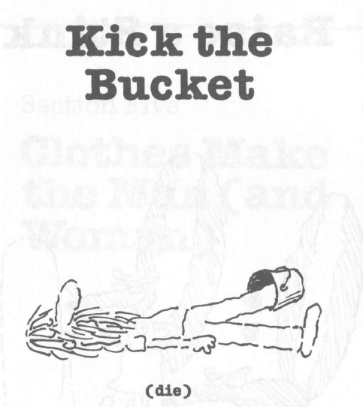
Idioms

Slide 19
What are Idioms ?
there are a great number of grammatical restrictions. A large number of idioms contain a verb and a noun, but although the verb may be placed in the past tense, the number of the noun can never be changed. We have spilled the beans, but not * spill the bean and equally there is no *fly off the handles, *kick the buckets, *put on good faces, *blow one's tops, etc. Similarly, with red herring the noun may be plural, but the adjective cannot be comparative (the -er form). Thus we find red herrings but not redder herring.
There are also plenty of syntactic restrictions. Some idioms have passives, but others do not. The law was laid down and the beans have been spilled are all right, but *the bucket was kicked is not. However, in no case could we say it was the beans that were spilled, law that was laid down, bucket that was kicked, etc... The restrictions vary from idiom to idiom. Some are more restricted or frozen than others.

Slide 20
What are Idioms ?
A very common type of idiom in English is what is usually called the phrasal verb, The meaning of these combinations cannot be predicted from the individual verb and adverb. Not all combinations of this kind are idiomatic, of course. Put down has a literal sense too and there are many others that are both idiomatic and not, e.g. take in as in the conjuror took the audience in, the woman took the homeless children in. There are even degrees of idiomaticity since one can make up a story, make up a fire or make up one's face. Moreover, it is not only sequences of verb plus adverb that may be idiomatic. There are also sequences of verb plus preposition, such as look after and go for, and sequences of verb, adverb and preposition, such as put up with (tolerate) or do away with (kill).

Slide 21
What are Idioms ?
There are also, what we may call partial idioms, where one of the words has its usual meaning; the other has a meaning that is peculiar to the particular sequence. Thus, red hair refers to hair, but not hair that is red in strict color terms.
What is and what is not an idiom is, then, often a matter of degree. It is very difficult to decide whether a word or a sequence of words is opaque. We could, perhaps, define idioms in terms of non-equivalence in other languages, so that kick the bucket, red herring, etc., are idioms because they cannot be directly translated into French or German. However, this will not really work. The French for nurse is garde-malade, but while this cannot be directly translated into English, it is quite transparent, obviously meaning someone who looks after the sick. On the other hand, look after seems quite idiomatic, yet it can be quite directly translated into Welsh.

Slide 22
What are Idioms ?
Guess what these mean:
Paint the town red
Apple of my Eye
Heard through the grapevine
Riding Shotgun
On cloud nine
Skeleton in the Closet
Bite the bullet

Slide 23
What are Idioms ?
Paint the town red (to go out and enjoy yourself in the evening)
Apple of my Eye (refers to something or someone that one cherishes above all others)
Heard through the grapevine(to hear news from someone who heard that news from someone else)
Riding Shotgun (To ride in the front passenger seat of a car or truck)
On cloud nine(very happy)
Skeleton in the Closet(a hidden and shocking secret)
Bite the bullet(To face a painful situation bravely.)

Slide 24
Thank you

