Slide 1
Consonants
Consonants are sounds that are made with the obstruction the flow of air as it passes from the lungs to the mouth or nose.
Alternative names for consonants and vowels are contoid(s) (consonants) and vocoid(s) (vowels).
As mentioned earlier, there are 24 consonants in English which can be thought of differently.

Slide 2
Consonants are described in terms of:
1. Place of articulation
When consonants are classified, one of the most important things to establish is the place where obstruction is made; this is known as the place of articulation. for examples, the place of articulation for [p] and [b] is bilabial for [f] and [v] labiodental, for [t] and [d] alveolar, for [k] and [g] velar, and for [h] glottal.
2. Manner of articulation
One of the most important things that we need to know about a speech sound is what sort of obstruction it makes to the flow of air:

Slide 3
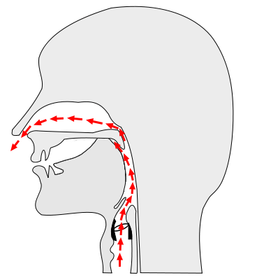
2.1 Nasals
There are the nasal consonants. The distinctive feature of nasal consonants is that you let air out of your nose as you pronounce them.
Let's take a word that starts with /m/ in English such as man. Pronounce only the M in man and put your finger right in front of your nostrils. You should feel some air coming out.

Slide 4
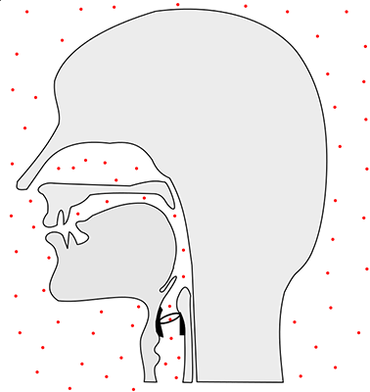
2.2 Plosives or Stops
Basically, these are consonants where air is blocked at the place of articulation to accumulate pressure and it is then released in one instant. Here are a few words so that you can check for yourself: bag, gap.

Slide 5
2.3 Laterals
Laterals obstruct the flow of air only in the center of the mouth, so obstruction is slight. Here are a few examples lake and bell.
2.4 Approximants
Approximants can be considered half way between vowels and fricatives. When pronouncing an approximant, the air flows smoothly through the vocal apparatus so that very little friction is created. Some examples of words with approximants are /w/, /j/, / r/).

