Slide 1
Introduction to the Teacher

Slide 2
Introduction to the Teacher
My name is Sinan Ameer. I am 28 years old. I have an MA degree in English Language and Linguistics. I have participated in a special program that deals with methods of teaching at Arizona State University (ASU), Arizona, USA.

Slide 3
I also obtained three online certificates on "The Principles of Written English", California University, USA.
I took part in a course entitled “Motivating Students in the English Lesson” sponsored by the British Council in Erbil.

Slide 4
I also obtained two online certificates on “Teach English Now", ASU, USA.
Finally I received an honor code certificate on "Methods of Teaching" sponsored by Iraqi Ministry of Higher Education and Scientific Research.

Slide 5
I teach at the following institutions:
Al-Mustansiriya University.
Consultation Bureau for Translation and Foreign Languages.

Slide 6


Slide 7


Slide 8




Slide 9

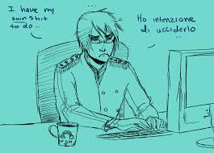

Slide 10




Slide 11


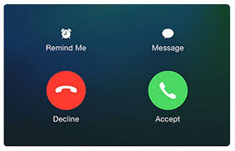

Slide 12




Slide 13


Slide 14
Introduction to the Book

Slide 15
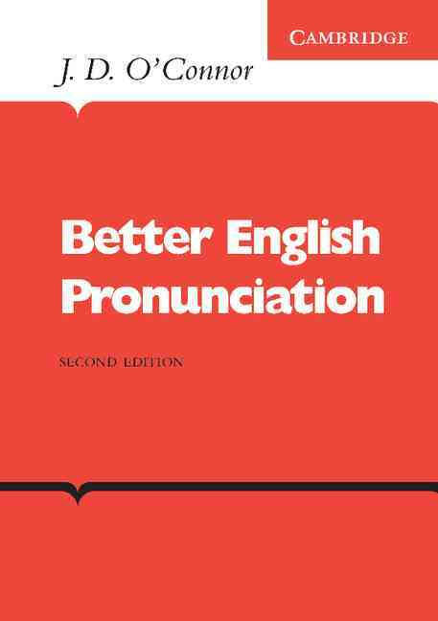

Slide 16
“Better English Pronunciation is a highly successful and widely used textbook on pronunciation.
It provides a systematic and careful introduction to the pronunciation of English to help intermediate and more advanced students to improve their spoken language.

Slide 17
The kind of an accent adopted in this book is RP (Received Pronunciation): the kind of pronunciation widely used by many educated speakers, particularly in south-east England; also called BBC English.
The author is J. D. O’Connor. It is published in 1988 by Cambridge University Press.

Slide 18
