Slide 1
The Paragraph Types: The Descriptive Paragraph 12th Lecture

Slide 2
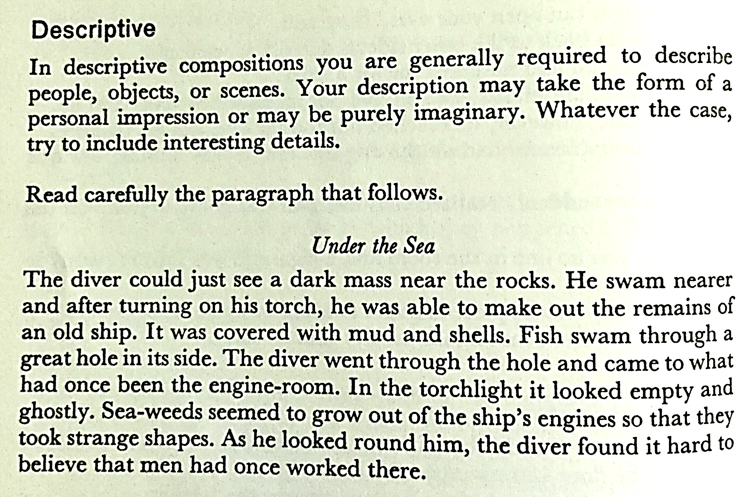

Slide 3
How should you write your description?
If there's one thing you should remember as you write your descriptive essay, it's the famous saying: show don't tell. But what's the difference between showing and telling?
Consider these two simple examples:
I grew tired after dinner.
As I leaned back and rested my head against the top of the chair, my eyelids began to feel heavy, and the edges of the empty plate in front of me blurred with the white tablecloth.

Slide 4
- The first sentence tells readers that you grew tired after dinner.
- The second sentence shows readers that you grew tired. The most effective descriptive paragraphs are loaded with such showing because they enable readers to imagine or experience something for themselves.

Slide 5
Activity
Write a paragraph describing your University.
Tips:
At least 20 sentences.
At least 80 words.
Give a title/topic.
Use the four types of sentences.

Slide 6
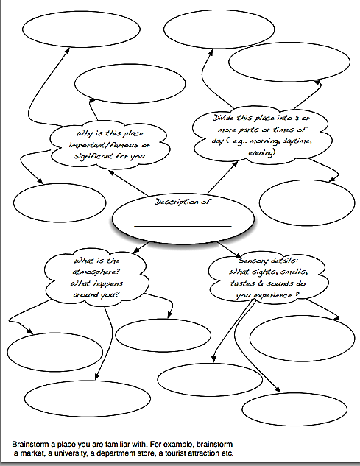

Slide 8
Choose your Topic
Describe your favorite place.
Describe your ideal bedroom.
Describe the house in which you grew up.
Describe what the first house on the moon would look like.
Describe some of your favorite places in your hometown.
Describe a peaceful place that you’ve visited.
Describe a place that exists only in your imagination.
Describe a friend’s or family member’s house where you enjoy spending time.
Describe your perfect fantasy vacation destination.
Describe your favorite store.
Describe your favorite teacher’s classroom.
Describe a museum that you’ve visited recently.
Describe a place you have dreamed about that doesn’t exist in real life.
Describe a place where your pet likes spending time.
Describe an outdoor place that you know well.

Slide 9
Important Exercises
On page 16 and 17 concerning the Narrative Paragraph.
On page 19 and 20 concerning the Descriptive Paragraph.

Slide 10
The End

