Slide 1
The Paragraph Types: The Narrative Paragraph 11th Lecture

Slide 3
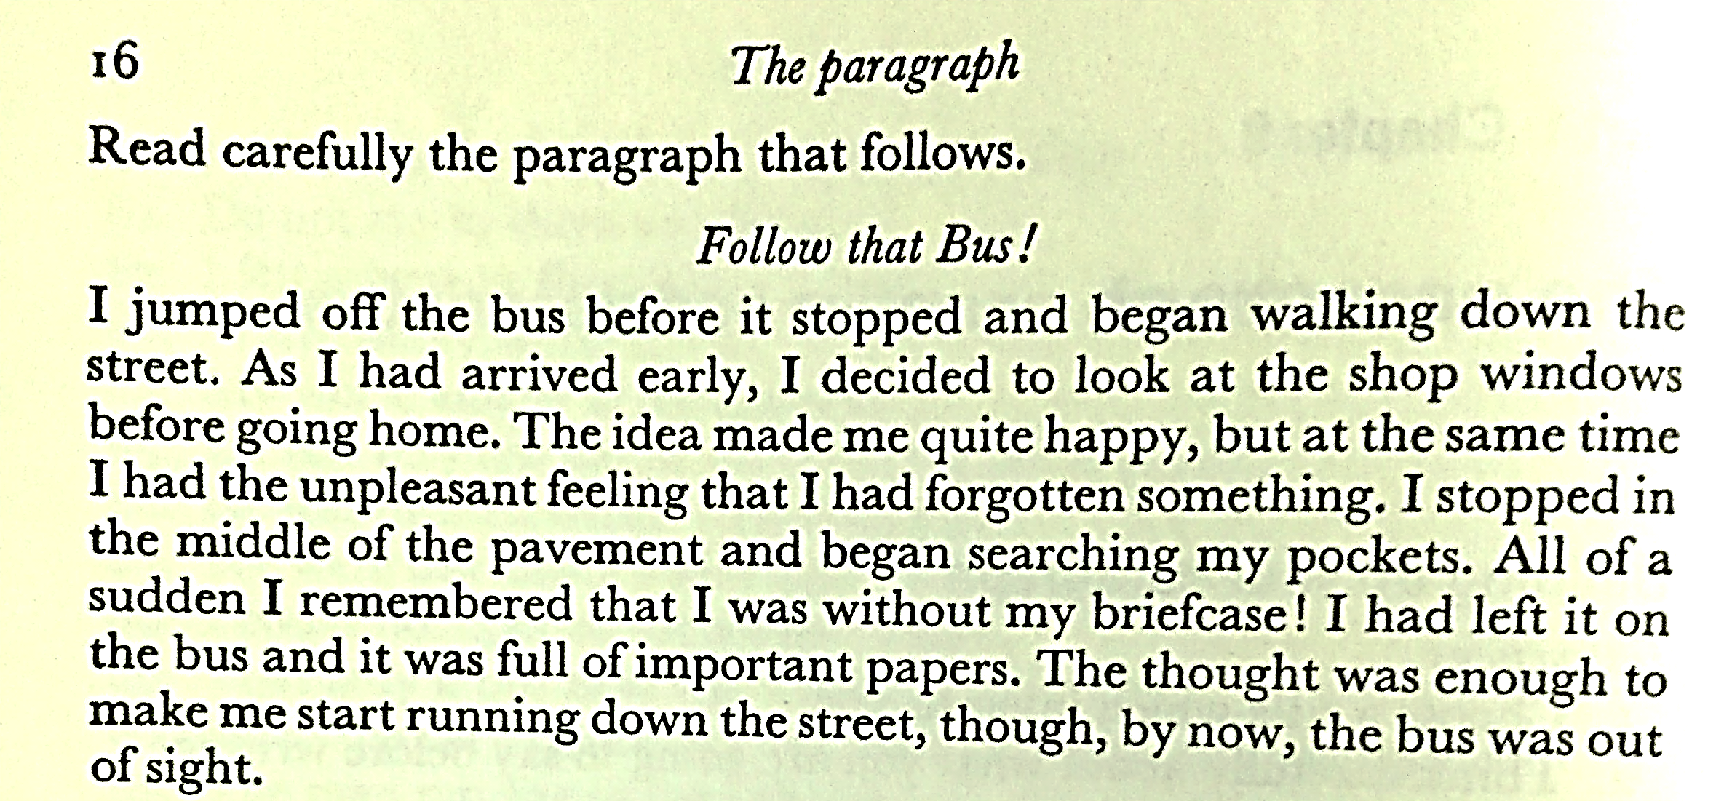

Slide 4
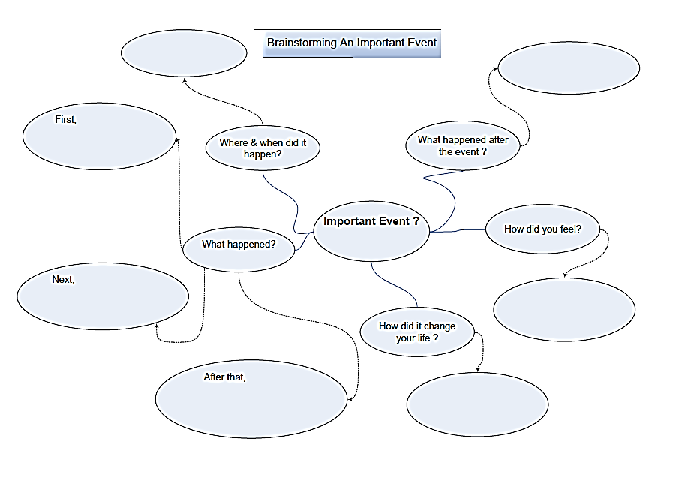

Slide 5
Write a narrative paragraph starting with the Topic Sentence below:
Activity
It was a stormy dark night. ………………………… ………………………………………………………………………………………………………………………………………………………………………………………………………………………………………………………………………………………………………………………………………………………………………………………………………………………… .

Slide 6
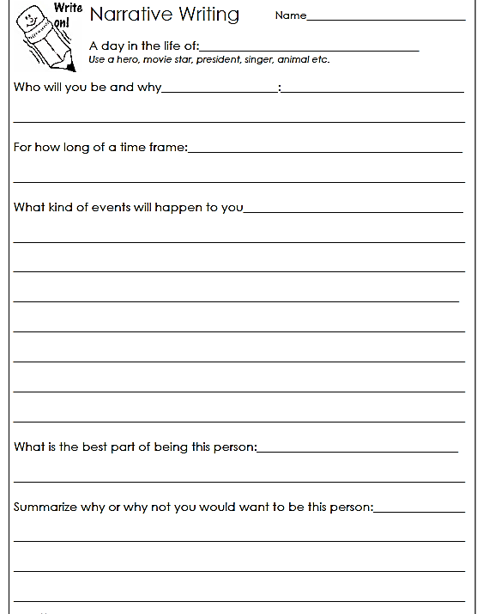
Activity

Slide 7
ACTIVITY: Some Interesting Narrative Topics
1 | Your first day at a new school or college
2 | Your first day at a new job
3 | Your last day on a job
4 | An embarrassing experience
5 | A dangerous experience
6 | Surviving a hurricane or a tornado (or other natural disaster)
7 | The day you decided to change your life
8 | The experience of being lost (or of frustrating)
9 | A communication barrier
10 | Your first time away from home

Slide 8
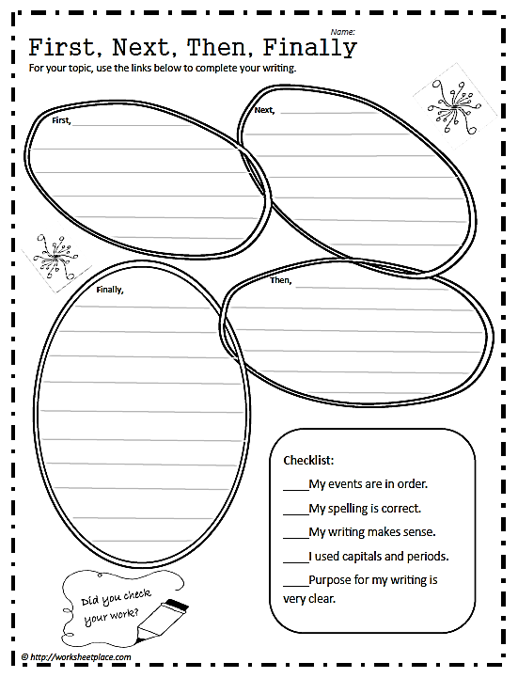
Activity

Slide 9
The End

