Slide 1
English texts in Information and Libraries Science Third Class First Lecture
College of Arts
Information and Libraries department
By: Dr. Boshra F. Zopon AL_Bayaty
2016-2017

Slide 2
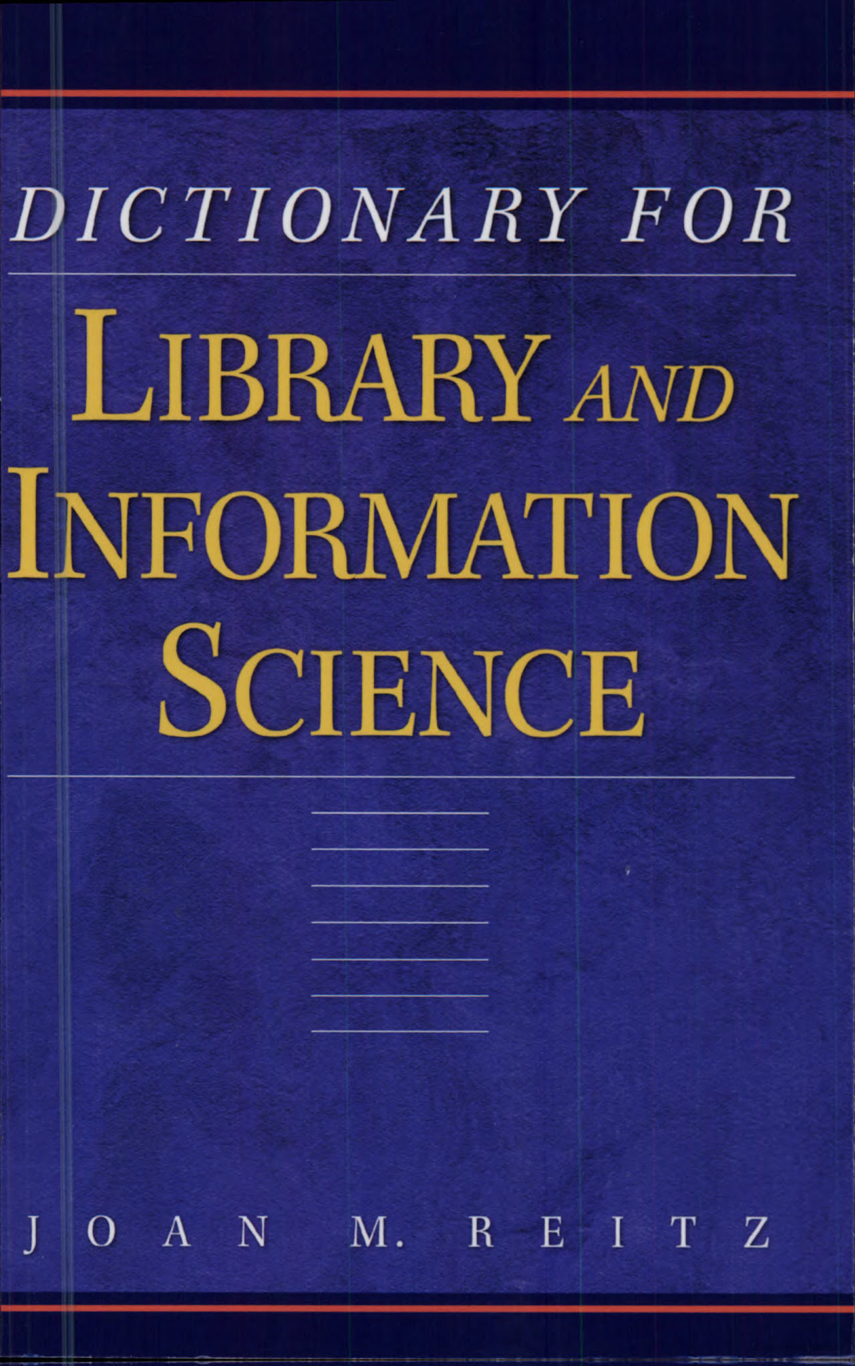

Slide 3
Type: | Book; English
Publisher: | Westport, Conn. [u.a.] Libraries Unlimited 2004

Slide 4
1. Archives Definition
Archives
An organized collection of the noncurrent records of the activities of a business, government, organization, information, or other corporate body, or the personal papers of one or more individuals, families, or groups, retained permanently (or for a designated or indeterminate period of time.
by their originator or a successor for their permanent historical, informational, evidential, legal, administrative, or monetary value, usually in a repository managed and maintained by a trained archivist.

Slide 5
2. Archival Value
Administrative value: utility in the conduct of current or future administrative affaires.
Evidential value: capacity of records to furnish proof of facts concerning their creator or the events/activities to which they pertain.
Fiscal value: utility in the conduct of financial business or fiscal accounting.
Historical value: capacity to document past events, providing information about the lives and activities of persons involved in them.
Informational value: usefulness for reference and research.
Intrinsic value: inherent worth of a document based on its content, cultural significance, antiquity, past uses, etc.
Legal value: utility in the conduct of future legal proceedings, or as evidence of past legal decisions.
Monetary value: worth in the market place, based on appraisal by a person experienced in making such judgments.

Slide 6
Many Software & Websites can help
Goggle Translate
Text – to- Speech Master, which is available on the internet.
Golden Al-wafi Translator, and so on.

Slide 7
ترجمة بعض الكلمات الصعبة The translation of some difficult words
The Word | معناها
Organized | منظمة أو مرتبة
Collection | مجموعة
noncurrent | غير متداولة
records | السجلات
activities of a business, | أنشطة الأعمال،
government, | حكومة،
organization, | منظمة،
information, | معلومات،

Slide 8
ترجمة بعض الكلمات الصعبة The translation of some difficult words
The Word | معناها
or other corporate body, | أو الهيئة الاعتبارية الأخرى،
or the personal papers of one or more | أو أوراق شخصية واحدة أو أكثر
Individuals, | الأفراد,
families, | العائلات،
or groups, | أو جماعات،
Retained | احتفظ
permanently | بشكل دائم
or for a designated | أو محدد او معين
or indeterminate period of time. | أو مدة غير محددة من الوقت.

Slide 9
ترجمة بعض الكلمات الصعبة The translation of some difficult words
The Word | معناها
Archival value | القيمة الارشيفية
Administrative value | القيمة الادارية
Utility | فائدة
Conduct | تسيير
affairs | الشؤون
Evidential value | القيمة الاثباتية
Decision | القرار

Slide 10
Any Questions?

Slide 11
Thank you &
All the best

