Slide 1
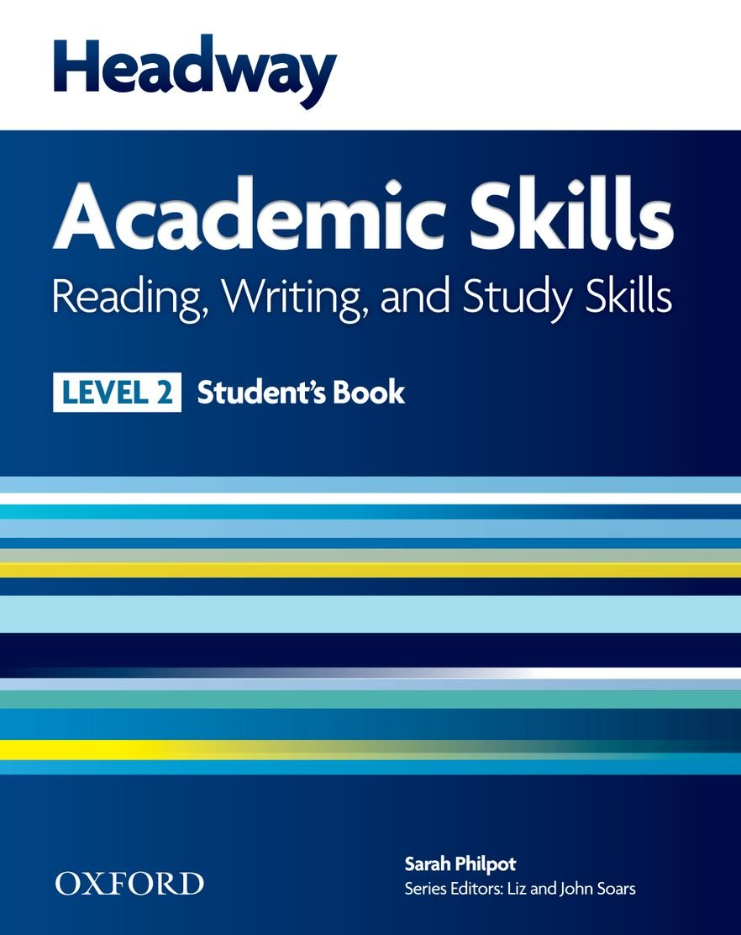
College of Law, Mustansiriyah U. English course for M. A. 2017-2018
Textbook: Headway Academic Skills
Reading, Writing and Study Skills, Level 2
Author: Sarah Philpot
Instructor:
Asst. Lect. Rania Adnan Aziz

Slide 2
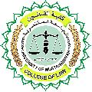
College of Law, Mustansiriyah U. Second Year Course in legal English
2017-2018
Instructor: Asst. Lect. Rania Adnan Aziz
College of Law, Mustansiriyah U. English course for M. A.
2017-2018
Instructor: Asst. Lect. Rania Adnan Aziz
Lecture 11
Unit 2
Where in the world
VOCABULARY DEVELOPMENT Organizing vocabulary (1)
This is another important part for the study skill in this unit. Here we will learn two very important terms: synonym and antonym. A synonym is a word or phrase that has the same meaning as another word or phrase. The following diagram provides some examples.
large
big
great
coastline
seashore

Slide 3
College of Law, Mustansiriyah U. Second Year Course in legal English
2017-2018
Instructor: Asst. Lect. Rania Adnan Aziz
College of Law, Mustansiriyah U. English course for M. A.
2017-2018
Instructor: Asst. Lect. Rania Adnan Aziz
Lecture 11
Unit 2
Where in the world
Continue VOCABULARY DEVELOPMENT Organizing vocabulary (1)
An antonym is a word or phrase that means the opposite of another word or phrase. The following diagram provides some examples.
small
big
loud
quiet

Slide 4
College of Law, Mustansiriyah U. Second Year Course in legal English
2017-2018
Instructor: Asst. Lect. Rania Adnan Aziz
College of Law, Mustansiriyah U. English course for M. A.
2017-2018
Instructor: Asst. Lect. Rania Adnan Aziz
Lecture 11
Unit 2
Where in the world
Continue VOCABULARY DEVELOPMENT Organizing vocabulary (1)
In Exercise 1 out the words in the box into two groups. Then organize them in order of size or speed.
Exercise 2 requires you to match 1-5 with synonyms (=) and antonyms (≠) from the box.

Slide 5
College of Law, Mustansiriyah U. Second Year Course in legal English
2017-2018
Instructor: Asst. Lect. Rania Adnan Aziz
College of Law, Mustansiriyah U. English course for M. A.
2017-2018
Instructor: Asst. Lect. Rania Adnan Aziz
Lecture 11
Unit 2
Where in the world
Continue VOCABULARY DEVELOPMENT Organizing vocabulary (1)
In Exercise 3 you must use the word in the box to label the compass. The words are
North
South
East
West
North-west
South-west
North-east
South-east.

Slide 6
College of Law, Mustansiriyah U. Second Year Course in legal English
2017-2018
Instructor: Asst. Lect. Rania Adnan Aziz
College of Law, Mustansiriyah U. English course for M. A.
2017-2018
Instructor: Asst. Lect. Rania Adnan Aziz
Lecture 11
Unit 2
Where in the world
Continue VOCABULARY DEVELOPMENT Recording vocabulary (2)
Recording words in groups can make them easier to remember. You can use:
Diagrams like the ones in this unit
A scale as in Exercise1
Synonyms and antonyms as in Exercise 2
A picture with labels as in Exercise 3
Exercise 2 requires you to match 1-5 with synonyms (=) and antonyms (≠) from the box.

