Slide 1
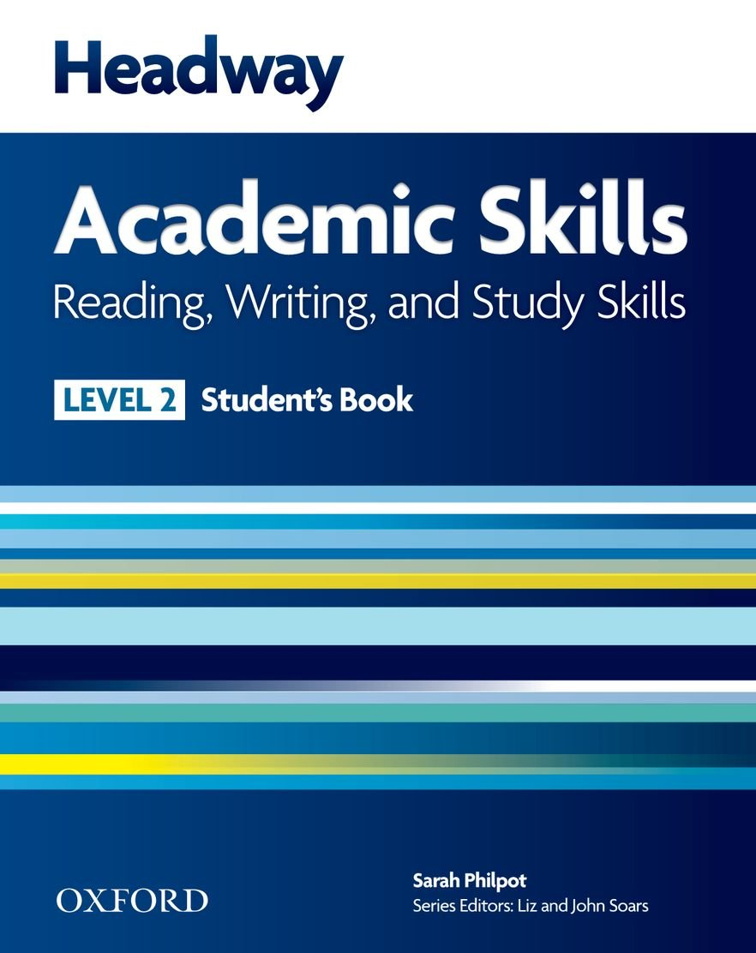

College of Law, Mustansiriyah U.
English course for M. A.
2017-2018
Textbook: Headway Academic Skills, Level 2
Author: Sarah Philpot
Instructor:
Asst. Lect. Rania Adnan Aziz

Slide 2

College of Law, Mustansiriyah U.
Second Year Course in legal English
2017-2018
Instructor: Asst. Lect. Rania Adnan Aziz
College of Law, Mustansiriyah U.
English course for M. A.
2017-2018
Instructor: Asst. Lect. Rania Adnan Aziz
Lecture 10
Unit 2
Where in the world
Continue WRITING My country
In this part we will learn how to link ideas. Linking ideas in a clear and logical way is part of good writing. We use but, however, and although to contrast ideas.
Look at sentences a and b. compare the way but, however and although are used to link them. What differences are there?

Slide 3
College of Law, Mustansiriyah U.
Second Year Course in legal English
2017-2018
Instructor: Asst. Lect. Rania Adnan Aziz
College of Law, Mustansiriyah U.
English course for M. A.
2017-2018
Instructor: Asst. Lect. Rania Adnan Aziz
Lecture 10
Unit 2
Where in the world
Continue WRITING My country
a The official language is French
b Many people speak a little English.
The official language is French, but many people speak a little English.
The official language is French. However, many people speak a little English.
Although the official language is French, many people speak a little English.
The official language is French, although many people speak a little English.

Slide 4
College of Law, Mustansiriyah U.
Second Year Course in legal English
2017-2018
Instructor: Asst. Lect. Rania Adnan Aziz
College of Law, Mustansiriyah U.
English course for M. A.
2017-2018
Instructor: Asst. Lect. Rania Adnan Aziz
Lecture 10
Unit 2
Where in the world
Continue WRITING My country
Exercise 6 provides further examples to practice using linking words.
Writing a description of my country
In Exercise 7 you are required to write a paragraph of about 150 words describing your country. Use your ideas from Exercise 4. link them using but, however and although.

