Slide 1
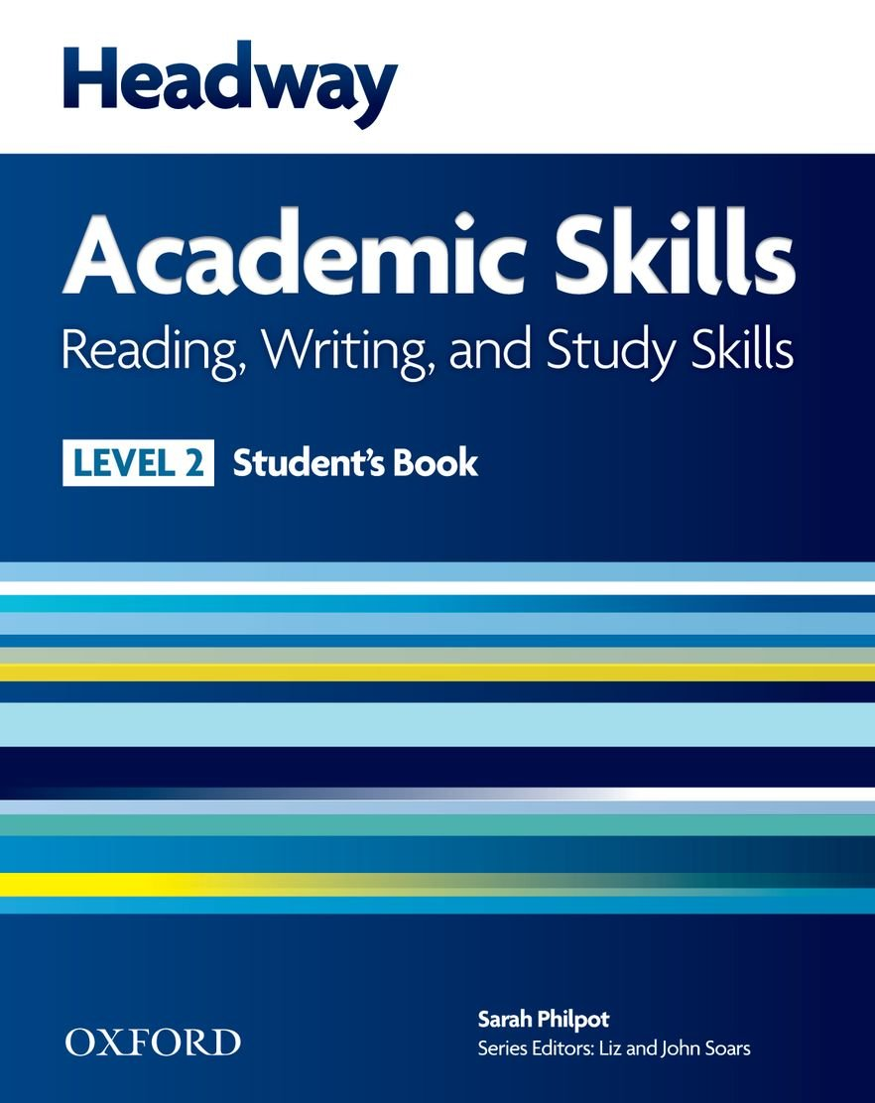
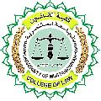
College of Law, Mustansiriyah U. English course for M. A. 2017-2018
Textbook: Headway Academic Skills, Level 2
Author: Sarah Philpot
Instructor:
Asst. Lect. Rania Adnan Aziz

Slide 2
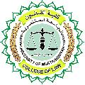
College of Law, Mustansiriyah U. Second Year Course in legal English
2017-2018
Instructor: Asst. Lect. Rania Adnan Aziz
College of Law, Mustansiriyah U. English course for M. A.
2017-2018
Instructor: Asst. Lect. Rania Adnan Aziz
Lecture 08
Unit 2
Where in the world
READING Three countries
The core of this reading part is a three-part essay on three countries. The exercises either introduce new concepts and rules or reinforce already existing ones.
Exercise 1 includes looking at photos and performing a skimming task in order to match the photos (a, b, c) with the texts and the titles provided.
Exercise 2 utilizes the scanning skill whereby students find certain pieces of information and use them to complete a table.

Slide 3
College of Law, Mustansiriyah U. Second Year Course in legal English
2017-2018
Instructor: Asst. Lect. Rania Adnan Aziz
College of Law, Mustansiriyah U. English course for M. A.
2017-2018
Instructor: Asst. Lect. Rania Adnan Aziz
Lecture 08
Unit 2
Where in the world
Continue READING Three countries
Exercise 3 also utilizes the scanning skill whereby students use some information on the countries mentioned in the essay as clues provided to them to answer questions.
Exercise 4 is a matching one where students scan the texts and match a word in A with another one in B and a definition in C.
After these extensive scanning exercises, students as asked in Exercise 5 to read the text, this time slowly (i.e. intensive reading), and compare the three countries with their own.

