Slide 1
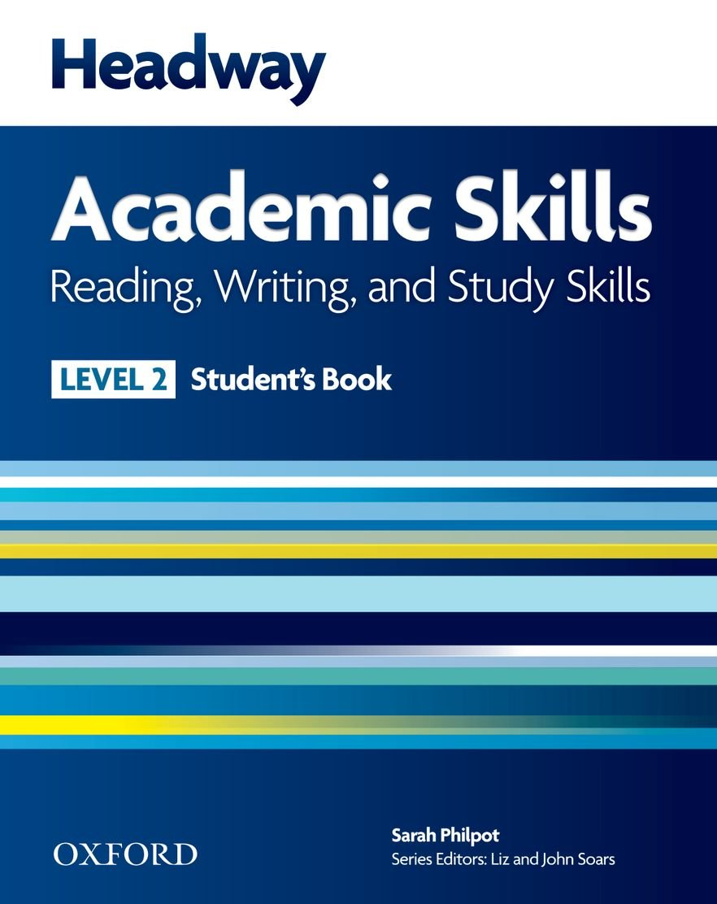

College of Law, Mustansiriyah U.
English course for M. A.
2017-2018
Textbook: Headway Academic Skills, Level 2
Author: Sarah Philpot
Instructor:
Asst. Lect. Rania Adnan Aziz

Slide 2

College of Law, Mustansiriyah U.
Second Year Course in legal English
2017-2018
Instructor: Asst. Lect. Rania Adnan Aziz
College of Law, Mustansiriyah U.
English course for M. A.
2017-2018
Instructor: Asst. Lect. Rania Adnan Aziz
Lecture 07
Unit 2
Where in the world
The second unit of this course focuses on the same skills as the earlier: READING, WRITING and VOCABULARY DEVELOPMENT. This time the focus is shifted from individuals to countries which reinforces rules of punctuating names of country and geographic areas. The contents of the unit also help students practice the methods of effective reading that they have learned in the earlier unit. Also, a very important concept is introduced to students: brainstorming. This concept will be very helpful to students when conducting research or writing proposals and papers.

Slide 3
College of Law, Mustansiriyah U.
Second Year Course in legal English
2017-2018
Instructor: Asst. Lect. Rania Adnan Aziz
College of Law, Mustansiriyah U.
English course for M. A.
2017-2018
Instructor: Asst. Lect. Rania Adnan Aziz
Lecture 07
Unit 2
Where in the world
Unit 2 is divided as follows:
READING Three countries
Skimming and scanning: reading for the general idea, and for particular information
WRITING My country
Brainstorming ideas: topic areas and examples; completing a paragraph
Linking ideas (1): but, however, although
Writing a description of my country

Slide 4
College of Law, Mustansiriyah U.
Second Year Course in legal English
2017-2018
Instructor: Asst. Lect. Rania Adnan Aziz
College of Law, Mustansiriyah U.
English course for M. A.
2017-2018
Instructor: Asst. Lect. Rania Adnan Aziz
Lecture 07
Unit 2
Where in the world
Unit 2 is divided as follows:
VOCABULARY DEVELOPMENT Organizing vocabulary (1)
Synonyms and antonyms: recognizing synonyms and antonyms
Recording vocabulary (2); diagrams; a scale; synonyms and antonyms; labeling a picture
REVIEW
The definite article – the

